Slide 1
MODULE: BMSK4002
EFFECTIVE TEAM WORKING AND COMMUNICATION
STUDENT NAMES: LUTHFA KHANAM - 1714391
SAJEELA TABASAM - 1713435
GROUP: 5
ASSSIGNMENT: PRESENTATION
LECTURER: YOHAN MENDIS
SUBMISSION DATE: 24/08/2018

Slide 2
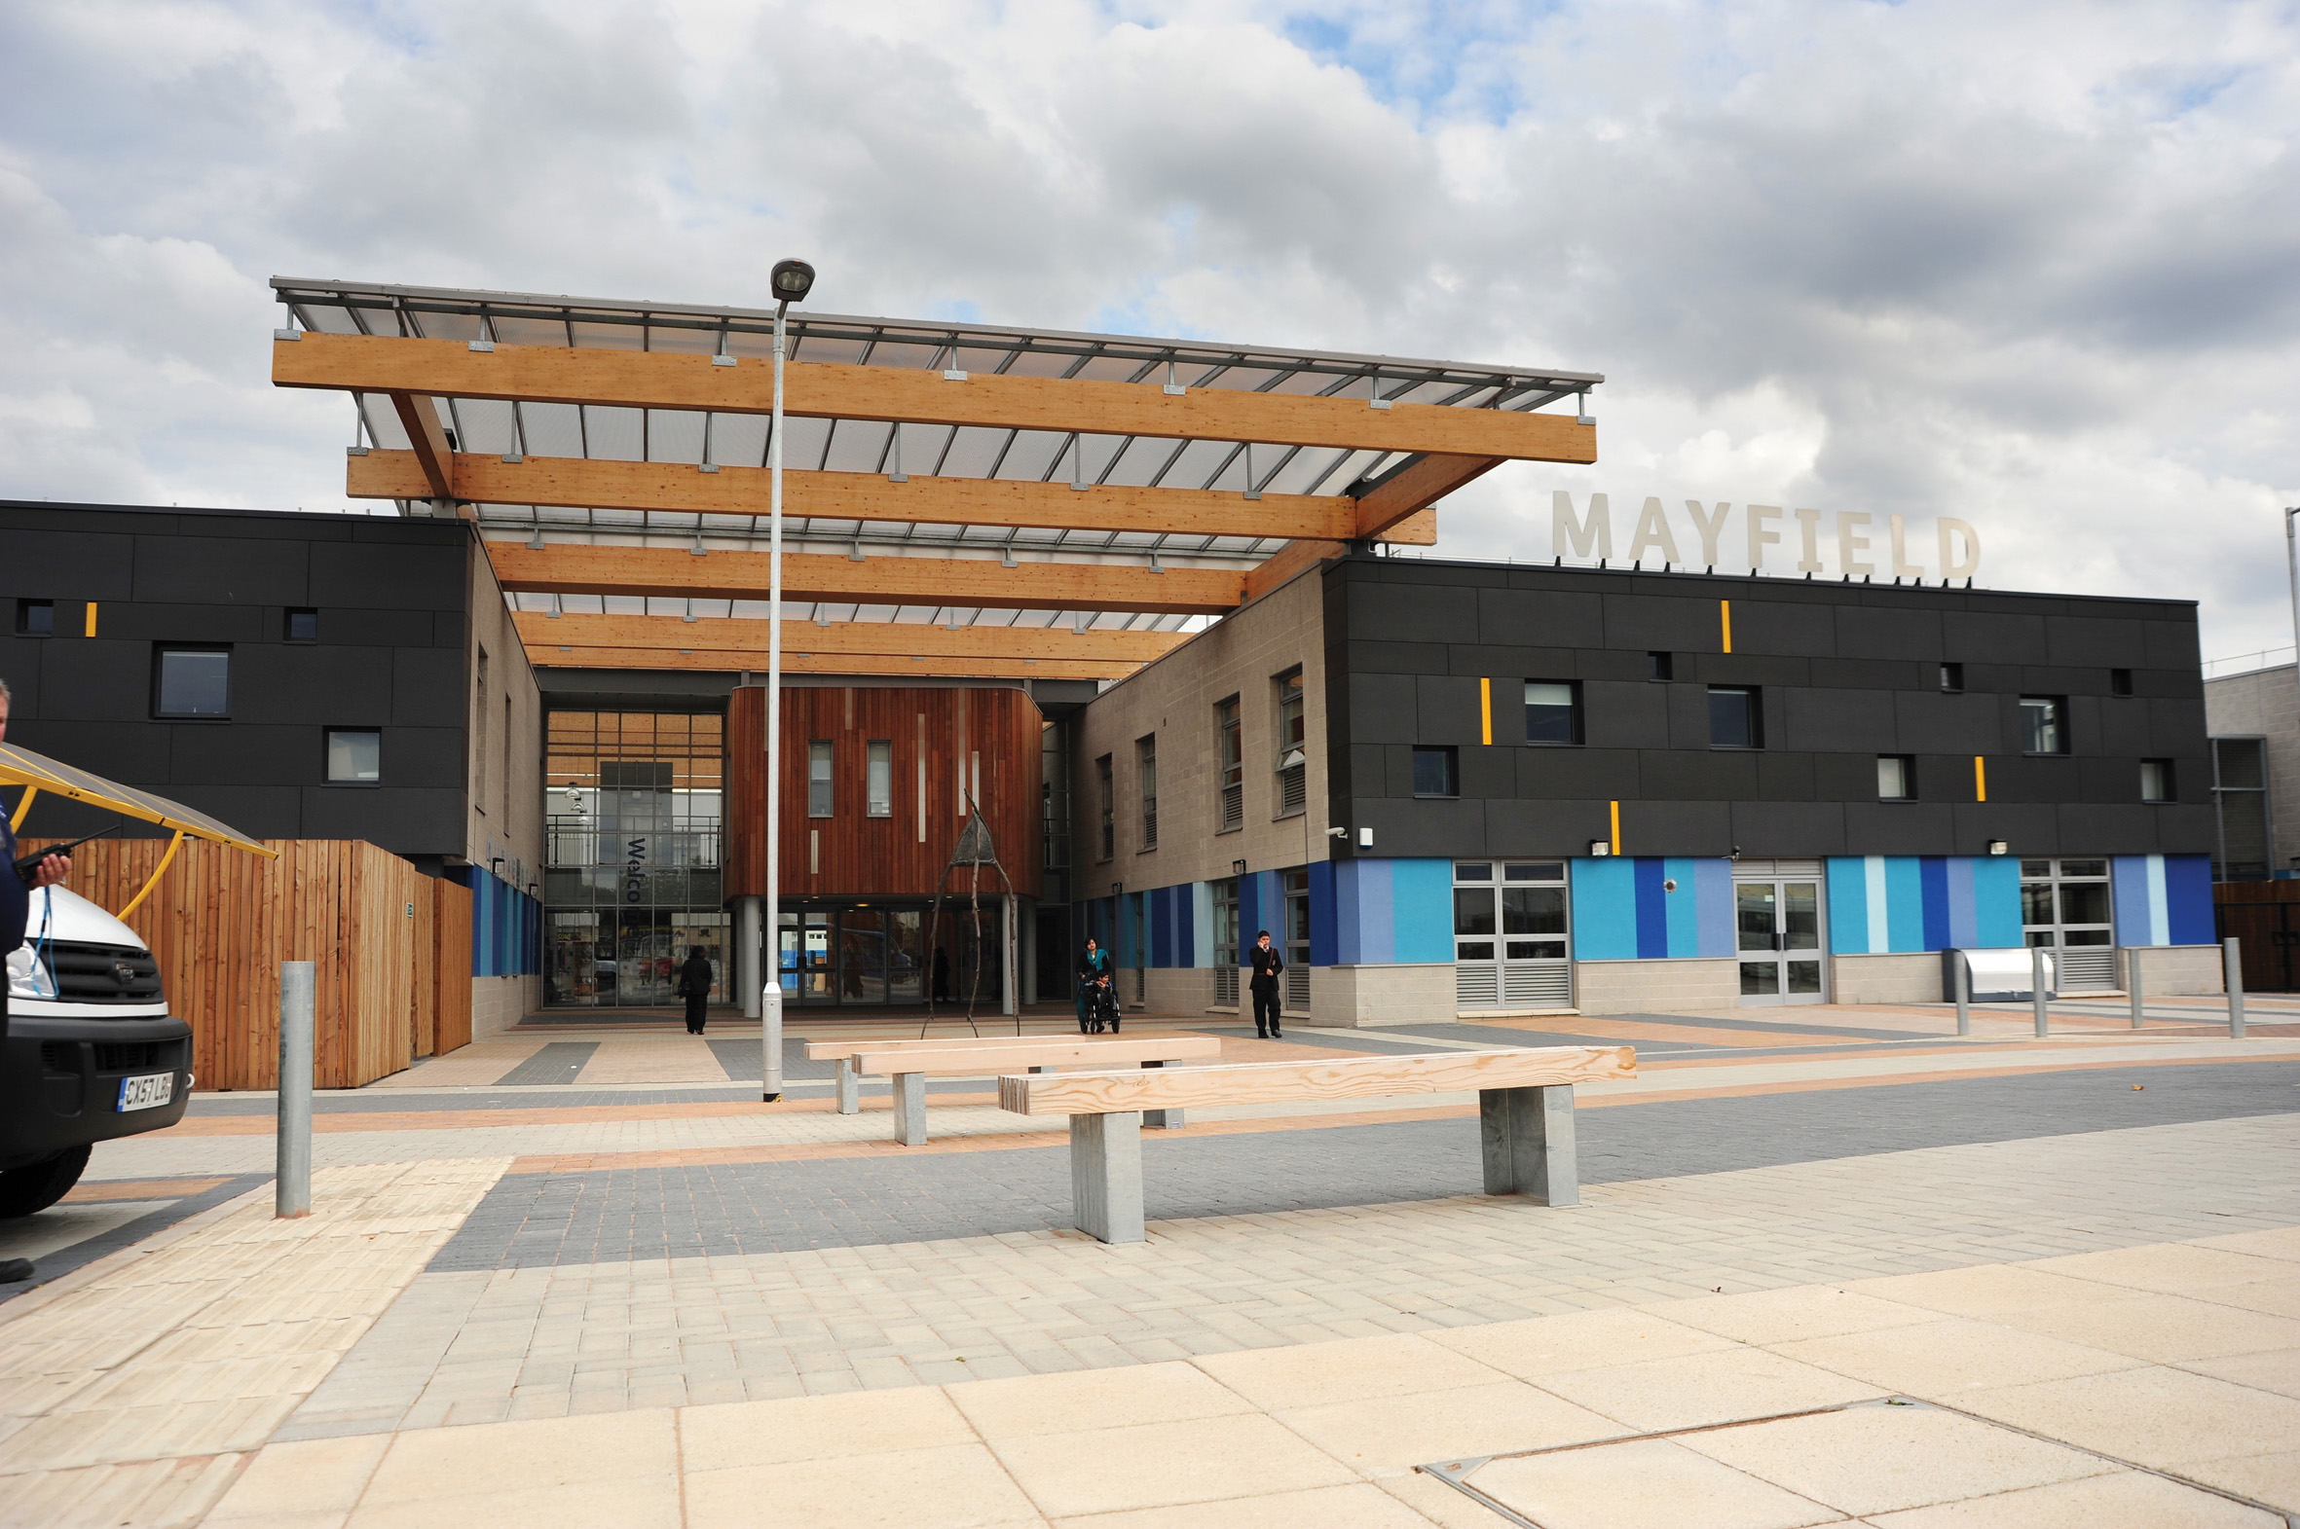
MAYFIELD SCHOOL

Slide 3
What we will be discussing
Benefits of team working
Different stages of team development
Managing conflicts in team
Team roles

Slide 4

BENEFITS OF TEAM WORKING
YOU CAN ACCOMPLISH MORE THAN WORKING INDIVIDUALY
INCREASES YOUR KNOWLEDGE AND SKILLS
DIFFERENT VIEWS/IDEAS
HELP EACH OTHER
MAKING ACCURATE DECISION

Slide 5
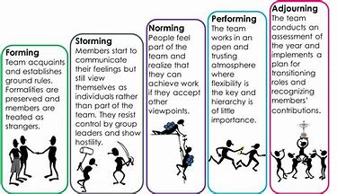
DIFFERENT STAGES OF TEAM DEVELOPEMENT

Slide 6

MANAGING CONFLICTS IN TEAMS
Focus on behaviour not personalities
Follow through on plans
Identify points of agreement and disagreement
Listen carefully
Develop a plan to work each conflicts

Slide 7
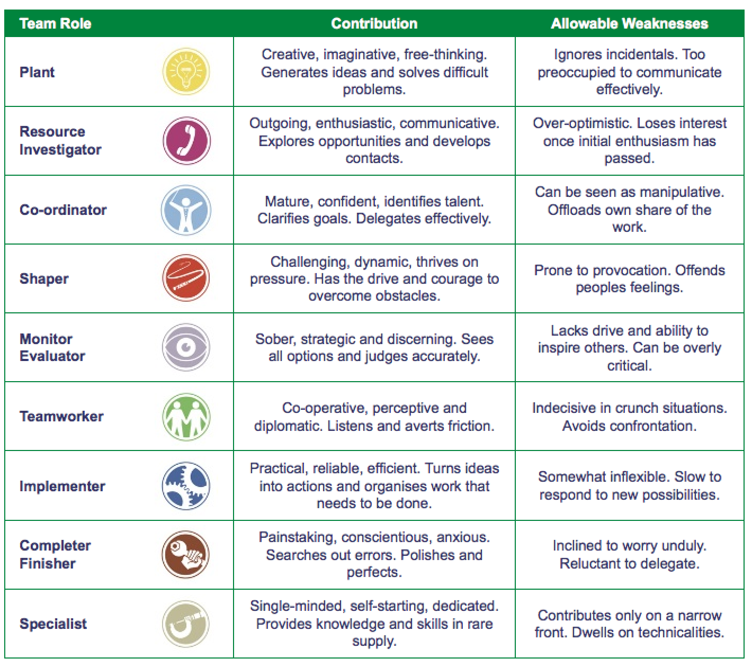

Slide 8
THANKYOU FOR LISTENING

Slide 9
REFERENCES
Tuckman's Theory (2018) Available at: https://www.teambuilding.co.uk/theory/Forming-Storming-Norming (Accessed: 14 August 2018).
Belbin 9 Team Roles (2018) Available at: https://www.belbin.com/about/belbin-team-roles (Accessed: 14 August 2018).

