Slide 1
Mst. Rahima Arobe Akhi (2524399)
Md. Aseiqur Rahaman (2524402)
Vignesh Kalsariya (2525353)
Module: Social Epidemiology and Public Health Development (LCHS7000_LON)
Lecturer: Muhammad Aliyu
Title: Fuel Your Future: A Health Promotion Campaign to Improve Nutrition Among University Students

Slide 2
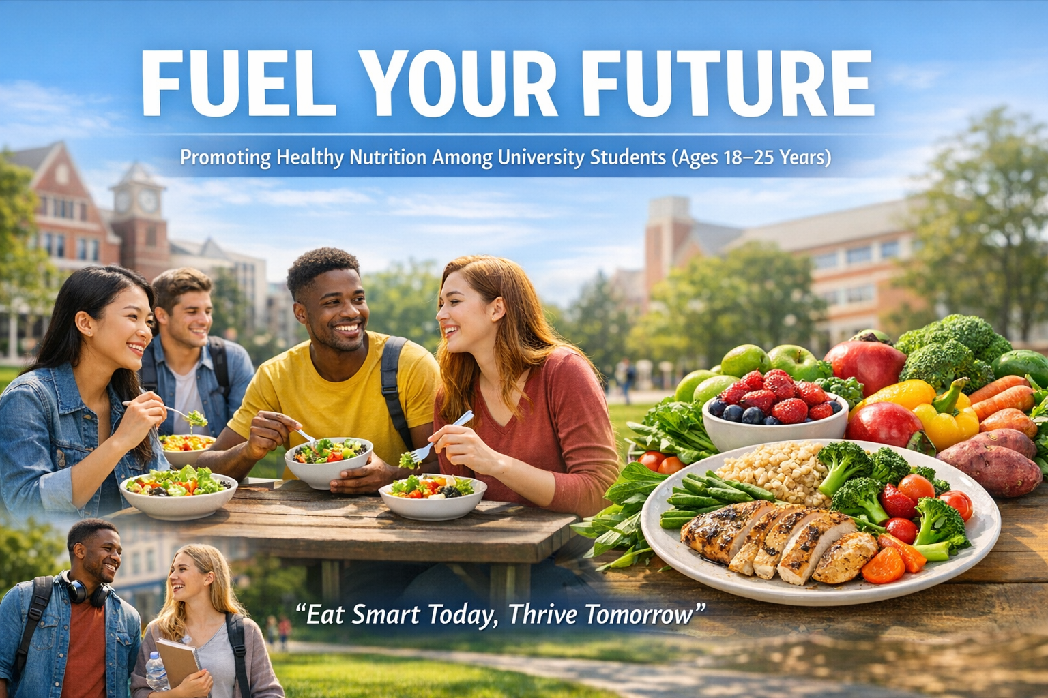

Slide 3
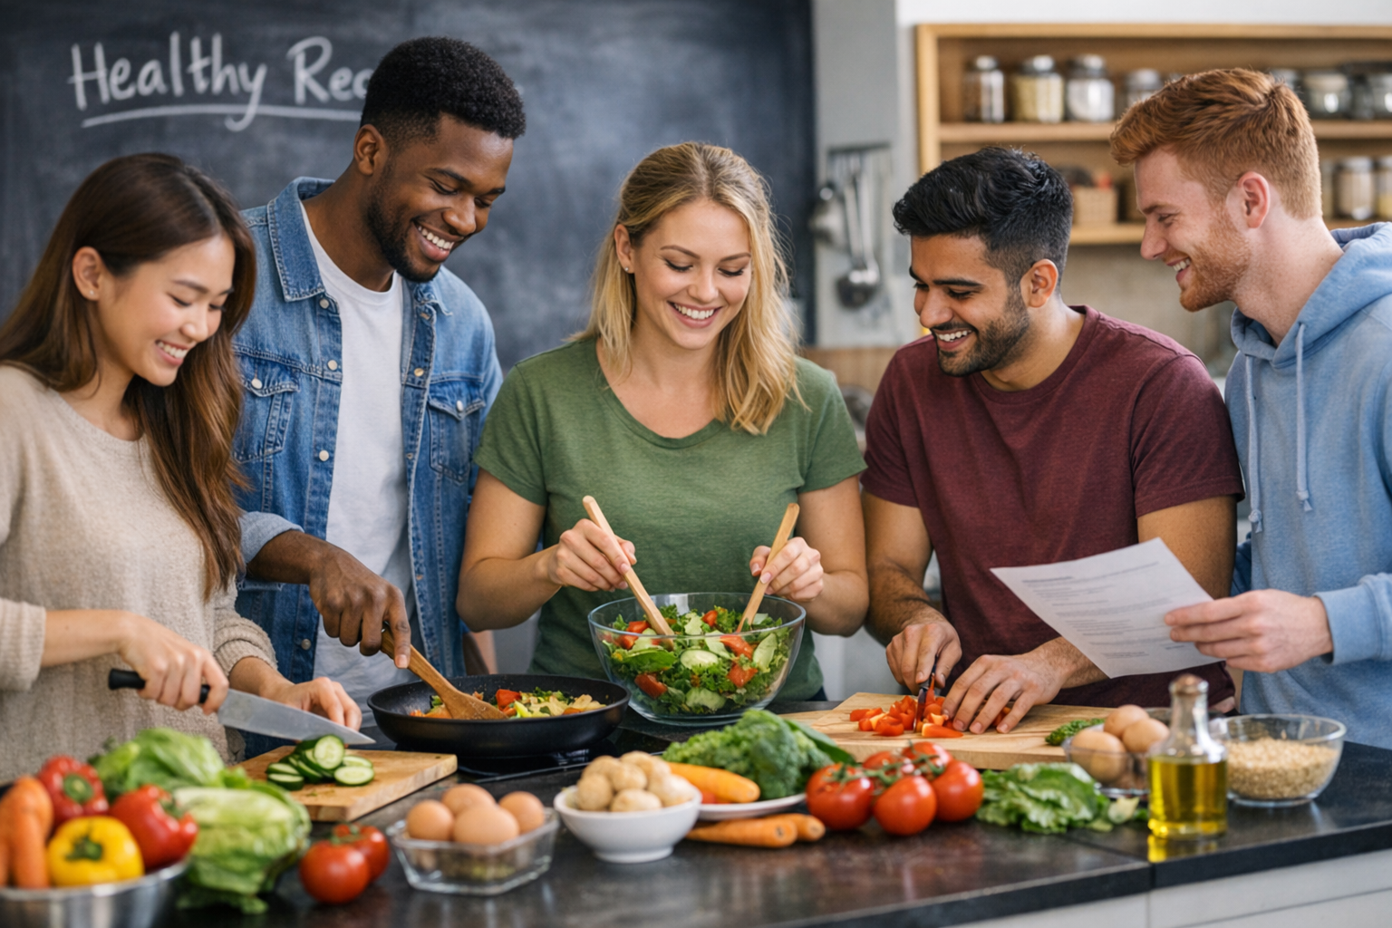
8-Week Healthy Nutrition Programme
Week 1 | Introduction & Healthy Eating Basics
Week 2 | Understanding Food Labels
Week 3 | Budget Meal Planning
Week 4 | Quick & Healthy Cooking Skills
Week 5 | Reducing Sugar & Ultra-Processed Foods
Week 6 | Diet & Mental Wellbeing
Week 7 | Energy, Fitness & Performance
Week 8 | Goal Review & Healthy Habit Maintenance

Slide 4
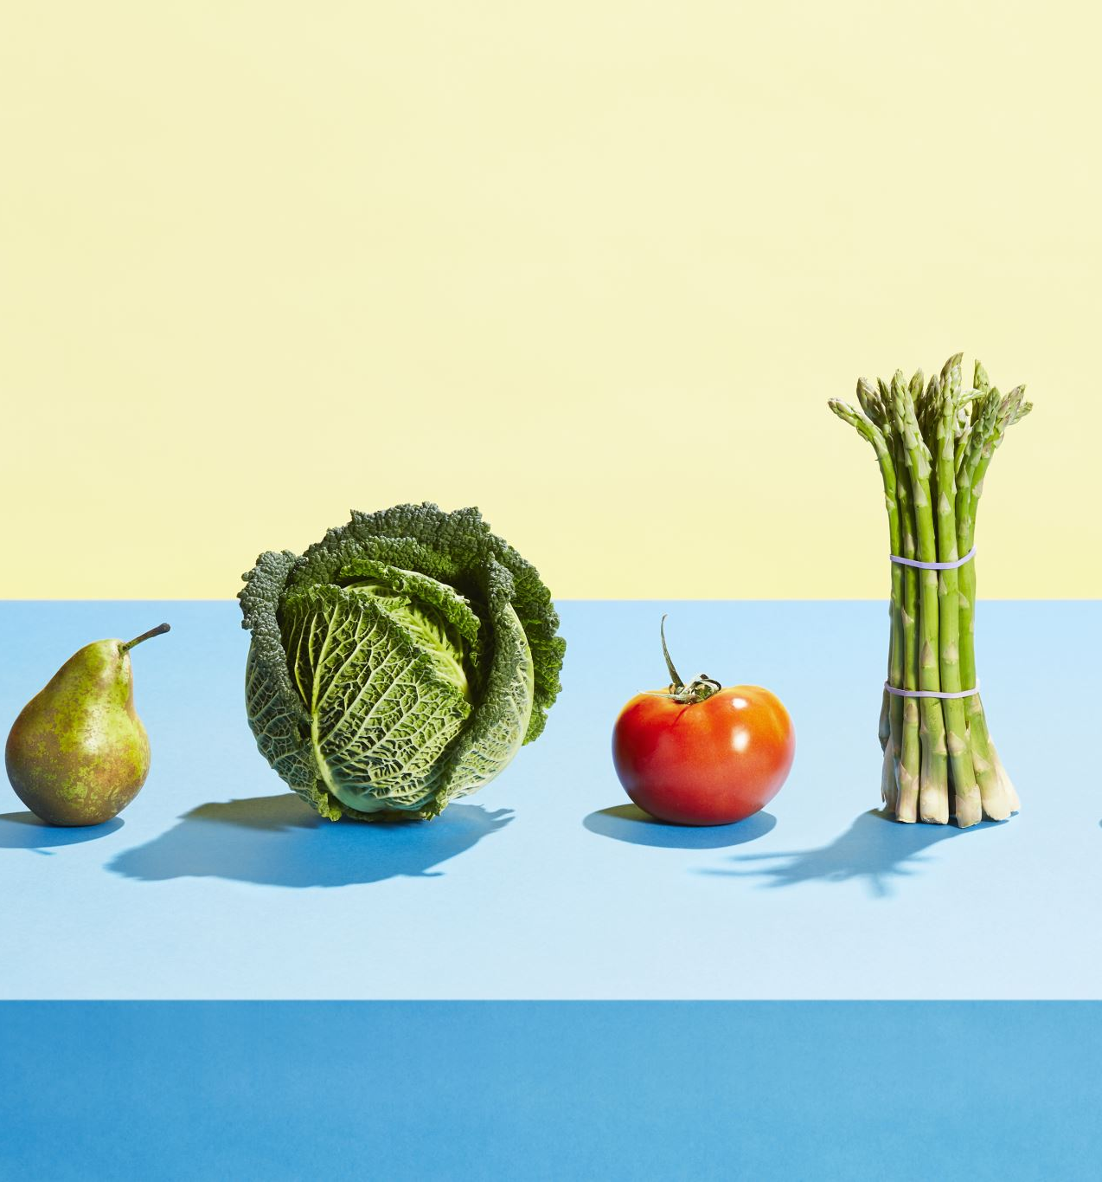
Why Diet Matters in Public Health?
Poor nutrition significantly increases the risk of developing non-communicable diseases.
Obesity rates in young adults are rising.
Early adulthood establishes lifelong health behaviours.
Social and environmental factors influence food choices.
According to the World Health Organization
Unhealthy diet contributes significantly to cardiovascular disease, diabetes, and cancer globally.

Slide 5
Are Young Adults Meeting Guidelines?
According to NHS and NHS Digital
Only around one-third of 19–24-year-olds meet 5-a-day recommendations.
High consumption of fast food and sugary drinks.
Increasing overweight and obesity prevalence in young adults.
National Guidelines (Eatwell Guide)
5 portions fruit & vegetables daily
Limit free sugars to 5% of daily intake
Reduce salt intake to <6g/day

Slide 6
Short-Term Consequences of Poor Diet
Mood swings & irritability
Poor academic performance
Digestive issues
Low energy & fatigue
Weakened immunity

Slide 7
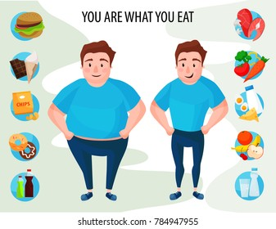
Long-Term Consequences of Poor Diet
Obesity and overweight.
Chronic diseases.
Mental health issues.
Lower academic and professional potential
Poor lifestyle habits
Source: Almased

Slide 8
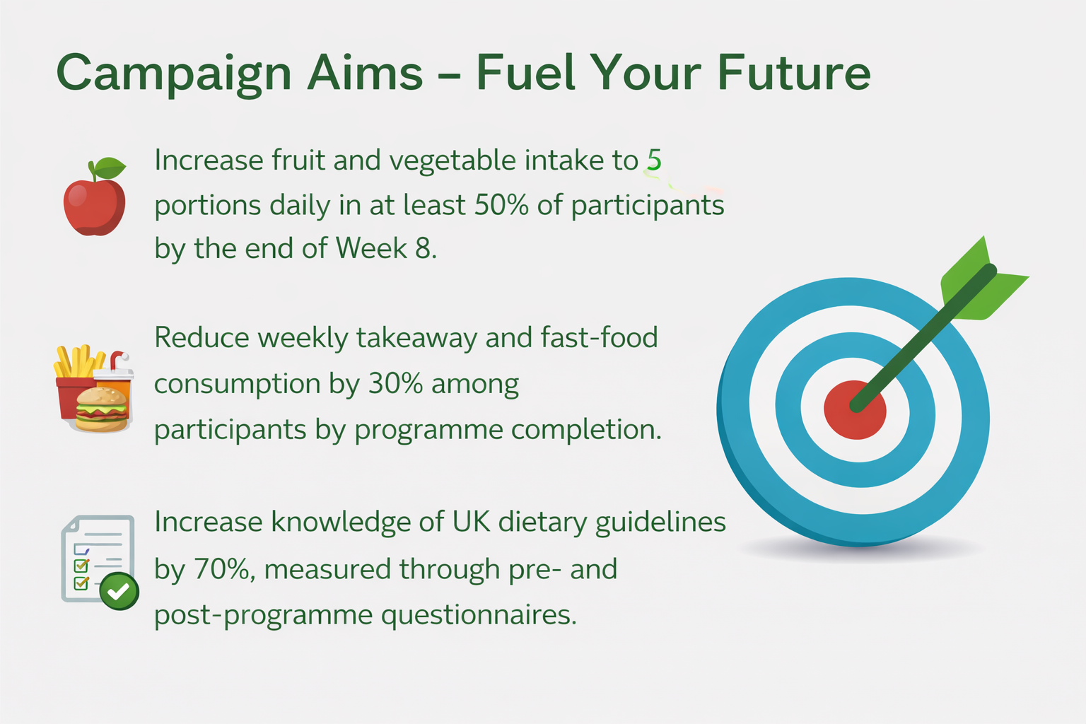

Slide 9

How Will the Campaign Achieve Its Aims?
Objective 1: Improve Access to Healthy Options
Partner with university food outlets
Promote affordable healthy meal deals
Share budget-friendly meal ideas
Objective 2: Increase Nutrition Knowledge
Short educational workshops
Social media infographics
Simple “5-a-day” awareness posts
Objective 3: Encourage Behaviour Change
8-week healthy eating challenge
Peer support groups
Weekly progress tracking

Slide 10
Campaign Evaluation
Process | Impact | Outcome
Session attendance | Pre & post knowledge survey | Increased fruit & vegetable intake
Participant engagement | Attitude toward healthy eating | Reduced takeaway consumption
Weekly feedback forms | Food label understanding | Healthier eating habits

Slide 11

Campaign Poster

Slide 12
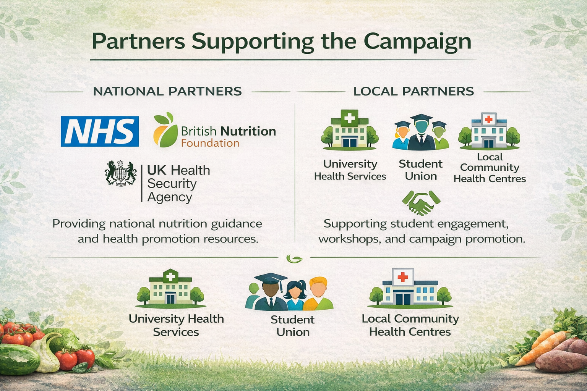
Partners

Slide 13



Behaviour Change Theories
Health Belief Model | Social Cognitive Theory | Theory of Planned Behaviour
Students change behaviour when they understand the risk of unhealthy diet and the benefits of healthy eating. | Students learn healthy habits through peer influence, observation, and confidence (self-efficacy). | Healthy eating depends on attitudes, social norms, and perceived control over food choices.

Slide 14
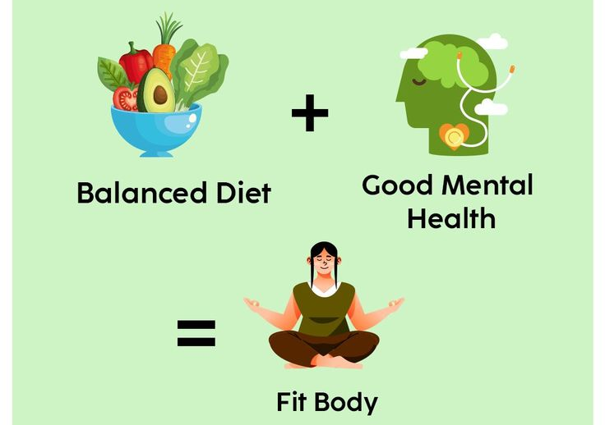
Physiological Benefits of Healthy Diet
Boosts energy levels for academic tasks and daily activities.
Supports proper growth and development.
Strengthens the immune system, helping prevent illnesses.
Reduces long-term risk of conditions like:
Obesity
Type 2 diabetes
Cardiovascular diseases
Source: Shutterstock

Slide 15
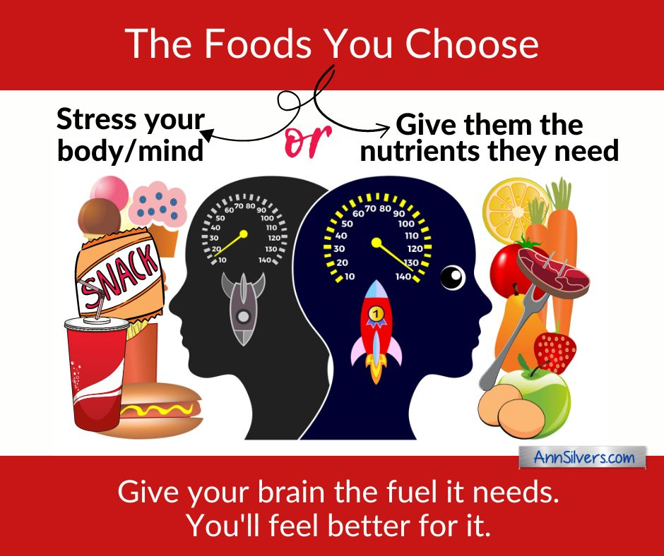
Psychological Benefits of Healthy Diet
Supports brain function and cognitive development.
Helps reduce stress, anxiety, and mood swings linked to poor eating habits.
Promotes better sleep quality, which improves mental wellbeing and learning ability.
Improves concentration and memory, helping students perform better in studies.
Source: Ann Silvers

Slide 16

Sociological Benefits of Healthy Diet
Encourages positive peer influence on healthy eating.
Builds community and family engagement.
Supports sustainable healthy habits.
Promotes social interaction through group meals or cooking activities.

Slide 17
Barriers: Individual & Physiological
Fatigue and low energy
Cravings for fast food, sugary drinks, and snacks.
Limited cooking skills
Lack of time
Irregular eating patterns

Slide 18





Barriers: Psychological & Social
Low motivation
Peer influence
Limited access to healthy food
Stress and emotional eating
Budget constraints

Slide 19
Solution 1: Education & Skills
Meal planning sessions
Cooking demonstrations
Informational resources
Healthy eating workshops

Slide 20
Solution 2: Social & Peer Support
Group cooking or meal prep sessions
Healthy eating challenges or competitions
Peer support groups

Slide 21
Solution 3: Practical Resources & Access
Quick and healthy snack ideas
Improved access to healthy foods
Budget-friendly meal guides
Online resources

Slide 22
Conclusion
Healthy diet improves body, mind, and social life.
Students face time, stress, peer, and access barriers.
Campaign offers education, peer support, and practical resources.
Healthy habits now prevent long-term health issues.

Slide 23

References
Glanz, K., Rimer, B.K., & Viswanath, K. (2015) Health Behavior: Theory, Research, and Practice. 5th edn. San Francisco: Jossey-Bass.
Hossain, S., Mahumud, R.A., & Alam, K. (2020) ‘Culturally tailored nutrition education improves dietary habits in university students’, BMC Public Health, 20(1), pp. 1–12.
Nutbeam, D. (2000) ‘Health literacy as a public health goal: a challenge for contemporary health education and communication strategies’, Health Promotion International, 15(3), pp. 259–267.
Public Health England (2021) Eatwell Guide. London: Public Health England. Available at: https://www.gov.uk/government/publications/the-eatwell-guide (Accessed: 5 March 2026).
World Health Organization (2020) Healthy diet. Geneva: WHO. Available at: https://www.who.int/news-room/fact-sheets/detail/healthy-diet (Accessed: 5 March 2026).

Slide 24

Thank You

