Slide 1

PROFESSIONAL DEVELOPMENT WITHIN HEALTH AND SOCIAL CARE LCHS4009 BIRMINGHAM
AZRA.M.HABIB SN 2507358

Slide 2

COMMUNICATION SKILLS IN HEALTH AND SOCIAL CARE.
This Photo by Unknown Author is licensed under CC BY-NC-ND

Slide 3
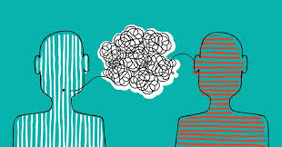
What is Communication?
Communication is the process of sharing information,
Ideas, Feelings, and instructions between Individuals.
Communication skills can be,
-Written skills,
-Verbal skills,
-nonverbal skills,
-Listening skills.
(Hutton, 2022)

Slide 4
Written communication.
-It is very important for record keeping
-It mainly contains vital Information about Patients needs,
Assessments, test results, care plans, handover sheets,
and other Records.
-It should be Factual, valid and accurate.
(MDU, 2024)

Slide 5

Verbal and Nonverbal Communication
Verbal communication involves the use of spoken or written language to convey messages.
[DeVito, 2022]
Nonverbal communication includes body language, facial expressions, gestures, and other forms of communication without words.
[Burgoon, Guerrero and Floyd, 2016]
(Margaretta, 2025)

Slide 6
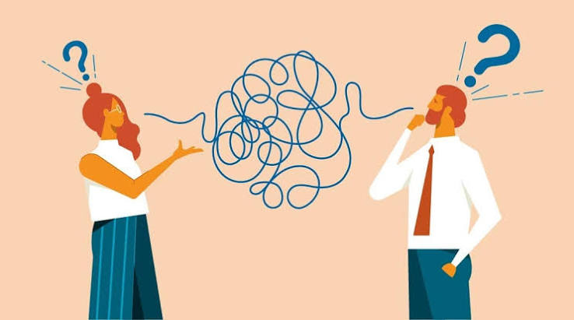
Listening skills.
Listening skills are the abilities that help a person accurately
Receive understanding, interpret, and response to spoken
Messages.
Good listening needs full attention, including focussing on
The speaker’s words, tone, and facial expressions.
(Lowenbraun, 2026)
(Bergeron and Loignon, 2024)

Slide 7
WHY COMMUNICATION IS IMPORTANT:-
-IT IMPROVES PATIENT’S SAFETY,
-REDUCES CONFUSION AND ERROR,
-IT BUILDS POSITIVE BOND,
-SUPPORTS PERSON CENTRED CARE,
-DEVELOP PATIENT SATISFECTION.
(NHS England, 2022)

Slide 8
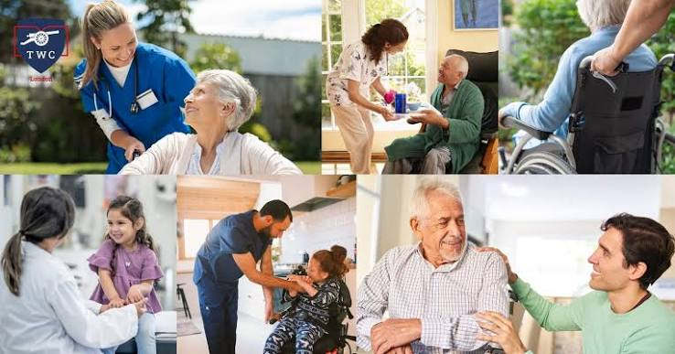
Practical Example In Health And Social Care.
A nurse is caring for an elderly patient
Who has hearing difficulty.
How Communication skills are Applied.
-Speak Clearly, slowly, and a bit loudly so that patients can understand.
-Maintain eye contact.
- Use simple language,
- Check whether the patient has understood.
- Ask if they have any questions.
(Twclondon.org.uk, 2025)

Slide 9
A Relevant Model for communication skill is
SBAR Communication Model.
SBAR Stands for:-
S-Situation –What is happening.
B-Background-What is the Relevant background information.
A-Assessment-What do you think the problem Is.
R-Recommendation-What action is needed.

Slide 10
Scenario:-A care Assistant Notices that an Elderly Resident,
Mrs Smith seems unwell and contacts the nurse.
Situation.
Mrs Smith is feeling dizzy and has become short of breath in the
Last 30 minutes.
Background.
She is 82 years and has a history of Heart disease, she was well
Earlier this morning.
Assessment.
Her breathing appears laboured, and her pulse is faster then usual
Recommendation.
Could you assess her immediately?
I think She May need Urgent Medical Attention.

Slide 11
Conclusion:-
Communication Is the Fundamental Professional skill.
-It Improves Patient’s Safety And quality care.
-Effective Communication Builds trust, Support, and Person Centered care.
-It Improves Patient Safety and Quality care.
-Health and Social care Professionals use communication
Everyday when working with patients, Families, and
Colleagues.

Slide 12
REFERENCES:-
-Arnold, E.C. and Boggs, K.U.[2023] Interpersonal Relationships: Professional
Communication Skills for Nurses. 9th ed. St. Louis: Elsevier.
Bergeron, D. and Loignon, A. (2024). What is active listening? [online] Center for Creative Leadership. Available at: https://www.ccl.org/articles/leading-effectively-articles/coaching-others-use-active-listening-skills/.
Hutton, L. (2022). Why Communication Should Be a Focus in Business. [online] Australian Institute of Business. Available at: https://www.aib.edu.au/blog/communication/6-reasons-effective-communication-focus-business/.
- Institute for Healthcare Improvement [2023] Communication and Patient Safety.
Boston: IHI.
Lowenbraun, N. (2026). Are You Using the Most Effective Listening Skills at Work? | Duarte. [online] Duarte. Available at: https://www.duarte.com/blog/using-effective-listening-skills-at-work/.
MDU (2024). Effective record-keeping - The MDU. [online] www.themdu.com. Available at: https://www.themdu.com/guidance-and-advice/guides/effective-record-keeping.
‌Margaretta, S. (2025). The Importance of Understanding Verbal and Non-Verbal Communication. [online] Prodi S2 Ilmu Komunikasi Telkom University. Available at: https://mcomms.telkomuniversity.ac.id/en/s2-communication-science-understanding-verbal-non-verbal-communication/.
NHS England (2022). How good communication skills benefit patients, service users and people affected by cancer, and those important to them. [online] NHS England. Available at: https://www.hee.nhs.uk/our-work/cancer-diagnostics/cancer-communications-resource-hub/patient/how-good-communication-skills-benefit-patients-service-users-people-affected
Twclondon.org.uk. (2025). Available at: https://www.twclondon.org.uk/blogs/service-user-groups-in-health-and-social-care.

