Slide 1

LIFESPAN DEVELOPMENT
EARLY YEARS
NAME: RABAB HAIDERALI MOHAMED
STUDENT NUMBER: 2528253
MODULE TITLE & CODE: PHYCOLOGY IN HEALTH & SOCIAL CARE – LCHS4010
LECTURER: DR. HELEN PARSONS
ASSIGNMENT TITLE: LIFESPAN DEVELOPMENT CASE STUDY

Slide 2


CASE STUDY
UNDERSTANDING SHONA’S NEEDS THROUGH ATTACHMENT THEORY
Shona is 3 years old and has recently started nursery.
She becomes upset when her carers leave.
She does not use many words yet and finds group play difficult.
We need to understand what she may be feeling and how to help her feel safe.
These signs do not tell us on their own that she has a problem or a disorder.
Bowlby (1988); Ainsworth et al. (1978); NICE (2015).

Slide 3
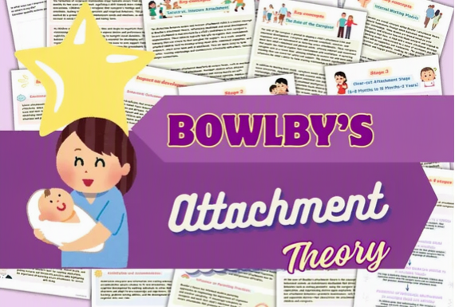


BOWLBY’S ATTACHMENT THEORY
John Bowlby developed attachment theory.
Attachment means the close emotional bond between a child and a trusted adult.
Children often look for their trusted adult when they feel scared, tired or unsure.
A trusted adult can be a ‘safe place’ when a child is upset.
When children feel safe, they are more likely to explore and try new things.
(Bowlby, 1982; Ainsworth et al., 1978)

Slide 4



WHY IS IT IMPORTANT FOR YOUNG CHILDREN
At age 3, children are still learning how to manage strong feelings.
They are learning to talk, play with others and do more things by themselves.
Kind and reliable adults can help children calm down and feel safe.
Nursery staff can become trusted adults too, by being patient and consistent.
(Sroufe, 2005; National Scientific Council on the Developing Child, 2004)

Slide 5
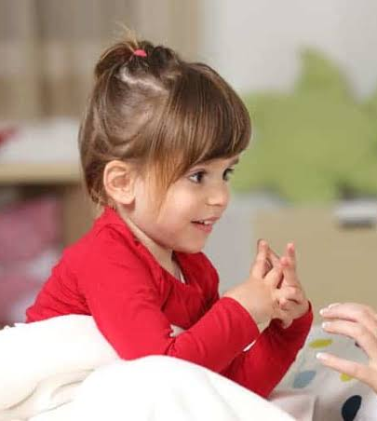



HOW CAN THE THEORY HELP US UNDERSTAND SHONA?
Shona may feel worried because nursery is new and her carers are leaving.
She may need time to learn that the nursery adults will care for her.
If she cannot easily explain her feelings with words, she may show them by crying or staying close to an adult.
A busy group may feel too much for her at first.
We should watch and learn what helps her instead of giving her a label.
(Bowlby, 1982; Ainsworth et al., 1978; NICE, 2015)

Slide 6

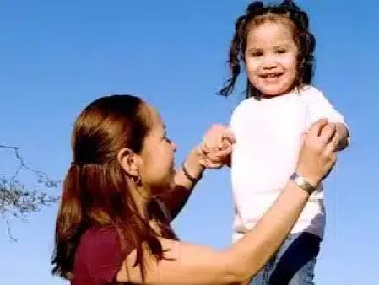
EMPOWERING
SHONA
HELPING WHEN CARERS LEAVE:
HELPING COMMUNICATE & PLAY:
Choose one main staff member to welcome Shona each day.
Keep the morning routine the same, so she knows what will happen.
Ask carers to say goodbye calmly and clearly. Do not leave secretly.
Let her bring an agreed comfort item or family photo if this helps.
Comfort her when she is upset and gently help her start an activity when she is ready.
(NICE, 2015; National Scientific Council on the Developing Child, 2004)
Speak slowly and use short, simple sentences.
Use pictures, pointing, songs and choices to help her show what she wants.
Give her time to answer. Notice gestures and sounds as well as words.
Start with playing beside one child, rather than expecting her to join a large group straight away.
Work with her carers and the nursery’s additional-support staff. If speech concerns continue, discuss advice from a health visitor, GP or speech and language therapist.
(Harvard Center on the Developing Child, n.d.; NICE, 2015; NHS, n.d.)

Slide 7
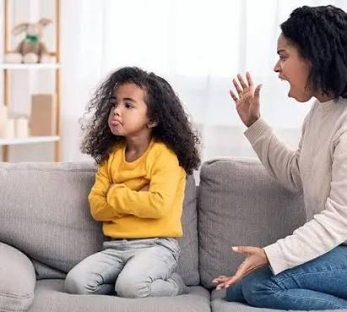


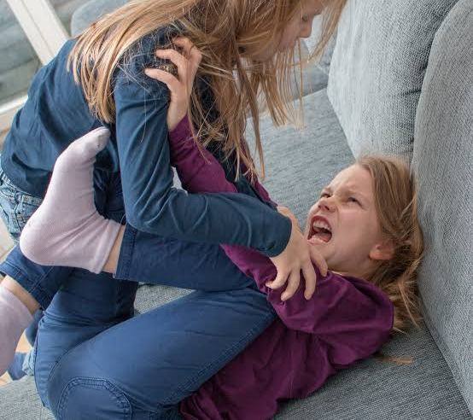
NATURE
&
NURTURE
Nature means the things a child is born with or their body and brain development, such as temperament or hearing.
Nurture means the child’s experiences, such as family support, language, routines and care from adults.
Both can affect how a child feels, learns, talks and plays.
For example, a child who is naturally shy may find a noisy room hard, but a calm adult and a quiet activity may help.
We should not blame Shona or her family. We should find out what support works best.
(Belsky, 1984; Sameroff, 2009)

Slide 8
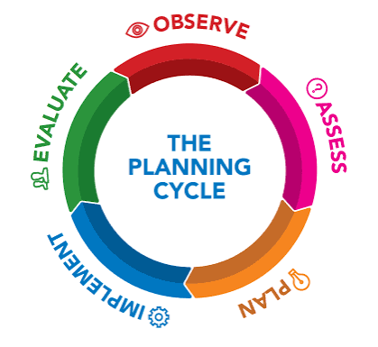
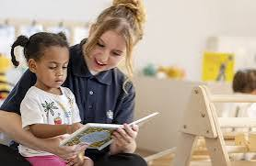
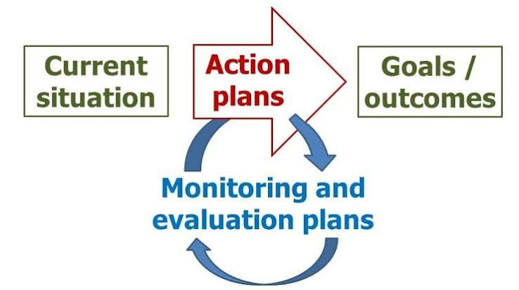
EVALUATION & SUPPORT PLAN
STRENGTHS & LIMITATIONS:
SUPPORT PLAN:
CONCLUSION:
The theory reminds us that children need trusted adults and emotional safety.
It gives staff useful ideas, such as comfort, routine and a strong relationship with a key person.
However it cannot explain everything about a child’s development. But Vygotsky emphasises how social interaction, language and culture shape children’s cognitive development.
Children are different. Their culture, health, temperament, language and life experiences also matter.
We cannot decide Shona’s attachment type just from these few behaviors. We need to observe her and work with her family.
(Fearon et al., 2010; Groh et al., 2014; NICE, 2015; Vygotsky, 1978).
Start with a key person, a calm goodbye and the same arrival routine.
Write down what helps Shona settle, communicate and play.
Check progress with carers and staff each week and change the plan if needed.
If speech or other development worries continue, follow nursery guidance to seek professional advice.
Keep information private and follow nursery safeguarding procedures.
(NICE, 2015; NHS, n.d.)
Bowlby’s theory helps us understand that Shona may need more safety, comfort and time to settle.
Staff can help by being reliable, using simple communication and introducing play slowly.
Every child is different, so we must listen to the family, observe Shona and get extra advice when needed.
(Bowlby, 1982; Sroufe, 2005; NICE, 2015)

Slide 9
REFERENCES
Ainsworth, M.D.S., Blehar, M.C., Waters, E. and Wall, S. (1978) Patterns of Attachment: A Psychological Study of the Strange Situation. Hillsdale, NJ: Lawrence Erlbaum Associates.
Belsky, J. (2005) ‘Differential susceptibility to rearing influences: An evolutionary hypothesis and some evidence’, in Ellis, B.J. and Bjorklund, D.F. (eds.) Origins of the Social Mind: Evolutionary Psychology and Child Development. New York: Guilford Press, pp. 139–163.
Bowlby, J. (1969) Attachment and Loss: Volume 1. Attachment. New York: Basic Books.
Bowlby, J. (1988) A Secure Base: Parent-Child Attachment and Healthy Human Development. New York: Basic Books.
Cassidy, J. and Shaver, P.R. (eds.) (2016) Handbook of Attachment: Theory, Research, and Clinical Applications. 3rd edn. New York: Guilford Press.
Fearon, R.M.P., Bakermans-Kranenburg, M.J., van IJzendoorn, M.H., Lapsley, A.-M. and Roisman, G.I. (2010) ‘The significance of insecure attachment and disorganization in the development of children’s externalizing behavior: A meta-analytic study’, Child Development, 81(2), pp. 435–456.
Groh, A.M., Fearon, R.M.P., van IJzendoorn, M.H., Bakermans-Kranenburg, M.J. and Roisman, G.I. (2017) ‘Attachment in the early life course: Meta-analytic evidence for its role in socioemotional development’, Child Development Perspectives, 11(1), pp. 70–76.
Harvard University, Center on the Developing Child (n.d.) Serve and Return. Available at: https://developingchild.harvard.edu/ (Accessed: 2nd October 2026).
National Institute for Health and Care Excellence (NICE) (2015) Children’s Attachment: Attachment in Children and Young People Who Are Adopted from Care, in Care or at High Risk of Going into Care. NICE Guideline NG26. Available at: https://www.nice.org.uk/guidance/ng26 (Accessed: 10th October 2026).
National Scientific Council on the Developing Child (2004) Young Children Develop in an Environment of Relationships. Working Paper No. 1. Cambridge, MA: Center on the Developing Child, Harvard University.
Sameroff, A. (ed.) (2009) The Transactional Model of Development: How Children and Contexts Shape Each Other. Washington, DC: American Psychological Association.
Sroufe, L.A. (2005) ‘Attachment and development: A prospective, longitudinal study from birth to adulthood’, Attachment & Human Development, 7(4), pp. 349–367.
van Rosmalen, L., van der Horst, F.C.P. and van der Veer, R. (2016) ‘From secure dependency to attachment: Mary Ainsworth’s integration of Blatz’s security theory into Bowlby’s attachment theory’, History of Psychology, 19(1), pp. 22–39.
Vygotsky, L.S. (1978) Mind in society: The development of higher psychological processes. Cambridge, MA: Harvard University Press.

Slide 10





