Slide 1
Digital Skills and Research Methods

Slide 2
Team Eventagious
Red carpet events management
Group Members
B. M SAHED 1710633
FOYSAL AHMED 1709523
MOHAMMAD RAHMAN 1709543
A. QURAISHI 1709589
ZUHEL MIAH 1709521
GMAIL – Bakshisahed1710633@gmail.com
Password – witness73
Alternatively - witness1973
redcarpetevents18@gmail.com
Password - redcarpet2018

Slide 3
Introduction
The following questionnaire survey was devised to understand the market demand for our events management company. We enticed the reader with a chance to win £100 in Amazon vouchers for their cooperation and response.In order to get the best results the questions were carefully selected.
Contributions were made by all members however it was I who created the survey from start to finish including theme colours and design.
Special mention to Mr. Quraishi for his question suggestion on 2,9 and 10.

Slide 4
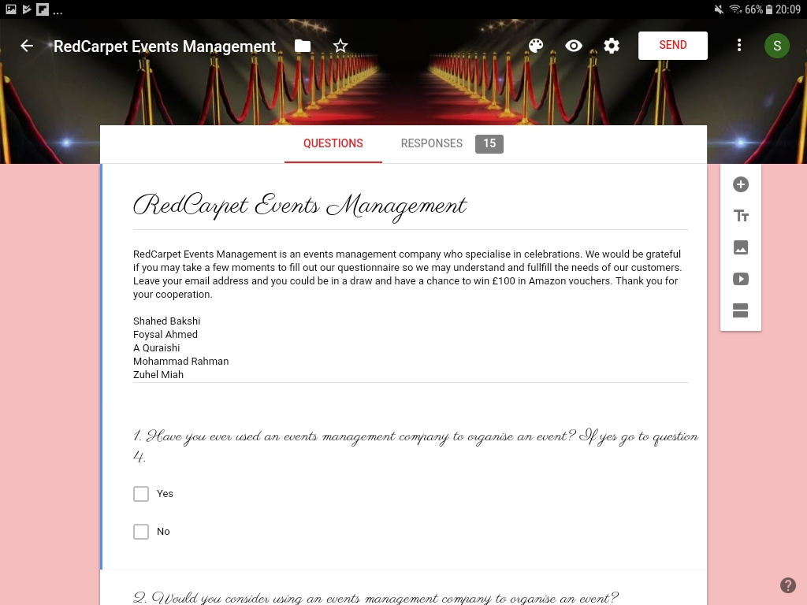
Marketing Questionnaire Survey
Q1.

Slide 5
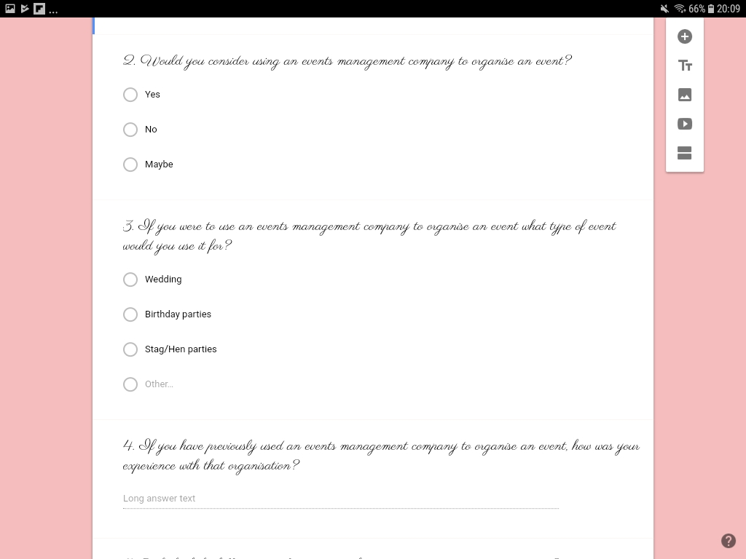
Q2. And Q3.

Slide 6
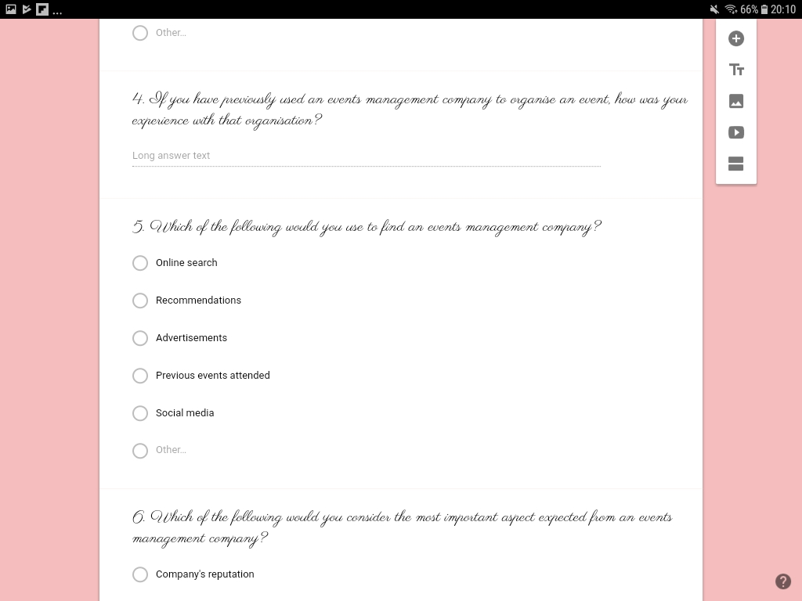
Q4. and Q5.

Slide 7
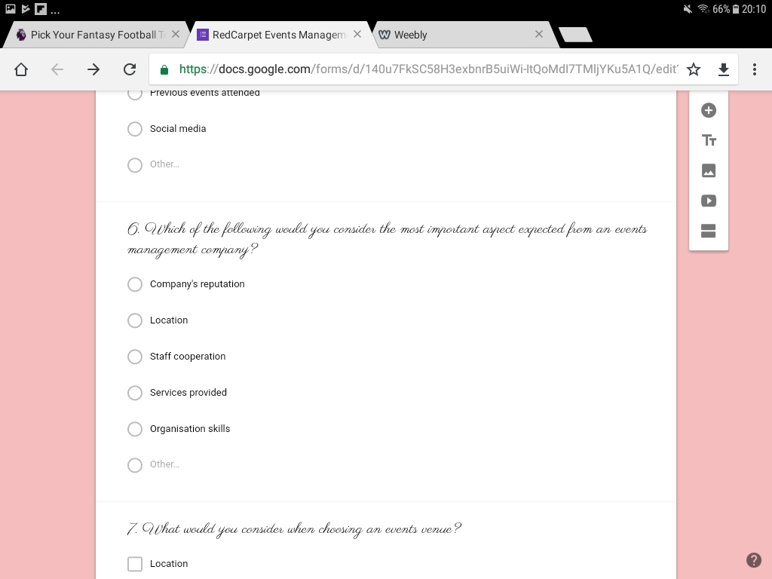
Q6.

Slide 8
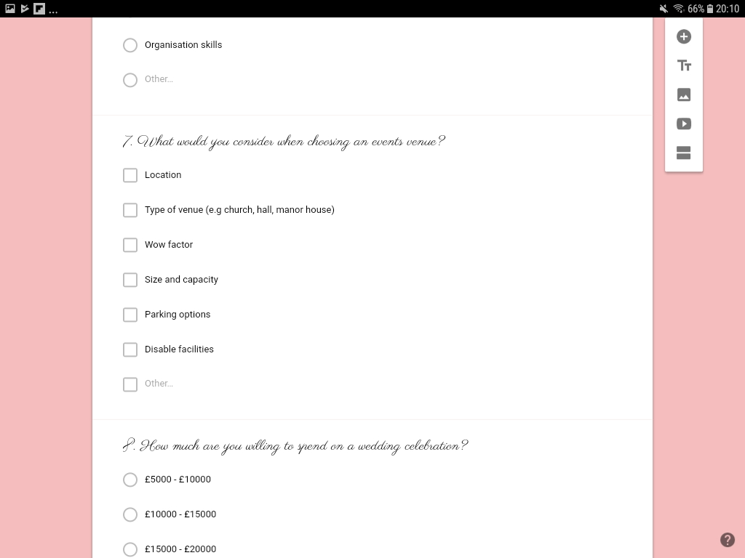
Q7.

Slide 9
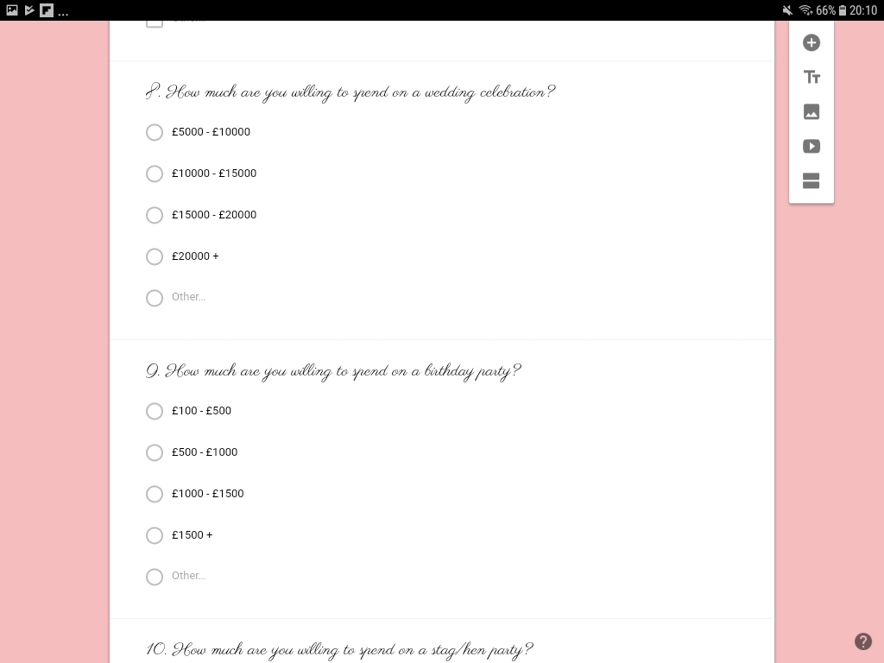
Q8 and Q9.

Slide 10
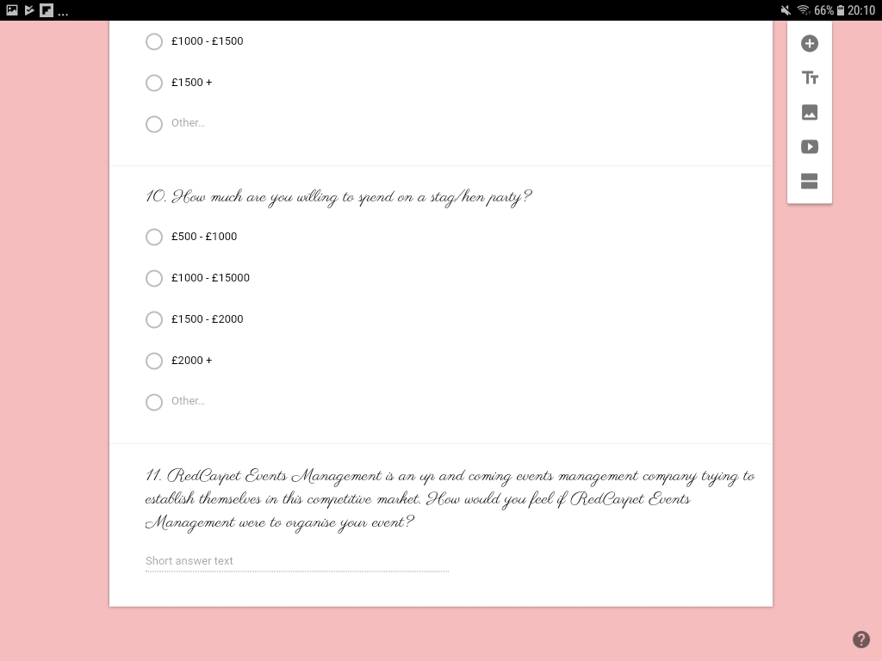
Q10. and Q11

Slide 11
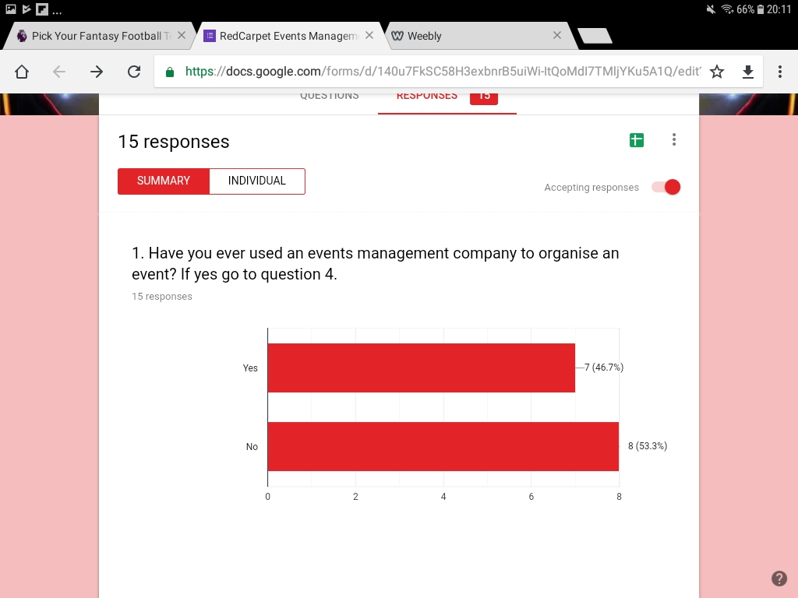
Responses

Slide 12
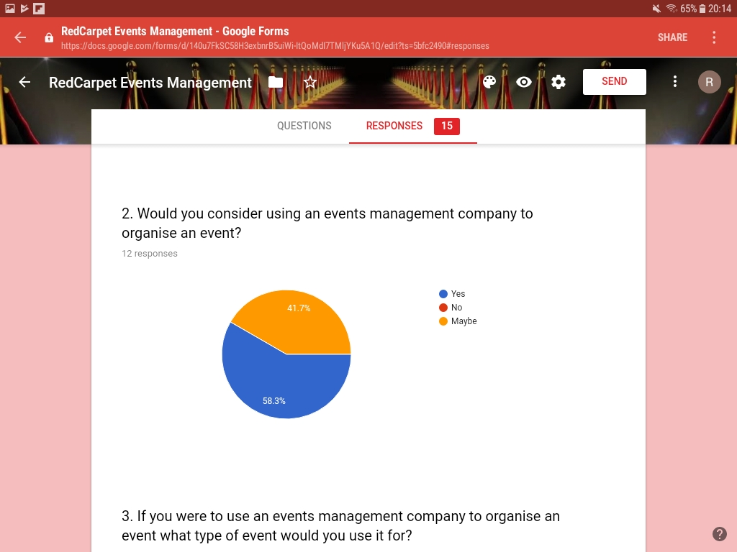

Slide 13
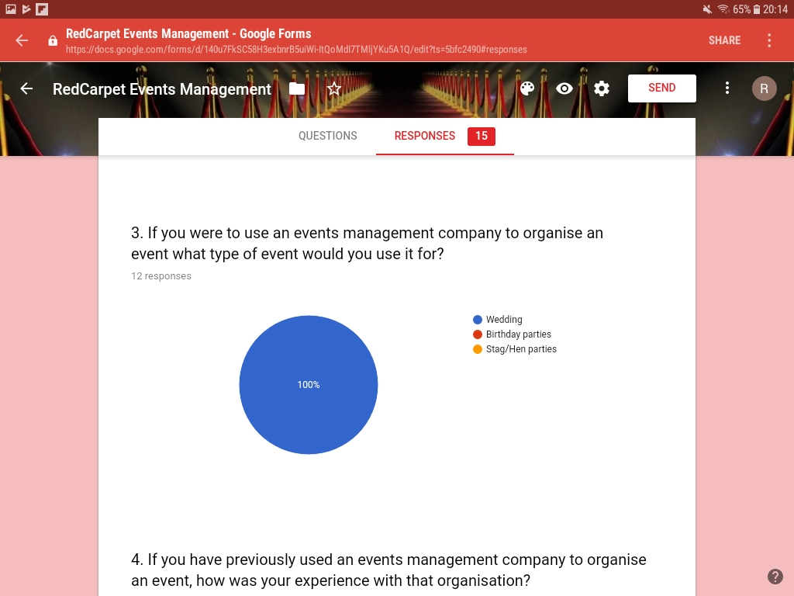

Slide 14
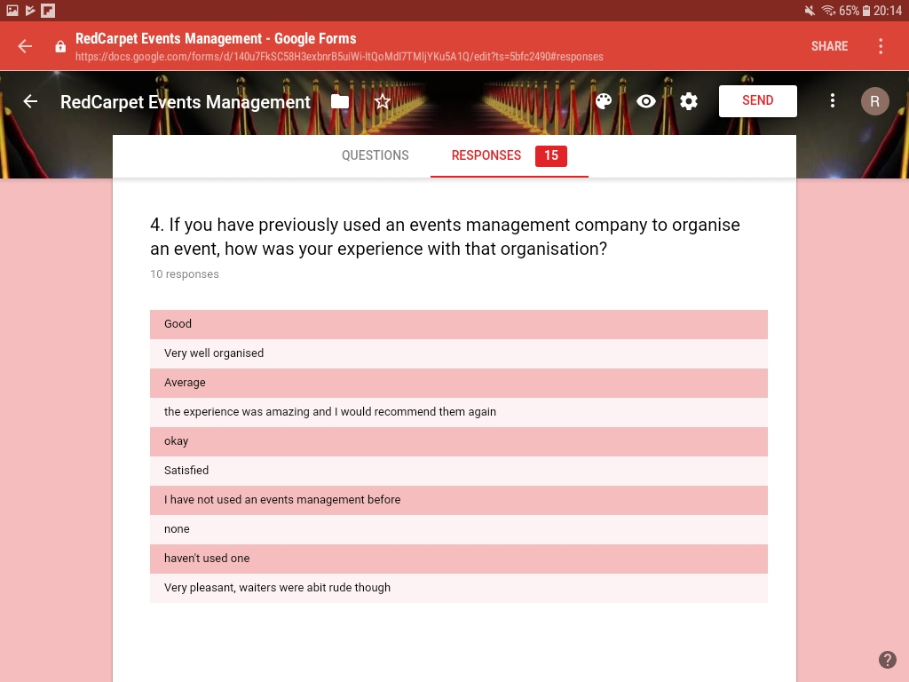

Slide 15
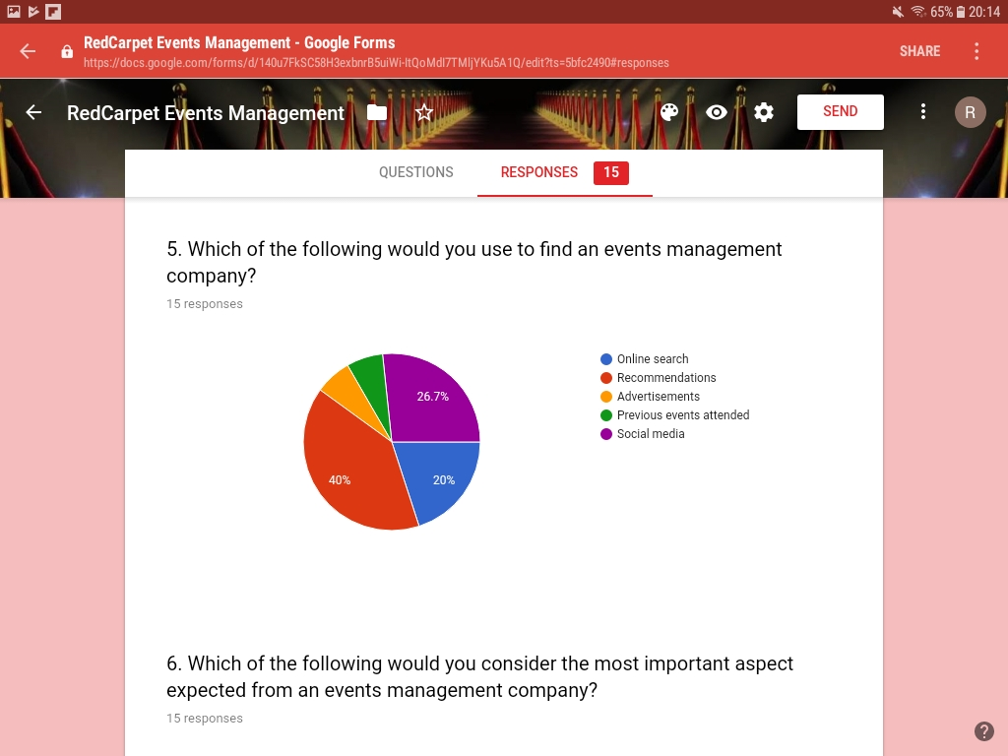

Slide 16
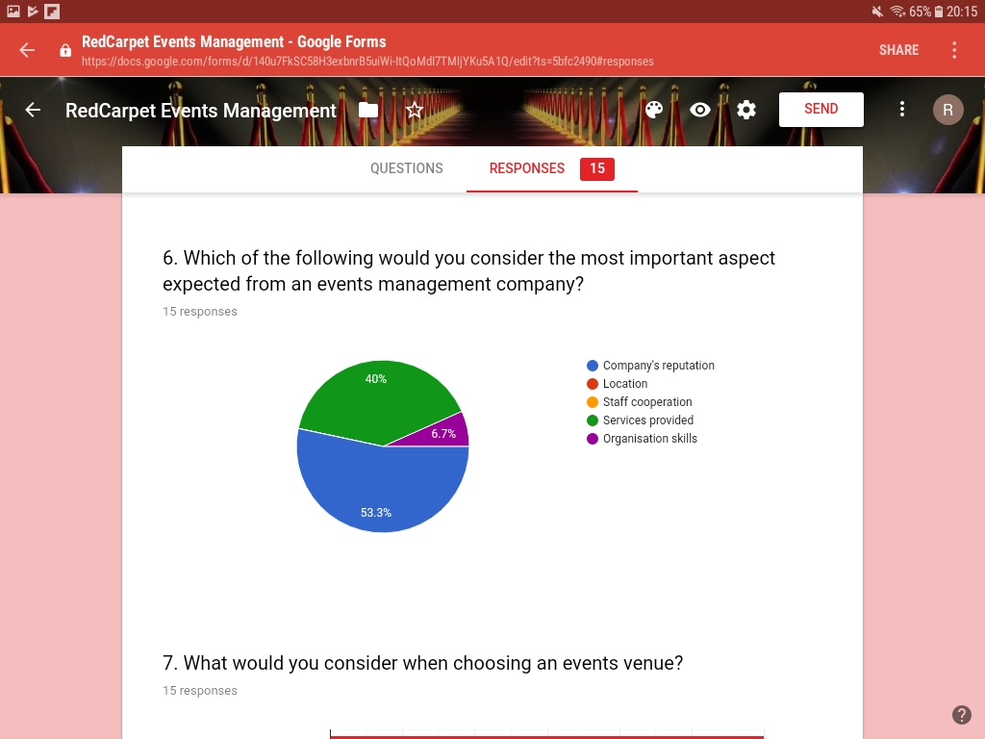

Slide 17
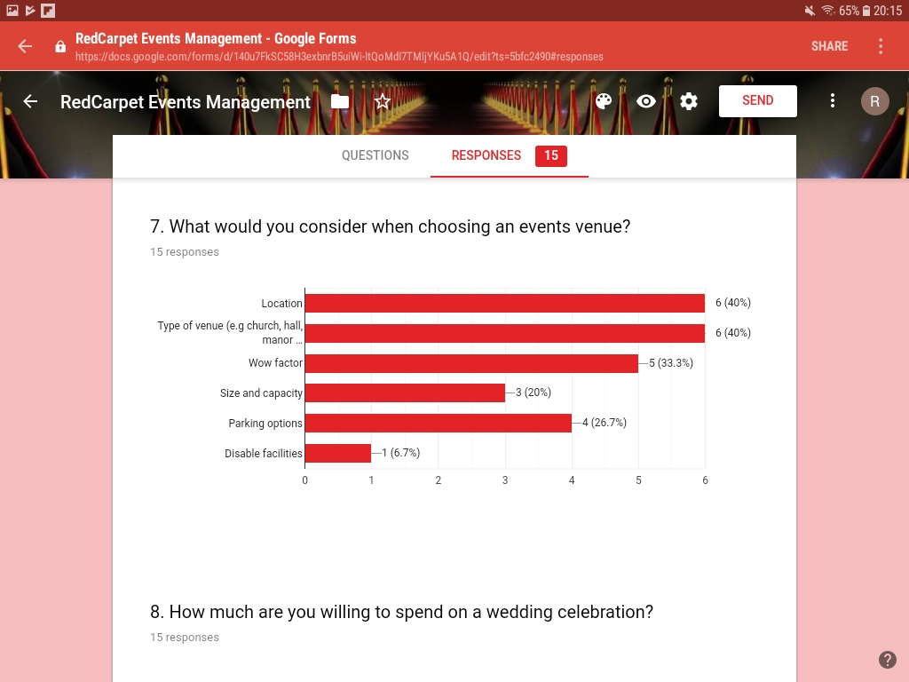

Slide 18
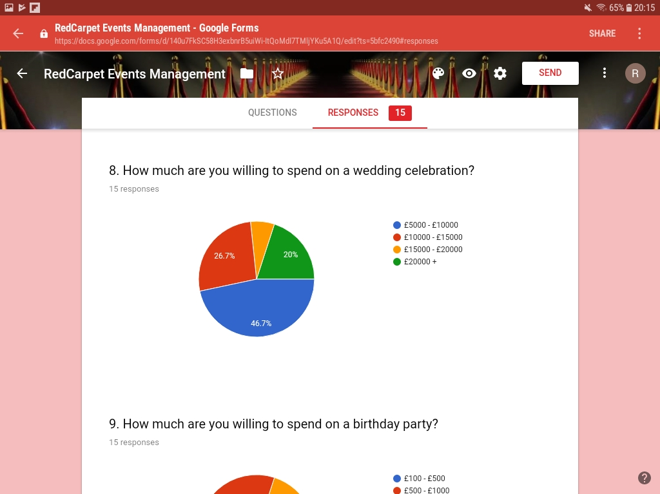

Slide 19
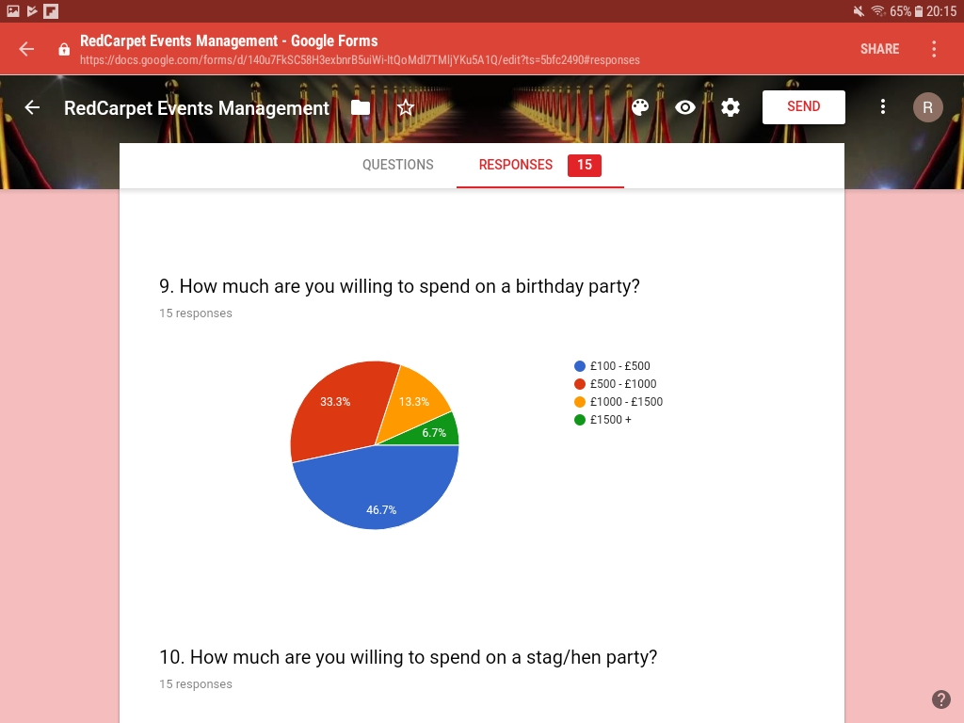

Slide 20
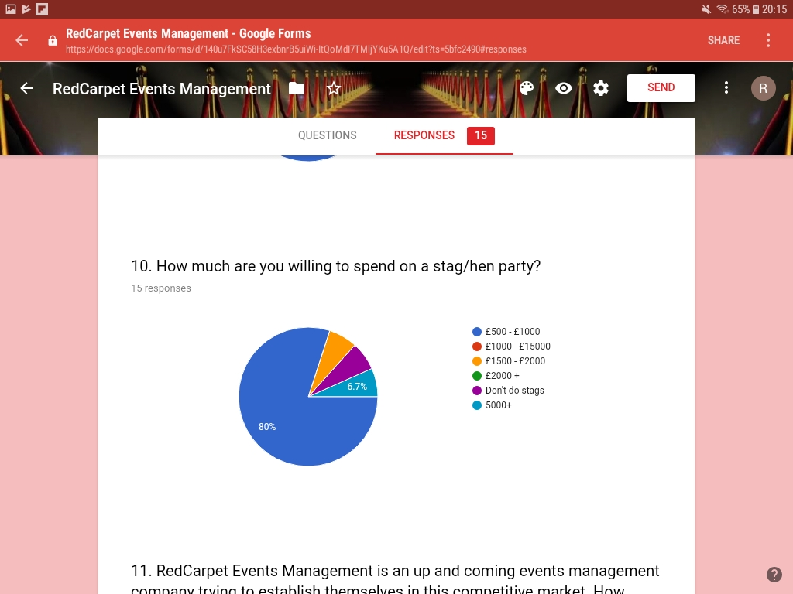

Slide 21
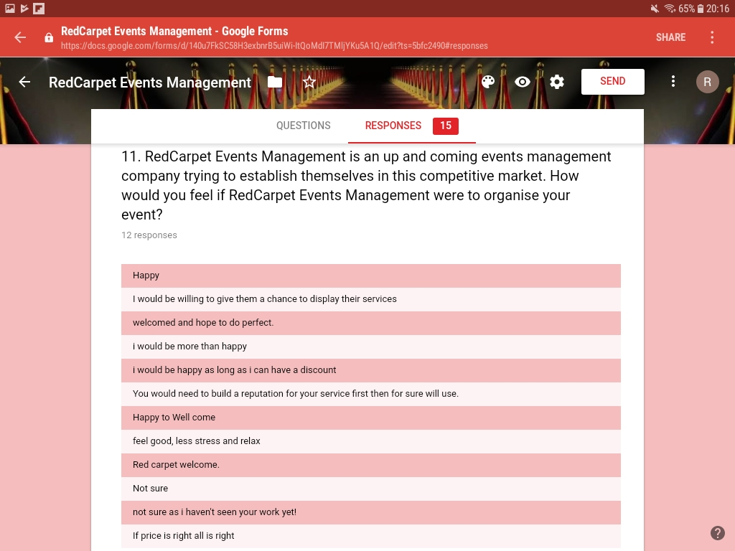

Slide 22
Conclusion
Regarding the questionnaire itself, we attempted to make it interesting. It was our intention to use different styles of questions (e.g linear scales), however Google forms proved to be tricky and did not allow us to use certain tools. On reflection, in future It would be wise to search for and use different applications such as "monkeysurvey.com“.
Although the questionnaire was given to a limited number of people, the response was encouraging. It was surprising to see how many people had already used an events management company to organise an event and would use one again. It showed us that there is a demand for an organisation like ours.

