Slide 1
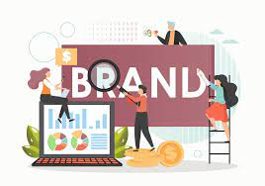
Building a Professional Brand and Identity:
Skills analysis and personal development planning

Slide 2
Lesson Content
What is a Brand
The Power of Brands
Brands in today’s Context
Personal Branding
Professional Branding
Professional Identity
Skills Analysis
Personal Development Plan

Slide 3
Lesson Aim and Objectives
Aim:
01
To establish a connection between brand and you.
Objectives:
02
To understand the role of brands in today’s context
Identify how developing a brand can be beneficial

Slide 4
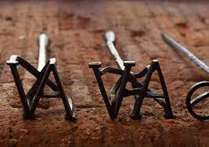
What is a Brand?
The word ‘brand’ derived from Old Norse and translated into Anglo Saxon:
“…to burn” (Blackett, 2004)
Early man burned to stamp ownership over livestock:
Claim ownership over products
To ensure quality of their products were associated with themselves
Notes:
A brand is not a name, positioning statement or marketing strategy, but a promise to consumers
A brand is a distinguishing name and/or symbol (such as logo, trademark, or package design) intended to
identify the goods or services of either one seller or a group of sellers, and to differentiate those goods or
services from those of competitors

Slide 5
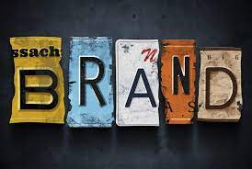
What is a Brand?
A brand doesn’t simply mean:
Name
Positioning statement
Marketing
A brand means:
A promise to consumers
Distinguishes from other services or goods (Competitors) (Yakup and Sevil, 2011)

Slide 6
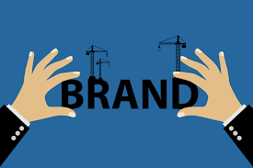
The Power of Brands
Brands attempt to establish a connection between product and perception/emotions (Pogorzelski, 2018).
Establish Loyalty
How to establish the above:
  Product packaging: Images
  Advertisement: tv, radio, print, spokespeople (advocating)

Slide 7
Brands:
In Today’s Context
According to Temproral (2019) brands are integral to our lives within the 21st Century due to the acceleration of innovation.
Seven World Market trends:
Boundaryless markets
Globalization
The digital world
Economy volatility and instability
Consumer sophistication
Market Fragmentation
Product Diversity and life-cycle
Notes:
Bounderyless markets: markets crossing over into other sectors
Globalization: trade deals/ travelling to other nations, you will see same brands (way to produce products and cheaper costs)
Digital world: Instant access to products and services (online shopping replacing high streets)
Economy: recessions
Consumer Sophistication: greater spending power/ educated people know what they want!
Market fragmentation: The concept that a marketplace can divide into many small markets, each containing customers with distinct preferences or requirements (this can be positive, for example Hospitality: The dominant nature of large restaurant chains leads smaller restaurants to form sub-markets that fulfill diverse market demands)
Product Diversity and life-cycle introduction, growth, maturity, and decline.

Slide 8
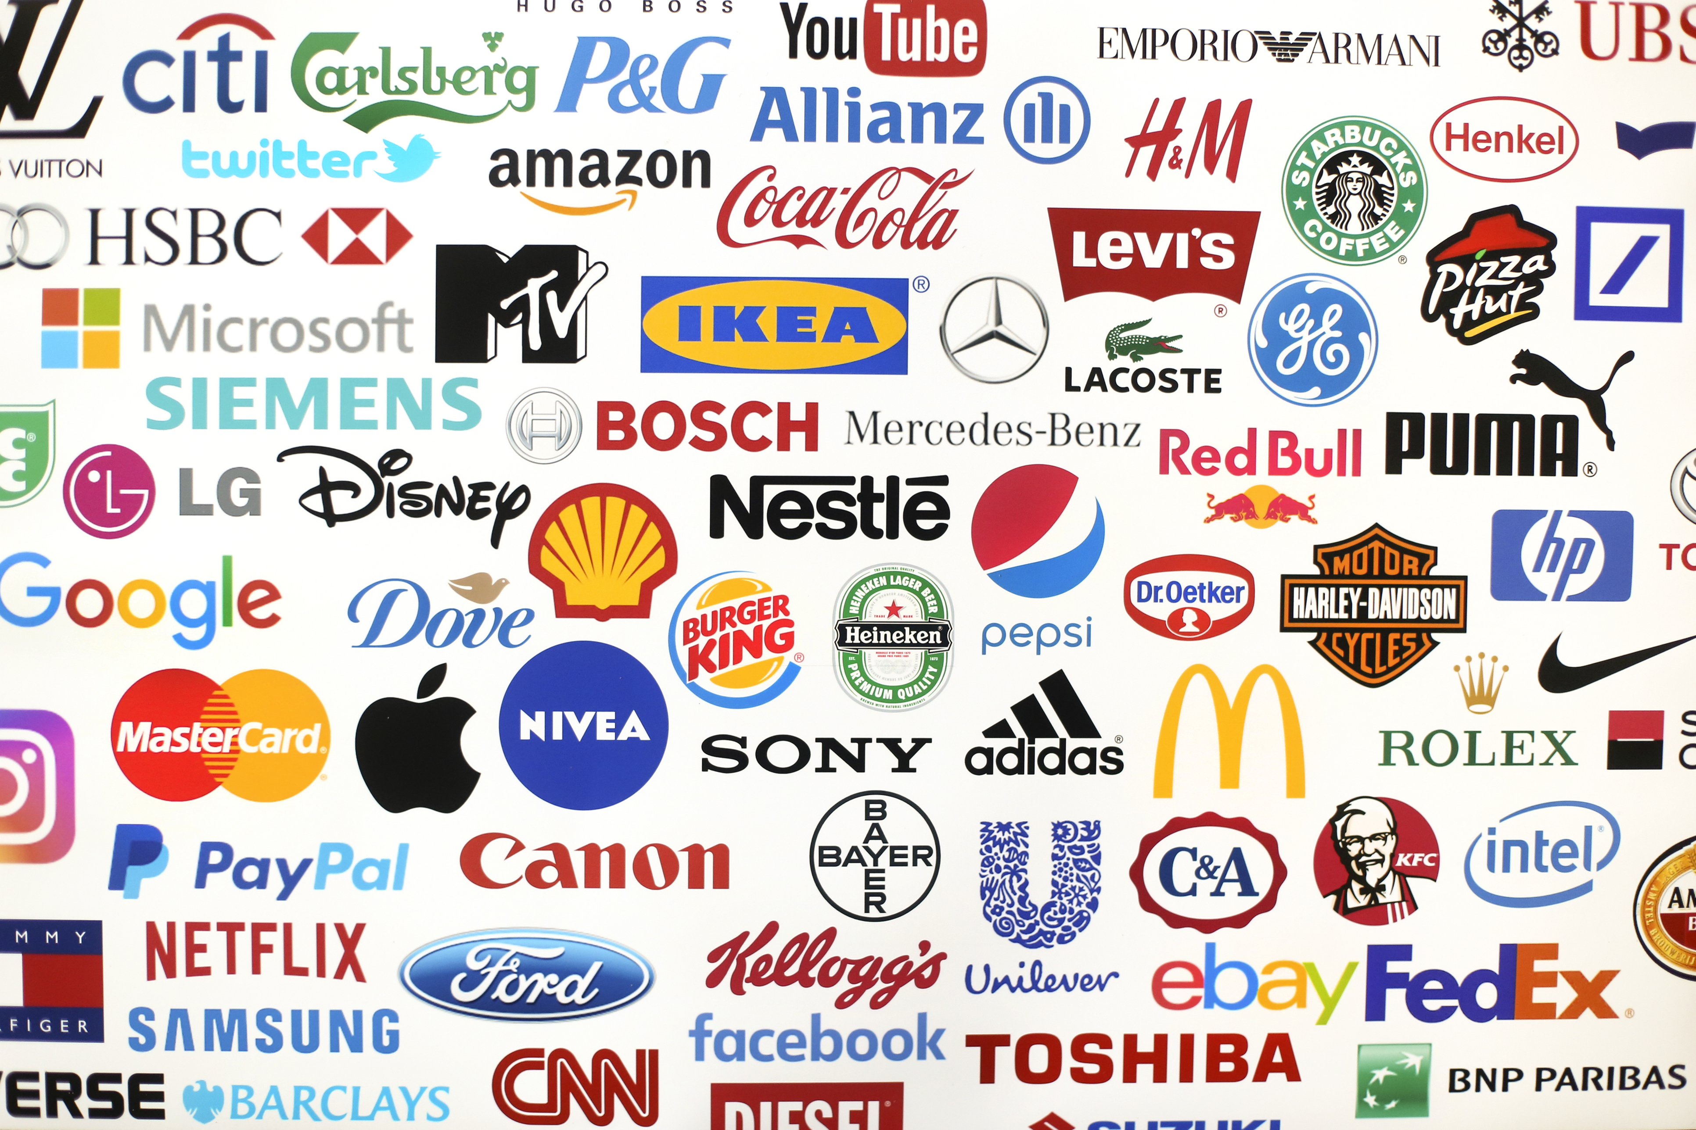
Brands: In today’s context
Notes:
This is just a small sample size of the mainstream and respected brands.
Why are these brands respected? What sets them apart form other brands?
Think in the context of: service and products; what do they offer compared to other brands?
Why do people continue to choose these brands?

Slide 9
Brand Task-
Choose one Brand…
What does your chosen brand provide?
Why are they a success?
How does this brand ensure quality
What are the perceptions of this brand?

Slide 10
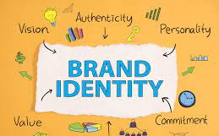
Personal Branding:
What is it?
Personal branding can be described as the act of self promotion.
  What do you or can you offer?
  What value do you hold?
  Who are you?
  Why are you worthy compared to your competitors?
Notes:
Essentially, it is how you project your brand and its values to the world and ensure that your target audience knows who you are, what you stand for, and why it’s worth choosing you over your competitors.
You are demonstrating to a company, organization or service provider why they should hire you? What can you bride what no one else can? This may be considered superficial.
But fundamentally, you want to consider: are you faking o make it? Or are you trying to genuinely portraying your true self?
How many of you have a phone voice? Or dress appropriate for certain occasions? This is known as dramaturgy first presented by Irvin Goughman:. it is the procedure of acting whereby we act accordingly to our surrounding environment/context.

Slide 11
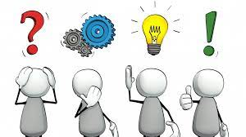
When someone hears your name; what do they think of you?

Slide 12
When a colleague hears your name; what do they think of you?
Notes:
Would your work peers/superiors characterise you the same as your closet friends and family outside of the professional context?
Are their similarities?

Slide 13
Personal Brand
A survey produced by CV library indicates that employers value 5 traits of personal brand:
Reliability
Confidence
Honesty
Honor
Loyalty
Indeed, however, recommend several traits you may need to consider:
Initiative
Optimism
Adaptability
Willingness to learn
Resilience
Notes:
200 UK employers cited reliability (62%), confidence (61%), honesty (58%), honour (51%), and loyalty (32%) as their top choices.
Resilience: Possess problem solving skills; Trust yourself
Motivation: Persistent and determined
Adaptability: Emotionally intelligent; Flexible and available to adjust to changes
Optimism: Focus on self-motivation and discipline

Slide 14
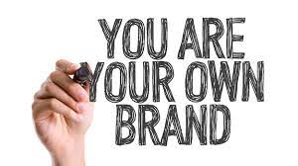
Personal and Professional Brand?
Pawar and Gandhi (2016) suggests that your individuality and profession identity are separate brands.
Do you agree?

Slide 15
Brand You: Professional Identity
Fitzgerald (2020) argues that professional identity is often used within literature but lacks consensus.
The concept analysis initially identified 737 articles, but through inclusion and exclusion criteria, 60 studies made the final sample.
Behaviours and attitudes
Skills and Knowledge
Values, Beliefs and ethics
Context of social socialization (professional identity cannot be separated
Group identity and personal identity
Notes:
Behaviours and attitudes: professional identity based on professional practice. The stronger the identification with behaviours and activities, the stronger the professional identity.
Example, a nurse (activity) who demonstrated communication, problem-solving, multitasking (behaviours) provides feelings of empowerment.
Experiences overlap with others, identity becomes confirmed.
Skills and Knowledge: Competent, well-informed practitioners are more likely to demonstrate a sense of professional identity
Values, Beliefs and ethics: Essential components which may influence behaviours and attitudes which contributes identity
Context of socialization: A member of a profession which serves society. Interactional relationships develops professional identity.
Group identity and personal identity: Profession being recognized by society. Interdisciplinary nature of professions (health care) increases indentity.

Slide 16
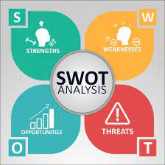
Skills Analysis:
SWOT
A planning tool, typically used for organisations.
However, this model can be applied on an individual basis.
Notes:
A SWOT analysis is a planning tool which seeks to identify the Strengths, Weaknesses, Opportunities and Threats involved in a project or organisation. It's a framework for matching an organisation's goals, programmes and capacities to the environment in which it operates.

Slide 17
Personal Development Plan (PDP)
A PDP, is an action plan that you can use to identify:
Individual goals and what you want to achieve.
Strengths and weaknesses.
Areas of development
What you need to do to achieve your goals.
Factors that could hinder your progress.

Slide 18
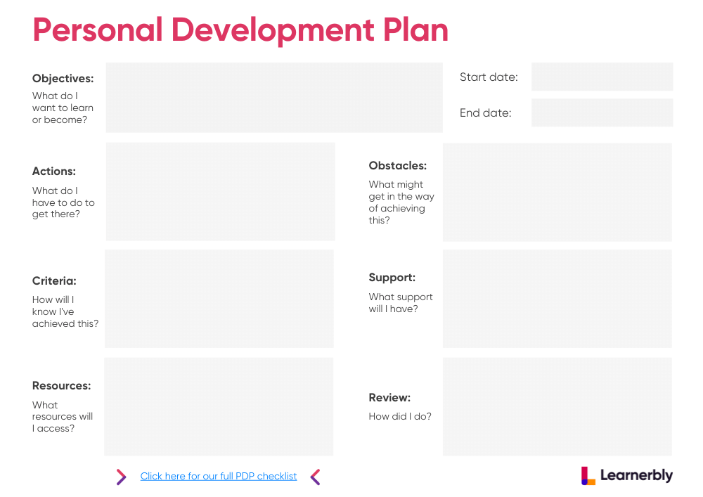

Slide 19
Task 1
Each of the eight tasks will be combined and submitted to form Assessment 1
Think about your own personal brand in an employment context.
Reflect on how you could develop or improve on this in the future to help achieve your aims and goals and eventually get your dream job.
200 words (+or- 10%) 2 References

Slide 20
Independent Research
https://www.aomrc.org.uk/wp-content/uploads/2020/05/Developing_professional_identity_in_multi-professional_teams_0520.pdf
Using the link above, please read the following document (Academy of Medical Royal Colleges), identify reasons for developing a professional identity and what skills are associated?
Please note that this is a requirement for our next session and students are required to present their findings.

Slide 21
Reference List
Blackett, T. (2004) What Is Brand New York: Interbrand.
Yakup, D. and Sevil, Z. (2011) ‘Teoratical Aproach to the Concept of Brand’. Contemporary Marketing Review. 1 (3): pp. 1-5.
Pogorzelski, J. (2018) Managing brands in 4D: Understanding perceptual emotional, social and cultural branding. Bingley: Emerald Publishing Limited.
Temporal, P. (2019) Advanced Brand Management. London: Herman House Limited.
Fitzgerald, A. (2020) ‘Professional Identity: a Concept Analysis’. Nursing Forum: 55 (1), pp.1-26.
Pawar, A. and Gandhi, R. (2016) ‘The Power of Personal Branding’. International Journal of Engineering and Management Research. 6 (1) pp.840-847

