Slide 1

Module Title: Professional Career Development within H&SC​
Module Number: LCHS 4010 (LON)
Assignment No: ASSIGNMENT 1​
Student Name: Alice N Naromba​
Student ID: 2425145​
Lecturer’s Name: Shaila Hussain
Declaration of use of AI OR declaration of non-use of AI
I declare that I did not use AI

Slide 2
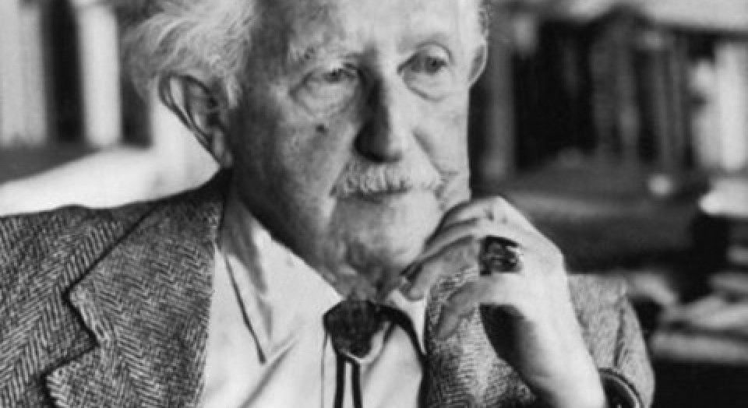
INTRODUCTION
Hello everyone, my name is Alice N Naromba. This presentation will focus on Amira's situation reflecting on Eric Erikson's psychosocial development stage.
The chosen theory in relation to the case study is Erickson's Psychosocial development which consist eight stages.
Trust vs. Mistrust
Autonomy vs. Shame and Doubt
Initiative vs. Guilt
Industry vs. Inferiority
Identity vs. Role Confusion
Intimacy vs. Isolation
Generativity vs. Stagnation
Integrity vs. Despair
(Erikson, 1950)
ERIC ERIKSON

Slide 3
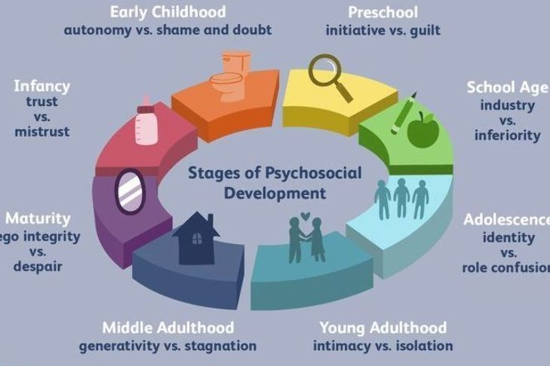
Outline your chosen theory – who proposed it? What does it focus on? What elements of the theory relate to early years development?
The theory of psychosocial development was proposed by Erik Erikson, a developmental psychologist who expanded on Freud’s ideas but placed greater emphasis on social and cultural influences (Erikson, 1950).
What does the theory focus on?
Erikson’s theory explains how individuals progress through eight stages of psychosocial development, each defined by a central conflict that helps shape personality. The theory argues that healthy development depends on successfully resolving each conflict, which supports identity formation and emotional wellbeing (Erikson, 1968)
Elements of the theory related to early years development
Erikson’s first three stages are particularly relevant to early childhood:
1. Trust vs Mistrust (0–1 year)
2. Autonomy vs Shame and Doubt (1–3 years)
3. Initiative vs Guilt (3–6 years)

Slide 4
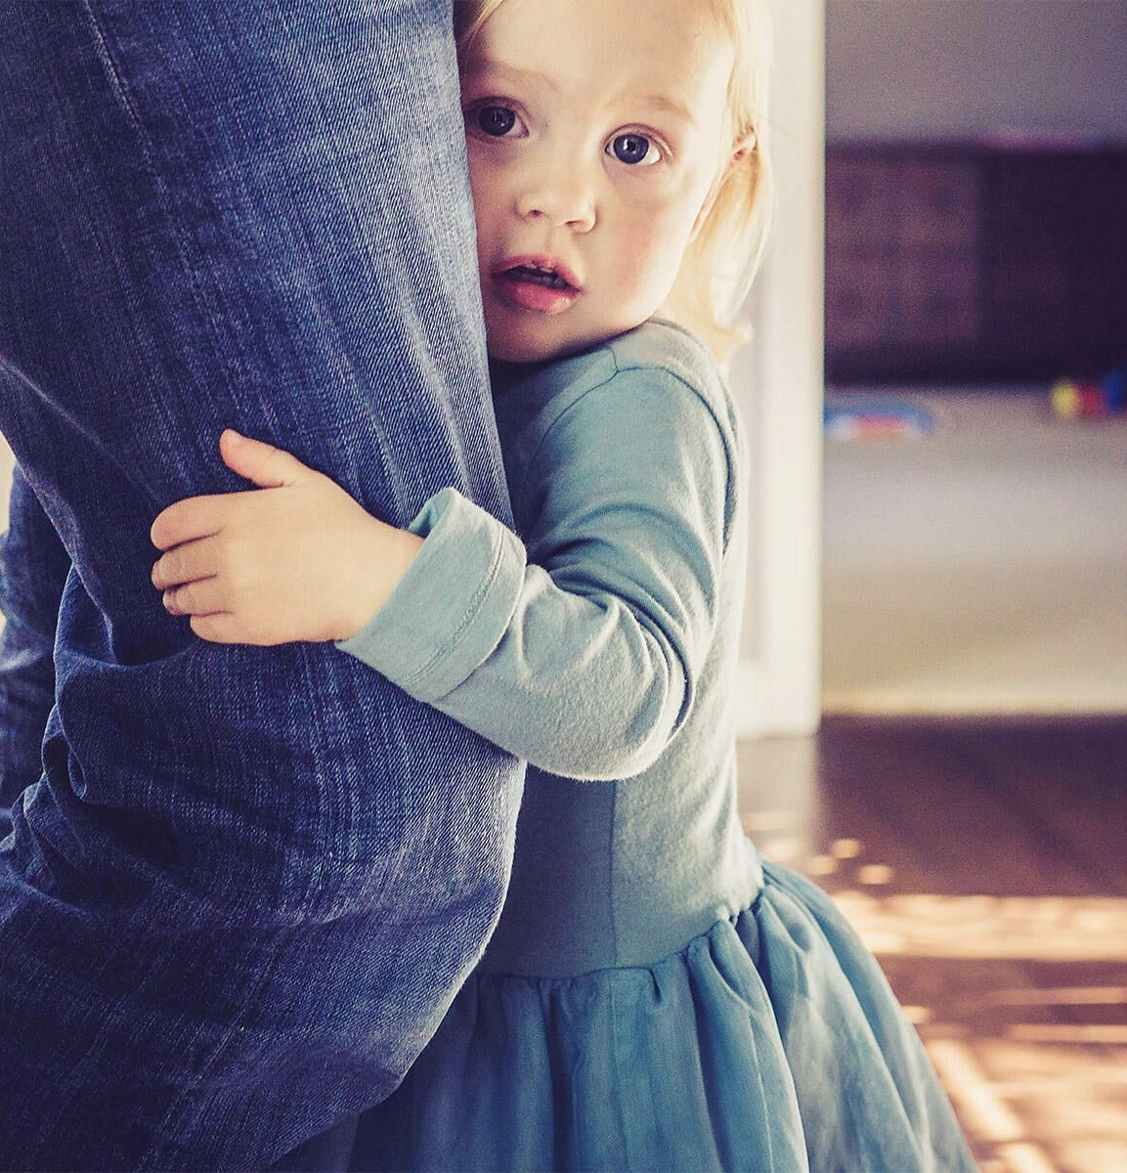
How does the theory link with Amira’s situation and needs?
In the Autonomy vs Shame and Doubt stage, children rely heavily on their primary carers to feel secure. Anxiety during separation may suggest that Amira has not yet fully developed a sense of autonomy and confidence in exploring the environment independently (Cherry, 2022).
Erikson emphasised that predictable, supportive caregiving helps children develop trust in themselves and others, enabling them to separate more comfortably (Sokol, 2009). Amira’s anxiety may indicate that she still requires reassurance and consistent emotional support to strengthen her sense of autonomy.
During the Initiative vs Guilt stage, children expand their language, social skills, and confidence in initiating activities. Limited verbal communication may reduce Amira’s ability to express her needs or participate fully in interactions, which could hinder her ability to take initiative (Knight, 2017). According to Erikson, children need encouragement and opportunities to build competence; without this, they may feel hesitant or guilty about trying new tasks.

Slide 5

How does the theory link with Amira’s situation and needs?
From an Eriksonian perspective, Amira may benefit from:
Consistent emotional reassurance to reduce separation anxiety.
Supportive language-rich interactions to strengthen communication skills.
Structured, guided play experiences to help her build confidence with peers.
These approaches align with Erikson’s view that children progress best when surrounded by responsive, nurturing adults who help them navigate each psychosocial challenge.

Slide 6
BIOLOGICAL (NATURE) VS ENVIROMENTAL (NURTURE) FACTORS INFLUENCING AMIRA'S ERIKSON'S PSYCOLOGICAL DEVELOPMENT STAGE
NURTURE
NATURE
Genetic predisposition to anxiety
Some children may have a biological tendency toward heightened emotional reactivity, making them more likely to experience distress during separation (Plomin et al., 2016)
Early attachment experiences​
A child who reacts strongly to separation may be expressing signs of insecure or anxious attachment, often shaped by inconsistent or less responsive caregiving patterns (Ainsworth et al., 1978). Such children may have difficulty trusting that their carers will return, which heightens distress during transitions
. Social experiences
Opportunities for play with peers help children learn social rules, communication skills, and confidence in group interactions. A child with fewer peer experiences, or one who has encountered negative peer interactions, may avoid group play (Rubin, Bukowski and Laursen, 2011)
Temperament
Temperamental traits, such as shyness or low adaptability, are biologically rooted and influence how children respond to new environments or peer groups (Thomas, Chess and Birch, 1968). A child with a slow-to-warm temperament might appear anxious or withdrawn during group play situations.
Early attachment and neurodevelopmental influences
The quality of early caregiving (which has both nurture and nature implications) influences brain development, stress-reactivity systems, and the child’s capacity to regulate emotions ( Malik; Marwaha. 2022).
Caregiving environment
If carers routinely provide high levels of protection or complete tasks for the child, the child may struggle to develop autonomy. According to Erikson (1963), children in the Autonomy vs. Shame and Doubt stage need opportunities to explore and try things independently.

Slide 7
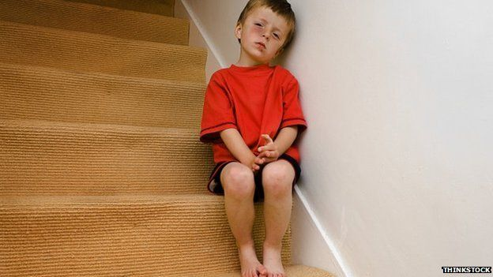
STRENGTHS AND WEAKNESSES OF ERIC ERIKSON'S DEVELPOMENT THEORY.
STRENGTHS
WEAKNESSES
Cultural and Social Relevance Erikson emphasized the role of culture, society, and social relationships in shaping personality, making his theory more holistic than Freud’s psychosexual stages (Sokol, 2009). | Lack of Empirical Evidence Critics argue that Erikson’s stages are difficult to scientifically test or measure. The theory is largely based on clinical observation rather than experimental research (McLeod, 2023).
Influence on Education and Counselling Erikson’s stages have been widely applied in education, counselling, and psychotherapy to understand students’ or clients’ emotional and social needs (Cherry, 2022). The theory’s focus on social interaction and identity formation helps professionals tailor interventions effectively. | Cultural Bias Erikson’s model was developed based on Western cultural norms, which may not universally apply to individuals from collectivist or non-Western societies (Sokol, 2009).
Comprehensive Lifespan Approach One of Erikson’s key contributions is his focus on development across the entire lifespan, not just childhood. This broader perspective highlights that personal growth and identity formation continue into adulthood (McLeod, 2023). | Vague Stage Boundaries The stages do not always occur in a clear or fixed sequence. Many individuals may experience crises from multiple stages simultaneously, challenging the linear structure Erikson proposed (Knight, 2017).

Slide 8

In my presentation, Amira's situation was assessed, Weakness and strength of Eric Erikson's development theory was discussed. Considering Erik Erikson’s stages of development, Amira appears to be navigating the Autonomy vs. Shame and Doubt stage, which is typical for a three-year-old. Her anxiety when separated from her carers, limited verbal expression, and challenges in joining group play may indicate that she is still developing confidence in exploring her environment independently. These behaviours suggest she may need additional emotional support, reassurance, and opportunities to build communication and social skills. With consistent, nurturing interactions from caregivers and educators, Amira can strengthen her sense of autonomy and develop greater comfort in social settings.

Slide 9
REFERENCES
Cherry, K. (2022) Erik Erikson’s Stages of Psychosocial Development. Verywell Mind. Available at: https://www.verywellmind.com/erik-eriksons-stages-of-psychosocial-development-2795740 (Accessed: 12 November 2025).
Erikson, E. H. (1950) Childhood and Society. New York: W. W. Norton & Company.
Erikson, E. H. (1963) Childhood and Society. 2nd ed. New York: Norton.
Erikson, E. H. (1968) Identity: Youth and Crisis. New York: Norton.
Hart, B. and Risley, T. R. (1995) Meaningful differences in the everyday experience of young American children. Baltimore: Paul H. Brookes.
Knight, Z. G. (2017) ‘A proposed model of psychodynamic psychotherapy linked to Erik Erikson’s eight stages of psychosocial development’, Clinical Psychology & Psychotherapy, 24(5), pp. 1047–1058.
Malik, F. (2022) Developmental Stages of Social Emotional Development in Early Childhood. In Encyclopaedia of Child Development. U.S. National Library of Medicine. Available at: https://www.ncbi.nlm.nih.gov/books/NBK534819/
McLeod, S. (2023) Erik Erikson’s Psychosocial Theory. Simply Psychology. Available at: https://www.simplypsychology.org/Erik-Erikson.html (Accessed: 12 November 2025).
McLeod, S. (2024) ‘Erikson’s Stages of Development’. Simply Psychology. Available at: https://www.simplypsychology.org/er-erikson.html
Plomin, R., DeFries, J. C., Knopik, V. S. and Neiderhiser, J. M. (2016) ‘Top 10 replicated findings from behavioral genetics’, Perspectives on Psychological Science, 11(1), pp. 3–23.
Rubin, K. H., Bukowski, W. M. and Laursen, B. (2011) Handbook of peer interactions, relationships, and groups. New York: Guilford Press.
Sokol, J. T. (2009) ‘Identity development throughout the lifetime: An examination of Eriksonian theory’, Graduate Journal of Counselling Psychology, 1(2), pp. 139–148

