Slide 1

Contemporary Theme(Sustainability) in Hilton Hotel

Slide 2
INTRODUCTION
The contemporary theme which I select is “Sustainability”
Sustainability means meeting our needs without making it harder for future generations to do the same(Molenkamp, D. 2023).
Sustainability aims are as follows:
To protect the ecosystem
Slow down global warming
To promote societal advancement

Slide 3


Slide 4
Sustainability Importance for the Hospitality Sector

Slide 5
In the 21st century, sustainability is seen as the key to the hospitality Sector’s success.
Sustainability is important for the hospitality sector it leads towards the following
Large financial returns
Great customer ratings
Efforts for the benefit of the “environment”, “society”, and “future generations” (Al-wattar, et.al, 2019
Reduced operating expenses through the reduction of resource use, such as energy and water

Slide 6
Sustainability can be a distinguishing factor for hotels, setting them apart from their competitors(Kain, D. 2023).
To get or keep a competitive edge in the hotel business, current and future hospitality managers must implement sustainable systems.
sustainability factor will lead to a bright future for the hotel business.
The hotel will be more eco-friendly and have less carbon footprint if it adopts sustainable tactics.

Slide 7



Slide 8
The “Travel with Purpose” CSR program is another way Hilton shows how seriously it takes its commitment to building strong bonds between its employees and the neighbourhoods where it operates (Dudovskiy, J. 2016).
Travel with Purpose” promotes responsible vacationing around the globe. By 2030
Hilton hopes to cut its environmental effect in half and increase its investment in social impact by 100%.
Across their business, their supplier chain, and local communities, through its "Travel with Purpose" program, Hilton Hotels hopes to have a beneficial impact on the world's environment and society.

Slide 9
Hotel Hilton strive for
operational excellence of the highest level
foster meaningful interactions with their guests and Team Members
To use their ingenuity and influence to create significant improvements in those areas.

Slide 10

Evaluation of future policy and management option for dealing issue

Slide 11
Hotel Hilton must invest more in energy-efficient HVAC systems, appliances, and lighting to reduce energy usage.
Hotel Hilton must consider pure energy production via research into renewables like solar panels.
Reduce water usage by putting in low-flow taps, showerheads, and toilets.
The Hilton hotel should promote energy conservation among its guests by providing clear instructions to turn off lights and electronic devices when they are not being utilised

Slide 12
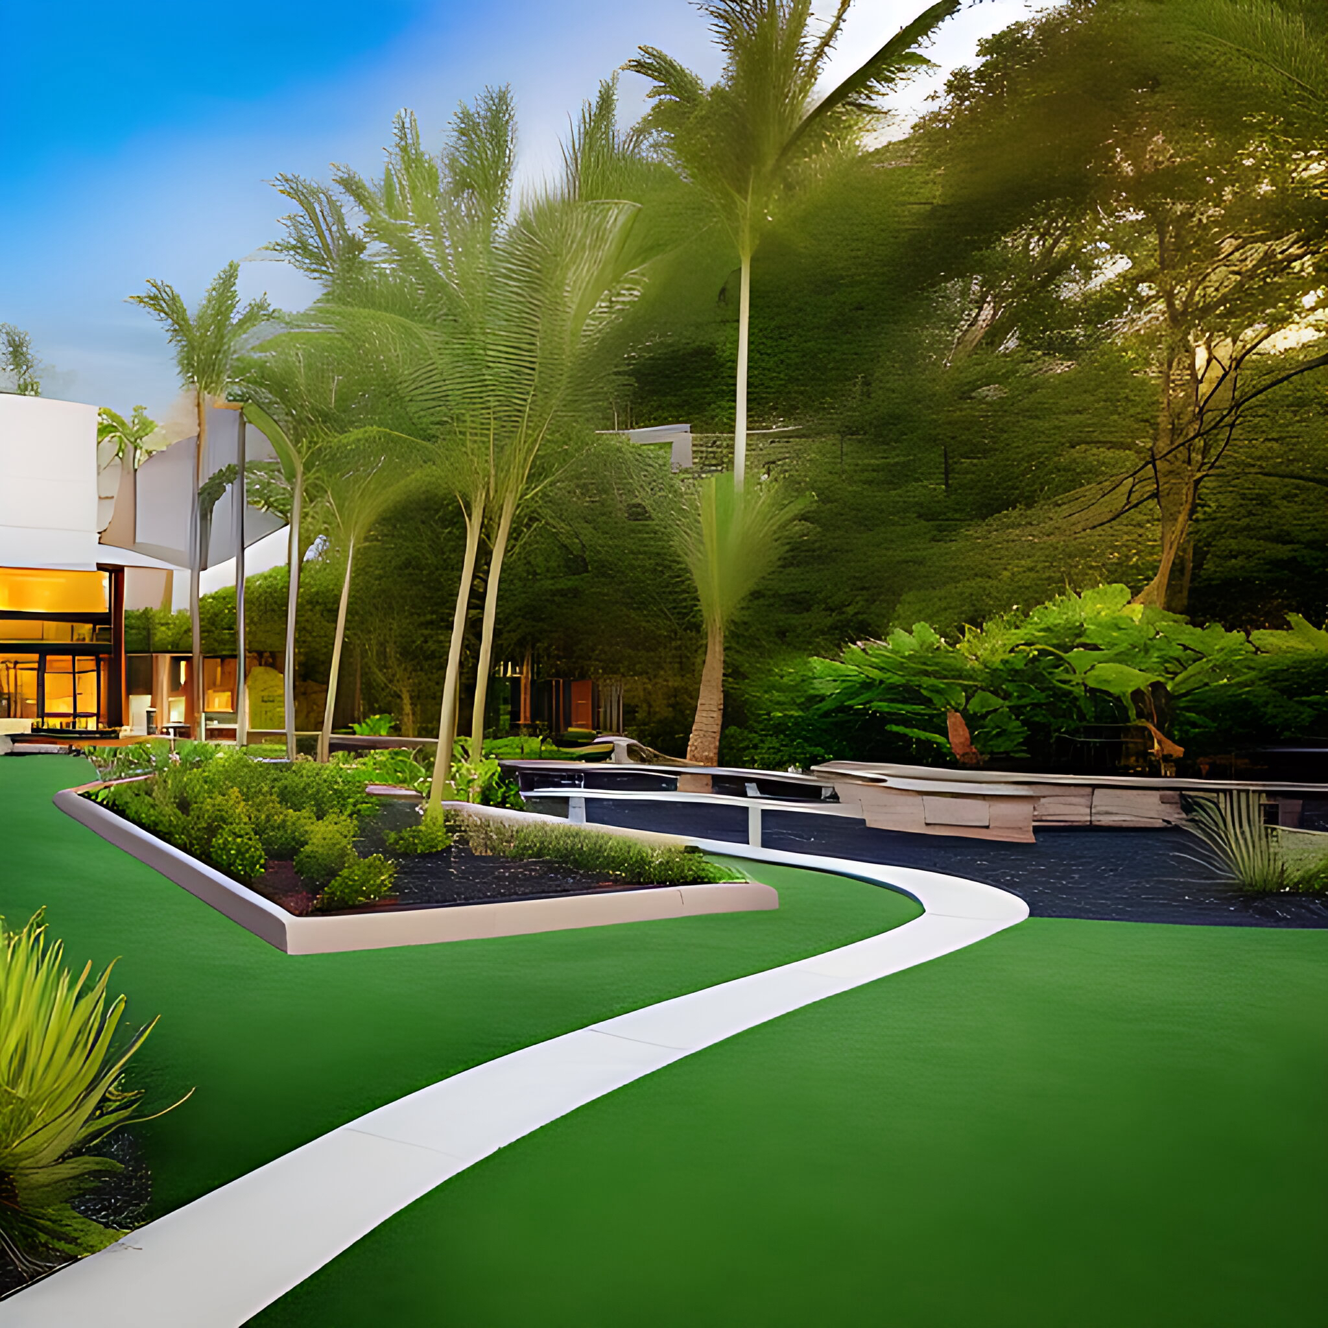

And so, the sustainability story in the Hilton Hotel reminds us that we all have the power to create a better future. By embracing sustainable practices, we can protect our environment, support local communities, and ensure a brighter tomorrow for future generations.

Slide 13
References
Jones, P., Hillier, D. and Comfort, D. (2016), "Sustainability in the hospitality industry: Some personal reflections on corporate challenges and research agendas", International Journal of Contemporary Hospitality Management, Vol. 28 No. 1, pp. 36-67. https://doi.org/10.1108/IJCHM-11-2014-0572
Kuhlman, T., & Farrington, J. (2010). What Is Sustainability? Sustainability, 2(11), 3436–3448. MDPI. https://doi.org/10.3390/su2113436
Kain, D. T. (2023, May 5). Sustainability Is Key To The Future Of The Hospitality Industry. Sigma Earth. https://sigmaearth.com/sustainability-is-key-to-the-future-of-the-hospitality-industry/
Mollenkamp, D. (2023, April 8). What is Sustainability? Investopedia. https://www.investopedia.com/terms/s/sustainability.asp

Slide 14
Adams, S., Kageyama, Y., & Barreda, A. A. (2022). Sustainability Efforts in the Hotel Industry: A Systematic Literature Review. Journal of Tourism Management Research, 9(1), 9–23. https://doi.org/10.18488/31.v9i1.2921
Al-Wattar, Y. M. A., Almagtome, A. H., & Al-Shafeay, K. M. (2019). The role of integrating hotel sustainability reporting practices into an Accounting Information System to enhance Hotel Financial Performance: Evidence from Iraq. African Journal of Hospitality, Tourism and Leisure, 8(5), 1-16.

