Slide 1

Policing The Public
Week 9
Digital Policing
Dr. Luke Roach
L.Roach@UWTSD.ac.uk

Slide 2

Introduction
Whilst many might imagine crimes involving computers (such as hacking) to be exciting, the reality of digital evidence is far different from what we typically see on television or in film.
Within police forces there exist specialist units, made up of specially trained police officers, police staff (or some combination of both), whose job it is to specifically tackle this digital evidence.
These units are typically called the Digital Forensic Unit, the Hi-Tech Crime Unit, or similar.

Slide 3
High Tech Crime Units (HTCU)
HTCU's face significant challenges, ranging from;
Large case backlogs due to an ever-increasing number of cases with some element of digital evidence within them
To the reality of a rapidly changing and evolving technological world.
It’s a “running just to catch up” scenario

Slide 4
The National Cyber Security Strategy
CPS (2019) Defines two types of cybercrime: cyber-enabled and cyber-dependent crimes.
Cyber-dependent crimes - crimes that can be committed only through the use of Information and Communications Technology (‘ICT’) devices, where the devices are both the tool for committing the crime, and the target of the crime
Cyber-enabled crimes - traditional crimes which can be increased in scale or reach by the use of computers, computer networks or other forms of ICT

Slide 5
Types of Cyber Crime
Cyber Dependant Crime: developing and propagating malware for financial gain, hacking to steal, damage, distort or destroy data and/or network or activity
Cyber Enabled Crime: sexual grooming, stalking or harassment, bullying, and financial or romance fraud

Slide 6

An Explosion in Technology
Over the past few decades, we have witnessed an explosion in consumer technology and the growth of the Internet.
In recent years in particular, the growth in both the prevalence and capabilities of mobile technology has been extreme.
Technology is now a pervasive part of society, putting it at the core of what we do and how we live.

Slide 7
Question
How have you seen technology and society change in your life time?
Where and how is technology used today that it wouldn’t have been 10-15 years ago?

Slide 8
The World has Changed
Similarly, the Internet has grown and changed how we interact with the world.
We can now reach people in other countries easily and inexpensively.
With this comes new capabilities for how crimes can be committed and new challenges with regards how to tackle them.

Slide 9
Police Priorities
Each individual police force has its own unique priorities.
What is (or should be) common to all police forces is a focus on tackling child abuse.
The Association of Police and Crime Commissioners/National Police Chiefs’ Council (2015) Policing Vision 2025 discussed the challenges faced in combatting child abuse and grooming.

Slide 10
Policing Vision 2025
The current major challenges and priorities within policing;
child protection,
mobile evidence
cloud-based storage
These are three areas which warrant significant consideration for the future.

Slide 11
Digital Crime is Growing
Data from the Office for National Statistics (2018):
Of the 3.3 million incidents of fraud in the year ending June 2018, 1.8-million of these were cyber-related.
The data also shows an 18% increase in the number of reported sexual offences compared to the previous year, and year-on-year rises have been evident since 2012.

Slide 12
Digital Crime is Growing
Offence categories relating to sexual offences specifically against children made up a significant proportion of the total figures;
Accounting for 24% of the growth in this most recent year, and for 37% of the growth in the previous year.
The ONS report also highlights that HMICFRS reports into a number of forces suggest that these figures are under-recorded, indicating that the real figures are in fact considerably higher (Office for National Statistics, 2018).

Slide 13
The Increasing Power of Consumer Technology
In 1995 a typical new consumer-grade computer would have had a hard drive with storage capacity in the region of 1 gigabyte.
Today, a new iPhone comes with a minimum of 64 gigabytes of storage.
Plus cloud-based access which is infinite in some cases.

Slide 14

Developing Technology
But I predict that within 100 years computers will be twice as powerful 10,000 times larger and so expensive that only the five richest kings of Europe will own them. (Professor Frink, 1996)

Slide 15
Short Film – The Power of Technology
https://www.youtube.com/watch?v=9cNIGycTE4g

Slide 16
Digital Investigations
In the UK, digital forensic investigations are conducted according to the principles and guidelines outlined in the Association of Chief Police Officers (ACPO) Good Practice Guide for Digital Evidence.
This guidance was most recently updated in 2012 and, as a result, does not account for the more recent developments in technology.
For instance, in providing guidance regarding mobile communication records between two parties, the guidance only really addresses telephone calls and ‘traditional’ text based messaging such as SMS.
That is the main issue with the speed of change

Slide 17
Cloud Storage
Cloud storage is a technology by which data is stored remotely and accessed over an Internet or network connection. There are a number of different popular Cloud storage technologies;
Google’s Drive, Microsoft’s OneDrive, DropBox, and Apple’s iCloud services.
Cloud storage has developed significantly over the last 10-15 years, with more and more capabilities having been added to it.
How does remote storage change our understanding of digital safety and security? Can you think of any implications for Policing?

Slide 18

Digital Policing Applications
We will now considered three distinct areas; child protection, mobile technology and Cloud-based evidence.

Slide 19
Child Abuse Investigations
Currently, child abuse cases typically are investigated by a variety of different staff working in different roles within a police force.
Likewise, the remit of the digital forensic unit (HTCU) staff can vary significantly depending upon which force they are working for.
Some forces use their HTCU staff to carry out the whole workflow, whilst others only use the HTCU staff for extracting and presenting the data for another officer/analyst to carry out the investigation

Slide 20
Victim Identification
INTERPOL (2019) specifically defines victim identification referring to the importance of the thorough analysis of photographs, videos and digital images of a child being sexually abused with the aim of identifying and locating the child and the abuser.
Anyone who is working on a case involving digital devices may have to perform victim identification.

Slide 21
Victim Identification
Whilst every case must be taken on its unique circumstances, there are certain universal considerations to look for within such imagery, which can help progress a case and produce actionable intelligence leads.
These include:

Slide 22
Victim Identification
Faces/identifiable marks (e.g. tattoos) present on the persons in images
Identifiable landmarks/points of interest present in images
Any other information present which might be usable to identify a location or person of interest
In order to help combat child abuse material, all police forces in the UK have access to the Child Abuse Image Database (CAID) (Home Office, 2015).

Slide 23
Victim Identification
This database is a collaborative endeavour, in which individual forces submit the results of their cases to the central database and in return receive updates from the central database.
In this way, each police force receives information from the other police forces who have uploaded information based on their own cases.
This means that previously categorised child abuse material can be automatically recognised when it appears on subsequent cases.

Slide 24
Victim Identification
Europol and over 50 countries are connected to the International Child Sexual Exploitation (ICSE) image and video database, which is maintained by INTERPOL (2018).
Indeed, within the UK, CAID (the Child Abuse Image Database) is the mechanism through which UK forces connect to ICSE.
This allows for international co-operation and assistance to be facilitated, and is something which is vital in an increasingly networked and connected world.

Slide 25

The Picture behind the Picture
Photographs can contain a lot of useful information, which is not ‘visible’ to the typical user.
GPS data relating to where picture was taken (latitude, longitude, elevation & more)
Camera Owner details
Make & model of camera used to take photograph
Serial number of the digital camera body and/or lens which took the photograph
Date & Time image taken (assuming local time on camera is correct)

Slide 26
Meta-Data
https://www.youtube.com/watch?v=i2a8pDbCabg

Slide 27
Mobile Phones
The mobile phone is becoming increasingly important in criminal investigations.
They are increasingly prevalent and capable, to the point where many people are carrying a fully-fledged computer with them, nearly everywhere they go.
Mobile forensics brings with it some significant challenges. Some of which the investigating officer can very much assist with, whilst others require the specialist skills of the digital forensic examiner.

Slide 28
Mobile Phones
Seizure is a key area where the scenes of crime officer or investigating officer can greatly assist.
When a mobile phone is taken from a suspect (or indeed witness or victim) it is important to recognise that it may well be powered on.
As a result, it will likely be connected to a cellular network.
Because of this, there is potential that the device may undergo some changes, such as receiving messages, emails or phone calls.
It would be a trivial matter for an accomplice with access to your suspect’s iCloud account to remotely access it and wipe the phone.

Slide 29
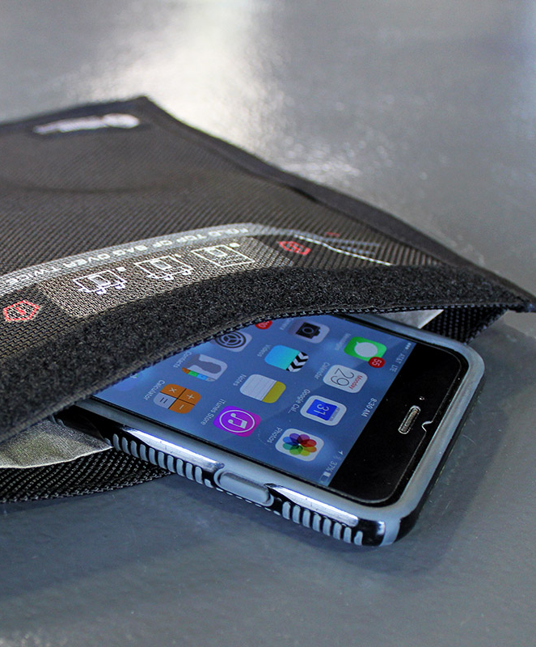
Mobile Phones
For this reason, the conventional wisdom is to either power off the device or isolate it from the network.
Whilst Faraday bags can be used to isolate devices from any external signals, engaging ‘aeroplane mode’ on the device is the easiest way to achieve this.

Slide 30

Mobile Phones
In a mobile forensic investigation, by far the most challenging step is the Acquisition stage. Questions that must be addressed include:
Do we have the right cables?
Which precise model of phone is this?
What version of the operating system is installed?
There are lots of errors made during recovery

Slide 31
Mobile Phones
The different terms used for evidence extracted from a mobile device and their basic meanings are as follows:
Physical: Effectively the raw data as it exists on the device. This is as close as we can get to getting everything; including deleted data, and information which is not typically accessible to the user. This kind of acquisition is rare, due to the way smartphones commonly secure the data they store.
Logical: The term logical is often used to represent how the user might see things on the device. This can include folders and files present, however access to deleted data is not always possible with this kind of acquisition. Furthermore, valuable metadata may or may not be captured. A logical image of some description is what is typically obtained.

Slide 32

Mobile Phones
File-system: This level of acquisition usually acquires more than logical acquisition methods. There may be user data, files and folders and some degree of otherwise user-inaccessible data recovered
File dump: generally this will only acquire user-accessible data. It will not typically acquire application specific data, and therefore much valuable information may be missing.
Manual preview: sometimes there is no option but to perform a hands-on look through the content of the device.

Slide 33
Cloud Based Storage
Where is the data actually stored?
Where are the servers actually located?
Does this have implications on the communications between nations and places to use that data effectively?
Do you have the legal right to access the data?
Are data protection laws the same across all nations?

Slide 34
Cloud Based Storage
What is the likely impact of any collateral information intrusion?
Whose data are we looking to investigate?
What else might we find there?
What are the moral and ethical implications of collateral intrusion?
Can we access it safely without changing or destroying the data stored?

Slide 35
Cloud Based Storage
Can we secure the remote data so that a third party (e.g. an accomplice/suspect on bail) cannot access the data and compromise it?
How do we clean-up cloud-based illegal material, post-conviction?

Slide 36
Cloud Based Storage
Securing the data from external intervention (for example a remote wipe) is also something which must be considered.
Here two primary options exist:
Gain access to the remote data and change the password so that it can no longer be accessed.
Contact the provider of the service and request that they ‘lockdown’ the account to prevent any changes from happening. This may or may not restrict access, therefore consideration must be given to downloading the data prior to any lockdown occurring.

Slide 37
Cloud Based Storage
After a successful conviction, it is highly likely that any illegal data present in a cloud-based service will still be present.
The service provider may or may not assist. If they assist, they may simply delete all of the data belonging to the offending account.
Either way, it may fall to the investigating officer to arrange this.
Failure to do this, especially in relation to cloud-based mobile evidence, could result in the offender (or others) being able to retrieve the material once again, and resume their illegal behaviour.

Slide 38
Future Developments
Whilst both cloud storage and mobile forensics have applications beyond child protection, they also have the potential to play a significant role in such crimes; this is a facility which is not currently being routinely exploited.

Slide 39
Future Developments
The future of the majority of digital evidence is certainly mobile.
The capabilities of mobile devices are improving at a tremendous pace.
Therefore it should be anticipated and expected that offenders in many different crimes will move their behaviour towards mobile devices, which will of course include child protection cases.
With mobile’s increasing integration of Cloud based services for storage of photographs, videos and backup of data, we can expect a knock on effect in which Cloud evidence becomes more and more relevant.

Slide 40
Case Study
A submission was received at the Digital Forensic Unit, in which it was alleged that communications of a sexual nature had occurred between an adult male and an underage female. This communication included text-based messages as well as pictures. According to the case background, the two parties were involved in a relationship and had been communicating via a popular smartphone communication application.
Furthermore, both parties stated that images of note were present on the handsets.
The adult male had stated in interview that he believed the girl to be aged 18 at the time of the alleged offence occurring. The submission therefore requested extraction of data from the offender’s phone to determine whether this was the case, along with confirmation of the presence of the expected notable/indecent images.

Slide 41
Case Study
Given the accounts given by both parties involved, there was a clear expectation that data would be found on the handset submitted for examination. The phone was examined following the unit’s standard operating procedures for the examination of mobile phones; however, nothing of apparent significance was recovered. As a result, a further, deeper investigation was authorised.
For thoroughness, the offender’s phone data was re-acquired using four different industry-standard acquisition tools.

Slide 42
Case Study
These four extractions were themselves further examined in a number of different forensic tools both for thoroughness and also to allow for validation of results. The pictures and messages of note were eventually located and were found to be embedded and stored within an encoded file, which was only acquired by two of the four industry-standard tools used to acquire the data.
The use of a separate forensic tool-suite, not ordinarily utilised for mobile forensics, was required in order to extract and examine the data contained within this file. What was most concerning was that none of the available industry-standard mobile forensic viewing tools parsed and presented the encoded file in order for the examiner to view the notable embedded data.

Slide 43
Reflective Question
With the rapid pace of technological development, and considering that digital forensic software and investigations are, by definition, most often reactive;
How can we assure that we get best evidence?
How do we know that we have acquired all of the data possible?
How do we know that we have seen everything that there is to see?

Slide 44
Concluding Thoughts
We have now seen that child protection and mobile technology are the future of digital forensics.
We have also seen how digital evidence can potentially interrelate with the cloud, and the challenges that cloud presents.
Technology changes quickly. It evolves and develops at an incredible pace. With this comes the potential for technology to be used in crimes.
There is an ever-moving game of ‘catch-up’ being played, between the developers of technology and the developers of forensic software.
New technology will always come along.

Slide 45

Week 9 Complete
Any Questions?
Thank you for listening!
See you soon!

