Slide 1
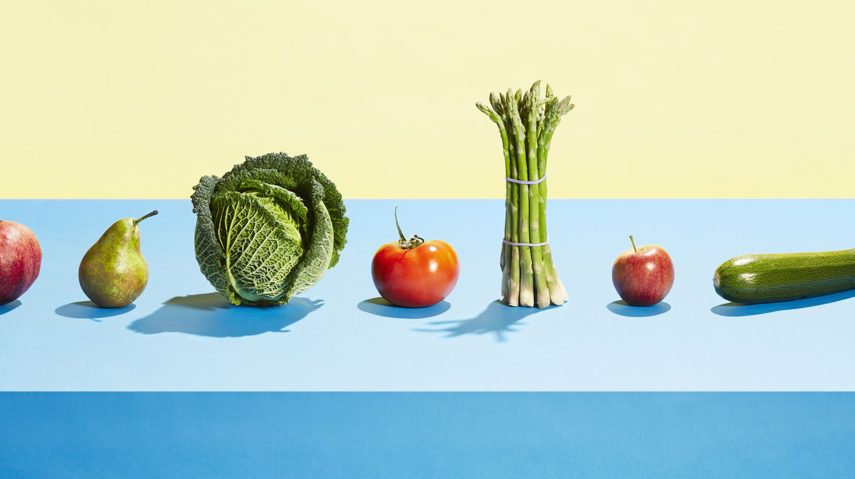
Nutrition in Sport and Exercise
Assignment 1 Feedback

Slide 2

AI
Remember to put the AI acknolwedgment at the start!

Slide 3
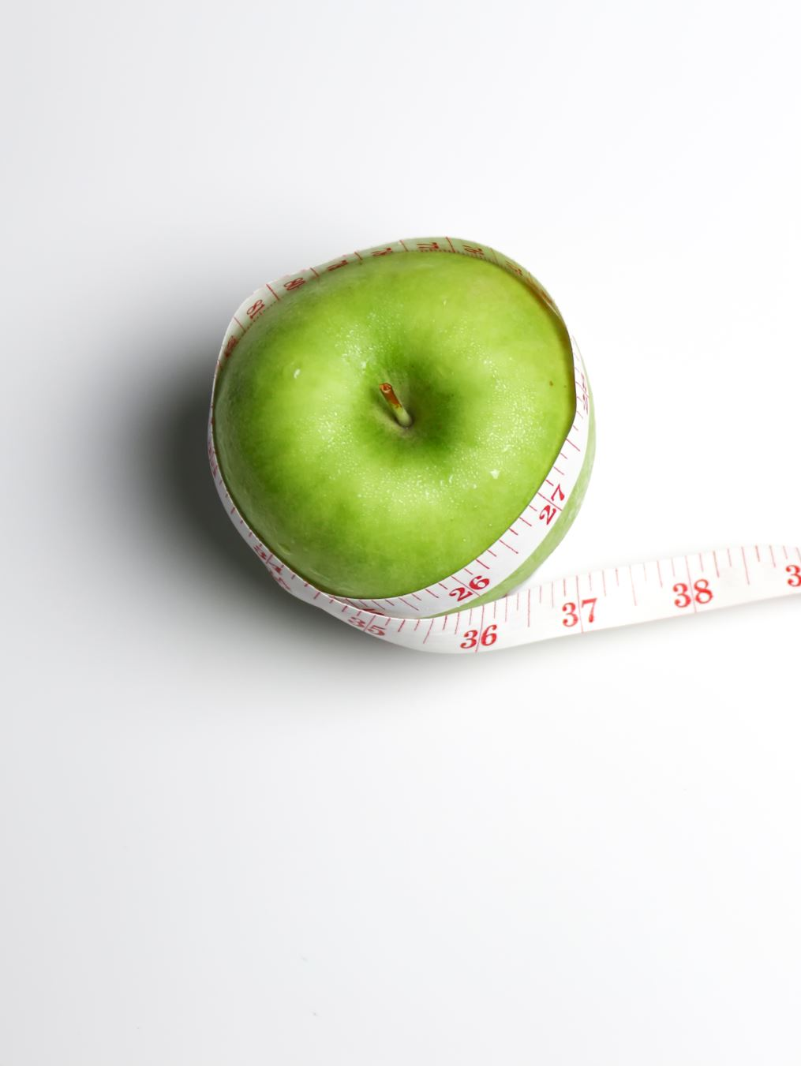
Healthy eating
Don’t forget health – healthy eating is the foundation for all athletes – an unhealthy/ill athlete will not excel

Slide 4
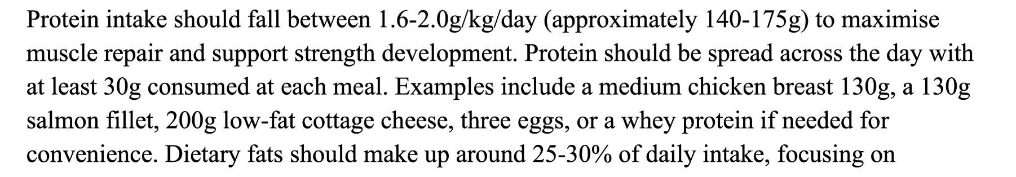
Include Quantities
Give examples of types of food, and also giving quantities makes it easier for athlete to implement e.g.

Slide 5
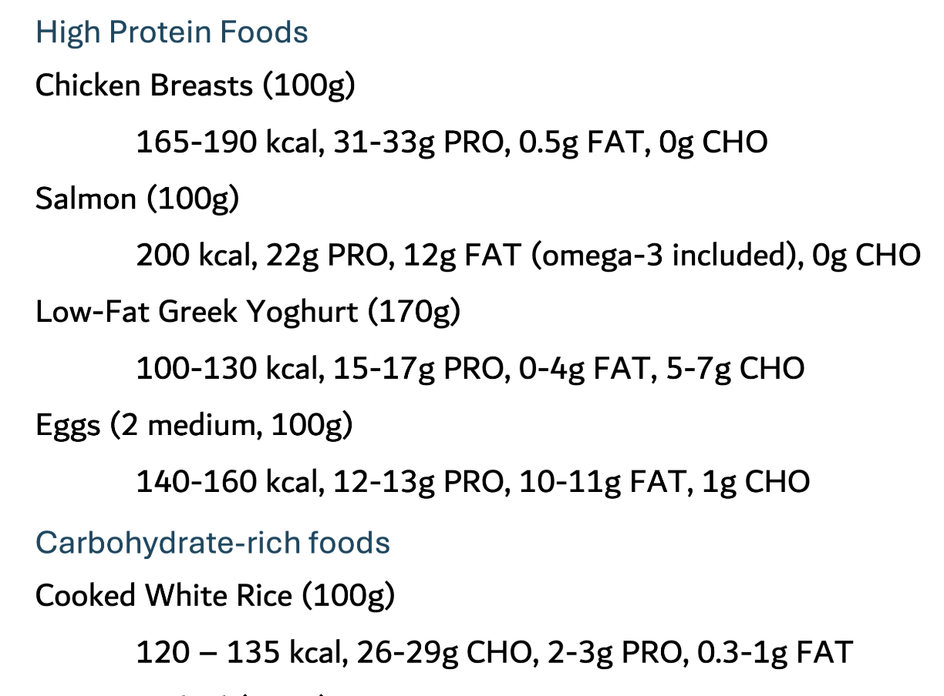

Slide 6
Typical Week exercise
Showing a typical week of training and how nutrition fits around it demonstrates your understanding more effectively

Slide 7
Tables, figures and infographics
Present information in whatever medium makes it easiest for the client to understand and follow – examples:

Slide 8
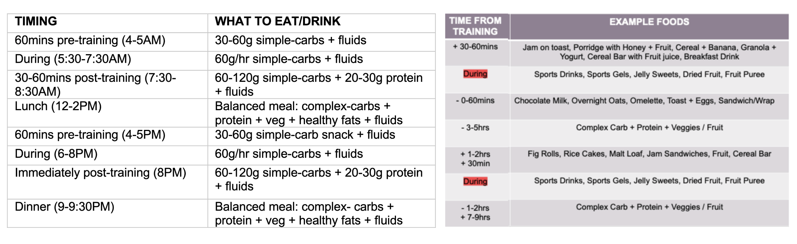

Slide 9
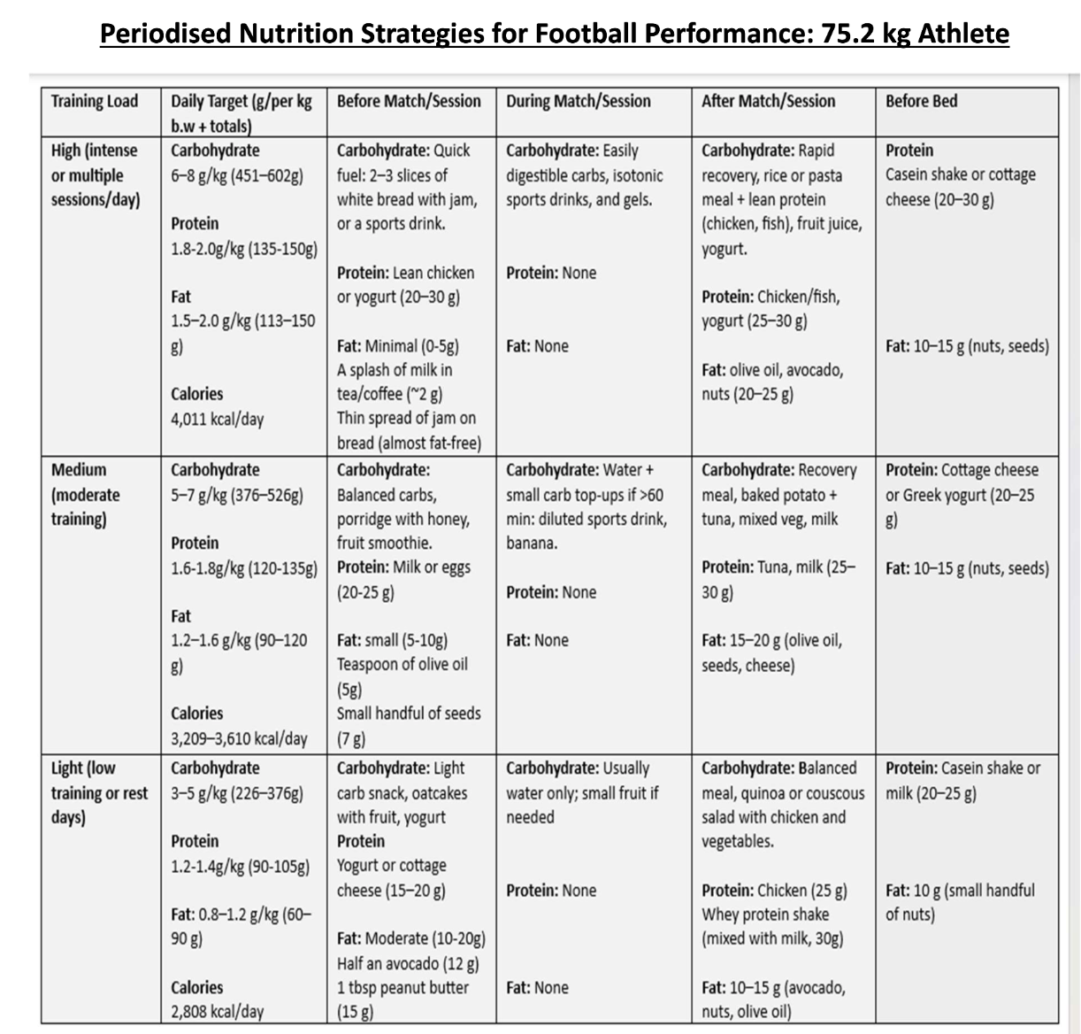

Slide 10
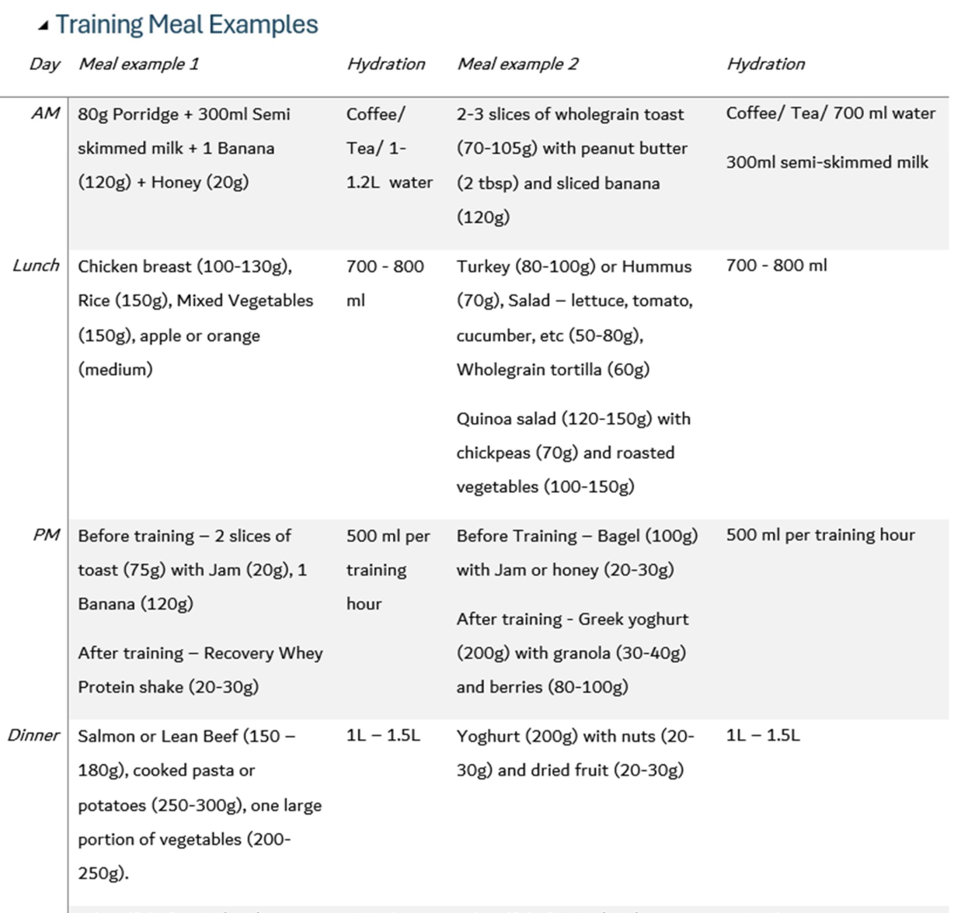

Slide 11
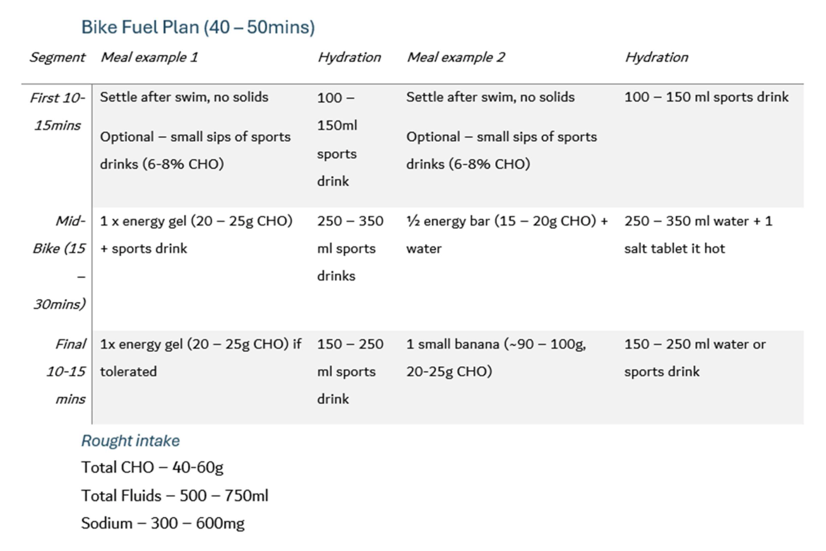

Slide 12
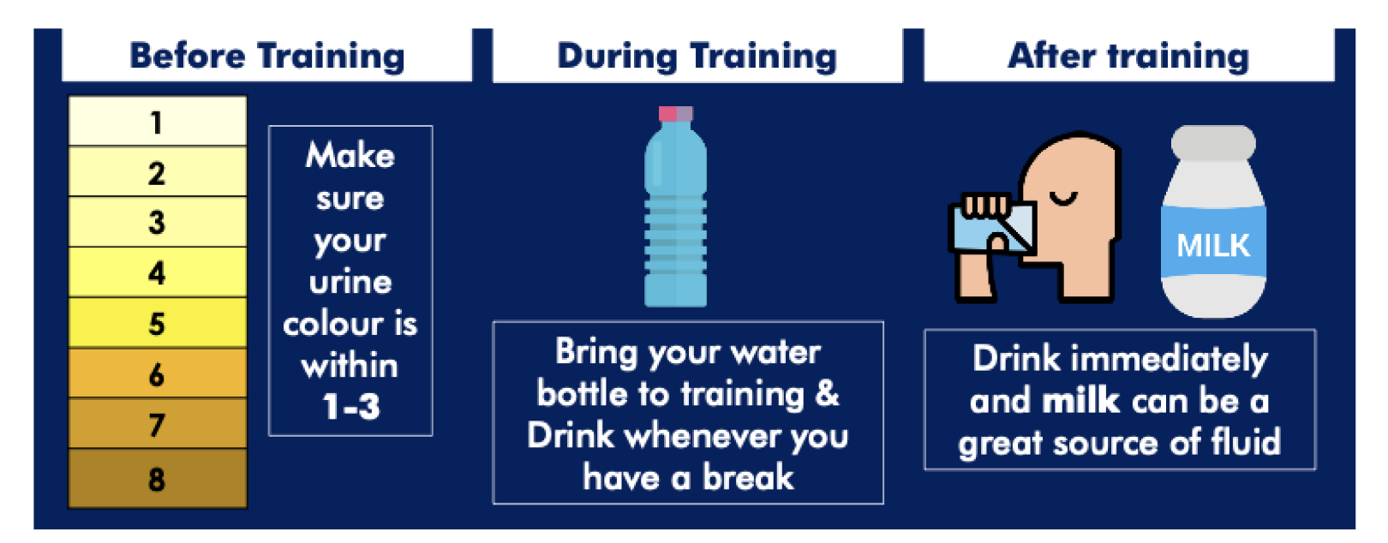

Slide 13
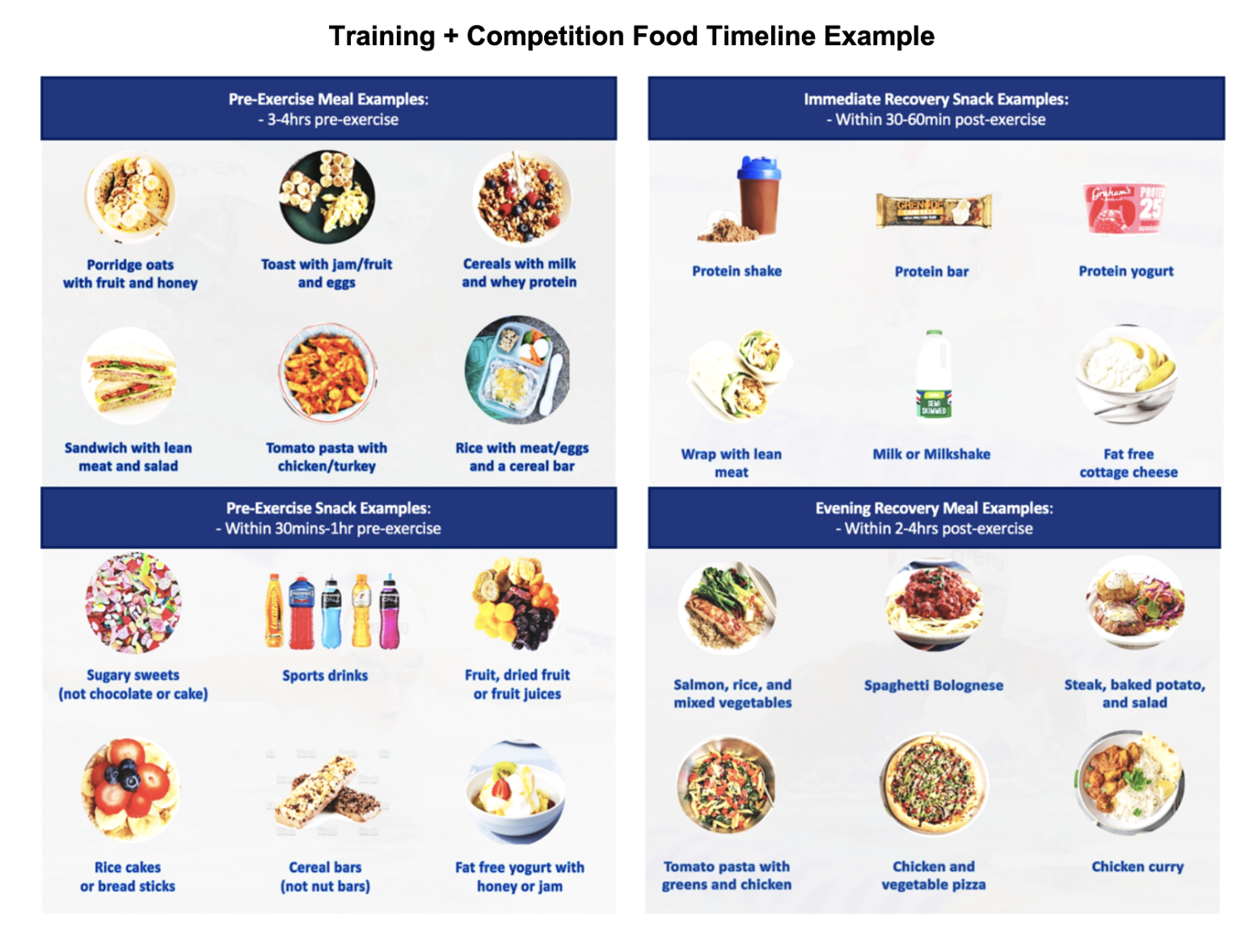

Slide 14
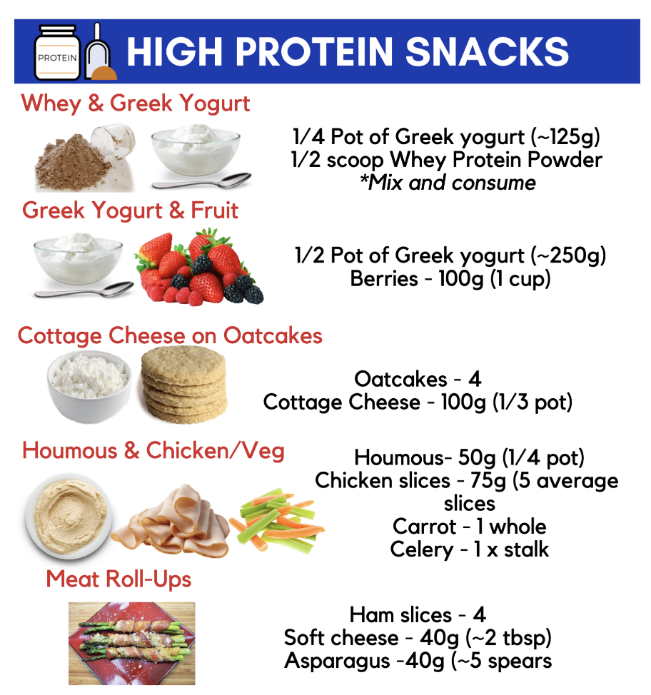

Slide 15
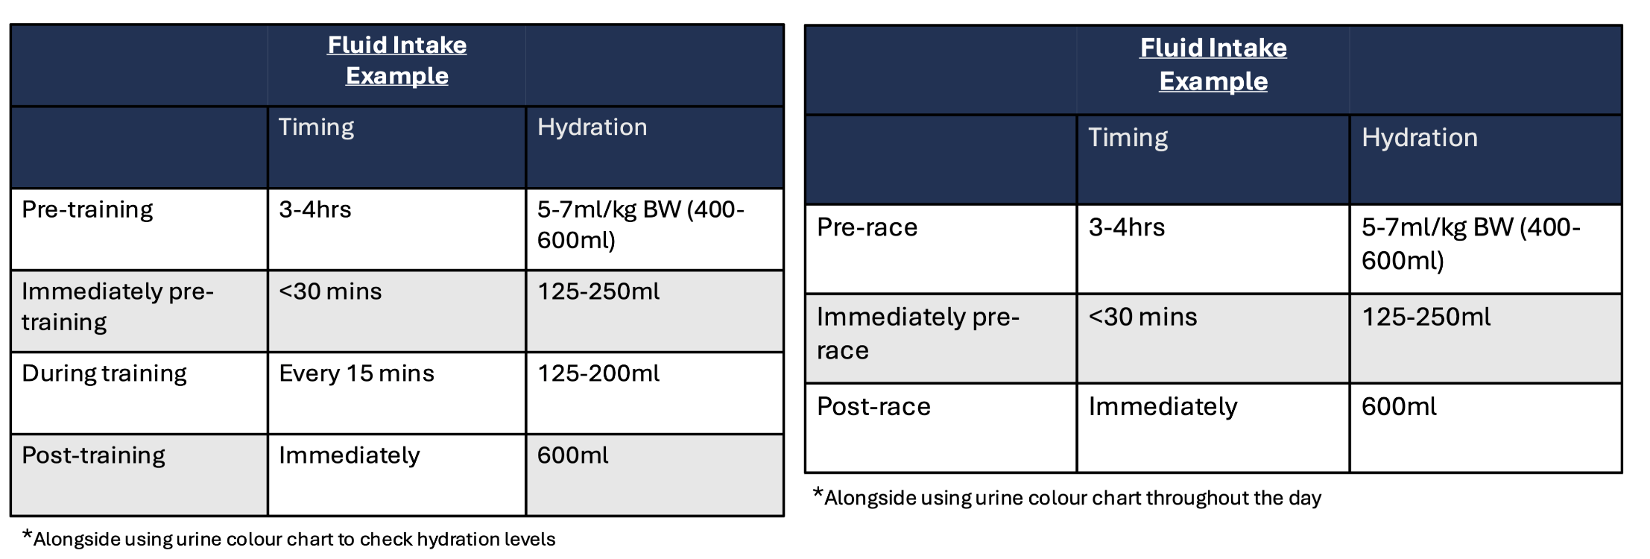

Slide 16
General good practice
Correct in-text citations
Correctly formatted reference list
Sufficient number of good quality sources (3-150 journal articles)
Structure –no overly long sentences or paragraphs; use sub-headings to separate sections

