Slide 1

Using MS Word
LCHS4002 Digital skills and research methods
Week 2

Slide 2



During this session
Ensure you understand basic tools for formatting within MS Word
Demonstrate your skills according to your level of confidence with MS Word
Set up a report template for use in different assignments

Slide 3

MS Word
Jeong & Lee (2017) highlight that MS Word, PowerPoint and Excel are the most popular form of document used worldwide.
MS Word was first developed in 1981 and has since been updated 17 times, the newest version is accessible with the Microsoft 365 package, this can be downloaded and used as a desktop app or can be used online as part of the OneDrive.

Slide 4
Basic MS Word skills
Creating and editing documents
Some of you may already feel confident and competent in using MS Word, if this is the case, please feel free to work independently to produce a MS Word document identical to that shown in the Advanced Activity jpeg, available on Moodle Week 2.
Editing font style and font size
Adjusting page orientation.
How to insert images, format and label.
How to insert page numbers and line spacing
Setting up a template for a report.
Notes:
Explain the skills that will be explained and modelled to the students. Make it clear that this will only be shown once and will be required in all assignments as students move through their course.
Some students will have a high level of competence already and can be encourage to go to a university computer if the shared computer area or the lab on top floor (Sparkhill) to create a document that will match that shown in ‘Advanced activity’.

Slide 5
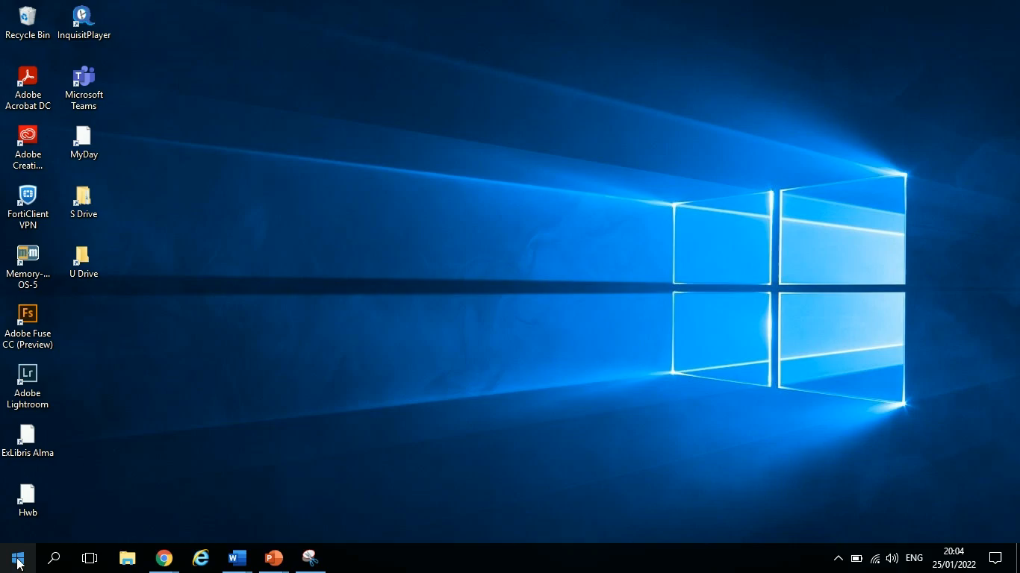
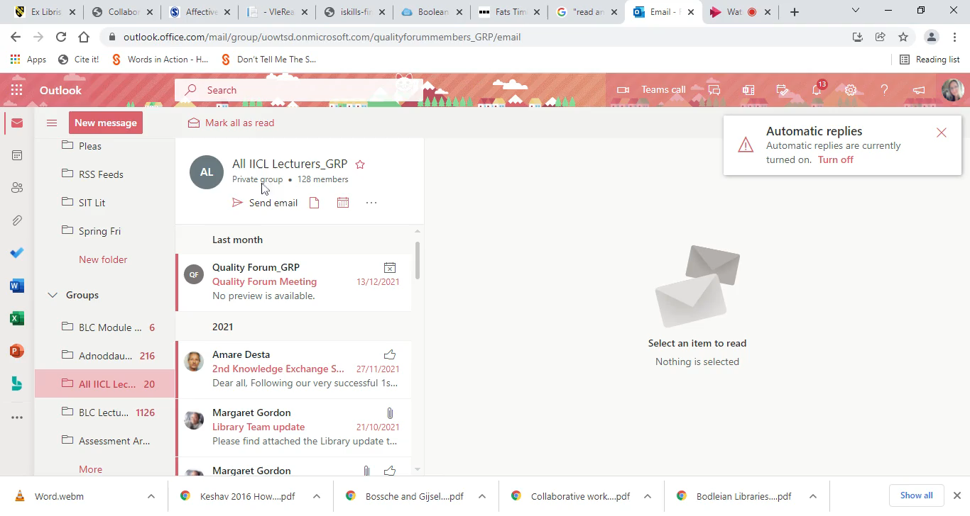
Creating and editing documents
On a desktop
On the OneDrive
Notes:
Remind the students how to save their work, encourage the students to back up their work onto the OneDrive if they are using a desktop version. As a student at UWTSD, they can download a desktop version of Microsoft 365 – direct to Birmingham IT service desk for more support with doing this.

Slide 6
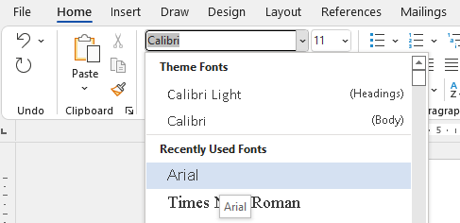

Editing font style and font size
At UWTSD we suggest using font style Arial and size 11.
At the top of your Word document, you will see the font style options. Click the small arrow to the side.
From the drop-down menu select Arial.
Notes:
Model to student how to select text in a document and change the font style and size.

Slide 7
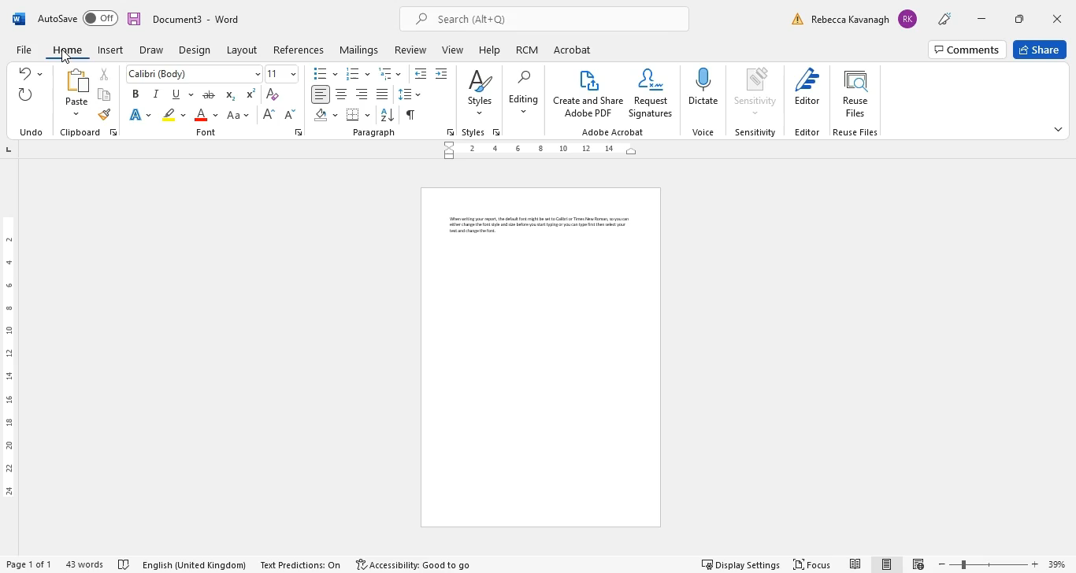
Adjusting page orientation.
Your document will appear in portrait orientation as a default but at time you may wish to present your work in landscape if you are creating a poster or a diagram.
To change the orientation of the page, click on the ‘Layout’ menu and select ‘Orientation’
Notes:
The example shown is from a desktop version but the OneDrive version has the layout menu and orientation option in the same place.

Slide 8
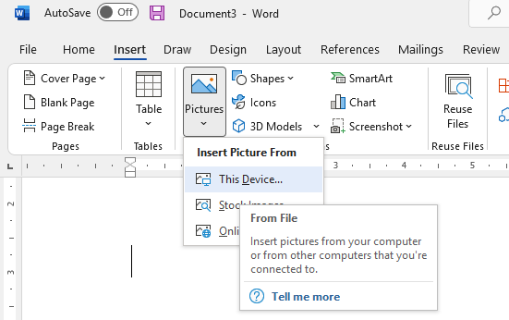
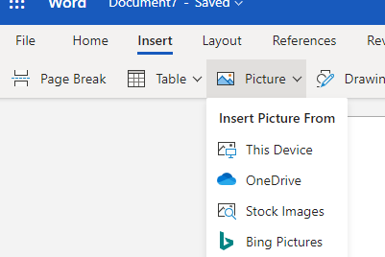
How to insert images, format and label.
The Insert menu is found at the top of the document, click the Pictures icon, and select where the picture can be found.
The desktop MSWord view
The OneDrive MSWord view
Notes:
Model to the student how to find an image and ‘Save as’ – Remind students to visit the website where images are found, rather than taking directly from Google, (visiting the website by clicking on the image) this will allow them to have the URL for their reference and name of website for their citation. (students have not yet covered referencing in LCHS4001).

Slide 9
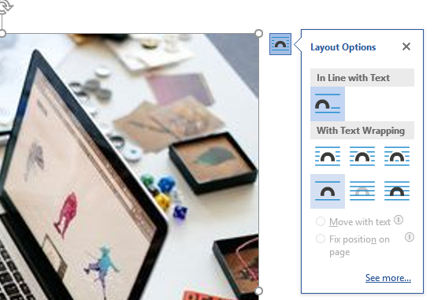
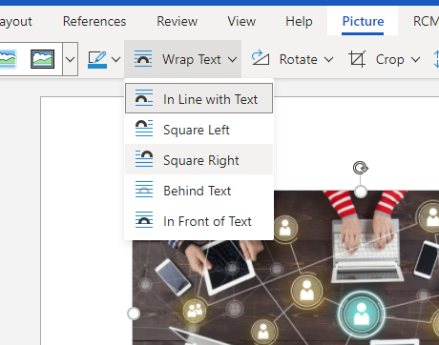
How to insert images, format and label.
Wrapping the text around your image is important to prevent the image from jumping around on the page.
The desktop version provides a pop-up menu after inserting the image.
The OneDrive version requires you to click on ‘Picture’ menu, then ‘Wrap text’
Notes:
Usually the best ‘Wrap text’ option is ‘Square’ but the OneDrive version offers ‘Square left’ and ‘Square right’ – suggest the students have a trial and error with it during the activity later.
Explain to students that any image that is inserted into a document needs to be labelled. The first image in a document would be ‘Figure 1’ and the next would be ‘Figure 2’, each image should have a brief description, for example, ‘Figure 1. An image to demonstrate the connectivity of group work. Or Figure 2. A diagram to show Berlo’s model of communication.

Slide 10
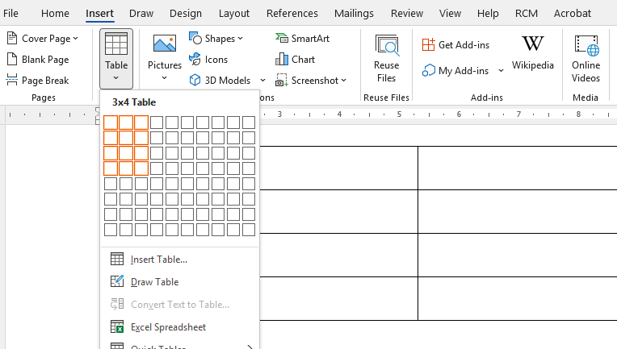
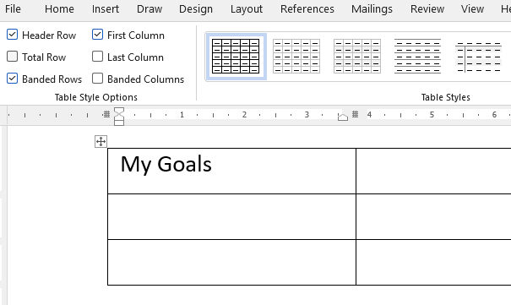
How to insert a table
To insert a table, select ‘Insert’ and ‘Table’ and choose the size of the table (number of rows and columns)
Once you have inserted a table, you can click on each box to add text or numbers.

Slide 11
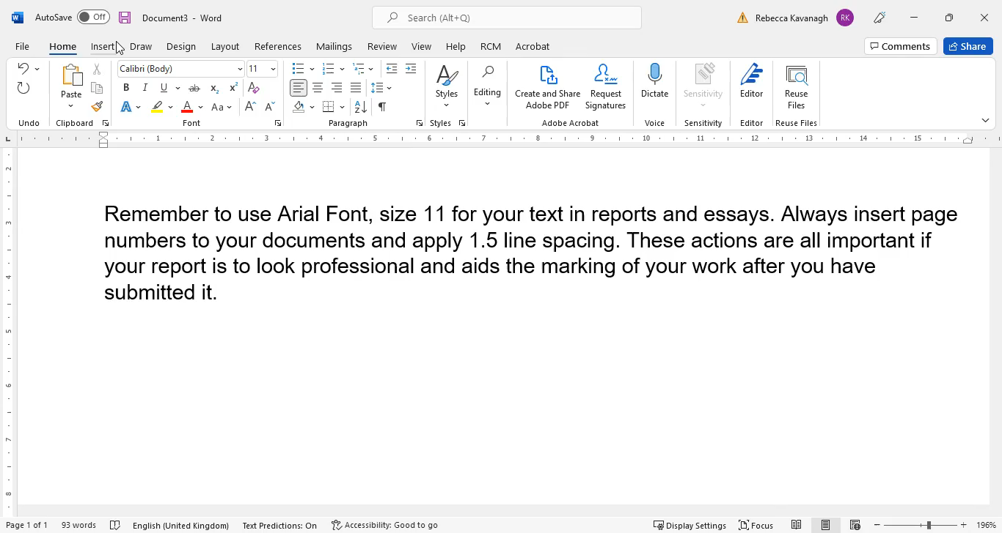
Inserting Page numbers
Page numbers must be inserted for all written submissions.
Notes:
The One Drive version is easier as there are fewer options.

Slide 12
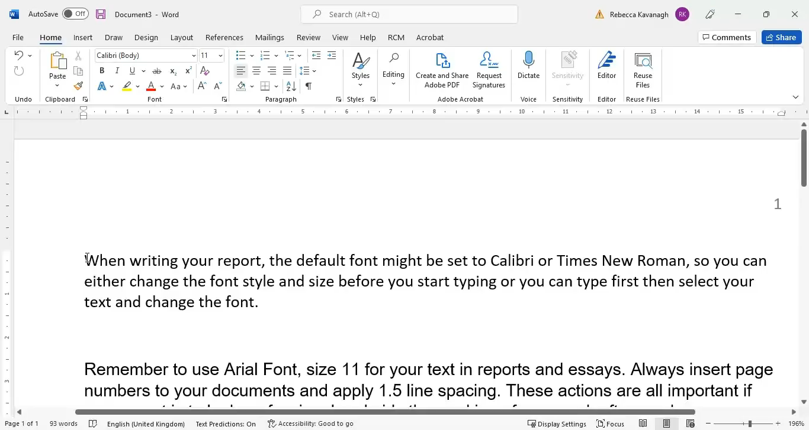
Applying 1.5 Line Spacing
It is important to apply 1.5 line spacing to your written submissions, as without this, marking can be difficult.
Notes:
Model this again for the students if needed as it is very important as they move forward in their course.

Slide 13
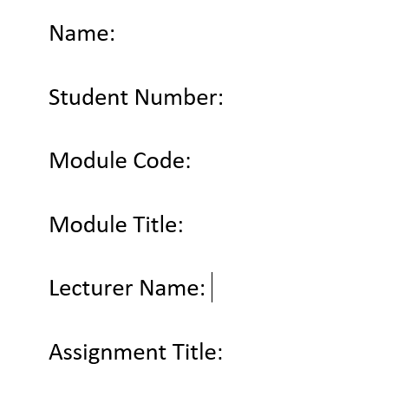
Setting up a template for a report.
Setting up a template may be useful as you move forward through your course.
Open a document and save as ‘Template for all submissions’ (in future you will need to ‘Save As’ and rename for each assignment in order to keep template)
On the first page, you will create a title page which you will adapt for each assignment.
On the second page put ‘Contents’
On the third page put ‘Introduction’ (when you begin writing your report, the number of pages in the main body of your report will increase, you will add additional subheading as appropriate)
On the fourth page put ‘Reference List’
Notes:
Students can choose to complete this in class or at home but ensure that you allow time to students to complete the MS Word activity.

Slide 14
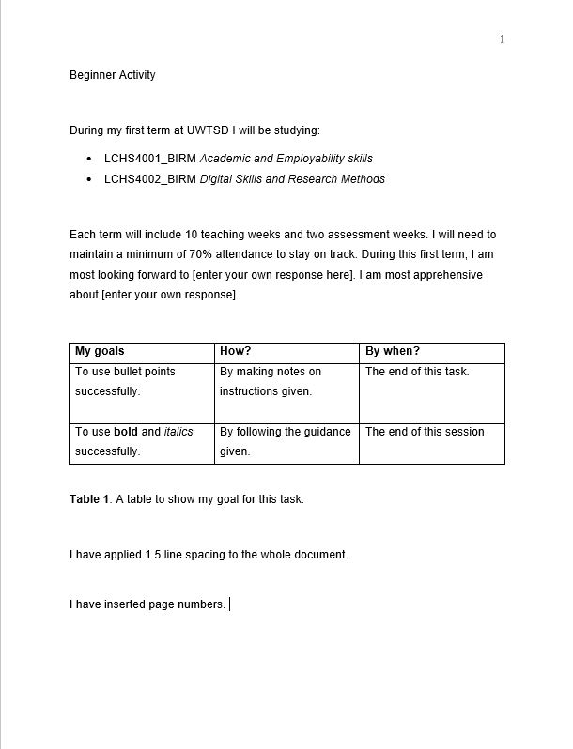
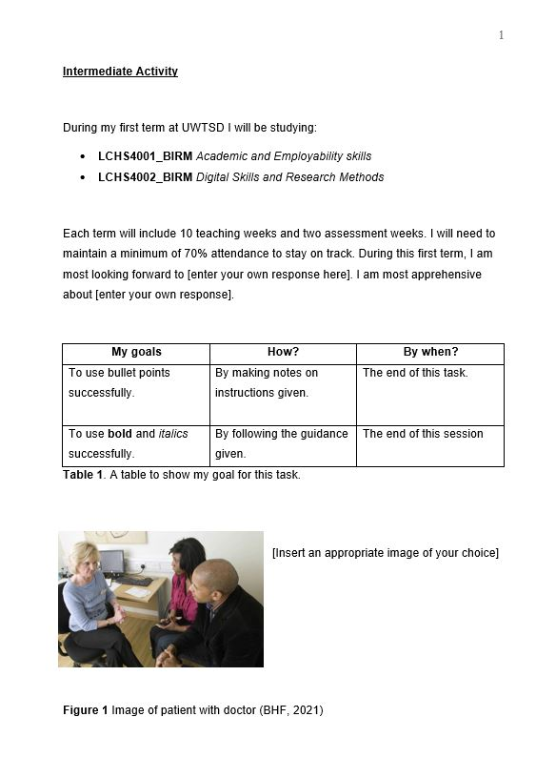
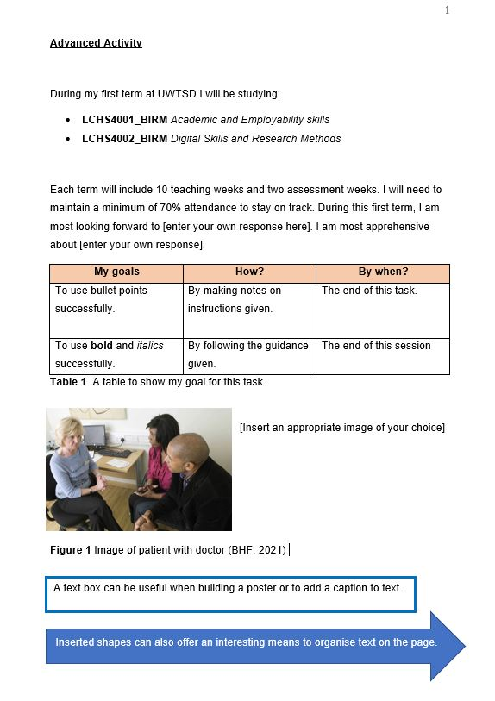
Activity – Test your MS Word skills.
Choose one activity to recreate in MS Word, when complete please email your file to your lecturer or share via the OneDrive.
Beginner Level activity
Intermediate Level activity
Advanced Level activity
Notes:
Advise students to choose one task only to replicate.
Direct students to use the relevant computer rooms (Sparkhill – common area on ground floor or top floor PC lab) (Quay Place – PC lab on middle floor)

Slide 15
References
Jeong, D. and Lee, S. (2017) ‘Study on the tracking revision history of MS Word files for forensic investigation’, Digital Investigation, 23, pp. 3–10. doi: 10.1016/j.diin.2017.08.003.

