Slide 1
Workshop – Component 1
Lecturer: Dushika Soundararajan
Module: BHMP6006

Slide 2


Component 1
Task 1
Debate
Equivalent to 1000 words
Deadline – 29th October 2021 (in-class assessment)
Task 2
Supporting Paper
2000 words
Deadline – 29th October 2021 before 3.00 p.m

Slide 3

Submission Method
Debate
  No submission Required in class activity within groups
Supporting Paper
  Submit to Turnitin by 3.00 p.m on the date of the deadline
  All papers should be independent work

Slide 4

Late Submission
By one week
  You will be capped at 40 percentage
More than one week
  You will be provided with 0 percentage
Extenuating Circumstances
  Every individual may be permitted to different time period based on circumstances.
  Seek support where appropriate

Slide 5

Academic Honesty and Referencing
This is very important
Academic dishonesty is not good practice
It is good conduct to give credit to authors when your ideas are based on their research.
Always include a reference list based on all your in-text citations
You should use Harvard referencing style
You can request for support if required

Slide 6

Task description

Slide 7
Task 1
Topic
“The UK supported and included individuals with mental disorders during the 20th century”
Duration of activity
Each individual will be expected to speak for at least 5 mins
The duration of the entire debate between a for and against group would last for maximum 45 minutes

Slide 8
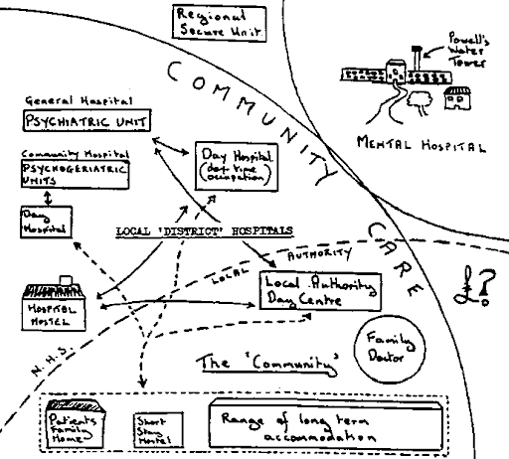
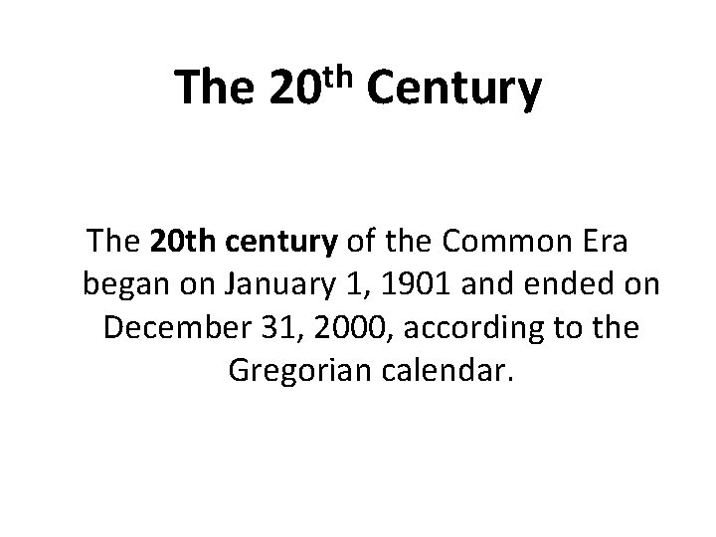

Slide 9
Assessment criteria for Debate

Slide 10



Engagement with literature
This section requires you to support the claims you are making with research evidence.
Minimum of at least three evidence by each individual in group
Some of the resources you could cite are as following
  NHS Websites
  NICE guidelines
  Governmental websites
  Peer-reviewed research papers

Slide 11

Knowledge and understanding skills
You should demonstrate that you have understood the topic you are arguing for in this section.
Highlight the mental health act, by clearly stating the year
Highlight both the changes in legislations and provisional changes that has taken place within the period of 20th century
  When you do this, you have to make sure to provide citation for your claims
  Clearly indicate how the changes are relevant to your argument rather than simply stating it.
  For example, how is the point you are making justifying if UK supported or did not support individuals with mental illness during the 20th century?
Notes:
Resource: https://digital.nhs.uk/blog/transformation-blog/2018/the-past-present-and-future-of-innovation-in-mental-health
https://www.ncbi.nlm.nih.gov/pmc/articles/PMC4595954/

Slide 12
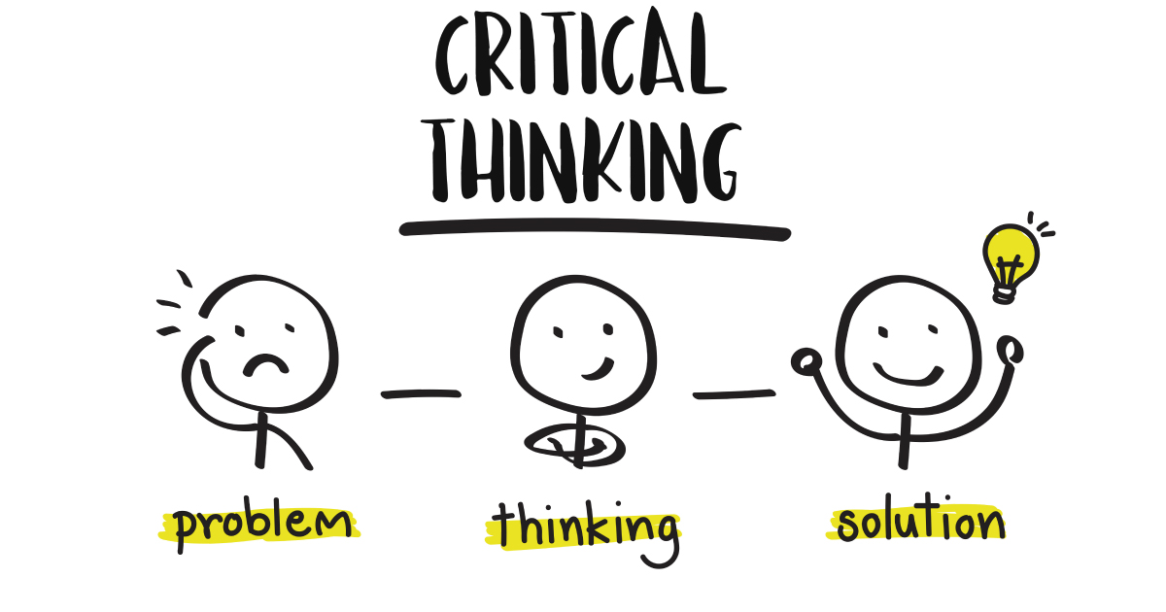
Cognitive and intellectual skills
It is very important to demonstrate your critical thinking and analytical skills in this section.
When you make a claim
  you have to justify the claim with research evidence.
  Then you have to clearly demonstrate how the claim supports your argument
  Remember to include statistics
Your initial argument would be based on the context of 20th century, but your justification should be based on current research.

Slide 13

Practical Skills
In this section you should demonstrate that the points you are making are appropriate to your debate topic.
The literature and statistical evidence you are providing should have relevance to your argument
Your arguments should be structured in a clear and meaningful way.

Slide 14

Transferable skills
In this section ensure that
  You maintain the same pace throughout the debate.
  The pace in which you speak should not be too fast or two slow.
  Use a professional tone and language
  Avoid using judgmental terms
  Acknowledge the points made by the previous presenter
  Do not interrupt while a presenter is making a claim.
  Respect all members

Slide 15

Assessment criteria for supporting paper

Slide 16
Task 2
Topic
Did the UK support and include individuals with mental disorders during the 20th century?
Word Count
2000 words
Key factors to take into account
Define what is meant by mental disorder.
Consider the historical context of mental health provision in the UK.
Describe what changes have occurred in UK mental health legislation
Provide example of inclusion and exclusion.
Make recommendations on future improvements.

Slide 17
Engagement with literature
This section requires you to support the claims you are making with research evidence.
Minimum of at least 12 evidence Some of the resources you could cite are as following
  NHS Websites
  NICE guidelines
  Governmental websites only. Avoid all other websites
  Peer-reviewed research papers
  It is important to include current research evidence

Slide 18


Engagement with literature
Ensure your paper is structured according to Harvard writing style
Make sure that you provide in-text citation for all your claims. This includes but is not limited to:
  Research evidence
  Statistical information
  Legislations
  Mental health acts
  Theories
Make sure the references for all the in-text citations used are provided within the reference page.

Slide 19

Knowledge and understanding skills
In this section you might use historical evidence when you explain about historical changes
However, you should justify your claims using current research evidence
Remember all the information you provide should be factual and not based on your personal opinion.
Include theoretical explanation in your supporting paper
  For example, how do different theories explain mental disorder?
You should highlight the changes in legislation and how it may have impacted the support individuals received.

Slide 20
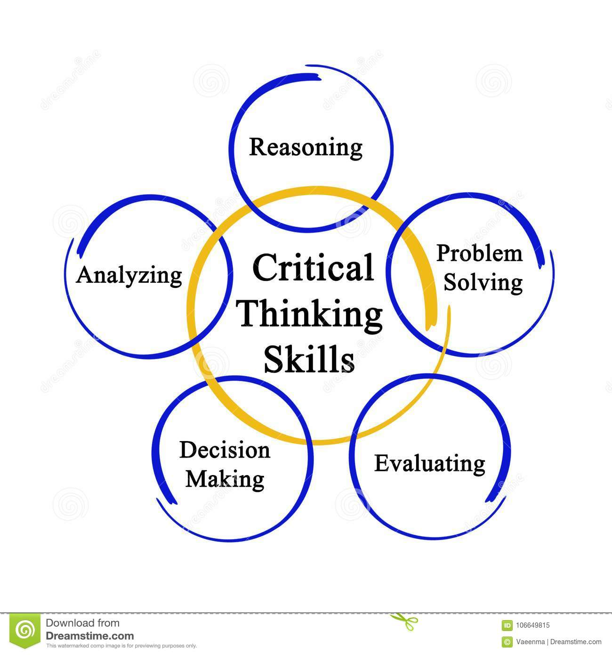
Cognitive and intellectual skills
It is important to demonstrate your critical thinking skills in this section.
You need to justify and provide a reasoning for your claims.
Highlight the consequences a change may have brought and how that is relevant to your topic.
  For example, how did change in provision, influence an individual with a mental disorder? What evidence is there to support the claim?
Your arguments should be logical
Your arguments should be based on research evidence rather than personal opinion.

Slide 21

Practical Skills
In this section you should mainly demonstrate your application skills.
Theory to practice link should be demonstrated
For example, when you make a recommendation for future improvement, the justification for your recommendation should be clear. You are then required to support your recommendation with evidence.
Application to real life situation should be observable.

Slide 22
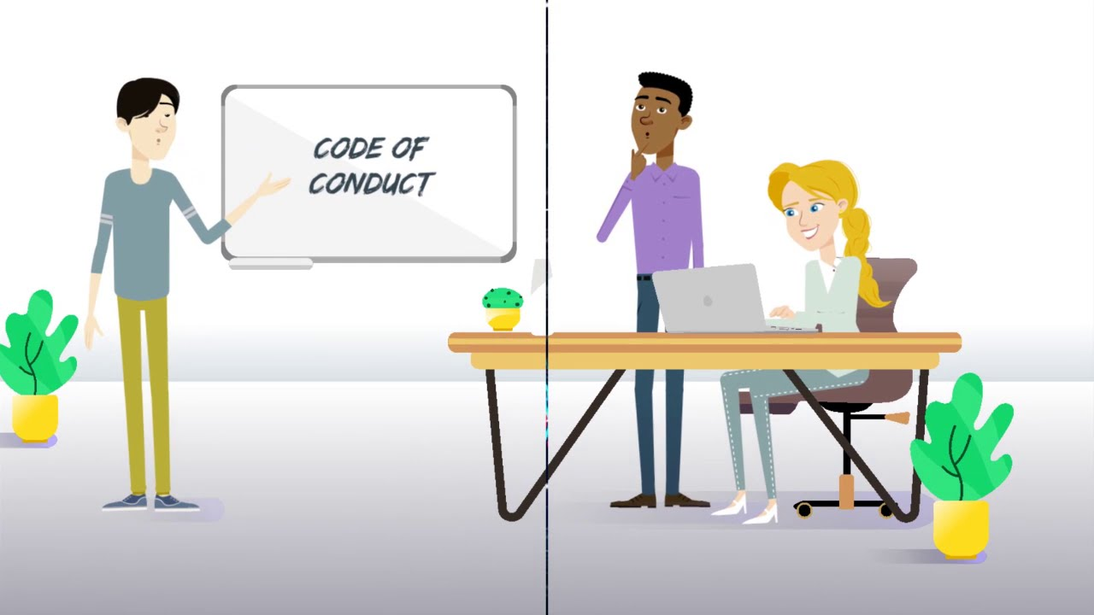
Transferable skills
It is important that you maintain professionalism throughout your paper
Ensure you use academic language
Avoid using judgmental terms
Ensure you structure your claims in an objective manner rather than subjective manner.
It is important to structure your paper in an organized manner.

