Slide 1
Cybersecurity Strategy for VTAM
Zero Trust Approach to Modern
Threats
Biniyam Memberu

Slide 2
Introduction
Rise of cyber risks in finance
Attacks are more sophisticated
Vigilant Trust & Asset Management (VTAM) has recently experienced security incidents.
The company is moving to a Zero Trust model.
covers modern cyber threats, effective security policies, and recommended technology,

Slide 3
Identification of modern threats
External threats;
Ransomware-as-a-Service (RaaS)
Easier access for attackers
Data theft and encryption
AI-powered social engineering (including vishing)
using AI to generate realistic emails, messages, and voice calls
used to try to extract logon details, demand payment
Supply chain compromises
Adversaries are known to target third-party software

Slide 4
External threats conti
Cloud adoption risk
Misconfigured storage and inadequate identity can put data and workloads at risk
Hybrid work and remote access risk
Attackers target home networks, unmanaged or insecurely configured personal devices,

Slide 5
Identification of modern threats conti.
Internal threats;
Malicious insiders
A disgruntled employee with appropriate access can siphon off customer information.
Compromise insiders
Users get compromised through phishing, breaches caused by malicious web scraping, and then are used as ‘trusted insiders’
Shadow IT
using unapproved cloud and file-sharing

Slide 6
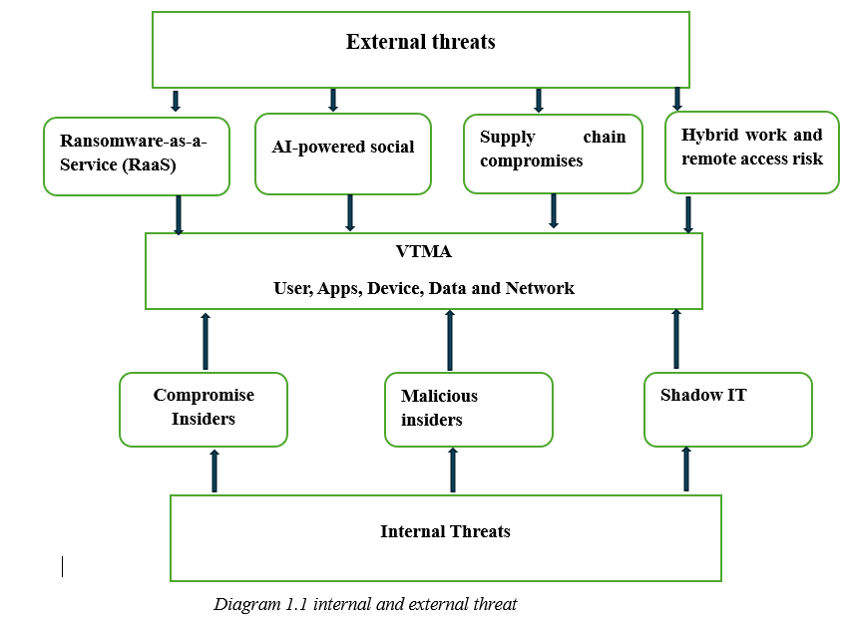
Identification of modern threats Diagram

Slide 7
Modern Security Policies
Modern security policies should follow the Zero Trust model
Identity and Access Management (IAM) Policy:
Ensure Multi-Factor Authentication (MFA)
Persistent Identity verification
Implement least privilege
Device Security & Endpoint Compliance Policy
Only managed and compliant devices are allowed to access
Protects devices that have been jailbroken
Network Segmentation & Access Control Policy
for sensitive systems
Secure remote access must be provided using Zero Trust Network Access

Slide 8
Modern Security Policies conti.
Data Protection & Classification Policy
classification of company information
Ensure that all data and connections are encrypted
Cloud Security & SaaS Governance Policy
Implement security in cloud environments
Track and record all actions performed
Supply Chain & Third‑Party Risk Policy
Security due diligence on all vendors.
Ensure Least Privilege rules are in place for third-party accounts

Slide 9
Technical Mitigation Measures
VTAM should implement a combination of technical and administrative controls aligned with Zero Trust principles. Key mitigation measures include:
Multi-Factor Authentication (MFA)
enforced on all privileged access accounts
recommend at least two-factor authentication
Security Information and Event Management (SIEM)
detect and respond to undetected intrusions, lateral movement.
while threat detection early-warning features.

Slide 10
Technical Mitigation Measures
Cloud Security Posture Management (CSPM)
Help to secure cloud workloads and data by identifying misconfigurations
automatically remediate by recommending actions such as encrypting data storage or restricting access to public-facing endpoints
Endpoint Detection and Response (EDR)
helps to discover and analyse unknown threats
provide a solution instantly and silently isolate the endpoint, preventing further spread
Network segmentation
Reduces the harm an attacker can cause by restricting lateral movement, and blocking unauthorised access to sensitive data
allow only necessary communication, and even then, under the strict constraint of Zero Trust policies such as "never trust, always verify."

Slide 11
Proactive Monitoring and Incident Response
Monitoring Strategy:
strategy is centred on our 24/7 Security Operations Centre (SOC), which monitors all network, endpoint
All logs are funnelled into a centralised (SIEM)
Monitoring is undertaken on a shift-rotation basis, aided by automated dashboards and alerts
All high-risk incidents are investigated and remedied immediately

Slide 12
Proactive Monitoring and Incident Response conti,
Threat Detection:
advanced analytics and threat intelligence to identify potentially suspicious behaviour.
allows one to quickly spot activities that indicate potential threat
incorporates threats identified by external parties
Endpoint Detection and Response (EDR) solutions monitor for threats like ransomware, malware,

Slide 13
Proactive Monitoring and Incident Response conti,
Automated response;
means that it can stop threats in an instant.
A (SOAR) platform executes automated workflows detailed in playbooks to contain active threats and allows SOC analysts to focus on investigating complex threats.
Within seconds of a threat alert, endpoints can be automatically quarantined, malicious IP addresses can be blocked, and compromised accounts can be disabled.
SIEM technology ensures that

Slide 14
Proactive Monitoring and Incident Response conti,
Incident response lifecycle management;
critical in the fight against advanced persistent threats
incidents: detection & analysis, where alerts are triaged and verified; containment, where the spread of the threat is halted and affected systems locked down to prevent further, eradication, vulnerabilities patched and compromised credentials reset; and recovery, where affected systems are restored from backups and verified to be operating properly.
a post-incident activities phase is conducted

Slide 15
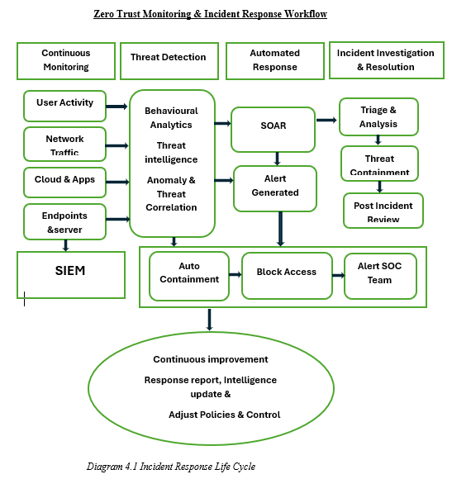
Proactive Monitoring and Incident Response

Slide 16
Continuous Training and Awareness
An effective security awareness programme, practical to help employees recognise and respond to modern cyber threats.
Simulation is also a critical component for a training program.
Incorporate interactive elements such as short videos, quizzes, and Scenario-Based Learning
Rewarding employees for best practices

Slide 17
Conclusion
This report concludes by reaffirming that the modern cyber threat landscape is complex
identifies emerging threats
recommended security policies, technical controls, monitoring solutions and awareness initiatives
use to implement a Zero Trust strategy (such as SIEM and SOAR)
encouraging employees to participate in security training and maintaining
Adapting a Zero Trust security stance is a practical important.

