Slide 1
ECDA7005 | MODELS OF BILINGUAL TEACHING
THESIS
Political ideologies do not merely contextualize the aims of bilingual education, they constitute them.
CASES COVERED
USA · Canada · Wales · Cambodia · Spain · Sámi · European Union
Bilingual Education & Political Ideology
Why the aims of one cannot be properly understood without the other
Kamila Notario-Galaj
MA Bilingualism & Multilingualism
University of Wales Trinity Saint David

Slide 2
IDEOLOGY
(Bourhis et al., 1997)
pluralist / civic / assimilation / ethnist
POLICY (Wiley, 2002)
promotion / tolerance / restriction / repression
ORIENTATION (Ruiz, 1984)
language as resource / right / problem
IMPLEMENTATION (Tosi, 1988)
LANGUAGE
RIGHTS (Skutnabb-Kangas, 1989)
explicit / implicit / concealed assimilation
overt / covert explicitness

Slide 3
Immersion
Maintenance / Heritage
Two way / Dual Language
Mainstream Bilingual
Mainstream with World Language Teaching
Transitional
Submersion with pull-out
Sheltered Submersion
Submersion
Separatist
Segregationist
Baker & Wright, 2017

Slide 4
Immersion
Maintenance / Heritage
Two way / Dual Language
Mainstream Bilingual
Pluralist / Promotion
Mainstream with World Language Teaching
Civic / Tolerance
Wales
Transitional
Submersion with pull-out
Sheltered Submersion
Submersion
Assimilation / Restriction
Separatist
Segregationist
Ethnist / Repression

Slide 5
Separatist
Transitional
Mainstream with Modern Languages Teaching
Heritage
Sheltered Submersion
Mainstream Bilingual
Segregationist
Two-Way Dual Language
Immersion
Submersion with pull-out
Submersion

Slide 6
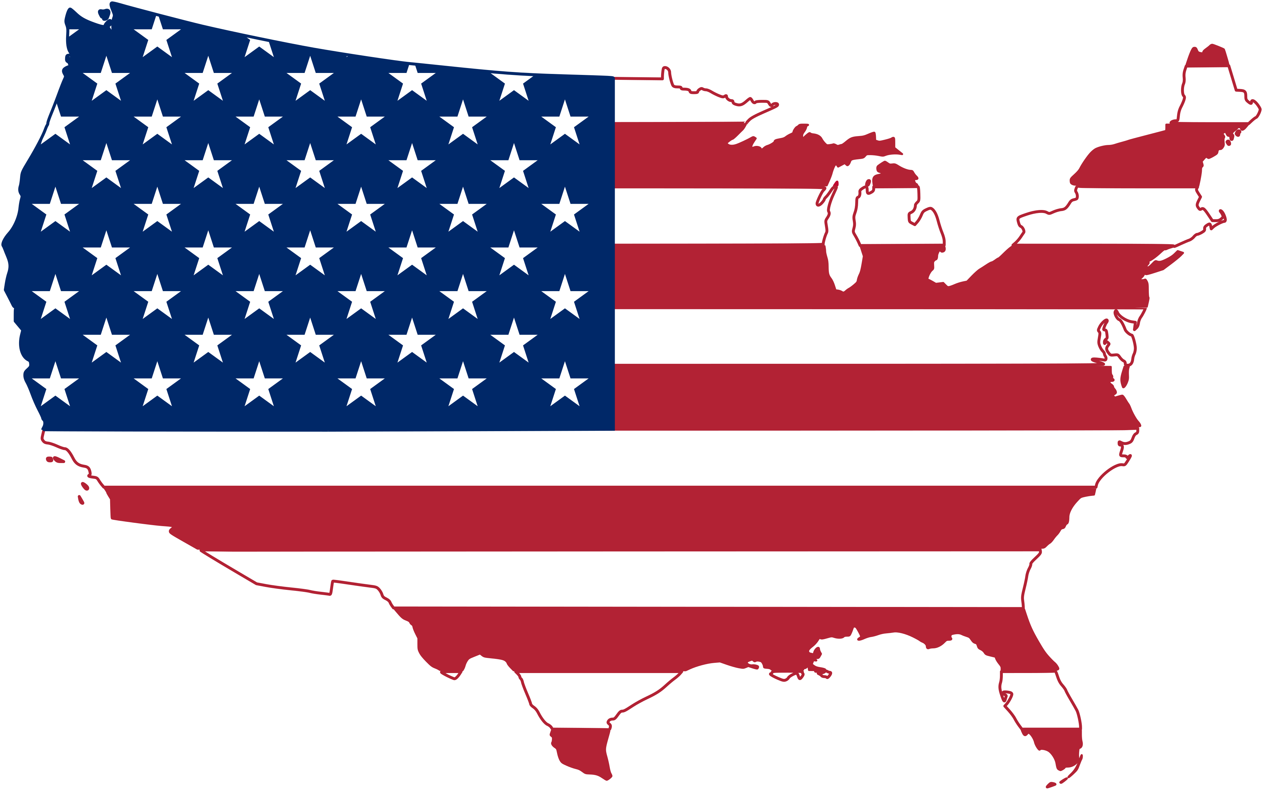

1968 Bilingual Education Act
1974 Lau v Nichols
1981 Reagan
1988 Bennet
1994 Clinton: America’s School Act
2001 No Child Left Behind
2015 Every Student Succeeds Act
2025 Trump
Casanova, 1991

Slide 7
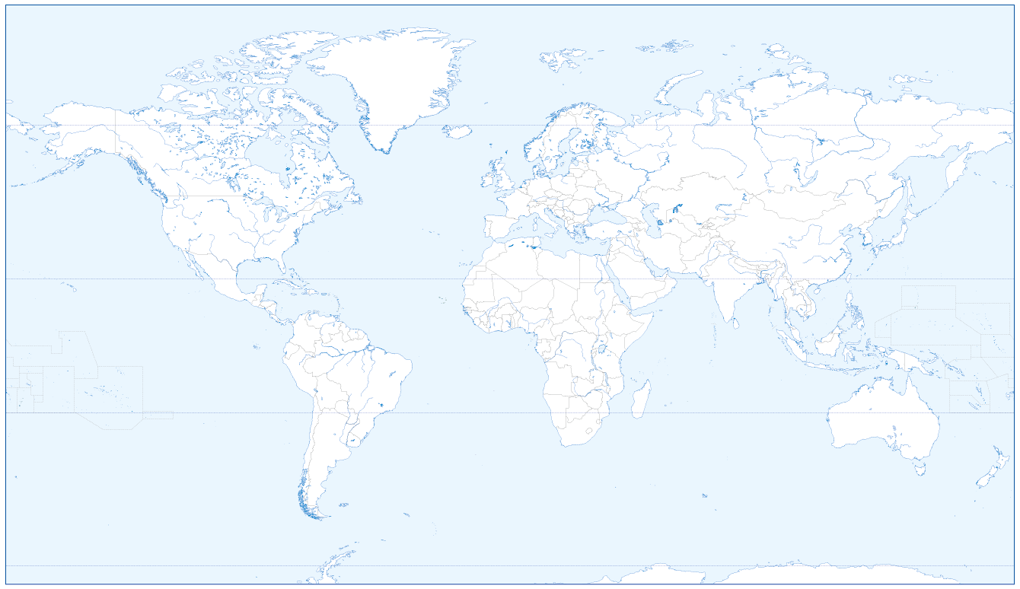
Canada
Sámi
Wales
Catalonian / Basque / Galician
USA
European School Model
Cambodia

Slide 8
BOURHIS CONTINUUM – FAR END
CASE EVIDENCE
Francoist Spain, 1939
Using national unity as an excuse, Catalan, Basque and Galician were banned from public education.
Nordic boarding schools
Sámi children were taken away from their families and forced into boarding schools. The use of their language was punished.
Ethnist ideology
Language as a threat to national unity
Penelo, 2009
Bryant, 2024
Manitoba, Canada, 1890
French was banned (in favour of the English language) and physical punishment was used in schools.
Wales, The Treason of the Blue Books, 1847
Using Welsh in the educational environment was forbidden and the use of the Welsh Not was implemented.
WILEY
Repression-oriented policy
RUIZ
Language as a problem
Genesee, 1988
UWTSD, 2023
SKUTNABB - KANGAS
Overt policy

Slide 9
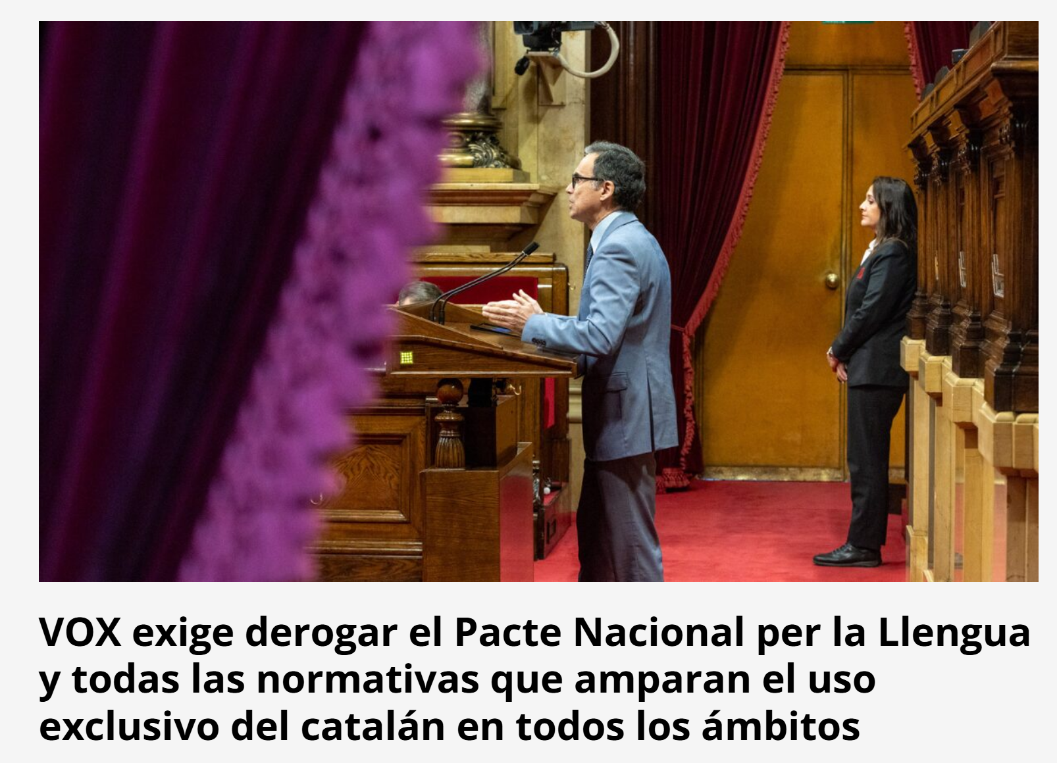
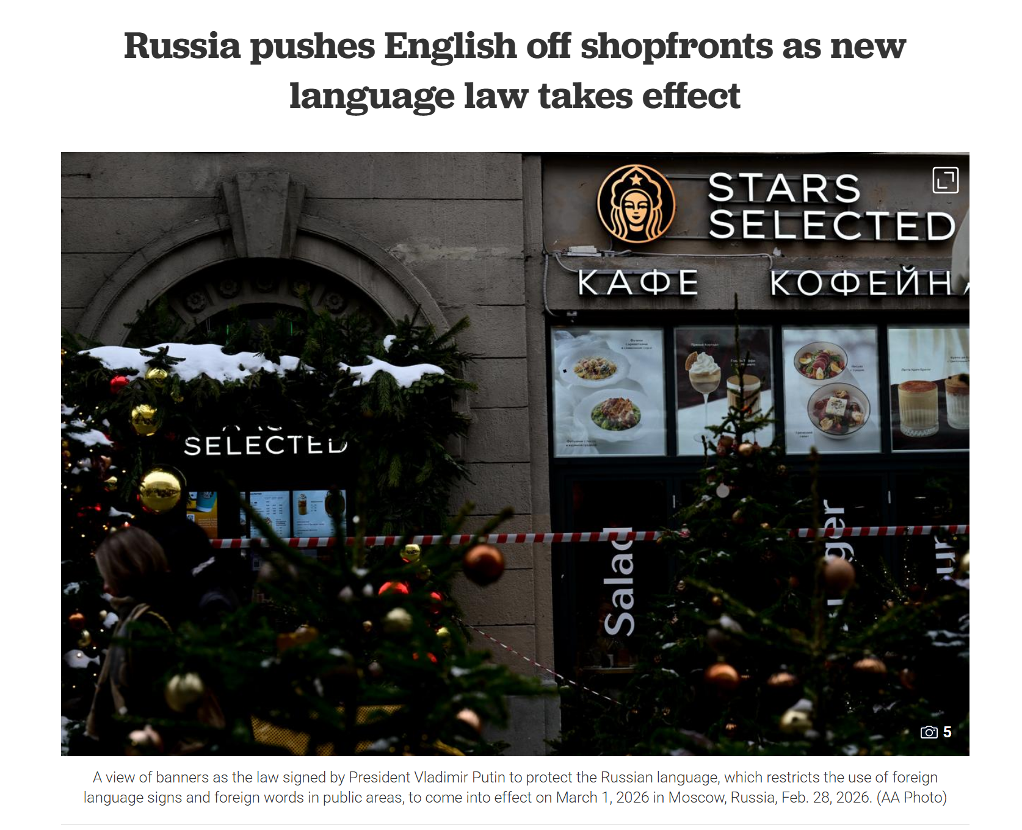
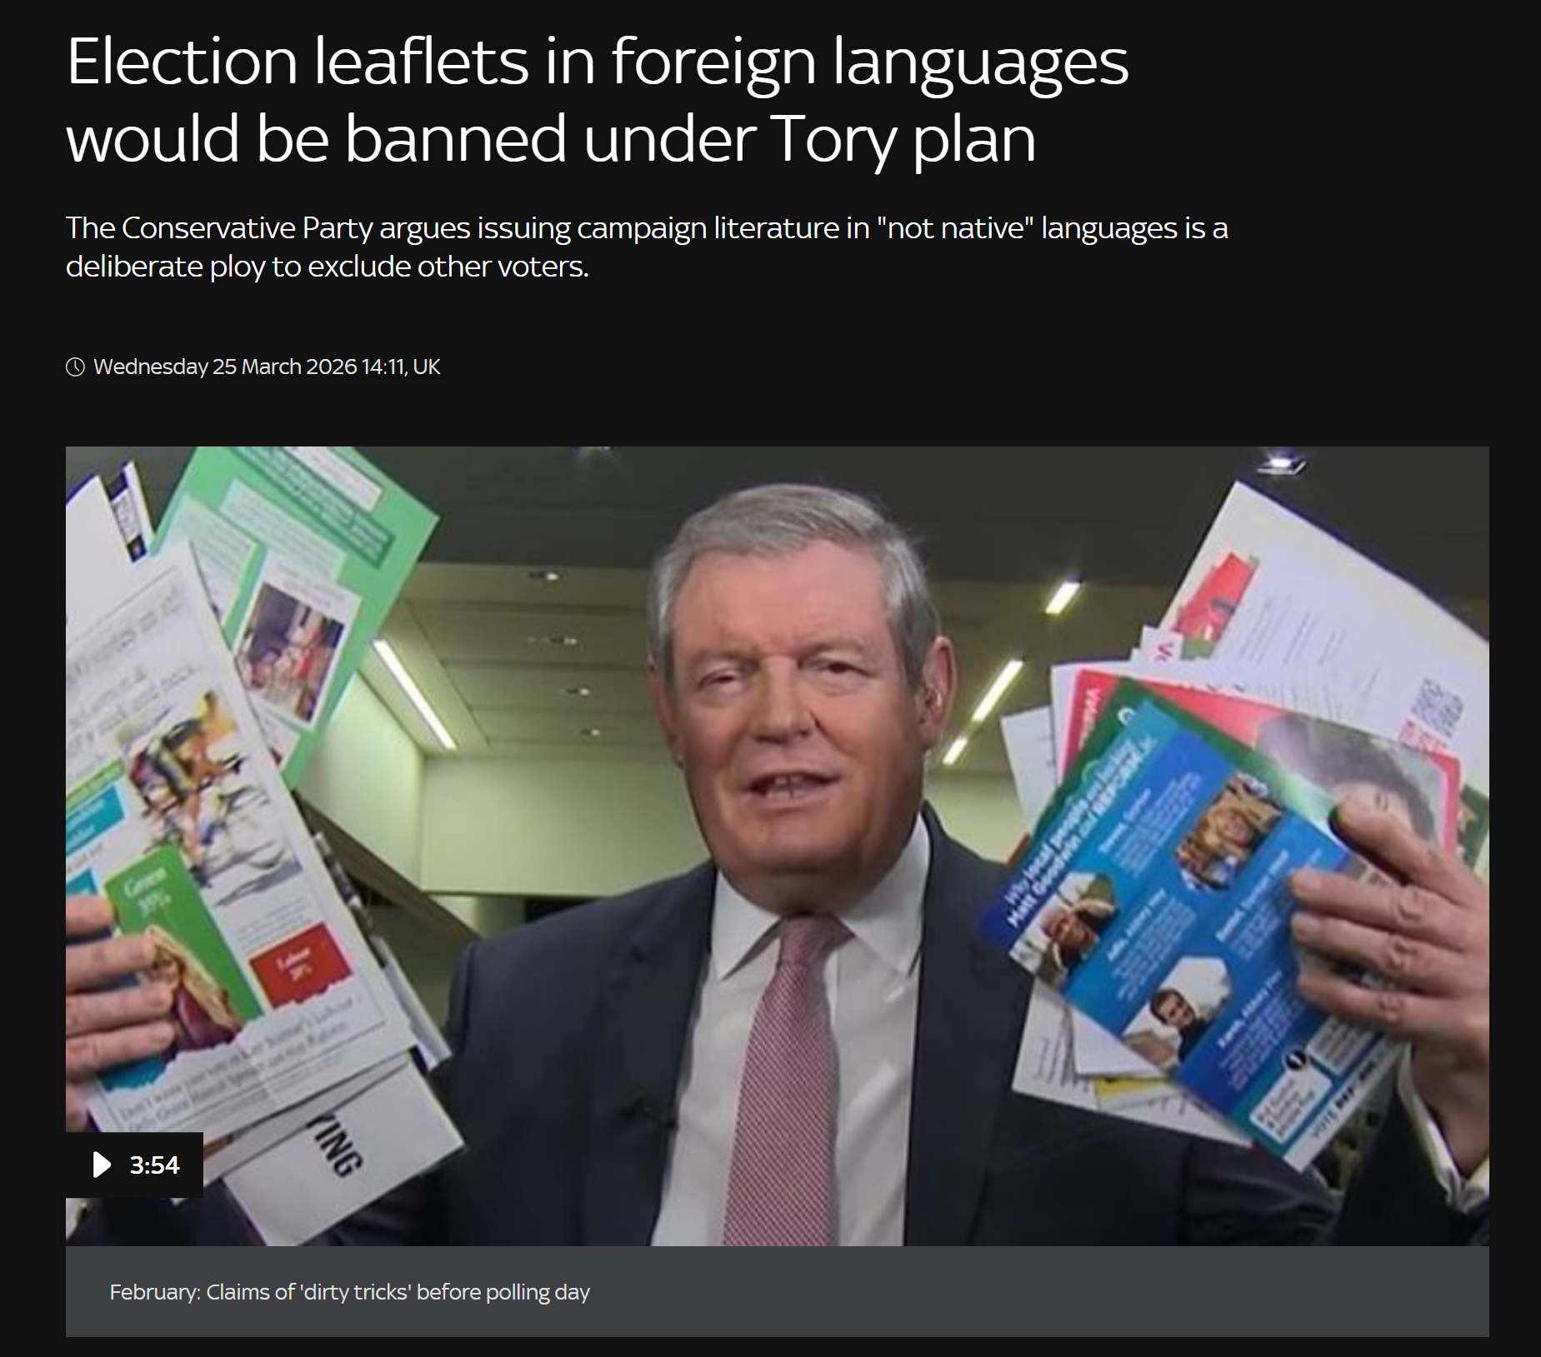
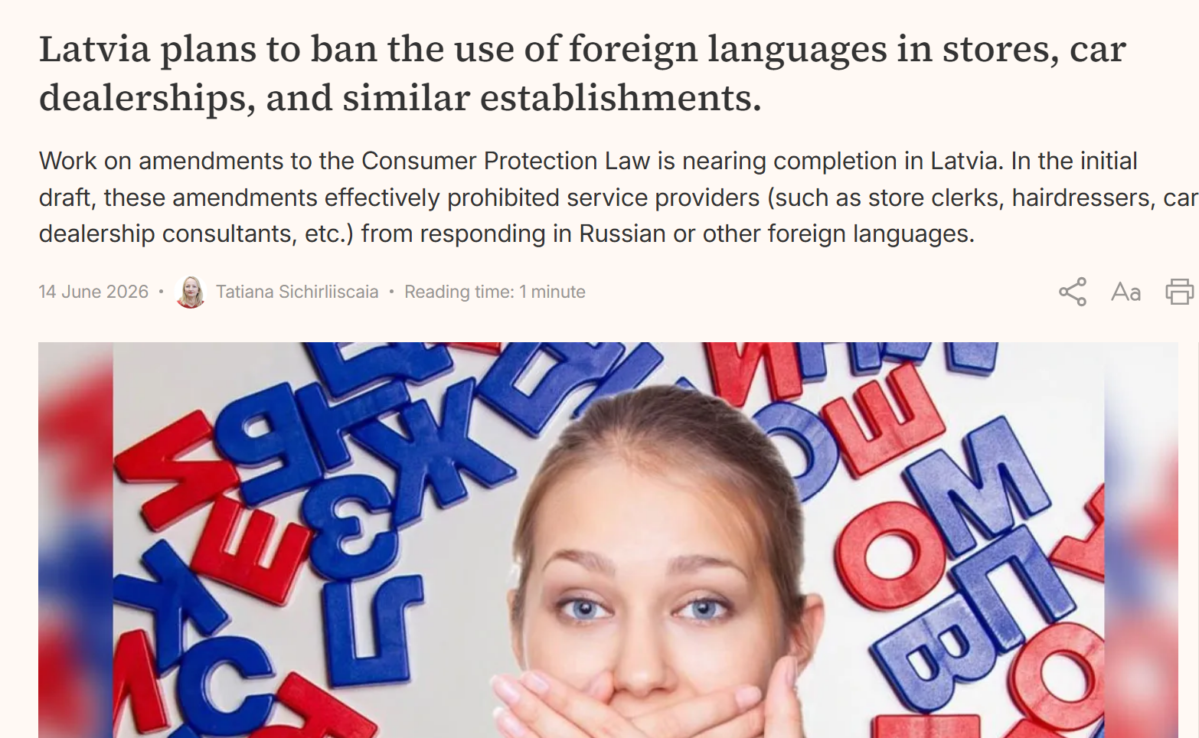
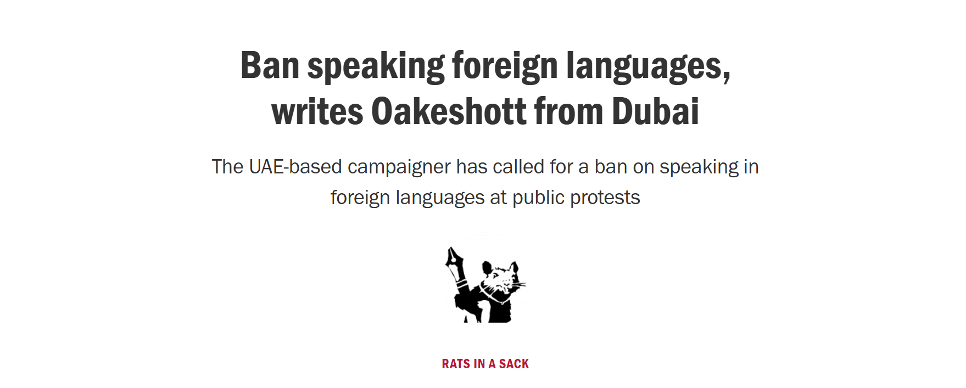
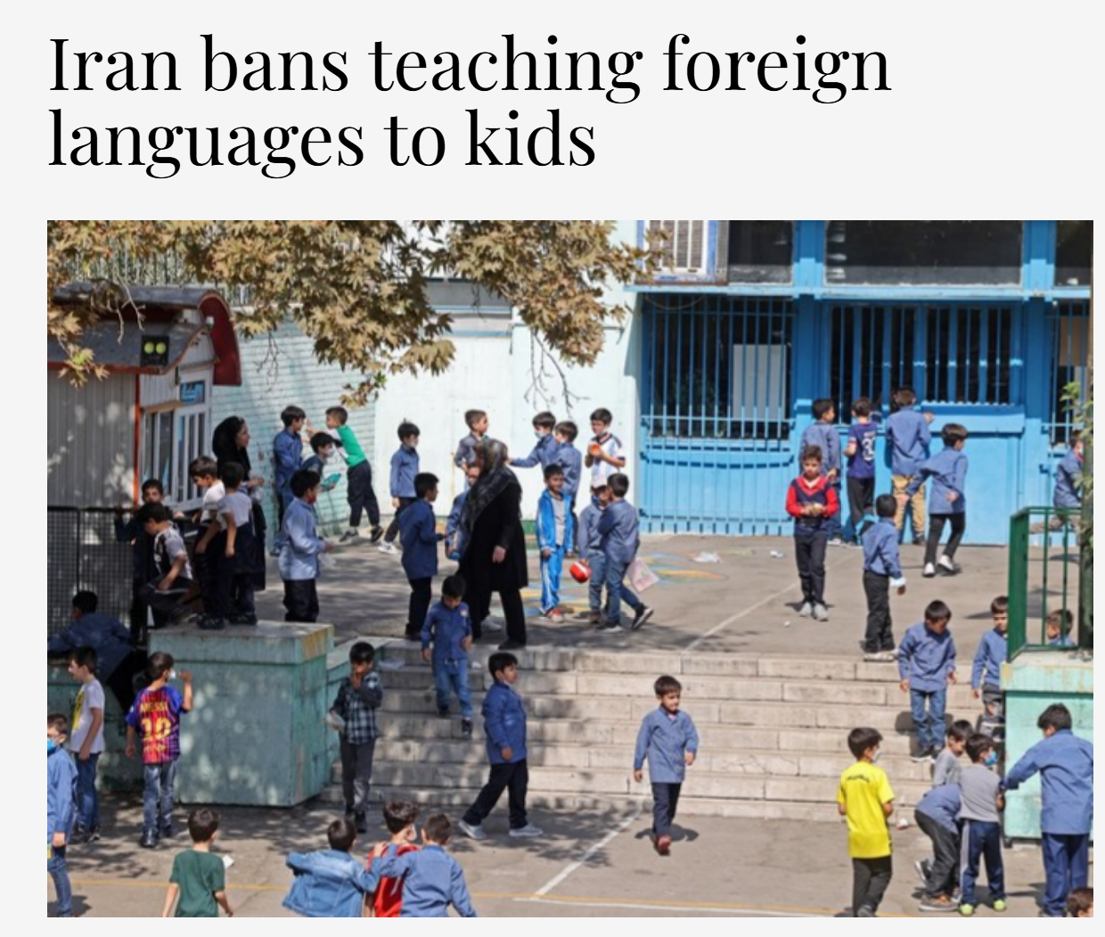
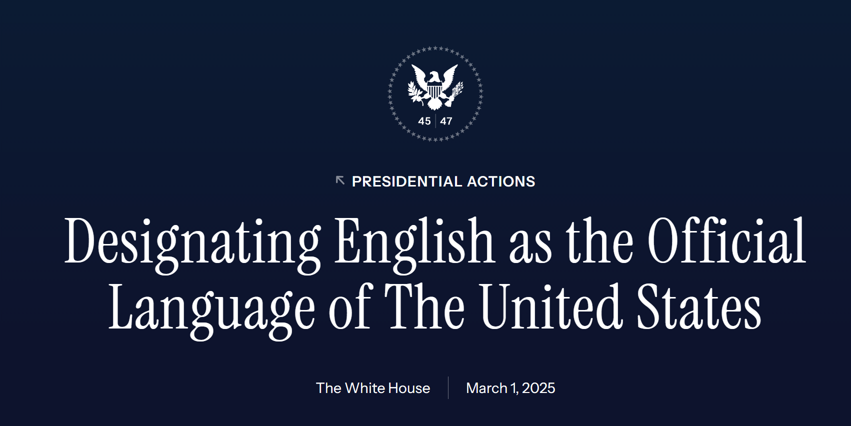
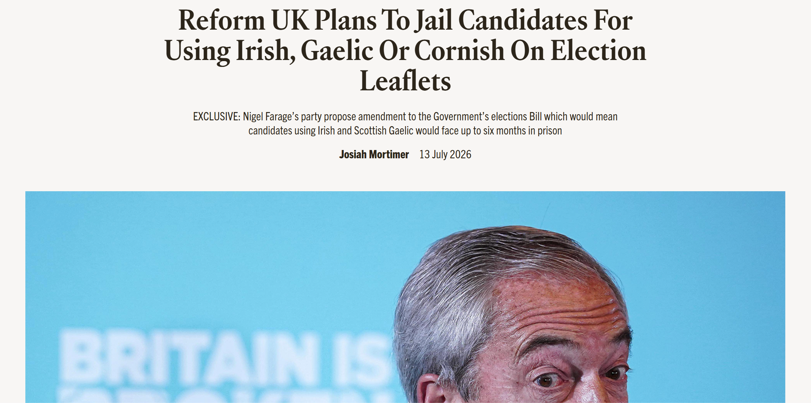

Slide 10
BOURHIS CONTINUUM – ASSIMILATION
CASE EVIDENCE
Submersion with Push-In
It can be effective when two teachers plan, teach, assess and reflect together on the progress of the students
Wales
Overt policy documents and covert reality
Assimilation ideology
Language as an obstacle
WILEY
Restriction-oriented policy
Baker, 2025
Stubbs, 1991
RUIZ
Language as a problem (disguised)
Cambodia
The Language is seen as a right and its teaching, promoted by the government
TOSI
Concealed assimilation
Wright, 2016
SKUTNABB - KANGAS
Covert explicitness

Slide 11
BOURHIS CONTINUUM – CIVIC
CASE EVIDENCE
Native American Languages Act
It was a shift from repression-orientated to tolerance-orientated policy
Mainstream with WL
Political tokenism: it looks good, but it doesn’t produce a bilingual outcome
Civic ideology
No suppression, no promotion
WILEY
Tolerance-oriented policy
Baker, 2017
RUIZ
Language as a right
The Lau Remedies, 1975
Included English as a Second Language classes, English tutoring and some form of bilingual education
TOSI
Implied assimilation
Baker, 2017
SKUTNABB - KANGAS
Absence of policy is a policy

Slide 12

BOURHIS CONTINUUM – PLURALIST
CASE EVIDENCE
Ofelia García’s Garden
if there were only one type of flower in a garden, it would be “dull and boring”
European School Model
Sámi children were taken away from their families and forced into boarding schools. The use of their language was punished.
Civic ideology
Active promotion of minority language
García, 1992 in Baker, 2001
Baetens Beardsmore, 1993
Macedonia
A Dual Language program was used as a tool to build a community and understand diverse cultures
Canada Immersion Program
St. Lamberts experiment: early immersion program
WILEY
Promotion-oriented policy
RUIZ
Language as a resource
Tankersley, 2001
Genesee, 1988
SKUTNABB - KANGAS
Overt acceptance

Slide 13
Separatist
Transitional
Mainstream with Modern Languages Teaching
Heritage
Sheltered Submersion
Mainstream Bilingual
Segregationist
Two-Way Dual Language
Immersion
Submersion with pull-out
Submersion

Slide 14


Separatist
Transitional
Mainstream with Modern Languages Teaching
Transitional: Cambodia
Heritage
Mainstream with Modern Languages Teaching
Sheltered Submersion
Heritage: Wales
Mainstream Bilingual
Segregationist
Two-Way Dual Language
Two-Way Dual Language: Macedonia
Submersion with push-in
Immersion
Submersion with pull-out
Immersion: Canada flipped
Submersion

Slide 15
SYNTHESIS
Ideology vs Pedagogy
ENTRY POINT
Political Ideology
ENTRY POINT
Pedagogical evidence
THE FRICTION POINT
Accumulated evidence creates political cost
↓
↓
DETERMINES
The aims
GENERATES
Evidence of outcomes
What works, for whom, in what context
BUT
Evidence alone cannot change aim
↓
↓
SHAPES
How policies are formulated
Skutnabb-Kangas: covert → overt
CREATES FRICTION WITH
Political aims over time
When outcome contradict ideology
PROOF
GAO (1987)
Casanova, 1999
↓
↓
PRODUCES
Outcomes
BUT CANNOT ALONE PRODUCE
Change

Slide 16
CONCLUSION
Across every model and context, the outcome and the political condition that produced it are indivisible. To evaluate bilingual education without political analysis is incomplete and not rigorous.

