Slide 1
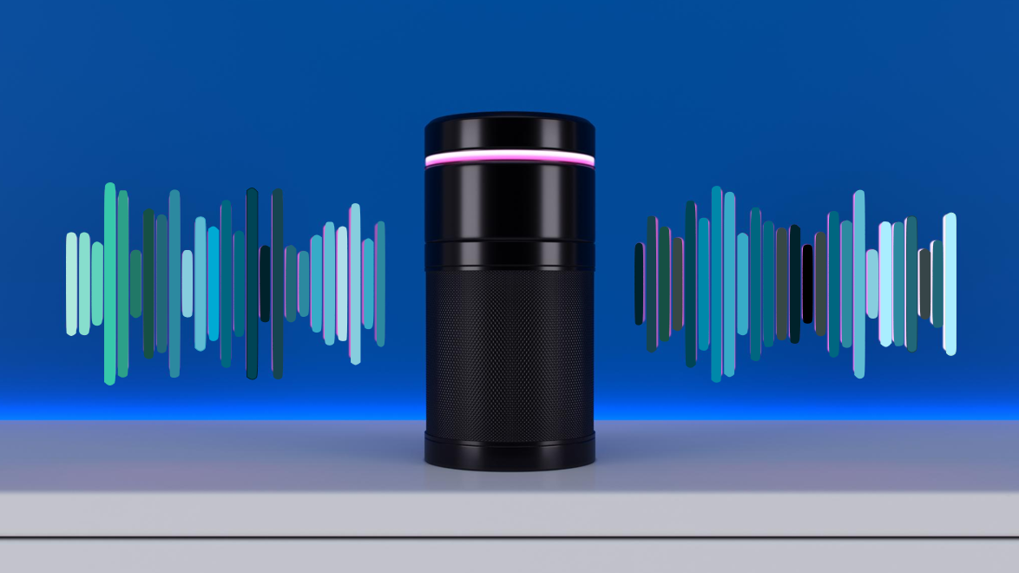


ClariVoice – AI-Based Voice Recorder for Automated Meeting Summaries
Advanced technology simplifies meeting documentation efficiently
Presenter Olimpiu Robu 2233652
Supervisor Dr Mobolanle Bello
Notes:
Hello, I’m Olimpiu Robu, and I’m presenting my interim viva on ClariVoice.
This project is supervised by Dr. Mobolanle Bello.
ClariVoice is an AI-based voice recorder designed to automate meeting summaries, especially in multilingual workplaces.
Example:
Imagine a company with teams in London, Berlin, and Tokyo. ClariVoice transcribes speech from English, German, and Japanese speakers, summarises the discussion, and translates the summary into each team’s preferred language—all in real time.

Slide 2
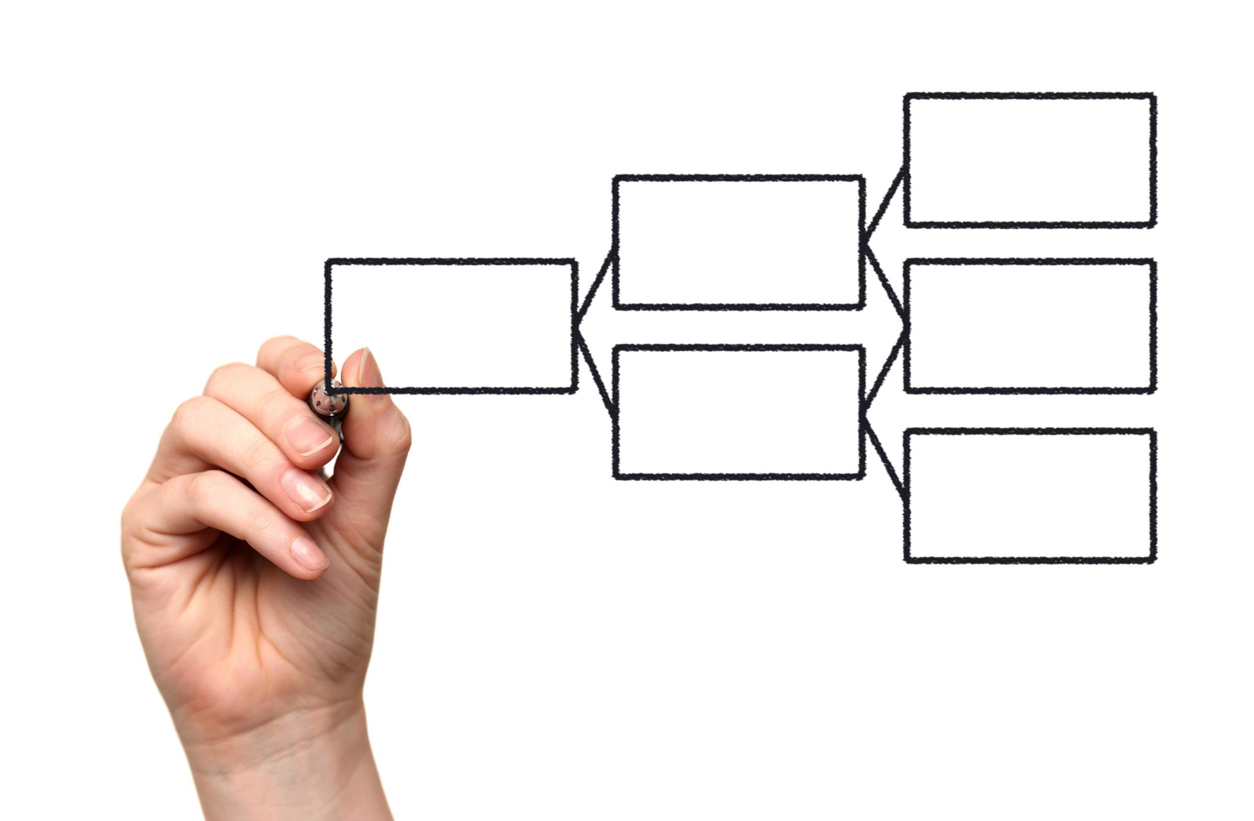
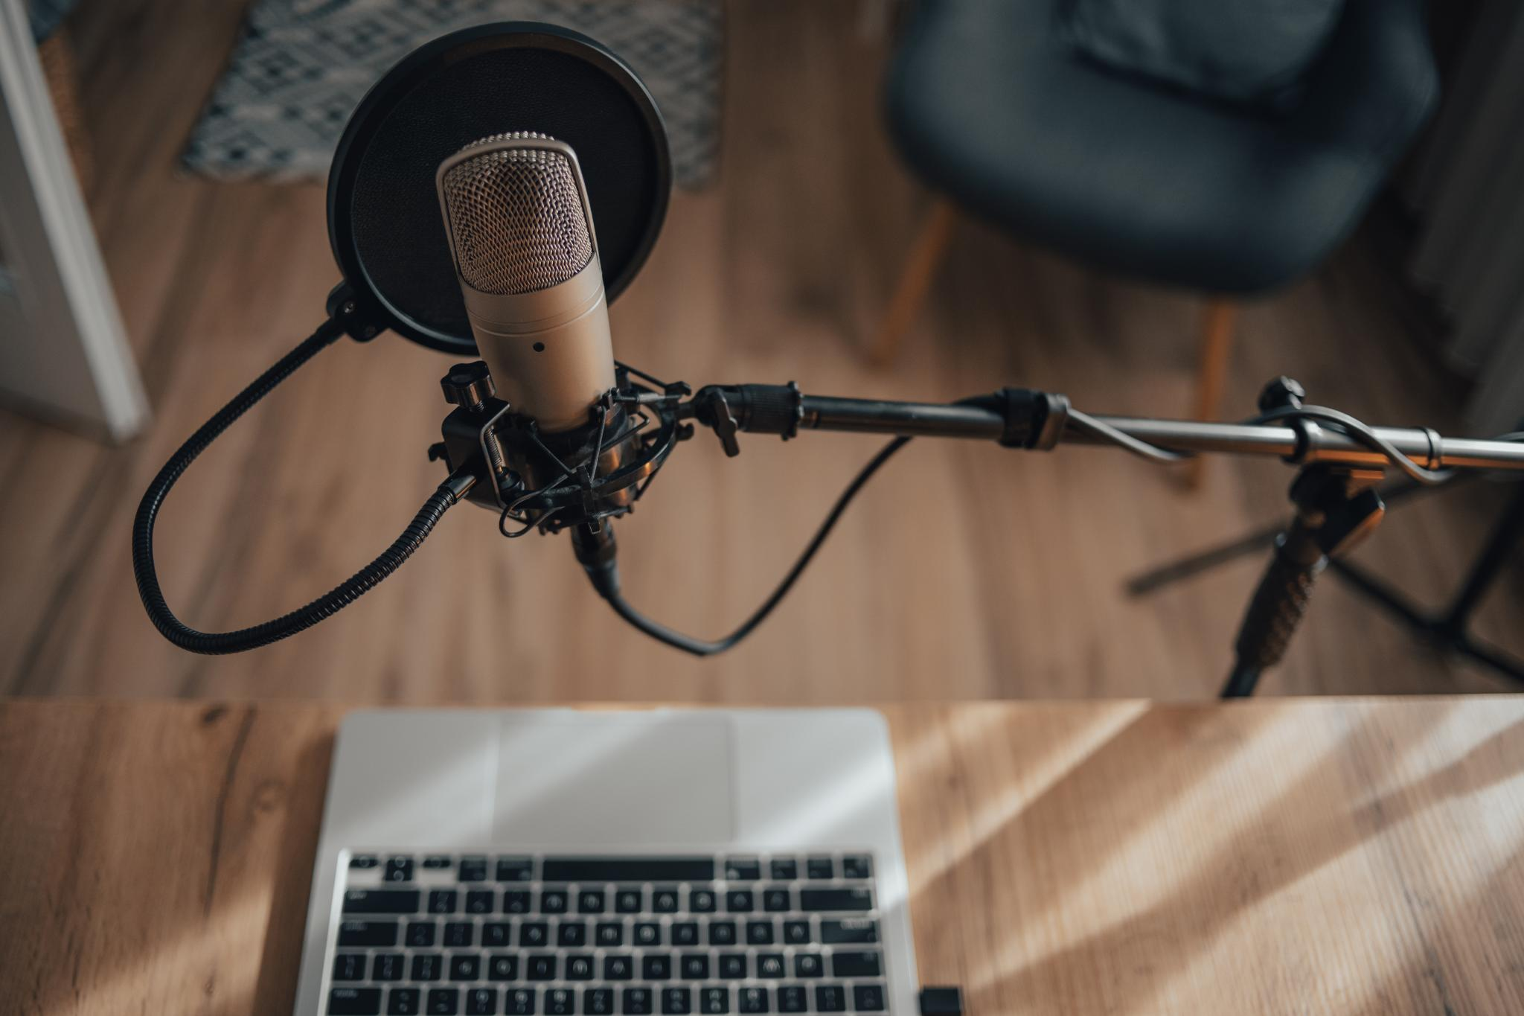
Presentation Overview
Presenter and Supervisor
  The presenter is Olimpiu Robu and the project is supervised by Dr. Mobolanle Bello, establishing academic guidance.
Key Sections Included
  Sections include Introduction, Project Aim, Problem Statement, Literature Review and Table, Methodology, Design and Home Page Mock up, Expected Outcome, Timeline, and Conclusion.
Audience Guidance
  This presentation helps the audience better understand the content and follow the flow effectively.
Credit for images; https://www.freepik.com/mockups#from_element=images-subhome
Notes:
-In this presentation I’ll walk you through the project’s background, problem statement, aims and objectives, methodology, literature review, system design, timeline, and conclusion.
- This structure helps you understand how ClariVoice was conceptualised, developed, and evaluated. It serves as a roadmap for you, helping to understand the flow and key components of the presentation.

Slide 3

Introduction / Background
Communication Challenges
  Traditional notetaking is inefficient and error-prone, especially in multilingual workplace settings.
Role of AI and NLP
  AI and NLP technologies enable real-time automated meeting analysis and summarisation to improve efficiency.
ClariVoice Solution
  ClariVoice is an AI-based voice recorder designed to boost productivity and accessibility in diverse workplaces.
Credit for images https://www.freepik.com/mockups#from_element=images-subhome
Notes:
The introduction highlights the importance of effective communication and information management in modern workplaces. Meetings are essential for collaboration, decision-making, and information sharing, but traditional notetaking methods are inefficient and prone to errors. In multilingual environments, these challenges are exacerbated by language barriers. The rise of AI and Natural Language Processing (NLP) technologies presents an opportunity to address these issues by enabling real-time, automated meeting analysis and summarisation. This background sets the stage for the development of ClariVoice, an AI-based voice recorder designed to enhance productivity and accessibility in diverse workplace settings.
Example:
In a hybrid meeting, one participant speaks Romanian, another speaks English, and a third speaks Spanish. ClariVoice transcribes each speaker’s input, identifies who said what, and generates a summary in English. It can also translate that summary into Romanian and Spanish for each participant.

Slide 4
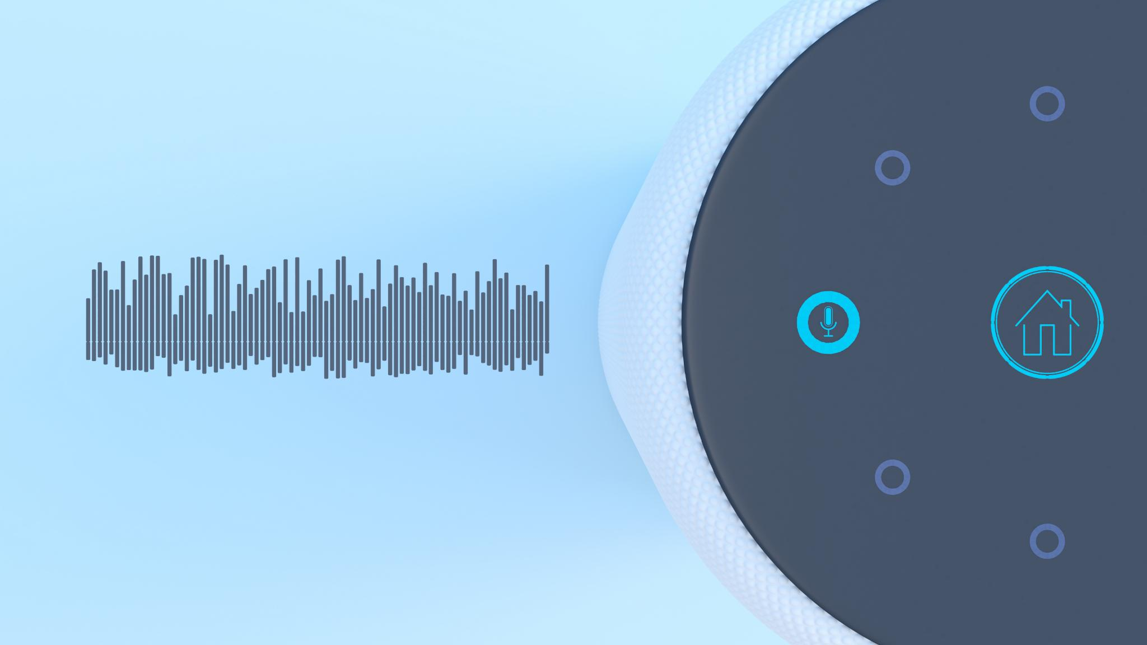
Project Aim & Objectives
AI-Based Voice Recorder
  Design and implement an AI-powered voice recorder that summarizes meetings accurately and concisely.
Multilingual Speech-to-Text
  Develop a robust STT module supporting multiple languages for diverse workplace environments.
Advanced NLP and Summarization
  Implement natural language processing techniques and a multi-stage summarization framework for content analysis.
User Interface and Audio Feedback
  Design an intuitive user interface with Text-to-Speech for providing audio summaries and feedback.
Credit for image; https://www.freepik.com/pikaso/mockup
Notes:
The aim of the ClariVoice project is to design, implement, and evaluate a prototype AI-based voice recorder capable of generating automated, concise, and accurate summaries of meetings in multilingual workplace environments. The objectives include developing a robust multilingual Speech-to-Text (STT) module, implementing advanced NLP techniques for content analysis, constructing a multi-stage summarisation framework, incorporating multilingual translation capabilities, designing an intuitive user interface, and integrating Text-to-Speech (TTS) functionality for audio feedback. These goals are directly aligned with addressing the identified problem and ensuring that the solution is both functional and user-friendly.
Example:
After a 45-minute meeting, ClariVoice generates a 5-minute summary highlighting decisions like 'approve budget increase' and 'schedule follow-up with marketing.' The summary is available in English and French, and can be played back using TTS.

Slide 5

Problem Statement & Motivation
Inefficient Meeting Information Flow
  Current meetings suffer from poor capture and sharing of critical spoken information, reducing knowledge retention and decision speed.
Challenges in Multilingual Settings
  Multilingual meetings face barriers with inaccurate transcriptions and lack of real-time multilingual support, hindering inclusivity.
Need for Real-time Summarisation
  There is a strong need for tools providing accurate, real-time meeting summaries to boost productivity and accessibility.
https://www.istockphoto.com/search/2/image-film?phrase=business+and+finance
Notes:
The primary problem addressed by ClariVoice is the inefficient capture, processing, and dissemination of critical information from spoken meetings, especially in multilingual environments. This leads to decreased knowledge retention, delayed decision-making, and barriers to inclusive communication. Existing solutions often lack real-time capabilities, accurate transcription across languages, and comprehensive summarisation features. The motivation behind ClariVoice is to improve workplace productivity and inclusivity by providing a tool that can generate accurate, real-time summaries of meetings, handle diverse linguistic inputs, and offer accessible insights. This slide emphasises the need for such a solution and the potential impact it can have on organizational efficiency.
- Spoken information in meetings is often lost or poorly documented.
- Manual transcription is slow and inconsistent.
- Multilingual meetings suffer from inaccurate transcriptions and lack of real-time translation.
- Existing tools don’t offer integrated solutions for speaker identification, summarisation, and multilingual support.
Example:
A project manager in a multinational firm struggles to understand meeting notes from a team in India due to inconsistent transcription. ClariVoice solves this by providing accurate, speaker-tagged summaries in the manager’s native language.

Slide 6

Literature Review
Limitations of Existing Tools
  Current tools lack features such as speaker recognition, non-verbal vocalisation capture, and effective summarisation.
Focus of LinguaFusion
  LinguaFusion targets multilingual video dubbing rather than providing summarisation capabilities.
DialogLM Characteristics
  DialogLM excels in long dialogue summarisation but lacks integration with speech-to-text and user interfaces.
Advantages of ClariVoice
  ClariVoice integrates speaker identification, robust multilingual STT, and comprehensive summarisation, overcoming prior tool limitations.
https://www.freepik.com/templates#from_element=images-subhome
Notes:
The literature review compares ClariVoice with existing tools and systems. Vink is an open-source STT tool that lacks speaker recognition and omits non-verbal vocalisations. LinguaFusion is a multilingual video translator focused on dubbing rather than summarisation. DialogLM is a pre-trained model for long dialogue summarisation but lacks STT integration and a user interface. Voice Note Taking is a mobile app with lower accuracy in noisy environments. ClariVoice improves upon these by integrating speaker identification, robust multilingual STT, and comprehensive summarisation capabilities. This review highlights the novelty and advantages of ClariVoice in addressing current limitations in the field.
Example:
Unlike Vink, which might transcribe 'Okay, let’s move on' without identifying the speaker, ClariVoice tags it as 'Manager: Okay, let’s move on,' preserving context and accountability.

Slide 7
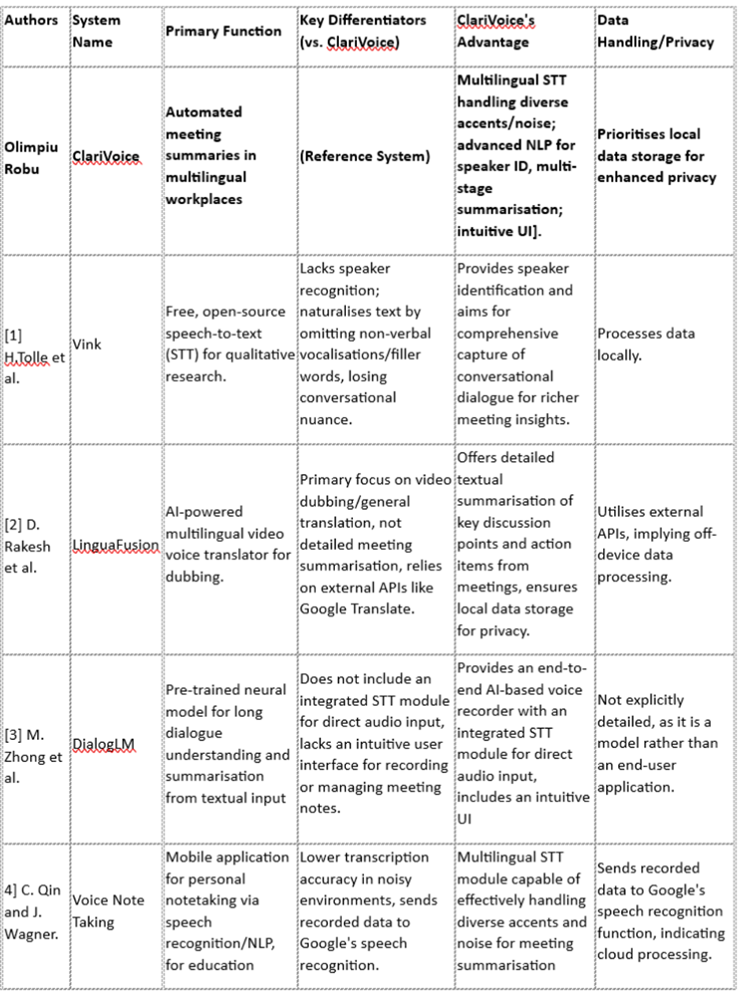

Literature Review
https://www.freepik.com/templates#from_element=images-subhome
Notes:
- Vink uses Whisper but lacks speaker recognition and omits non-verbal cues.
- LinguaFusion focuses on video dubbing, not meeting summarisation.
- DialogLM handles long dialogues but doesn’t integrate STT or offer a user interface.
- Voice Note Taking is useful for students but struggles in noisy environments.
- ClariVoice integrates speaker identification, robust multilingual STT, and comprehensive summarisation.

Slide 8

Methodology
Agile Development Approach
  The project uses Agile methodology with short, iterative sprints to enable rapid feature development and flexible adaptation.
Technology Stack Components
  Backend development uses Python; ASR by Vosk; NLP through SpaCy and NLTK; UI with HTML and Css; SQLite for storage; TTS via Google.
System Architecture Workflow
  Audio input is processed by ASR and NLP modules, summarised, then played back with TTS, ensuring privacy with local storage.
Benefits of Methodology
  Supports rapid prototyping, continuous feedback, and flexible adjustments to overcome challenges effectively.
https://www.freepik.com/templates#from_element=images-subhome
Notes:
The project follows an Agile development methodology, allowing for iterative progress through short sprints focused on specific features.
The technology stack includes Python for backend development, Vosk for ASR, SpaCy and, HTML AND CSS for cross-platform UI design, SQLite for local data storage, and Google TTS for audio playback.
The system architecture involves capturing audio input, processing it through ASR and NLP modules, generating summaries, and providing playback via TTS. Local storage ensures data privacy and low-latency access. This methodology supports rapid prototyping, continuous feedback integration, and flexible adaptation to emerging challenges.
- This stack ensures scalability, privacy, and accessibility.

Slide 9
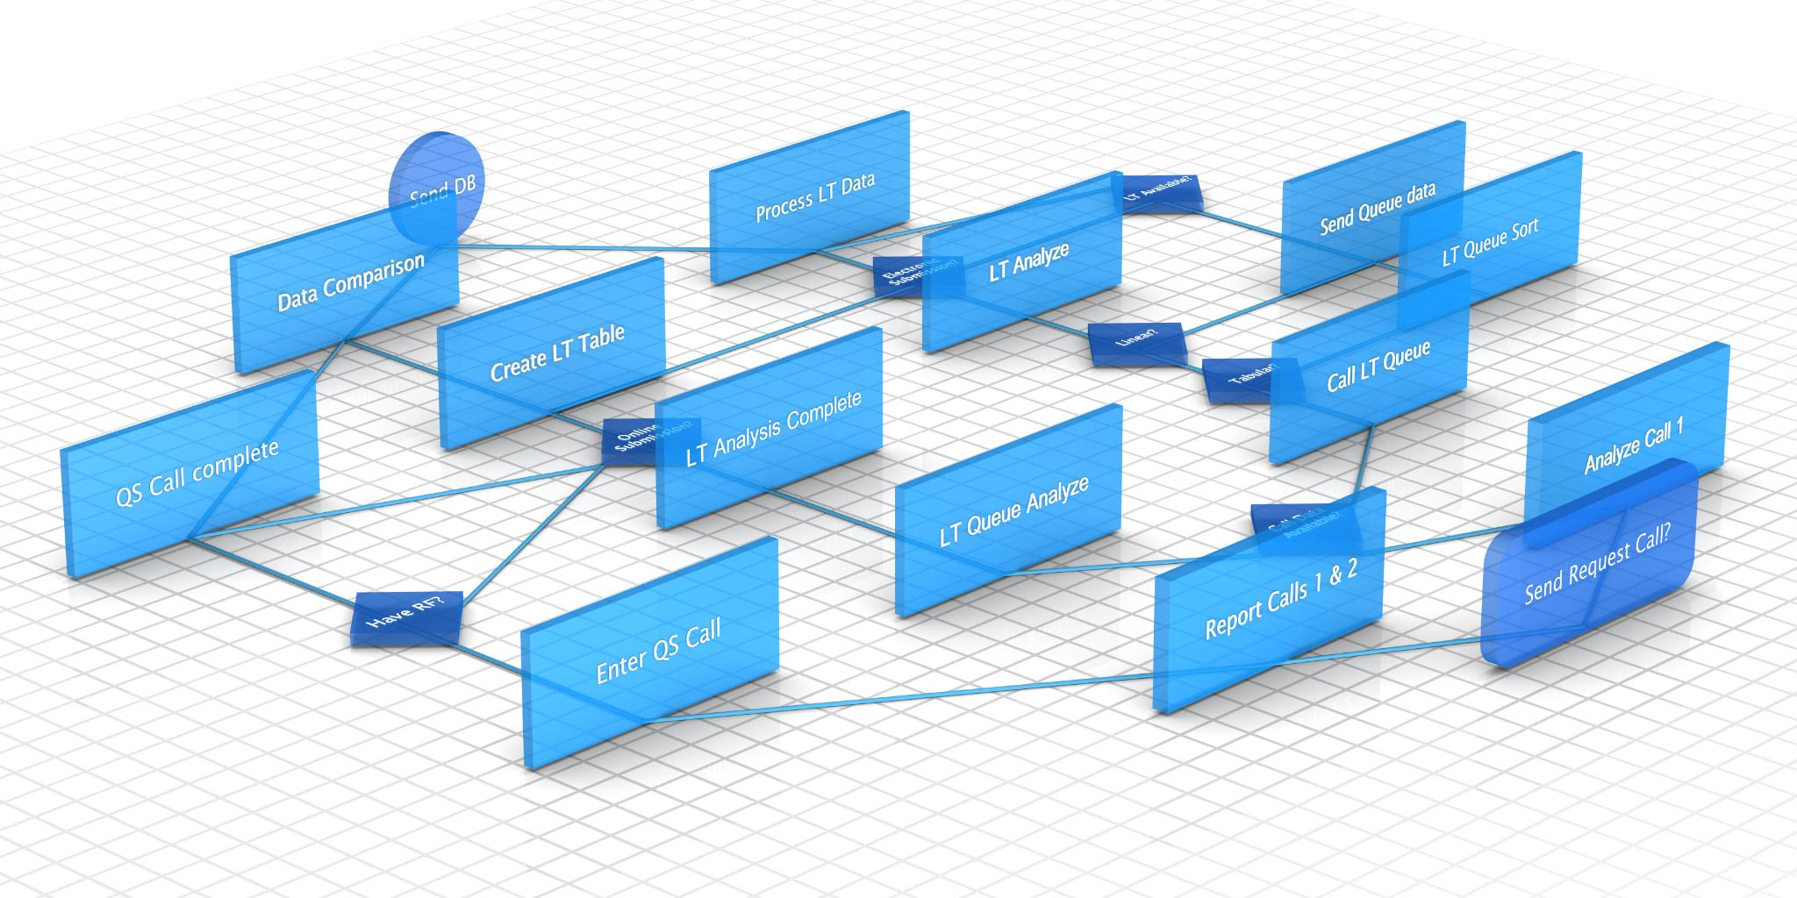
Design Overview
Audio Capture and Transcription
  Audio is captured via microphone and transcribed using Vosk for accurate speech-to-text conversion.
NLP Analysis
  Transcribed text undergoes sentiment analysis, keyword extraction, and summarization using NLP techniques.
Data Storage and Access
  Summarised content is stored locally in SQLite and accessed through a user interface.
User Interaction and Playback
  Users can record, edit, search, and playback summaries using Google Text-to-Speech technology.
https://www.freepik.com/templates#from_element=images-subhome
Notes:
The design overview presents the system architecture of ClariVoice.
The process begins with capturing audio via a microphone, followed by preprocessing and transcription using Vosk.
The transcribed text is then analyzed using NLP techniques for sentiment analysis, keyword extraction, and summarisation. The summarised content is stored locally in SQLite and can be accessed through an intuitive UI. Users can record, edit, search, and playback summaries using Google TTS. A conceptual flowchart illustrates the data flow and module interactions. This design ensures a seamless and efficient user experience while maintaining data privacy and supporting multilingual capabilities.
Example:
A user records a brainstorming session. Later, they search for the term 'launch date' and ClariVoice highlights the sentence: 'We agreed to launch the product on November 15th.'

Slide 10
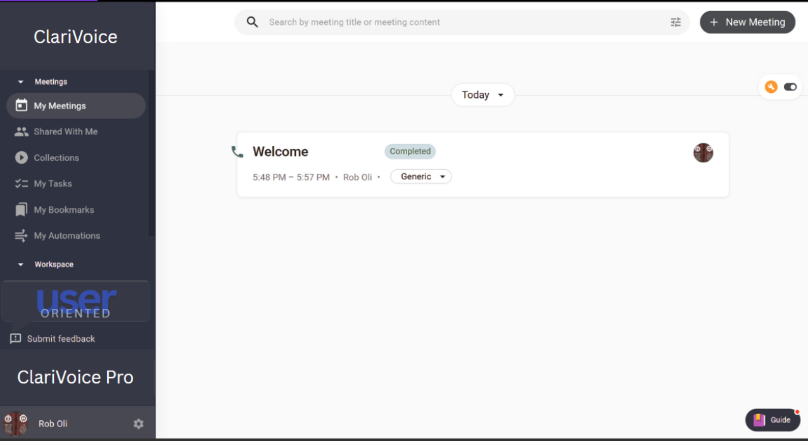
Notes:
ClariVoice Home page
- This is the main interface where users can start recordings, view summaries, and access past sessions.
- The design prioritises simplicity and accessibility.

Slide 11
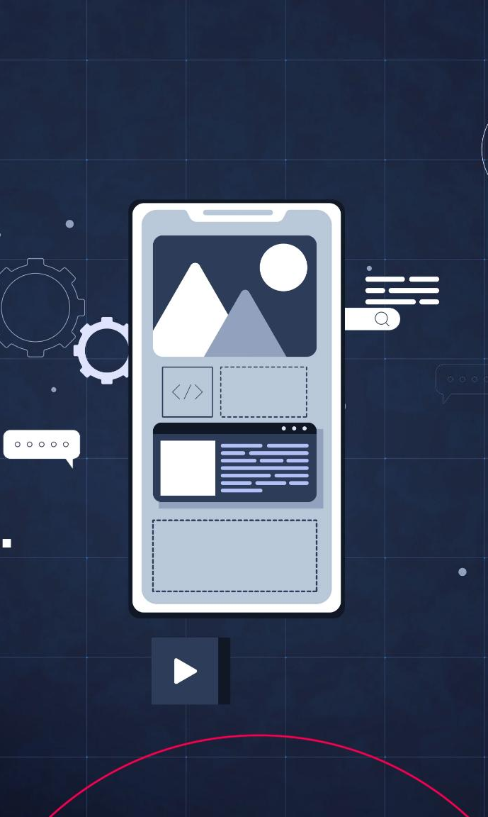
Expected Outcomes
Multilingual Transcription and Summarisation
  The system accurately transcribes and summarises meeting content in multiple languages to enhance understanding and accessibility.
User-Friendly Interface
  Offers a simple and intuitive interface for recording, editing, and retrieving meeting notes for seamless user experience.
Integration of AI Technologies
  Incorporates ASR, NLP, summarisation, and TTS modules to create an efficient architecture for meeting information management.
Impact on Workplace Productivity
  Validates AI's role in improving communication and productivity through efficient meeting content management tools.
https://www.freepik.com/templates#from_element=images-subhome
Notes:
The expected outcomes of the ClariVoice project include a functional prototype capable of accurate multilingual transcription, automated summarisation, and translation of meeting content.
The system will feature a user-friendly mobile interface for recording, editing, and retrieving notes, along with TTS functionality for audio playback.
The architecture will integrate ASR, NLP, summarisation, and TTS modules, providing clear performance metrics. These outcomes validate the feasibility of using AI and NLP for effective meeting information management and demonstrate the potential impact of ClariVoice on workplace communication and productivity.
- Improve workplace communication and decision-making.
Example:
A company uses ClariVoice to archive weekly team meetings. Each summary is stored locally and exported as a PDF for internal documentation, reducing manual effort by 80%.

Slide 12
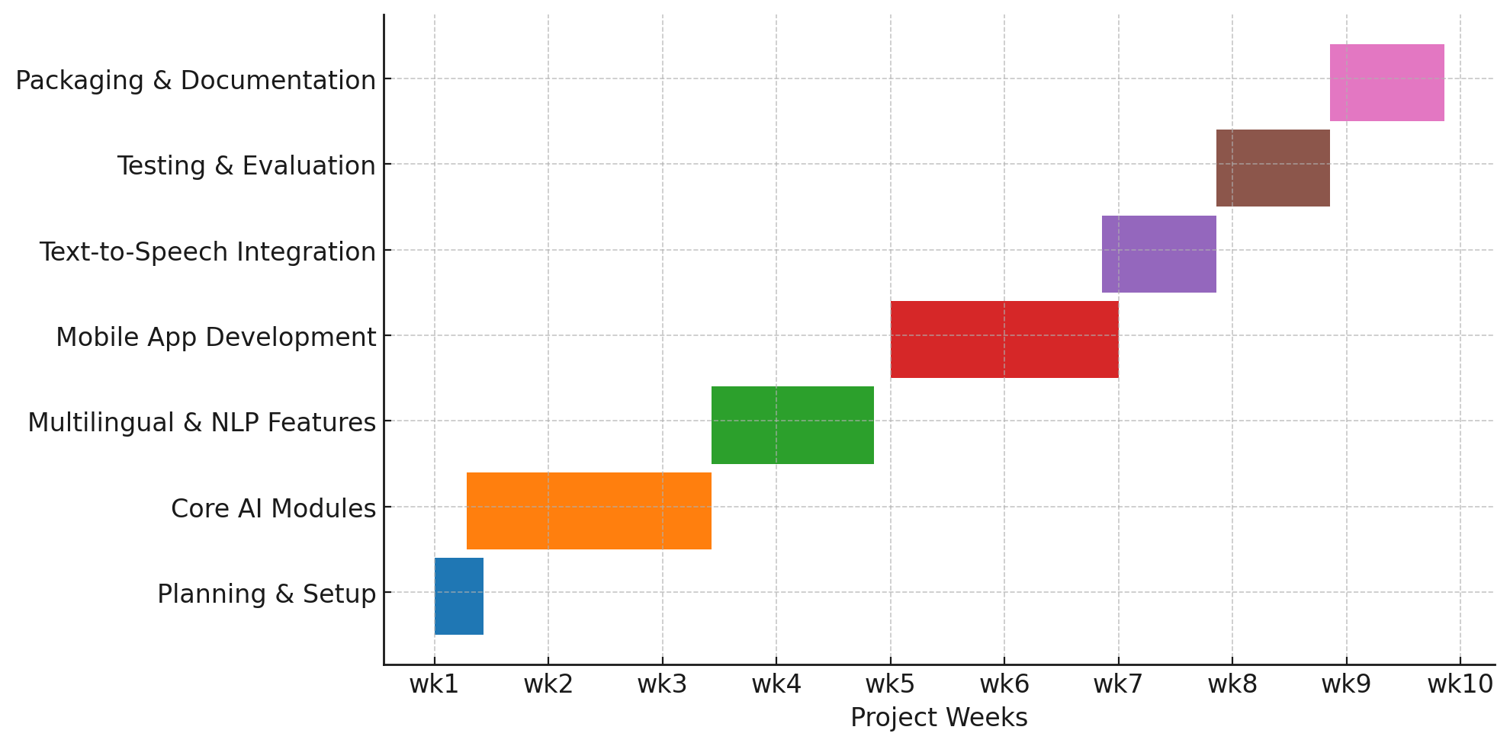
Project Timeline
Structured Project Phases
  The project spans 10 weeks divided into phases: research, development, testing, and evaluation.
Visual Scheduling with Gantt Chart
  This Gantt chart visually represents the schedule highlighting key milestones and current progress.
  Progress Tracking
  In week 3 the research phase was concluded, and the development phase is started.
Notes:
The project is structured across a 10-week timeline, divided into phases such as research, development, testing, and evaluation.
A Gantt chart visually represents the schedule, highlighting key milestones and current progress.
Each phase is designed to build upon the previous one, ensuring a coherent and systematic development process.
The timeline helps in tracking deliverables, managing resources, and maintaining focus on project objectives.
By presenting this timeline, the slide demonstrates the feasibility and planning behind the project, reinforcing its structured approach and readiness for interim evaluation.

Slide 13

Conclusion
Addressing Multilingual Challenges
  ClariVoice solves communication barriers in multilingual meetings using advanced AI technologies for inclusivity.
Integration of AI, NLP, and TTS
  The project combines artificial intelligence, natural language processing, and text-to-speech for seamless communication.
Enhancing Workplace Productivity
  Real-time, accurate meeting summaries improve organizational efficiency and decision-making processes.
Innovation and Societal Impact
  ClariVoice highlights technological innovation with significant benefits for modern organisational communication.
Image credited; https://www.istockphoto.com/search/2/image-film?phrase=Abstract%20coding
Notes:
The conclusion reiterates the significance of ClariVoice in addressing challenges faced in multilingual meeting environments.
By combining AI, NLP, and TTS technologies, the project offers a comprehensive solution for efficient and inclusive communication.
The prototype demonstrates the potential to transform workplace productivity by enabling accurate, real-time meeting summaries.
This slide emphasizes the innovation and societal impact of the project, reinforcing its relevance and value in modern organizational contexts.
Example:
A remote team in a healthcare startup uses ClariVoice to summarise clinical meetings. The summaries help doctors quickly review decisions and improve patient care coordination.

Slide 14

References
[1] H. Tolle, M. d. M. Castro, J. Wachinger, A. Z. Putri, D. Kempf, C. M. Denkinger and S. A. McMahon. From voice to ink (vink): Development and assessment of an automated, free-of-charge transcription tool. BMC Research Notes BMC Research Notes 1717(1), pp. 95. pp. 95. 2024. .
[2] D. Rakesh, D. P. Raj Sandesh and V. Nirmalrani LinguaFusion: AI-powered multilingual video voice translator. Presented at 2025 7th International Conference on Intelligent Sustainable Systems (ICISS). 2025, . DOI: 10.1109/ICISS63372.2025.11076313.
[3] M. Zhong, Y. Liu, Y. Xu, C. Zhu and M. Zeng. Dialoglm: Pre-trained model for long dialogue understanding and summarization. Presented at Proceedings of the AAAI Conference on Artificial Intelligence. 2022, .
[4] C. Qin and J. Wagner. An intelligent mobile application to assist in taking mathematical notes using speech recognition and natural language processing. Presented at CS & IT Conference Proceedings. 2023, . DOI: 10.5121/csit.2023.130919.
[5] K. S. Brahmachari, M. Hanumesh, G. Anitha and B. Pattanaik. Efficient meeting insights: NLP-enhanced summarization of voice and text. Presented at 2024 15th International Conference on Computing Communication and Networking Technologies (ICCCNT). 2024, . DOI: 10.1109/ICCCNT61001.2024.10725706.
Image credited; https://www.istockphoto.com/search/2/
Notes:
Thank You. And Q&A

