Slide 1



Assignment Title
Marketing Management (LCMB7001_BIRM)
Student name:mohammed kamruzzaman student ID:2237652

Slide 2
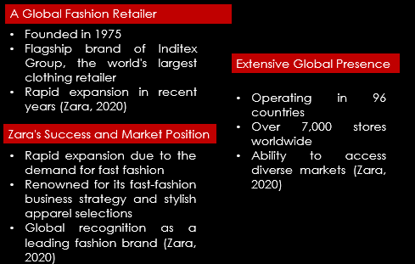
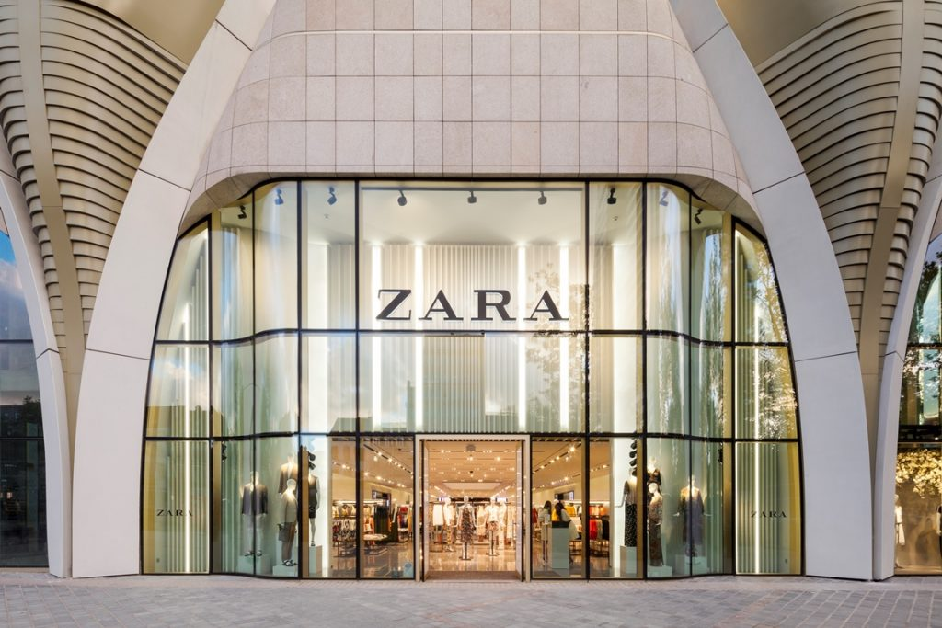
Introduction
Notes:
Spanish global apparel store Zara was established in 1975. The largest clothes retailer in the world, Inditex Group, employs it as its flagship brand. Successful company Zara has expanded quickly in recent years. As long as there is a demand for fast fashion, Zara will be in a good position to expand. In 96 countries, Global fashion retailer Zara is renowned for its fast-fashion business strategy and stylish apparel selections. Zara enjoys a substantial edge over its rivals due to its global recognition as one of the leading fashion brands. Zara has more than 7,000 stores. As a result, it has a global reach and may access a variety of markets (Zara, 2020).

Slide 3


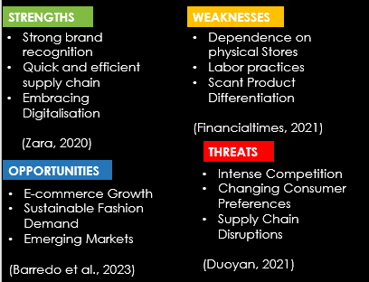
Notes:
Here are the following internal factors that are identified by using SWOT that are driving Zara's global business environment in the post-pandemic era:
Strengths:
========
Strong Brand Identity:
Zara is considered as the most recognisable fashion brand due to its fast-fashion offerings and trendy designs which is a significant advantage over Zara's competitors .
Quick and efficient supply chain:
Short response to market demands is made possible by Zara's vertically integrated supply chain, which enables short turnaround from design to shop shelves.
Embracing Digitalisation:
Zara has assimilated the digitalisation for its online platforms more effectively specially after pandemic leading to increase its digital presence and e-commerce.
skills. (Zara, 2020)
Weaknesses:
==========
Dependence on physical stores:
Heavy dependency of Zara on physical stores makes it vulnerable in the events of lockdowns during pandemic.
Labour Practices:
For its employment practices, Zara has drawn criticism. The business is charged with operating sweatshops and giving its employees low wages.
Scant Product Differentiation:
Zara's capacity to offer distinctive and exclusive products in comparison to rivals may be constrained by the fast-fashion business model, which could result in price-based rivalry (Financialtimes, 2021).
Opportunities:
==========
E-commerce Growth:
By increasing its online presence and making digital investments, Zara can expand its consumer base and capitalise on the expanding online shopping trend.
Sustainable Fashion Demand:
Fostering Zara's sustainability practices and advertising them as a major differentiator would help the company take advantage of the growing consumer demand for environmentally friendly and sustainable fashion.
Emerging Markets:
Discovering new markets, particularly in emerging nations where there are prospects for expansion due to increased disposable budgets and fashion-conscious populace (Duoyan, 2021).
Threats:
========
Intense Competition:
Zara must constantly innovate to maintain its place in the market given the severe competition it confronts from both conventional retailers and online fashion platforms.
Changing Consumer Preferences:
Zara's fast-fashion business model may face difficulties if consumer attitudes and shopping behaviour change in favour of more ethical and sustainable fashion options.
Supply Chain Disruptions:
Any interruptions to the global supply chain, such as pandemic, labour shortages, natural disasters, or trade conflicts, may affect Zara's capacity to continue running efficiently and delivering goods on schedule.

Slide 4

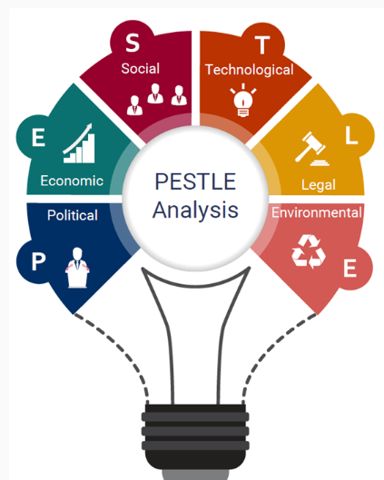
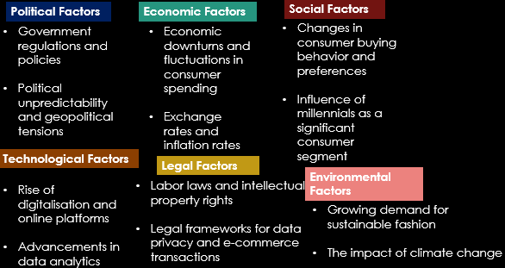
(Gracia, 2022; Jain, 2022; Aftab et al., 2018; Zara, 2020; Barredo et., 2023)
Notes:
Identifying Zara’s External Factors through SWOT Analysis
Political Factors:
Zara's business operations and supply chain may be impacted by government regulations and policies regarding labour laws, commerce, and international relations.
Zara's aspirations to expand in specific locations may be impacted by shifts in governmental stability and geopolitical conflicts (Gracia, 2022).
Economic Factors:
Consumer spending alterations and economic downturns may have an impact on Zara's sales and profitability.
The price and profitability of Zara in international markets may be impacted by exchange rates and inflation rates in various nations (Jain, 2022).
Sociocultural Factors:
In order to remain competitive, Zara must modify its product lineup and marketing plans in response to shifts in consumer purchasing patterns, preferences, and fashion trends.
Zara's marketing strategies and target market are influenced by the emergence of millennials as a sizable consumer demographic (Aftab et al., 2018).
Technological Factors:
Zara must invest in online platforms, e-commerce capabilities, and information systems in order to conduct efficient marketing and business operations given the ongoing increase of digitalisation.
The effectiveness and consumer experience of Zara can be improved by technological breakthroughs in fields like data analytics, AI, and supply chain management (Zara, 2020).
Legal Factors:
For Zara to operate in several markets, compliance with labour laws, intellectual property rights, and consumer protection legislation is crucial.
The legal frameworks governing e-commerce and data protection have an impact on Zara's online business (Barredo et., 2023).
Environmental Factors:
Zara is required to adopt environmentally friendly procedures and promote sustainability throughout its value chain due to the rising demand for "green" and sustainable fashion.
Zara might need to close stores or move production facilities if extreme weather events start to happen more frequently (Zara, 2020).

Slide 5

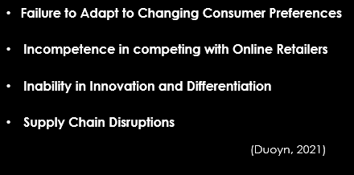
Notes:
Failure to Adapt to Changing Consumer Preferences:
Zara risks losing relevance and market share if it does not adapt its product lineup and marketing plans to evolving consumer preferences, such as a move towards sustainable fashion or modifications in consumer behaviour (Duoyn, 2021).
Incompetence in competing with Online Retailers:
According to Duoyn (2021), Zara may face difficulties as a result of the growth of internet shopping and growing competition from e-commerce behemoths. Customers may switch to online retailers if the business is unable to successfully compete in the online market.
Inability in Innovation and Differentiation:
Duoyn (2021) identified that Zara may lose market share to more creative and trend-setting rivals if it struggles to consistently innovate and differentiate its goods, styles, and customer experiences.
Supply Chain Disruptions:
Zara's capacity to meet client requests could be impacted by any disruptions in its supply chain, such as difficulties with sourcing, production delays, or logistical problems, which could lead to lost sales and unsatisfied customers (Duoyn, 2021).

Slide 6



Notes:
Zara Allocating Resources to Meet the Current Challenges Within its Environment
Technological Advancements:
Zara is continuously investing resources in terms of technology with the intention to enhance operational efficiency and customer experience such as data analytics, advanced point-of-sale system and improving its online shopping platforms (Aftab et al., 2018).
Employee Training and Development:
Aftab (2018) identified that allocating resources to Zara's R&D ensure a highly skilled and knowledgeable workforce by inducting training sessions, industry trends, and product knowledge.
Sustainability Initiatives:
Zara heavily invest resources to implement eco-friendly practices in production, sourcing sustainable materials, and promoting recycling programs (Aftab et al., 2018).

Slide 7

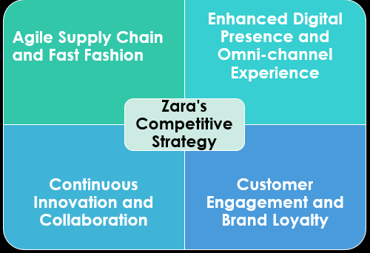
Notes:
Agile Supply Chain and Fast Fashion:
Zara may leverage its agile-supply chain by promptly acknowledging the evolving market trends to deliver new collections to stores. It may offer Zara an edge over its competitors in terms of providing latest fashion trends results in reduce time to market (Barredo et al., 2023).
Enhanced Digital Presence and Omni-channel Experience:
Zara can surely enhance its online shopping experience by equipping its e-commerce platform, leveraging data analytics , and to personalize customer experiences. This may lead to provide a seamless integration between online and offline channels (Financialtimes, 2021).
Continuous Innovation and Collaboration:
Zara can capitalise its culture of constant creativity and collaboration among its design teams. It can be possible if Zara collaborates with designers, artists, or other brands can introduce fresh perspectives and unique collections to stay ahead of the competition (Garcia, 2022).
Customer Engagement and Brand Loyalty:
Zara can effectively establish strong customer relationships through loyalty programs, personalized communication, and exclusive offer. It can be achieved through influencers, social media, and community initiatives leading to uplift brand loyalty and results in creating a sense of community around the Zara brand (Jain, 2022).

Slide 8

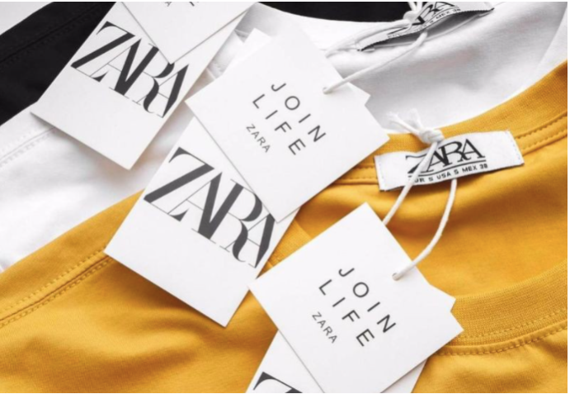
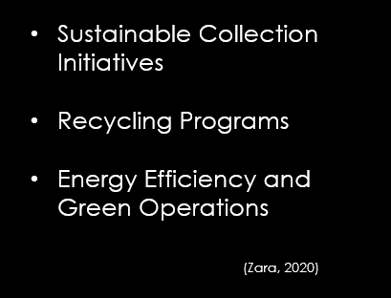
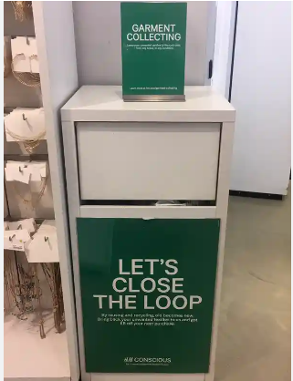

Notes:
Sustainable Collection Initiatives:
The introduction of "Join Life" collection by Zara shows its efforts towards CSR policies which is make from eco-friendly, recycled, and organic materials (Zara, 2020).
Recycling Programs:
Zara has placed "Closing the Loop" collection points in several of its stores which offer convenience to its customers to discard their unwanted clothing to reuse and recycle (Zara, 2020).
Energy Efficiency and Green Operations:
Zara has taken initiatives to execute energy-efficient efforts in its stores and distribution centers. For example environmentally friendly store designs, smart energy management systems, and the utilisation of LED lighting (Zara, 2020).

Slide 9

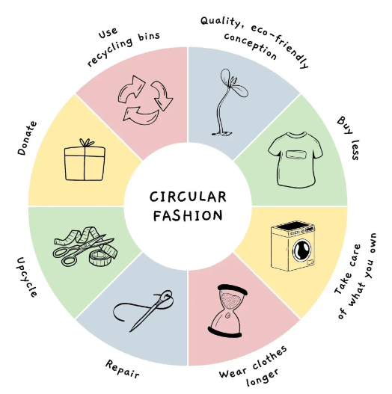

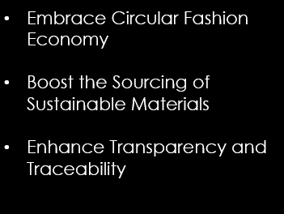

Notes:
Embrace Circular Fashion Economy:
Improve Zara's recycling programs to promote consumer participation, circular fashion, and a commitment to sustainability.
Boost the Sourcing of Sustainable Materials:
Increase the use of eco-friendly materials in Zara's products by working with suppliers and encouraging research and development for new eco-friendly textiles
Enhance Transparency and Traceability:
Increase supply chain transparency by disclosing thorough data on manufacturing, sourcing, and environmental effects. Use blockchain technology for ethical behaviour and traceability.

Slide 10
References
Aftab, M.A., Yuanjian, Q., Kabir, N. and Barua, Z., 2018. Super responsive supply chain: The case of Spanish fast fashion retailer Inditex-Zara. International Journal of Business and Management, 13(5), pp.212-227.
Barredo, B.R., González-Valerio, B.G. and Critikián, D.M., 2023. Zara Joins the Trends: Analysis of Its Content Creation Within the Framework of Its Business Strategy. In Handbook of Research on Digitalization Solutions for Social and Economic Needs (pp. 274-289). IGI Global.
Duoyan, H., 2021, April. Research on ZARA strategy from the perspective of SWOT analysis method. In 2021 6th international conference on social sciences and economic development (ICSSED 2021) (pp. 201-205). Atlantis Press
Financialtimes, 2021. Zara-owner Inditex posts record results but Omicron casts shadow. [online] @FinancialTimes. Available at: https://www.ft.com/content/017d1eae-d719-4560-9dd0-a0f7478dc7d3 [Accessed 7 July. 2023].
Garcia, C. 2022. Porter’s Five Forces Analysis of Zara. [online] Konsyse.com. Available at: https://www.konsyse.com/articles/porters-five-forces-analysis-of-zara [Accessed 7 July. 2023].
Jain, A. 2022. Business Plan of Zara. [online] Investor Guruji. Available at: https://investorguruji.com/business-plan-of-zara/ [Accessed 7 July. 2023].
Zara, 2020. ZARA Official Website. [online] Zara.com. Available at: https://www.zara.com/ [Accessed 7 July. 2023].

