Slide 1
Enhancing Database Design
Notes:
explore indexing in databases and how it can improve query performance. By the end of this lecture, you’ll understand what an index is, how it works, how to create one, and how it helps your queries run faster

Slide 2
Objectives
Indexing & Performance Tuning in Databases
How to speed up queries and optimize operations
Dropping and Managing Indexes

Slide 3

What is an Index?
An index is a data structure that improves the speed of data retrieval
Notes:
a special data structure that allows the database to find data without scanning every row in a table. Think of it like the index at the back of a book. When you want to find a topic, you don’t read the entire book – you go straight to the page numbers listed in the index. Similarly, a database index lets you quickly locate rows matching a condition without scanning the whole table.

Slide 4
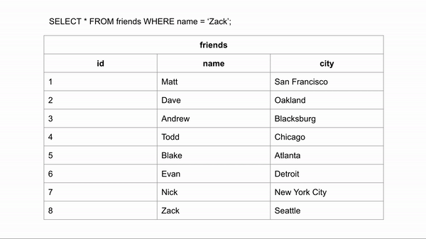
Why Indexing Matters
Large tables → full table scans are slow
Performance-critical queries benefit from indexes

Slide 5
Creating an Index for Products table
CREATE TABLE products (
id INT AUTO_INCREMENT PRIMARY KEY,
name VARCHAR(100),
category VARCHAR(50),
price DECIMAL(10, 2)
);

Slide 6
INSERT INTO products (name, category, price) VALUES
('Laptop', 'Electronics', 999.99),
('Smartphone', 'Electronics', 499.99),
('Desk Chair', 'Furniture', 150.00),
('Coffee Table', 'Furniture', 200.00),
('Headphones', 'Electronics', 89.99),
('Monitor', 'Electronics', 299.99),
('Bookshelf', 'Furniture', 120.00);

Slide 7
Creating Indexes
Index Name
CREATE INDEX idx_category ON Products(category);
Multi-column example:
CREATE INDEX idx_category_price ON Products(category, price);
This index helps queries filtering by both category and price
Notes:
creating a simple index on the category column of our Products table.“
Now queries filtering by category will use this index if it improves performance

Slide 8
Dropping & Managing Indexes
DROP INDEX idx_category ON Products;
check existing indexes using:
SHOW INDEXES FROM Products;
Maintenance of indexes:
OPTIMIZE TABLE Products1;
rebuilds the table and its indexes.
Notes:
Sometimes, you may need to remove an index, for example if it’s not being used or it slows down inserts/updates.
Maintenance of indexes is important in large tables, such as running OPTIMIZE TABLE or re-indexing after massive updates

Slide 9
Using Indexes in Queries
Indexes improve the performance of queries that use WHERE, JOIN, ORDER BY, and GROUP BY clauses
Example 1: Filter by category
SELECT * FROM Products WHERE category='Electronics';
Example 2: Sort by price
SELECT * FROM Products ORDER BY price DESC;
Example 3: Composite index filter
SELECT * FROM Products
WHERE category='Electronics' AND price>100;
Notes:
All these queries can benefit from single or multi-column indexes."

Slide 10
EXPLAIN ANALYZE
SELECT * FROM students WHERE age > 18;
Index Scan using idx_students_age on students
(cost=0.15..8.17 rows=1 width=32)
(actual time=0.005..0.007 rows=1 loops=1)
Index Cond: (age = 20)

Slide 11
Performance Considerations
They consume storage and slightly slow down inserts, updates, and deletes because the index must also be updated. They are most useful on:
Large tables
Frequently searched columns
Columns with high selectivity
On small tables, a full scan may actually be faster than using an index.

Slide 12
Further Reading :
Chapter 8 Advanced SQL
Database Systems: A Practical Approach to Design, Implementation, and Management Sixth edition by • Thomas Connolly • Carolyn Begg

