Slide 1
Protect my computer
By Chaudhry Badar Munir Mehar
Student 2334056

Slide 2

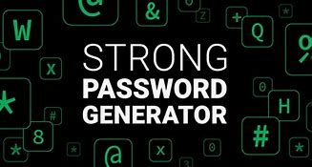
How to protect my computer
Use of strong password
Use and subscribe to a Antivirus software
Do not share your password to anyone
Use only credible website
This Photo by Unknown Author is licensed under CC BY-NC-ND

