Slide 1
LCHS4006 Psychology in Health and Social Care
Individual Presentation-Working with children in a social care setting
Student ID: 2128699
Student Name: JUBLI AKTAR
Lecturer Name: ALICE CLAYTON

Slide 2
Table of Contents
Particulars | Slide Number
Introduction | Slide-3
The Concrete Operation stage of Piaget | Slide-4
Indoors Games Activity for children | Slide-5-6
Fun Learning Activity for children | Slide-7
Conclusion | Slide-8
References | Slide-9

Slide 3
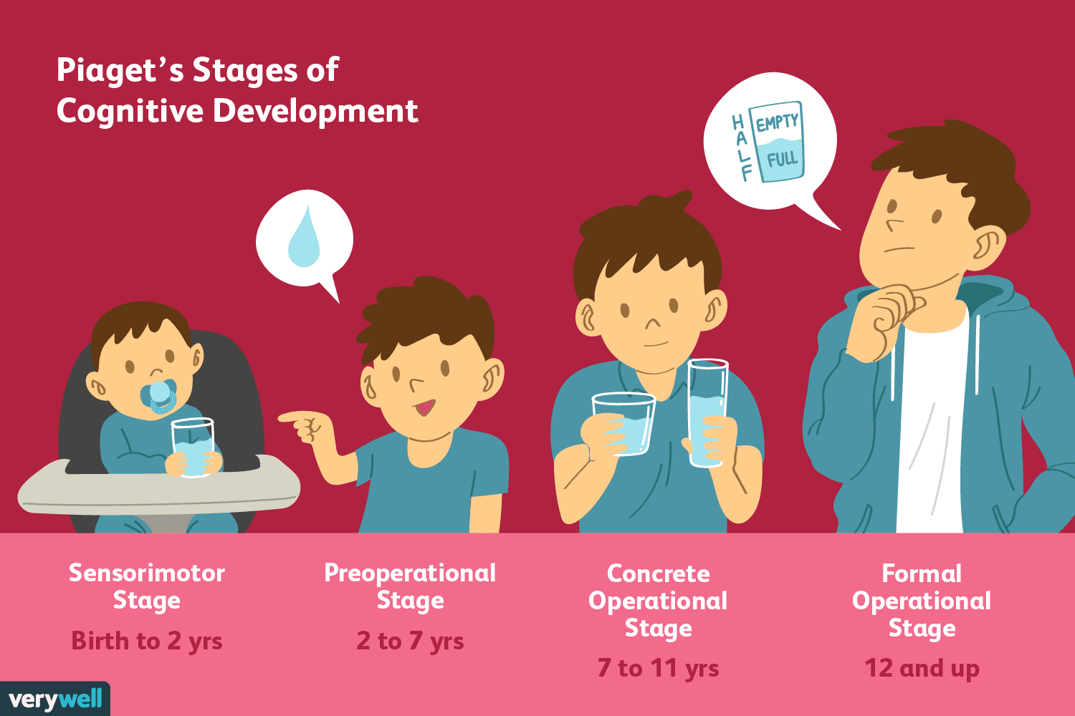

Introduction
I have selected children aged 7 to 11 for two creche activities while their mothers attend support sessions at the women's refuge centre. Children between the ages of 7 and 11 represent the concrete operational stage of Piaget's theory development. I will undertake two creche activities for the children , they are
1. Indoor games activity for children
2. Fun learning activity for children.
(Wadsworth, 2019)

Slide 4
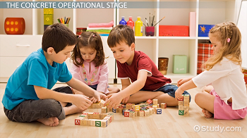
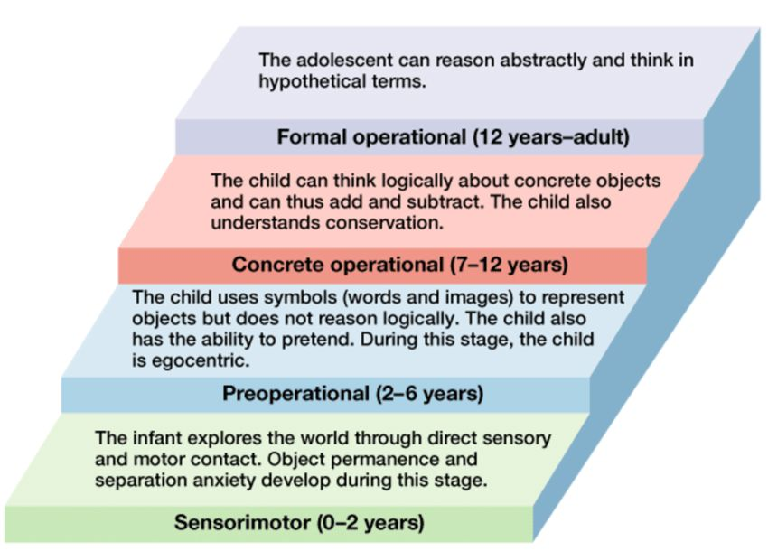
The Concrete Operation stage of Piaget
In this stage, children are-
Less Egocentric
More logical
Begin to reason in a rational, concrete manner
Problem solving with objects
(Cherry, 2020).

Slide 5
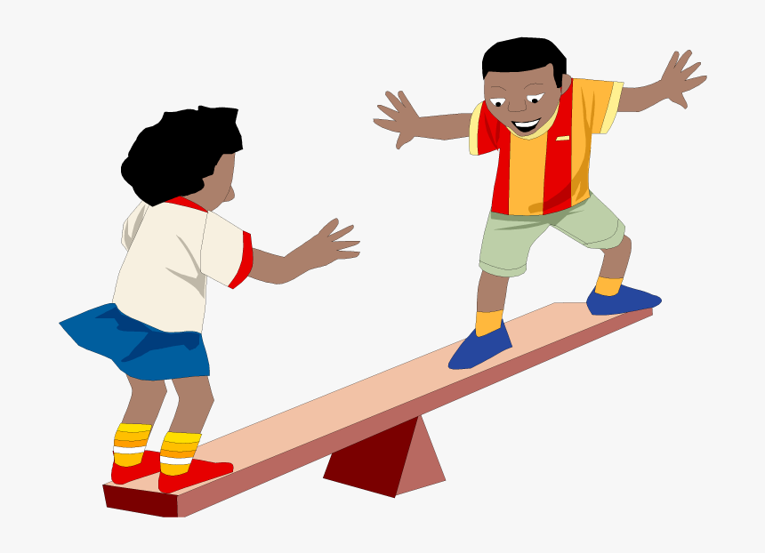


Indoors Games Activity for children
Develop cognitive capabilities
Ability to adapt
Critical thinking
Logic reasoning
Ability to control
(Loris, 2020).

Slide 6




Some Indoors Games for children
Sardines
Paper Aeroplane Race
Sardines is the reverse of hide-and-seek.
Racing the plane
Two Truths and a lie
Geography Game
Determination of True or false
Identify of location
These games are use for concrete operational stage children because they get to practice their problem-solving skills.
(KidsTime, 2022)

Slide 7
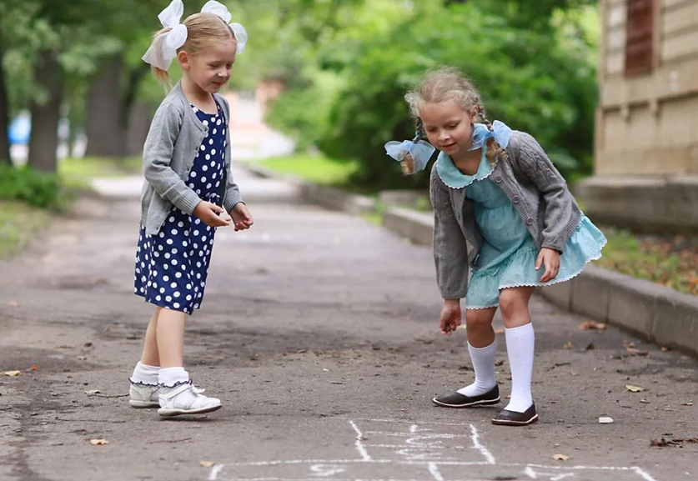



Fun Learning Activity for children
Learning having fun can help Children by-
Some fun learning Activities are-
Acquiring phonic abilities,
Ability of word recognition,
Logical reasoning,
Acquiring of music theory, etc.
Quick Dice activity
Hopscotch
Music with bottles
Food For ants etc.
These fun learning activity will help them to develop their problem solving skills because this is really important for the development at this stages.
(Manota Books, 2020)

Slide 8


Conclusion
I have selected children within the age range of Piaget's concrete operational stages (7-11 years) to provide the services. Therefore, I have decided to conduct two creche activities for children: indoor games and a fun learning activity that will keep them amused and make them more effective at learning and problem solving while having fun.

Slide 9
References
Cherry, K. (2020) Piaget’s 4 stages of cognitive development explained, Verywell Mind. Available at: https://www.verywellmind.com/piagets-stages-of-cognitive-development-2795457 (Accessed: February 9, 2023).
Fun learning activities for 7-11 year-olds (2019) Oxford Owl for Home. Available at: https://home.oxfordowl.co.uk/kids-activities/learning-activities-age-7-8/ (Accessed: February 8, 2023).
KidsTime (2022) “best indoor games for kids aged 7-11 years.” Available at: https://www.mykidstime.com/things-to-do/25-best-indoor-games-kids-aged-8-12-years/ (Accessed: February 8, 2023).
Loris, J. K. (2020) 100 games for children: Easy to follow directions entertaining illustrated indoor and outdoor new and old. Independently Published.
Manota Books (2020) The Everything Kids Learning Activities Book The Everything Kids Learning Activities Book: Entertaining activities and learning games and more for kids -for hours for fun and learning. Independently Published.
Wadsworth, B. J. (2019) Piaget’s theory of cognitive and affective development: Foundations of constructivism (Allyn & bacon classics edition). 5th ed. Upper Saddle River, NJ: Pearson.

