Slide 1

空白演示
Presentation for Research Project
Bowen Yu
2008848
单击输入您的封面副标题

Slide 2
Topic of the Research Project
Analyse the Importance of Crisis Management: Application of Crisis Management Before, During and After the Corporate Crisis.
Key Words: Corporate Crisis, Crisis Management, Corporate Management
Research Questions:
Is Crisis Management still effective to Corporate Crisis?
How to make sure Crisis Management is always effective and important to corporate?

Slide 3
What is Corporate Crisis?
Corporate Crisis is a very urgent situation, which can cause the organization to suffer severe losses and face the worst. (Paraskevas, 2006, Yeha and Coombs, 2017)
Corporate Crisis is a low probability and high impact event. (Paraskevas, 2006, Yeha and Coombs, 2017)
It has ambiguous causality and solutions, so it needs to make relevant decisions quickly. (Paraskevas, 2006, Yeha and Coombs, 2017)
Organizational crises have serious and adverse effects on all aspects of the organization. (Paraskevas, 2006, Yeha and Coombs, 2017)

Slide 4
Tesla Brake Failure and Vehicle Accelerator Out of Control
On December 19, 2019, the National Highway Safety Administration (U.S) received a petition calling for the recall of Tesla Model S, Model X and Model 3 since 2013.
The petition claims that the vehicle will move in a stopped and unmanned state.
86% of the accidents occurred in parking lots, parking lanes or other close "non-traffic" locations.
Almost all "out-of-control acceleration" are short-lived, sudden bursts, and only occur within three seconds.

Slide 5

Nanyang, Henan, China
When a Model 3 encountered a red light, it was suspected of having a braking problem and hit a vehicle waiting for a red light in front.
Model 3 stopped completely after hitting the concrete protective pier on the side of the road.
The two occupants suffered various degrees of damage to their bodies.
The driver shouted before the accident: "Brake failure"
The driver wants Tesla to conduct a full investigation of the vehicle.

Slide 6
Crisis Management
Crisis management is a management theory aimed at Corporate Crisis. (Pearson and Mitroff, 1993)
Teams or individuals transform crises into opportunities through monitoring, early warning and decisions to
Reduce or avoid losses caused by Corporate Crisis. (Pearson and Mitroff, 1993)

Slide 7
Application of Crisis Management
Generally speaking there are 4 steps for application of Crisis Management:
Crisis monitoring: establish an effective computer management and monitoring system to monitor the organization's operation and management and evaluate the crisis. (Pearson and Mitroff, 1993)
Crisis early warning: establish a crisis early warning mechanism, try to eliminate the crisis before it breaks out, and reduce the loss as much as possible.(Pearson and Mitroff, 1993)
Crisis decision: Use reasonable methods to make crisis decisions suitable for the organization. (Pearson and Mitroff, 1993)
Crisis response: resolve the crisis. (Pearson and Mitroff, 1993)

Slide 8
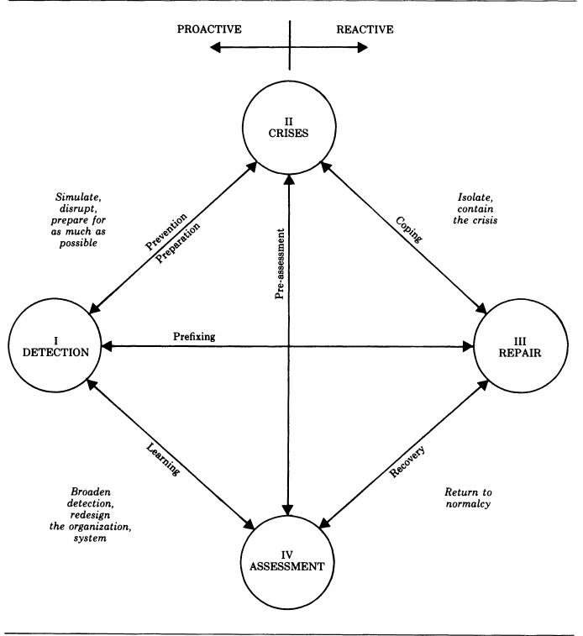
Application of Crisis Management
Detection
Crisis
Repair
Assessment
Model of Crisis Management (Mitroff et al, 1987)

Slide 9
What Tesla Did? Bad Example!
The driver contacted Tesla several times, hoping to investigate the issue of "brake failure". However, Tesla officials did not make a positive response except for "sending the vehicle to a third party for vehicle inspection."
The Tesla sales staff has claimed to the public that the cause of the accident was the driver’s fault, and their attitude has disappointed customers.
The driver said: Tesla said that we should agree to the insurance company to repair the car. They helped us sell the repaired car and promised to sell it at a good price. This is extremely irresponsible behavior.
Refuse to admit mistakes before state agencies intervene.

Slide 10
That’s the Reason
Many managers still do not pay attention to Crisis Management.
They do not notice the importance or underestimate the organization crisis, thinking that the organization crisis is not dangerous.
They believe that it only takes a little effort to solve the Corporate Crisis and restore the organization to its original state.

Slide 11
How to Research?
Research Theory
Research Theme
Qualitative Research Design for Research

Slide 12
Action Research Theory
Action Research is a practical sociological method that seeks social change through critical thinking, action and research. (McGill, 1973.)
Action research consists of a series of steps, and each step includes sub-projects such as plans, actions, and results surveys. (McGill, 1973.)
Action research is one or more systematic and disciplined processes. It is also a self-critical process aimed at achieving change through individual or collective self-transformation. (McGill, 1973.)

Slide 13
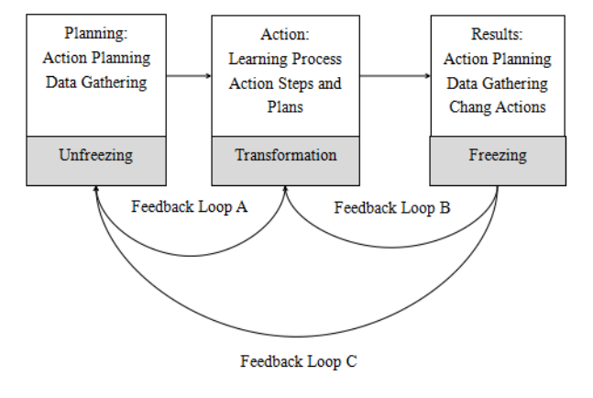
Action Research Theory
Process of Research Action (McGill, 1973）

Slide 14
Interpretivism from Epistemology
As a kind of epistemology, interpretivism focuses on taking reality as a subjective understanding of the structure of human society. （Kroeze, 2011）
Observe reality and use real cases as the theoretical basis. （Kroeze, 2011）
Corporate Crisis is a social phenomenon, which has a negative impact on all organizations that exist in society. （Kroeze, 2011）
Crisis management is a management theory aimed at perceiving, preventing, confronting and evaluating organizational crises.（Kroeze, 2011）
Close to reality, exist in the real society.

Slide 15
Qualitative Research Design
Narrative Analysis:
It uses stories as data to tell first-person experiences in the form of stories. The content of this research includes biography, life history, oral statement and life experience. (Merriam, 2002)
Narrative analysis usually adopts the perspective of the narrator to deepen the understanding of people's views and opinions on specific events. (Merriam, 2002)
Easy access to deeper data makes narrators more willing to tell stories about specific events. (Merriam, 2002)
The knowledge gained from narrative analysis can provide researchers with a detailed understanding of the subject and then provide further insights on how to apply the story to their own research. (Merriam, 2002)

Slide 16
Qualitative Research Design
Narrative analysis can help researchers obtain richer storylines and narratives when conducting research on social phenomena.
Researchers use narrative analysis to achieve the goal of obtaining the most authentic narrative events.

Slide 17
Interview Design
Confirm whether the current Corporate Crisis has changed and whether a new form of crisis has emerged.
Test whether the previous crisis management theory and crisis management process can control the current Corporate Crisis.
Researchers classify respondents according to their needs to understand specific events from different directions.
Company managers, employees, consumers, collaborators and external internal personnel (media, the public, etc.)

Slide 18
Questions for Interview (Still Working in Progess)
Questions for interviewing corporate managers (Part of it):
Do you think the impact of this crisis still exists in the organization? Will it accompany the development of the corporate for a long time? Do you think the countermeasures and management of corporate have effectively resolved the crisis?
Questions for interviewing employees of corporate (Part of it):
Do you think this crisis has been resolved? What kind of impact do you think this crisis has brought to the corporate and employees?
Questions for Consumers (Part of it)
After the crisis broke out, do you think corporate has changed their attitude towards consumers? Has the organization changed the corresponding service?

Slide 19
Validity and Reliability for Current Research Plan
The researcher's team is a good interviewee.
Successful project services in 2017, 2020 and 2021: large-scale exhibitions, stage performances, etc.
Obtained TV interviews and special reports, affirmed and supported by government departments.
In the process of project establishment, the team encountered many crises, and these crises are more that the team has not experienced.
The records of these crises can provide researchers with very timely and effective data so that they can understand the current crises in various forms and the extent of their impact.

Slide 20
References
Kharpal, A. and Chen, E., 2021. Tesla branded as ‘arrogant’ in China as pressure mounts on the electric car maker. [online] CNBC. Available at: <https://www.cnbc.com/2021/04/23/tesla-in-china-pressure-mounts-on-carmaker-after-customer-protest.html> [Accessed 20 May 2021].
.Kroeze, J., 2011. Interpretivism in Information Systems: A Postmodern Epistemology?. University of South Africa, 12.
Mitroff, I., Shrivastava, P. and Udwadia, F., 1987. Effective Crisis Management. The Academy of Management Executive, 1(3), pp.283-292.
McGill, M., 1973. ACTION RESEARCH DESIGNS FOR TRAINING AND DEVELOPMENT. Academy of Management Proceedings, 1973(1), pp.542-549.
Merriam, S., 2002. Qualitative research in practice. San Francisco, Calif.: Jossey-Bass.
Paraskevas, A., 2006. Crisis management or crisis response system?. Management Decision, 44(7), pp.892-907.
Pearson, C. and Mitroff, I., 1993. From crisis prone to CrIsis prepared: a framework for crlsis management. Academy of Management Executive, 7(1), pp.48- 59
Yehya, N. and Coombs, W., 2017. Catalytic defiance as a crisis communication strategy: The risk of pursuing long-term objectives. Business Horizons, 2017(60), pp.463- 472.

Slide 21
THANK YOU :)

