Slide 1
LCMB7003
Strategic Management
Week 3
The Micro Environmental Analysis
(Evaluating Internal Environment)

Slide 2
Learning Objectives
Define industries and use Porter’s competitive five forces framework to analyse industries or sector
Define industry attractiveness and identify how the forces can be managed
Understand different industry types and how industries develop and change in industry life cycles
Analyse strategic and competitor positions in terms of strategic groups and market segments
UWTSD - Copyright 2023

Slide 3
Activity
Let’s review the independent study!

Slide 4
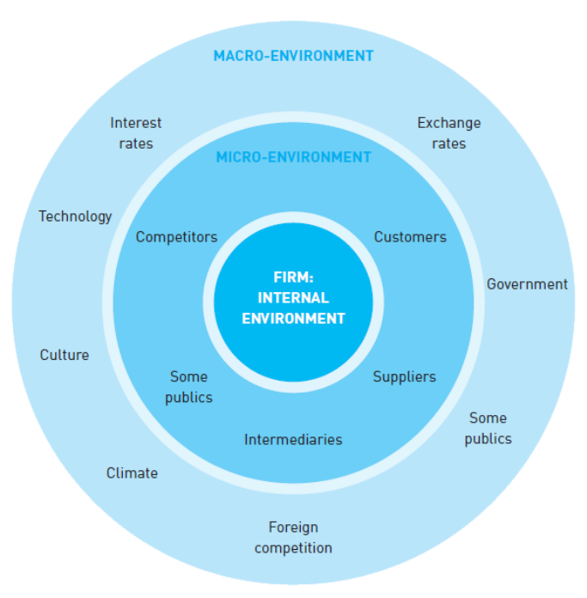
The Competitive Environment
A study of the environment will provide information on the nature of competition as a step to developing sustainable competitive advantage.
Organisations will perceive opportunities that might be explored and threats that need to be contained.
UWTSD - Copyright 2023

Slide 5
Industry & Market
An industry is a group of firms producing products and services that are essentially the same. Industries and sectors are often made up of several specific markets or market segments.
A market is a group of customers for specific products or services that are essentially the same (e.g. a particular geographical market).
UWTSD - Copyright 2023

Slide 6
The Competitive Forces
Industries vary widely in terms of their attractiveness, as measured by how easy it is for participating firms to earn high profits.
A key determinant of profitability is the extent of competition and the strength of buyers and suppliers, and this varies between industries.
Profitability between industries can thus vary considerably; for example, the pharmaceutical industry has performed very well while others, like the airline industry, have underperformed.
Which industry is more attractive: airline industry or pharmaceutical industry? Why?
UWTSD - Copyright 2023

Slide 7
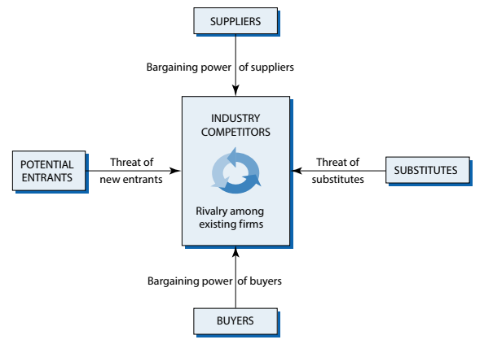
Porter’s Five Forces Framework
Porter’s Five Forces Framework helps to analyse an industry and identify the attractiveness of it in terms of five competitive forces: (i) extent of rivalry between competitors (ii) threat of entry, (iii) threat of substitutes, (iv) power of buyers and (v) power of suppliers.
UWTSD - Copyright 2023

Slide 8

Competitive Rivalry
Competitive rivals are organisations aiming at the same customer groups and with similar products and services.
  Competitor concentration and balance
  Industry growth rate
  High fixed costs
  High exit barriers
  Low differentiation
UWTSD - Copyright 2023
Notes:
Five factors tend to define the extent of rivalry in an industry or market:
Competitor concentration and balance. Where competitors are numerous or of roughly equal size or power there is the danger of intensely rivalrous behaviour as competitors attempt to gain dominance over others, through aggressive price cuts, for example. Conversely, less rivalrous industries tend to have one or two dominant organisations, with the smaller players reluctant to challenge the larger ones directly (e.g. by focusing on niches to avoid the ‘attention’ of the dominant companies).
Industry growth rate. In situations of strong growth, an organisation can grow with the market, but in situations of low growth or decline, any growth is likely to be at the expense of a rival, and meet with fierce resistance. Low-growth markets are therefore often associated with price competition and low profitability.
High fixed costs. Industries with high fixed costs, perhaps because they require high investments in capital equipment or initial research, tend to be highly rivalrous. Companies will seek to spread their costs (i.e. reduce unit costs) by increasing their volumes: to do so, they typically cut their prices, prompting competitors to do the same and thereby triggering price wars in which everyone in the industry suffers. Similarly, if extra capacity can only be added in large increments (as in many manufacturing sectors, for example a chemical or glass factory), the competitor making such an addition is likely to create short-term over-capacity in the industry, leading to increased competition to use capacity.
High exit barriers. The existence of high barriers to exit – in other words, closure or disinvestment – tends to increase rivalry, especially in declining industries. Excess capacity persists and consequently incumbents fight to maintain market share. Exit barriers might be high for a variety of reasons: for example, high redundancy costs or high investment in specific assets such as plant and equipment which others would not buy. Low differentiation. In a commodity market, where products or services are poorly differentiated, rivalry is increased because there is little to stop customers switching between competitors and the only way to compete is on price. Petrol is a commodity market, for instance.

Slide 9

The Threat of Entry
How easy it is to enter the industry influences the degree of competition. The greater the threat of entry, the worse it is for incumbents in an industry. An attractive industry has high barriers to entry that reduce the threat of new competitors. Barriers to entry are the factors that need to be overcome by new entrants if they are to compete in an industry.
  Scale and experience
  Access to supply or distribution channels
  Expected retaliation
  Legislation or government action
  Incumbency advantages
UWTSD - Copyright 2023
Notes:
Five important entry barriers are:
Scale and experience. In some industries, economies of scale are extremely important: for example, in the production of automobiles or the advertising of fast-moving consumer goods. Once incumbents have reached large-scale production, it will be very expensive for new entrants to match them and until they reach a similar volume they will have higher unit costs. This scale effect is increased where there are high capital investment requirements for entry, for example research costs in pharmaceuticals or capital equipment costs in automobiles. Barriers to entry also come from experience curve effects that give incumbents a cost advantage because they have learnt how to do things more efficiently than an inexperienced new entrant could possibly do. Until the new entrant has built up equivalent experience over time, it will tend to produce at higher cost. In some industries there are ‘demand or buyer side’ economies of scale or network effects as buyers value being in a ‘network’ of a large number of other customers.
Access to supply or distribution channels. In many industries manufacturers have had control over supply and/or distribution channels. Sometimes this has been through direct ownership (vertical integration), sometimes just through customer or supplier loyalty. In some industries this barrier has been overcome by new entrants who have bypassed retail distributors and sold directly to consumers through e-commerce (e.g. Dell Computers and Amazon).
Expected retaliation. If an organisation considering entering an industry believes that the retaliation of an existing firm will be so great as to prevent entry, or mean that entry would be too costly, this is also a barrier. Retaliation could take the form of a price war or a marketing blitz. Just the knowledge that incumbents are prepared to retaliate is often sufficiently discouraging to act as a barrier.
Legislation or government action. Legal restraints on new entry vary from patent protection (e.g. pharmaceuticals), to regulation of markets (e.g. pension selling), through to direct government action (e.g. tariffs). Of course, organisations are vulnerable to new entrants if governments remove such protection, as has happened with deregulation of the airline industry over the last couple of decades.
Incumbency advantages. Incumbents may have cost or quality advantages not available to entrants including access to proprietary technology, raw material sources and geographical locations or an established brand identity. The medical instruments industry is, for example, protected by many patents and Coca Cola and Pepsi have brand loyalties developed over decades that few can overcome.

Slide 10

The Threat of Substitutes
Substitutes are products or services that offer the same or a similar benefit to an industry’s products or services, but have a different nature. For example, aluminium is a substitute for steel or a tablet computer is a substitute for a laptop. Substitutes can reduce demand for a particular type of product as customers switch to alternatives – even to the extent that this type of product or service becomes obsolete.
  the possible threat of obsolescence;
  the ability of customers to switch to the substitute;
  the costs of providing some extra aspect of the service that will prevent switching;
  the likely reduction in profit margin if prices come down or are held.
UWTSD - Copyright 2023
Notes:
There are two important points to bear in mind about substitutes:
The price/performance ratio is critical to substitution threats. A substitute is still an effective threat even if more expensive, so long as it offers performance advantages that customers value. Thus aluminium is more expensive than steel, but its relative lightness and its resistance to corrosion gives it an advantage in some automobile manufacturing applications. It is the ratio of price to performance that matters, rather than simple price.
Extra-industry effects are the core of the substitution concept. Substitutes come from outside the incumbents’ industry and should not be confused with competitors’ threats from within the industry. The value of the substitution concept is to force managers to look outside their own industry to consider more distant threats and constraints. If the buyers’ switching costs for the substitute are low the threat increases and the higher the threat, the less attractive the industry is likely to be

Slide 11
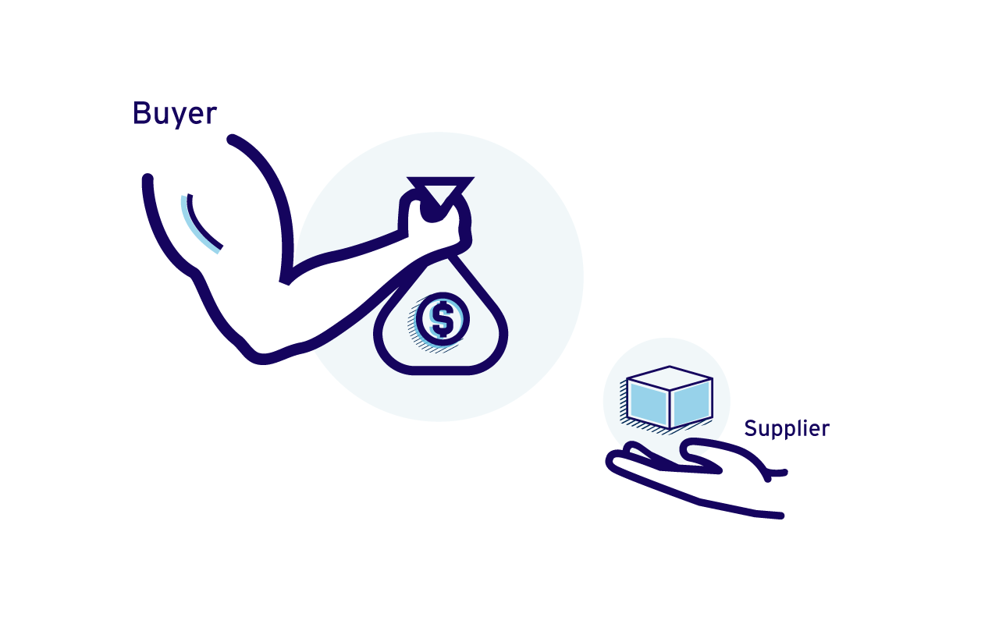
The Power of Buyers
Buyers are the organisation’s immediate customers, not necessarily the ultimate consumers. If buyers are powerful, then they can demand low prices or costly product or service improvements.
  Concentrated buyers
  Low switching costs
  Buyer competition threat
  Low buyer profits and impact on quality
UWTSD - Copyright 2023
Notes:
Buyer power is likely to be high when some of the following four conditions prevail:
Concentrated buyers. Where a few large customers account for the majority of sales, buyer power is increased. This is the case for items such as milk in the grocery sector in many European countries, where just a few retailers dominate the market. If a product or service accounts for a high percentage of total purchases of the buyer their power is also likely to increase as they are more likely to ‘shop around’ to get the best price and therefore ‘squeeze’ suppliers more than they would for more trivial purchases.
Low switching costs. Where buyers can easily switch between one supplier and another, they have a strong negotiating position and can squeeze suppliers who are desperate for their business. Switching costs are typically low for standardised and undifferentiated products like commodities such as steel. They are also likely to be low when the buyers are fully informed about prices and product performance.
Buyer competition threat. If the buyer has the capability to supply itself, or if it has the possibility of acquiring such a capability, it tends to be powerful. In negotiation with its suppliers, it can raise the threat of doing the suppliers’ job themselves. This is called backward vertical integration, moving back to sources of supply, and might occur if satisfactory prices or quality from suppliers cannot be obtained. For example, some steel companies have gained power over their iron ore suppliers as they have acquired iron ore sources for themselves.
Low buyer profits and impact on quality. For industrial or organisational buyers there are two additional factors that can make them price sensitive and thus increase their threat: first, if the buyer group is unprofitable and pressured to reduce purchasing costs and, second, if the quality of the buyer’s product or services is little affected by the purchased product.

Slide 12
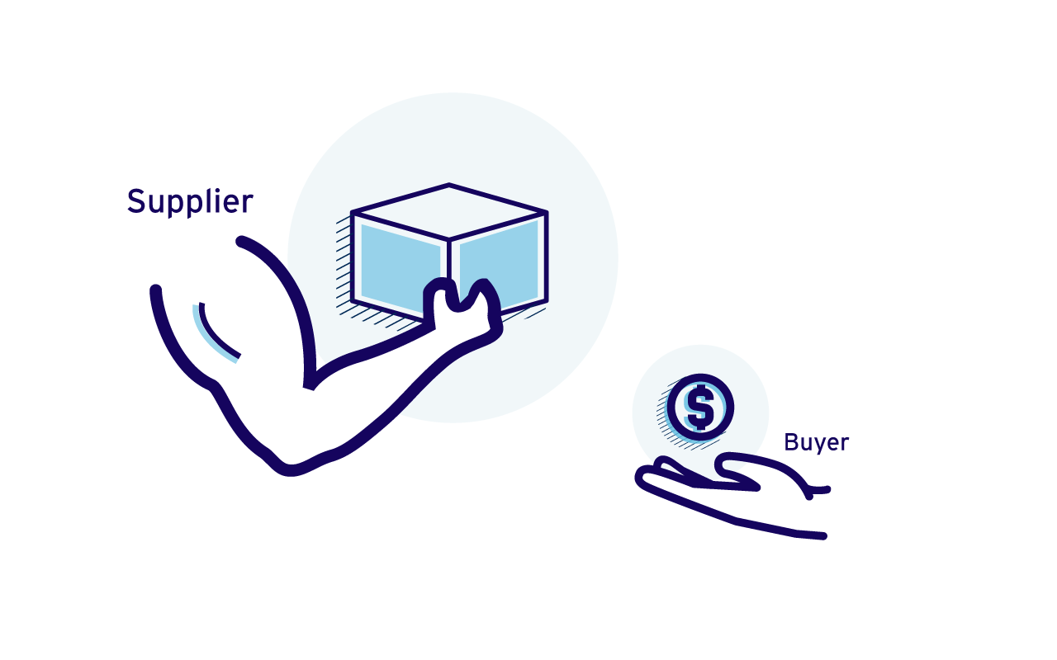
The Power of Suppliers
Suppliers are those who supply the organisation with what it needs to produce the product or service. As well as fuel, raw materials and equipment, this can include labour and sources of finance. The factors increasing supplier power are the converse to those for buyer power.
  Concentrated suppliers
  High switching costs
  Supplier competition threat
  Differentiated products
UWTSD - Copyright 2023
Notes:
Thus supplier power is likely to be high where there are:
Concentrated suppliers. Where just a few producers dominate supply, suppliers have more power over buyers. The iron ore industry is now concentrated in the hands of three main producers, leaving the steel companies, still relatively fragmented, in a weak negotiating position for this essential raw material.
High switching costs. If it is expensive or disruptive to move from one supplier to another, then the buyer becomes relatively dependent and correspondingly weak. Microsoft is a powerful supplier because of the high switching costs of moving from one operating system to another. Buyers are prepared to pay a premium to avoid the trouble, and Microsoft knows it.
Supplier competition threat. Suppliers have increased power where they are able to enter the industry themselves or cut out buyers who are acting as intermediaries. Thus airlines have been able to negotiate tough contracts with travel agencies as the rise of online booking has allowed them to create a direct route to customers. This is called forward vertical integration, moving up closer to the ultimate customer.
Differentiated products. When the products or services are highly differentiated, suppliers will be more powerful. For example, although discount retailers like Walmart are extremely powerful, suppliers with strong brands, like P&G with Gilette, still have high negotiating power. Also, if there is no or few substitutes for the input the supplier group will be more powerful, like pilots’ unions in the airline industry.

Slide 13
Implications of the Competitive Five Forces
1
There are several important steps in an industry analysis before and after analysing the five forces.
In group, read the coffee shop case study and discuss important steps in the industry analysis.
The aim of the five force analysis is an assessment of the attractiveness of the industry and any possibilities to manage strategies in relation to the forces to promote long-term survival and competitive advantage.
UWTSD - Copyright 2023

Slide 14
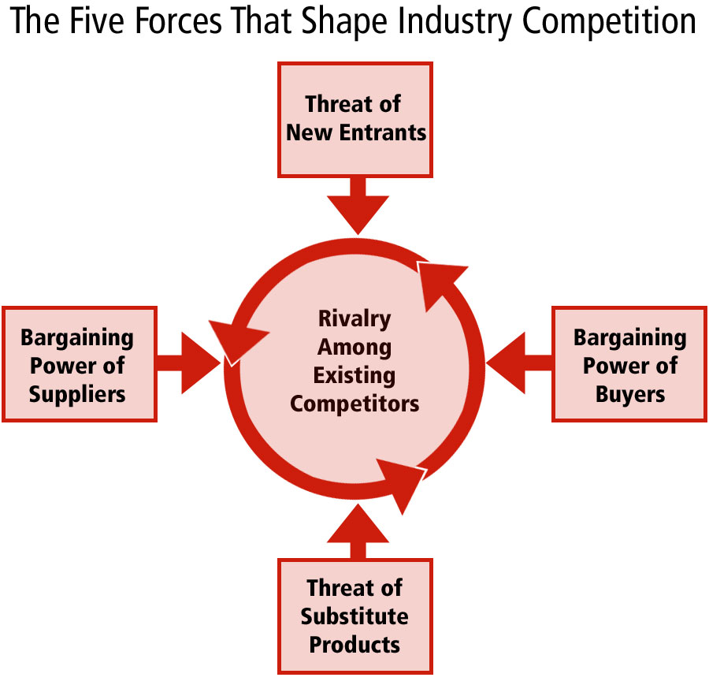
Implications of the Competitive Five Forces
2
When each of the five forces has been evaluated, the next step is to understand the implications of these:
    Which industries to enter (or leave)?
    How can the five forces be managed?
    How are competitors affected differently?
UWTSD - Copyright 2023

Slide 15
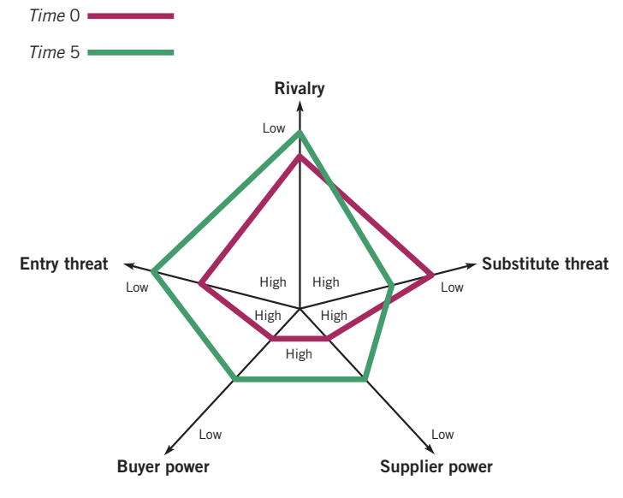
Comparative Industry Structure Analyses
Competitive forces may change over time.
We not only need to understand the current strength of the competitive forces, but how it may change over time.
Comparing the five forces over time helps to give industry structure analysis a dynamic aspect.
Source: Whittington et al., (2020)
UWTSD - Copyright 2023

Slide 16
The Competitive Five Forces and Industry Types
The Five Forces Framework is the most well-known strategy tool for industry analysis, but it has to be used carefully.
Industry types and their underlying economic characteristics should be considered as they have major implications on industry attractiveness and what competitive strategies are available.
Industry structures change over time and industries can evolve from one type to another, depending on the macro-environment, the degree of industry maturity and competitive strategies in the industry with consequences for competitive force strengths.
UWTSD - Copyright 2023

Slide 17







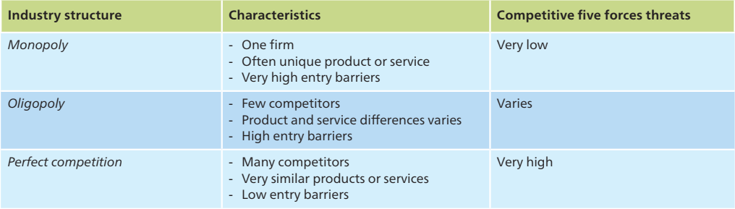
Industry Types
Source: Whittington et al., (2020)
UWTSD - Copyright 2023

Slide 18
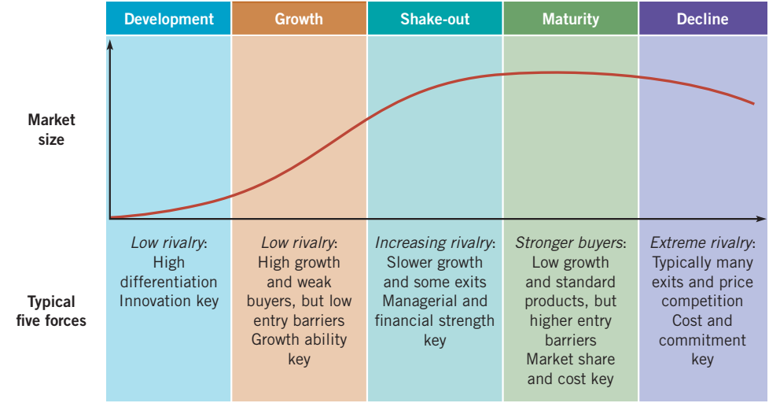
The Industry Life Cycle
Source: Whittington et al., (2020)
UWTSD - Copyright 2023

Slide 19
Strategic Groups Analysis
1
Strategic groups are organisations within the same industry or sector with similar strategic characteristics, following similar strategies or competing on similar bases. These characteristics are different from those in other strategic groups in the same industry or sector.
Some characteristics for identifying strategic groups:
Scope of activities
  Extent of product (or service) diversity
  Extent of geographical coverage
  Number of market segments served
  Distribution channels used
Resource commitment
  Extent (number) of branding
  Marketing effort (e.g. advertising spread, size of salesforce)
  Extent of vertical integration
  Product or service quality
  Technological leadership (a leader or follower)
  Size of organisation
UWTSD - Copyright 2023

Slide 20
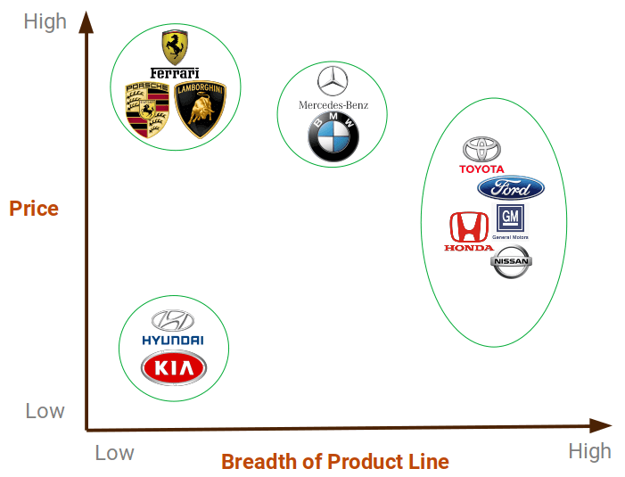
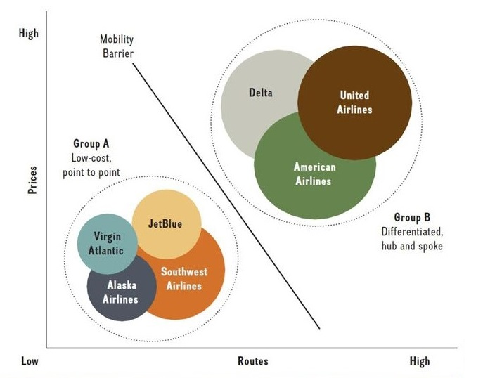
Strategic Groups Analysis
2
Within industries strategic group analysis and market segment analysis can help identify strategic gaps or opportunities.
AIRLINE
INDUSTRY
CAR
INDUSTRY
UWTSD - Copyright 2023

Slide 21
Market Segments
Industries can also be disaggregated into smaller and specific market sections known as segments. The concept of market segment focuses on differences in customer needs.
A market segment is a group of customers who have similar needs that are different from customer needs in other parts of the market. Where these customer groups are relatively small, such market segments are often called ‘niches’.
Segmentation should reflect an organisation’s strategy and strategies based on market segments must keep customer needs firmly in mind. Therefore, two issues are particularly important in market segment analysis:
  Variation in customer needs. Focusing on customer needs that are highly distinctive from those typical in the market is one means of building a long-term segment strategy.
  Specialisation within a market segment can also be an important basis for a successful segmentation strategy. This is sometimes called a ‘niche strategy’.
UWTSD - Copyright 2023

Slide 22
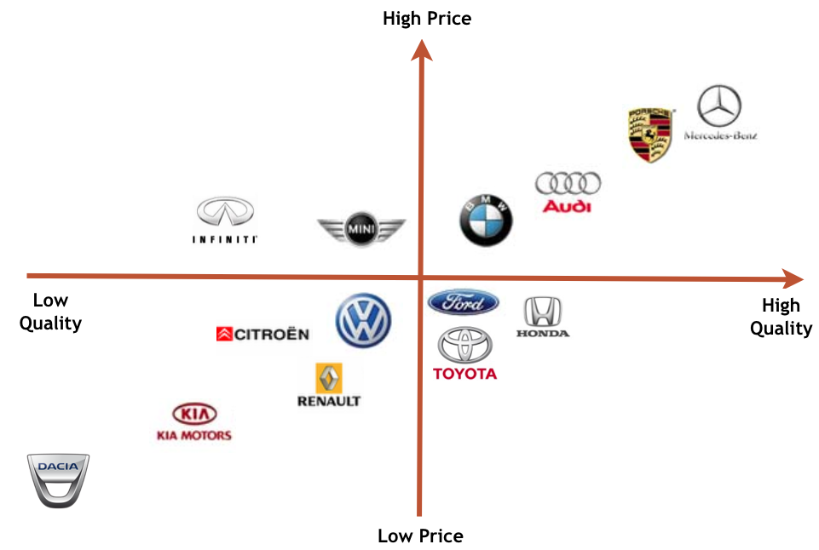
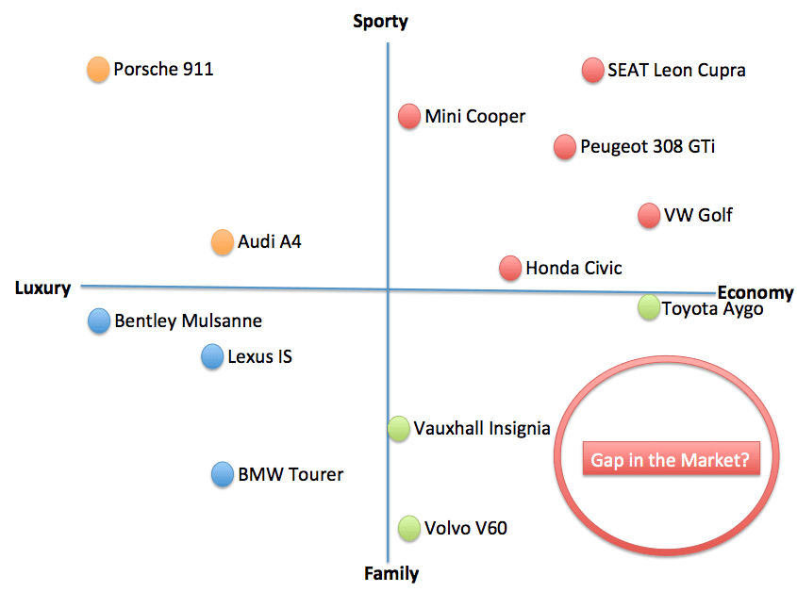
Strategic Groups Analysis / Market Segmentation
Car Industry
UWTSD - Copyright 2023

Slide 23
Summary
Today we have covered:
The competitive environment
Sustainable competitive advantages
5-forces analysis
Industrial life cycle
Market segment
Strategic group analysis

Slide 24
Activity – Business Development Proposal(BDP)
Where We Are: Needs were identified in the previous section.
What to Do Now:
  Identify the services, products, or solutions that could serve the selected need.
  Select one company that is currently active in the same or a similar market.
  Examine the industry to determine whether this market has potential (the previous exercise checked if the need has a market; this exercise checks whether that market is attractive or not).
Considerations:
  Theories to use: Apply relevant theoretical frameworks.
  Data collection: Gather relevant data.
  Data analysis: Analyze the data.
Deliverables: Your group may be asked to present your answers to the class.

Slide 25
Independent study
Complete at least one task, prepare to make a 5-minute presentation next week
Task 1: Take a closer look at the “Comparative PESTLE Analysis between Mexico & Norway” (available on Moodle) and as Business Strategist make a suggestion / recommendation how the Negatives elements in either of the country’s PESTEL analysis can potentially be converted into something positive.
Task 2: Take a closer look at the “Comparative PEST Analysis between USA & China (Sample)”. As Business Strategist conduct PESTLE analysis between your country of origin and the UK. (available on Moodle) and be prepared to present a 2-minute verbal summary of your thoughts.
Task 3 and Task 4: please examine the next slides

Slide 26
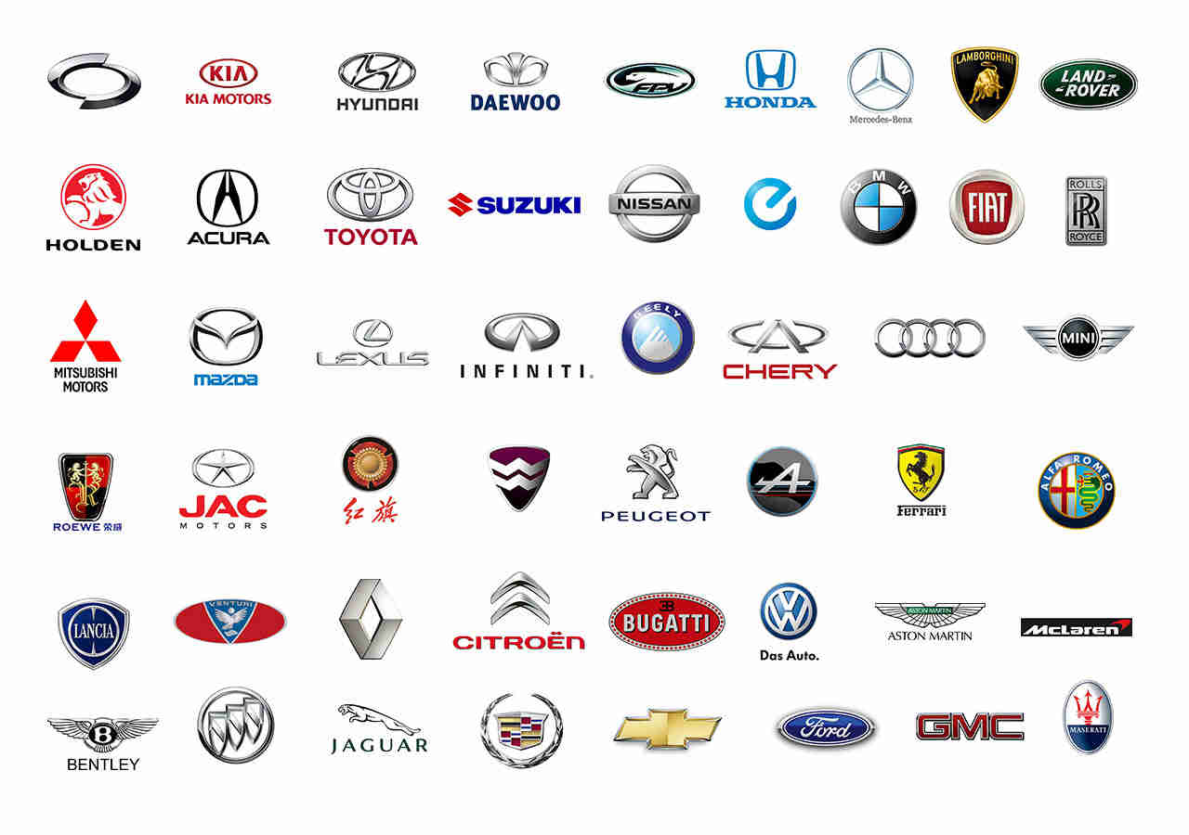
Task 3:
Choose any vehicle from the list below and conduct the Competitive Five Forces Framework
UWTSD - Copyright 2023

Slide 27
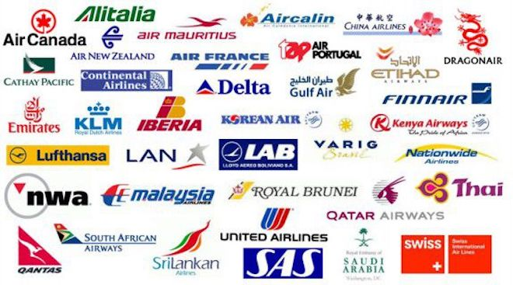
Task 4:
Choose any airline from the list below and conduct the Competitive Five Forces Framework
Based on your analysis, find ways how the competitiveness could be sustained.
UWTSD - Copyright 2023

Slide 28
Bibliography
Barney, J. B. & Hesterly, W. S., 2015. Strategic Management and Competitive Advantage: Concepts and Cases. 5 ed. Essex: Pearson Education Limited.
Gamble, J. E., Peteraf, M. A. & Thompson Jr, A. A., 2015. Essentials of Strategic Management: The Quest for Competitive Advantage. 4 ed. New York: McGraw-Hill Education.
Grant, R. M., 2018. Contemporary Strategy Analysis. 10 ed. NJ: John Wiley & Sons, Inc.
Hill, C. W. L., Schilling, M. A. & Jones, G. R., 2017. Strategic Management, Theory. 12 ed. Boston: Cengage Learning.
Lynch, R., 2018. Strategic Management. 8 ed. Harlow: Pearson Education Limited.
Wheelen, T. L., Hunger, J. D., Hoffman, A. N. & Bamford, C. E., 2018. Strategic Management and Business Policy: Globalization, Innovation and Sustainability. 15 ed. Harlow: Pearson Education.
Whittington, R. et al., 2020. Exploring Strategy. 12 ed. Harlow: Pearson Education Limited.
UWTSD - Copyright 2023

Slide 29
Reading
CHECKLIST:
Global Market Analysis – Airlines
Global Market Analysis - Car Manufacturing
UWTSD - Copyright 2023

Slide 30

Any Questions?
Thank You ☺
UWTSD - Copyright 2023

