Slide 1
BA (Hons) Business Management module: Entrepreneurship module code:LCBB5013 module lecturer: Fouziya Farheen
Assignment Title – Business Idea Presentation restaurant root&ritual
Student name – Elena Ene
Student ID - 2310121

Slide 2
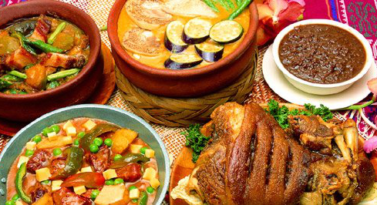
Table of Content
Introduction to Root & Ritual
Products & Services
Objectives & Unique Selling Proposition (USP)
PESTLE Analysis
SWOT Analysis
STP Strategy (Segmentation, Targeting & Positioning)
Marketing Mix (4Ps)
Legal Structure
Financial Plan
Conclusion
Reference List
This Photo by Unknown Author is licensed under CC BY-SA

Slide 3

Introduction
Root & Ritual - a sustainability-driven and hyper-seasonal tasting restaurant to be launched in Manchester
Will deliver immersive dining through hyper-locally sourced ingredients (no more than 50 miles), zero-waste operations and storytelling
Blends modern culinary with British heritage
Figure 1: Business logo of Root & Ritual

Slide 4
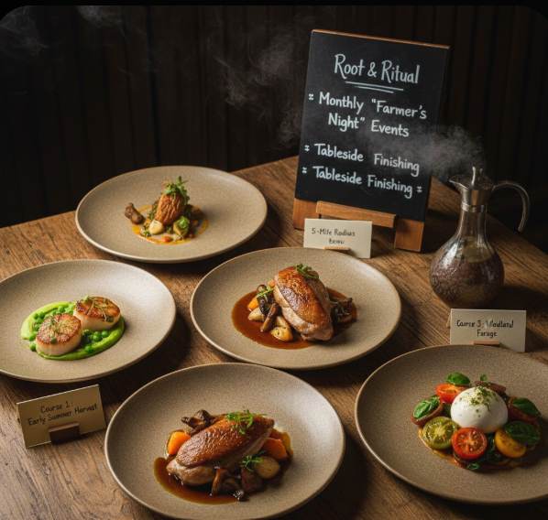
Products & Services
Hyper-seasonal five-to-seven-course tasting menus
The food items will get changed every 6 to 8 weeks, as the foods will be sourced within a 50-mile radius of the restaurant
“Farmer’s Night” events, storytelling and tableside finishing.
Figure 2: Glimpse of Root & Ritual food items

Slide 5

Objectives & Unique Selling Proposition (USP)
Short-term - Successful launch in Manchester and achieving 70 to 80% seating capacity by partnering with 10 local suppliers, reaching break-even in 24 months
Long-term - Expansion in 2 different towns, London and Royal Leamington Spa, increasing annual revenue by 15% to 20%, retail product line development and dining excellence
USP - zero-waste operations, hyper-local 50-mile sourcing model, strictly seasonal tasting menus and immersive storytelling experience
This Photo by Unknown Author is licensed under CC BY

Slide 6
PESTLE Analysis
Political | Restricted policies (Velaoras et al. 2025), 15% less investment as per 2025 Autumn Budget (Clark, 2026)
Economic | UK GDP just grew by 0.1% in the last quarter, limited growth opportunity
Social | 38% of Britons have reduced their food consumption due to 65% price increase (Marsh, 2025)
Technological | Need to invest in digital tools (Zezar and Kalifia, 2025)
Legal | Need to align the practices under the UK food law (Buckley and Lewis, 2022)
Environmental | Stresses on sustainability commitment of restaurants (Fleiden, 2022)

Slide 7
SWOT Analysis
Strengths Sustainable positioning Zero-waste model Hyper-local sourcing and experiential dining | Weaknesses High-operational costs
Opportunities Growing demand on sustainable dining | Threats Competition Economic downturn

Slide 8

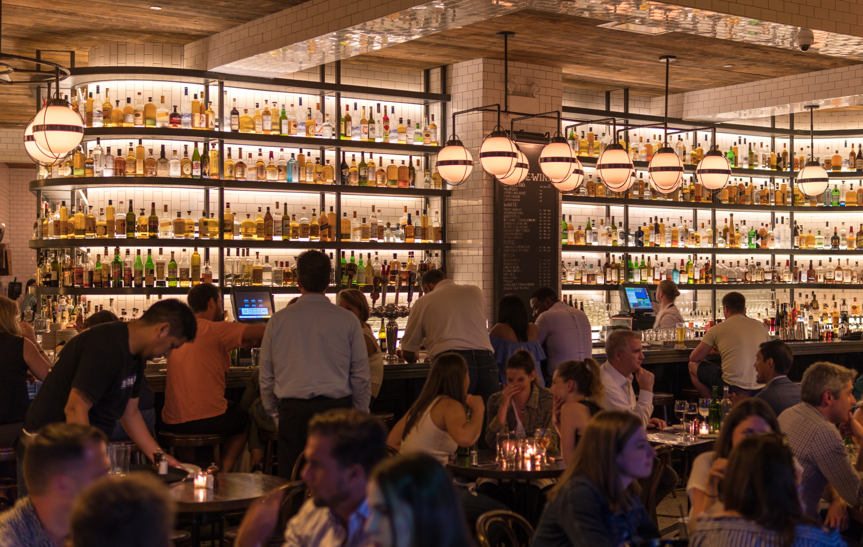
STP Strategy (Segmentation, Targeting & Positioning)
Ethically conscious diners, young affluent professionals
Experience-oriented, sustainability-driven consumers in Manchester.
Figure 3:Target consumers

Slide 9

Marketing Mix (4Ps)
Product - New Seasonal tasting menus every 6 to 8 weeks
Pricing - Value-based pricing to reflect the experiential worth (Helmold, 2022)
Placement - High-footfall locations in Manchester, London and Royal Leamington Spa, easy to find using Google Maps
Promotion - social media, bloggers and journalists.

Slide 10
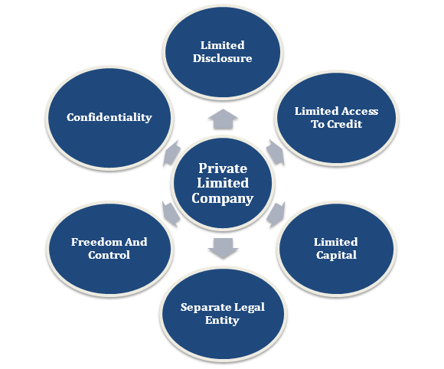

Legal structure
Root & Ritual’s legal structure can be categorised as a private limited company (Ltd)
To protect assets and intellectual properties (Singh et al. 2025)

Slide 11


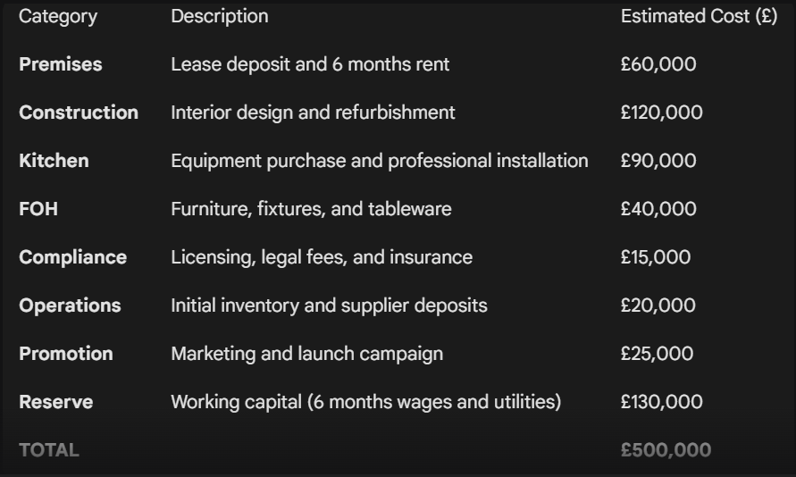


Financial Plan
£500,000 start-up funding via founders, loans, angel investors, and crowdfunding

Slide 12
Conclusion
A viable business
Will obtain growth in no time in a steady but sure manner.
Will build name recognition within the restaurant and food industry.

Slide 13
Reference List
Buckley, S. and Lewis, T. (2022) ‘The influence of society on the UK’s food and food regulatory systems’, in Clay’s Handbook of Environmental Health. London: Routledge, pp. 516–566.
Clark, E. (2026). Government’s pub support package sparks calls for wider hospitality relief. Available at: https://startups.co.uk/news/pub-support-package/ (Accessed 24th February 2023).
Feilden, E. (2022). Half of Brits more likely to choose eco-friendly bars and restaurants. Available at: https://www.thedrinksbusiness.com/2022/11/half-of-brits-more-likely-to-choose-eco-friendly-bars-and-restaurants/ (Accessed 24th February 2023).
Helmold, M. (2022) ‘Value-based and cost-based pricing concepts’, in Performance excellence in marketing, sales and pricing: Leveraging change, lean and innovation management. Cham: Springer International Publishing, pp. 75–81.
Marsh, S. (2025). Dining out ‘under pressure’ as Britons cut back due to price rises, says YouGov. Available at: https://www.theguardian.com/business/2025/oct/23/dining-out-britons-rising-prices-yougov (Accessed 24th February 2023).
Singh, S.K., Rao, S., Harish, N. and Guduru, P. (2025) Business organization and management. RK Publication.
Velaoras, K., Menegaki, A.N., Polyzos, S. and Gotzamani, K. (2025) ‘The role of environmental certification in the hospitality industry: Assessing sustainability, consumer preferences, and the economic impact’, Sustainability, 17(2), p. 650.
Zezar, B.P. and Kalifia, A.D. (2025) ‘QR code-based ordering and reservation system design to improve cafe operational efficiency’, bit-Tech, 8(2), pp. 2630–2640.

