Slide 1
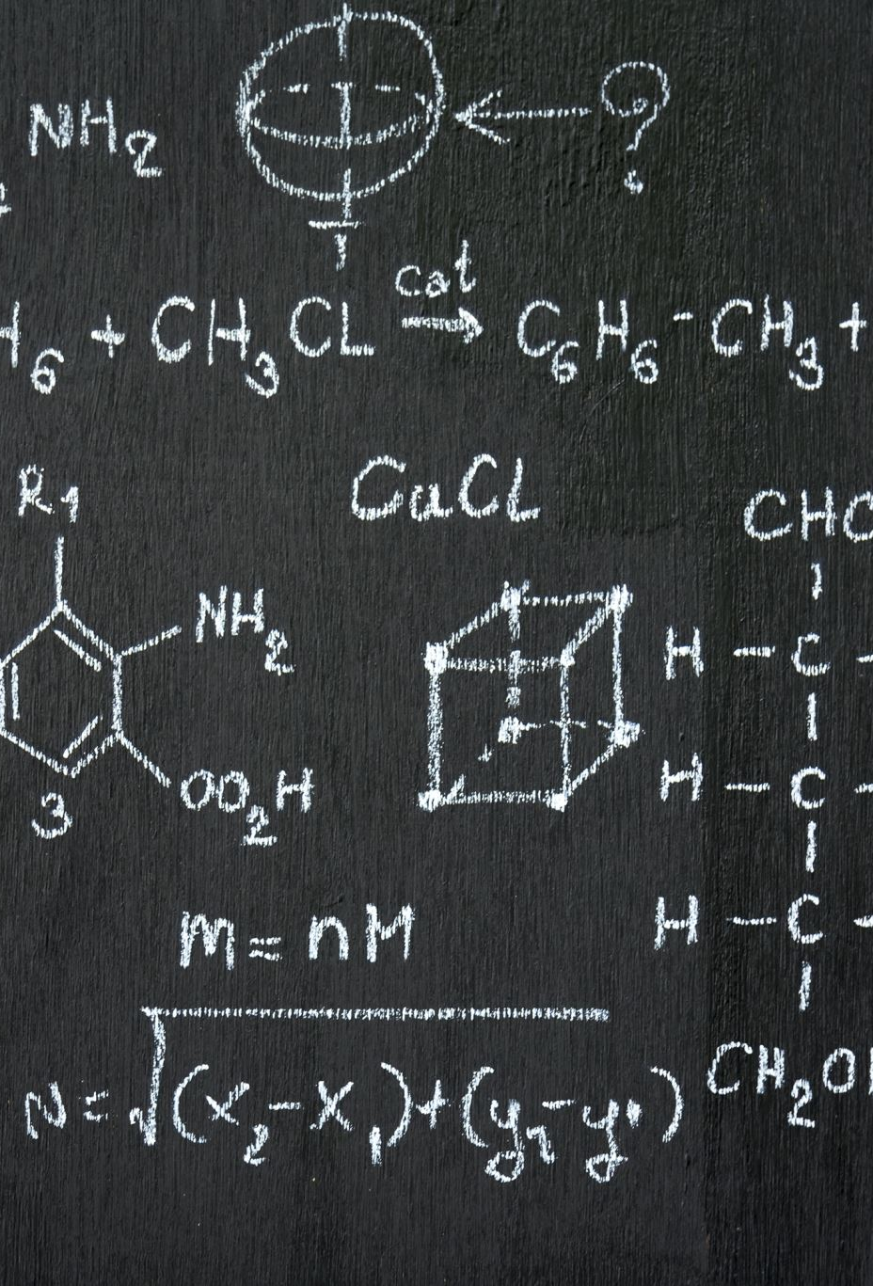
Student Name: Ilie Alexandru Tranca
Module Code: LCLM 4004
Module Name: Problem Solving and Decision-Making
Component 1: Basil’s Bakery

Slide 2
Overview of presentation
Greetings for the morning or afternoon. Ilie Alexandru Tranca is my name.
I will give a summary of Basil's Bakery in today's session and look at the type and extent of the issues they are now facing.
After that, I'll use the PESTEL framework to critically analyze and determine the main external factors influencing the company.
After that, I'll assess the Cause-and-Effect model rigorously and utilize it to investigate the root causes of the issues found.
Lastly, I will summarize the most important conclusions and draw attention to the primary concerns that Basil's Bakery should think about going forward.

Slide 3
Overview of basils bakery
Serving the neighborhood, Basil's Bakery is a small, independent bakery.
A variety of freshly baked foods, including bread, pastries, cakes, and other bakery products, are produced and sold by the bakery.
Basil's Bakery has to strike a balance between profitability, product quality, and customer pleasure as a small business.
The bakery faces competition from larger merchants and supermarkets in addition to other independent bakeries.
The case study focuses on Basil's Bakery's potential and problems as well as how the company might perform better.
The basis for analyzing the problems and offering suitable suggestions for future expansion is an understanding of the bakery's current situation.
Important lesson:
The goal for Basil's Bakery, a small local business, is to maintain quality, please consumers, and achieve sustainable growth while staying competitive.

Slide 4
Nature and Scope of the Problems
Root problem: Sales stagnation
Between 2023 and 2025, sales were roughly 25% below 2019 levels. The following external factors: Shops are closing, the retail park has become quieter, and former customers have lost their jobs due to the COVID-19 pandemic.
• Shifting consumer behavior: As more office workers work from home, lunchtime purchases are declining.
• Internal factors: Basil may lose sales because he does not provide delivery and finds it difficult to handle pre-orders and answer the phone during busy times.
• Growing operating expenses: Profitability is being negatively impacted by increased rent, utility costs, business rates, and insurance.
• Supply chain challenges: Stock costs are unpredictable due to the higher cost of organic ingredients and their susceptibility to crop failures.

Slide 5
Critique of the PESTEL Framework
Six external factors—political, economic, social, technological, environmental, and legal—that could have an impact on a business can be analysed using the PESTEL framework, a strategic business tool. It aids companies in comprehending their external surroundings, spotting opportunities and dangers, and coming to wise decisions.
It can draw attention to significant issues for Basil's Bakery, including growing business expenses, shifting consumer preferences, the expansion of online ordering, and the growing demand for organic and sustainable goods.PESTEL's primary advantage is that it offers a concise, organised summary of outside factors, which aids Basil in making plans and lowering risks. But the framework is not without flaws.
Internal issues like Basil's inability to make deliveries or his trouble taking pre-order calls are not directly examined. Furthermore, the analysis may become out of date due to the rapid changes in external factors. Additionally, PESTEL does not automatically rank problems by importance or offer solutions, and some factors may be challenging to measure or predict.
All things considered, PESTEL is a good place to start when figuring out why Basil's sales have dropped. However, in order to pinpoint the underlying causes of the issue and create workable solutions, it should be used in conjunction with other tools like a Fishbone Diagram.

Slide 6
PESTEL Analysis of Basil’s Bakery: Application and Discussion
Political aspects
Sub-factor 1: Government assistance for small enterprises
Application: Basil may be able to cut expenses.
Discussion: Basil could not have as much money as its bigger rivals.
Sub-factor 2: Policies related to food and energy
The bakery's expenses may be impacted by government regulations.
Discussion: Organic components.
Social factors
Sub factor 1: changing workig patterns , customers reduced as workers are working from home.
Sub factor 2: customer convinience.
Make new services that could help basil attract new customers
Environmental factors
Sub factor 1: Climate change. Poor weather can affect organically grown ingrdients.
Sub factor 2: Food waste, unsold things waste ingridients and money
Economic aspects
Sub-factor 1: Inflation and growing operating expenses
Application: Since 2019, Basil's costs have gone up.
Discussion: Profits are lowered by higher expenses.
Sub-factor 2: Reduced local economic activity and consumer expenditure
Reduced sales chances result from fewer employees purchasing lunch and fewer passing consumers.
Technological factors
Sub factor 1: online ordering systems. Make website.
Sub factor 2: online delivery. Could reach customers homes
Legal factors
Sub factor 1: Safety/health
Maintain hygiene and store food safely
Sub factor 2: allergen labelling
Basil should provide accurate allergen information

Slide 7
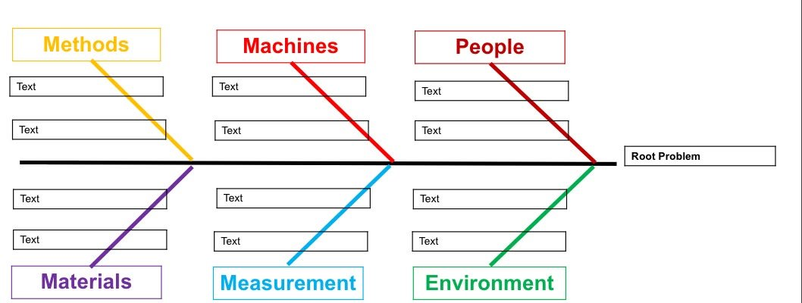
Poor staff scheduling
Slow kitchen equipment
Insufficient staff
Inefficient order taking
Order system faulty
Employees don’t have experience
ingredients out of stock
No monitoring time
Overcrowded dining area
Poor ingredients preparation
Poor kitchen layout

Slide 8
Critique of cause and effect model
The Cause-and-Effect Model, sometimes referred to as the Fishbone Diagram or Ishikawa Diagram, is a method for organising and identifying potential causes of a given issue.It is employed in decision-making, quality assurance, and business management to look into the causes of issues.
The primary issue is typically depicted as a fishbone-shaped diagram, with potential causes—such as people, processes, materials, machinery, and the environment—branching off from it. One important advantage is that it promotes organized thinking, aids in determining the underlying causes of issues, and fosters teamwork by facilitating idea sharing.
The model does, however, have certain drawbacks. It can take a long time, generate an excessive number of potential causes, and fail to demonstrate that a proposed cause is the cause of the issue. Additionally, it relies on the accuracy of the data supplied and may fail to recognise relationships between causes.
To sum up, the Cause-and-Effect Model is a helpful place to start when looking into business issues, but before making decisions, its conclusions should be backed up by data and additional research.

Slide 9
Key findings – Basils Bakery
• Falling sales: Despite the lifting of COVID-19 restrictions, sales between 2023 and 2025 stayed roughly 25% below 2019 levels.
• Decreased consumer demand: More office workers are working from home, the retail park has become quieter, a number of stores have closed, and devoted customers have lost their jobs.
• Limited services: Customers have trouble placing pre-orders during busy times, and Basil does not offer delivery, which could lead to lost sales.
• Increasing operating costs: Profitability is being strained by higher rent, utility bills, business rates, and insurance.
• Unpredictable supply costs: Stock costs are challenging to control and budget for because organic ingredients are costly and susceptible to crop failures.
• External business pressures: The bakery's performance and future expansion may be impacted by political, economic, social, technological, environmental, and legal factors.
• Needs improvement: Basil should think about implementing a dependable pre-ordering system, investigating delivery choices, enhancing marketing and customer interaction, and examining expenses without sacrificing product quality.

Slide 10
REFERENCE LIST
Basil’s Bakery Case Study (n.d.) LCLM4004 – Task Description. Module assessment brief, pp. 3–4.
Aguilar, F.J. (1967) Scanning the Business Environment. New York: Macmillan. (PESTEL analysis and external business factors.)
Ishikawa, K. (1986) Guide to Quality Control. 2nd revised edition. Tokyo: Asian Productivity Organization. (Fishbone diagram and root-cause analysis.)
CIPD (n.d.) PESTLE Analysis. Available at: https://www.cipd.org/ (Accessed: 12 October 2026).
GOV.UK (n.d.) Business guidance and support. Available at: https://www.gov.uk/business-support (Accessed: 12 October 2026).
Office for National Statistics (n.d.) Business and economic statistics. Available at: https://www.ons.gov.uk/businessindustryandtrade (Accessed: 12 October 2026).

Slide 11
THANK YOU FOR LISTENING !

Slide 12


