Slide 1
ASSIGNMENT TITLE: ARE DIGITAL SKILLS IMPORTANT FOR STUDY AND WORK ?
Student’s Name: Mohammad Shakil Ahmad (MSA) & Sharmin M Ahmad (SMA)
Student ID’s: 2233030 (MSA) & 2232368 (SMA)
Course: Certificate in Higher Education Skills for the workplace in Health &Social care
Module: Digital Skills and Research Methods
Module Code: LCHS4002_BIRM
Tutor Name: Professor Neale Haddon

Slide 2
Introduction
Digital skills are needed now a days for all kind of non face-to-face communications in workplace, academic, business, medical and other purposes. We need to establish what we know about Digital skills and which skills are most popular at university level.
“Instead of using pen and paper, students nowadays use various software and tools to create presentations and projects.” (Abid Haleem et al. 2022).
The expertise of someone to search, assess, use, share and create content by using digital instruments.
Top Digital Skills at UWTSD:
Office 365
Moodle
Microsoft Teams
One Drive
eLibrary search
We will research on the topic “which digital skill do UWTSD students think is most important?”

Slide 3
Rationale
We will study eBook, articles and journals to find out the digital skills used most by the students while they studying at university.
We will gain our own insight by carrying out a student survey from the current students at UWTSD to determine the accuracy of the research.
It will give feedback to University administration as well as teacher to put their emphasis on which skill they need to explore.
By knowing less using digital skills will limit them to save time and cost.
Haider Th.Salim Alrikabi et al. (2022) states that Universities and other academic organizations have to think carefully to adapt on new digital skills what today’s student expect.

Slide 4
Method
We will conduct a survey with voluntary participating students of UWTSD who are still studying at different levels at Birmingham campus for a total of 30 students.
“It is essential to define the purpose of the survey and to be as specific as possible in terms of the data to be collected” (Sinkowitz-Cochran, R.L. 2013).
We will establish a survey questionnaires by doing our research to get best possible outcomes.
This is a online survey designed by us (group allocated by UWTSD) with 6 unique questionnaires to reach a conclusion.
The survey questions will be transcripted in “MS form” format and will be shared with target students on “one drive” @ UWTSD hwb for their submission of feedback.

Slide 5
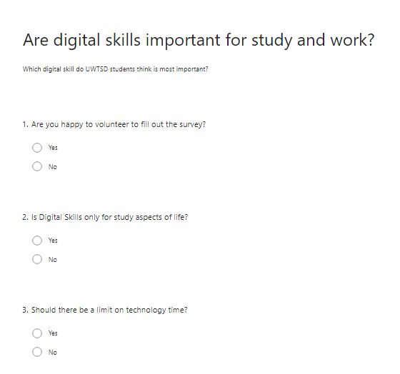
Method

Slide 6
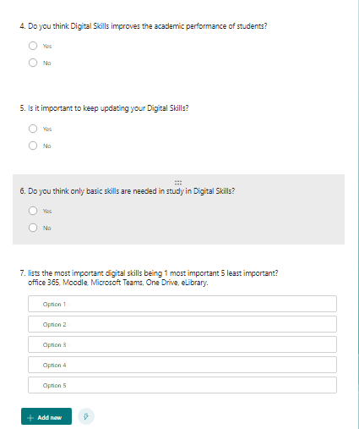
Method

Slide 7
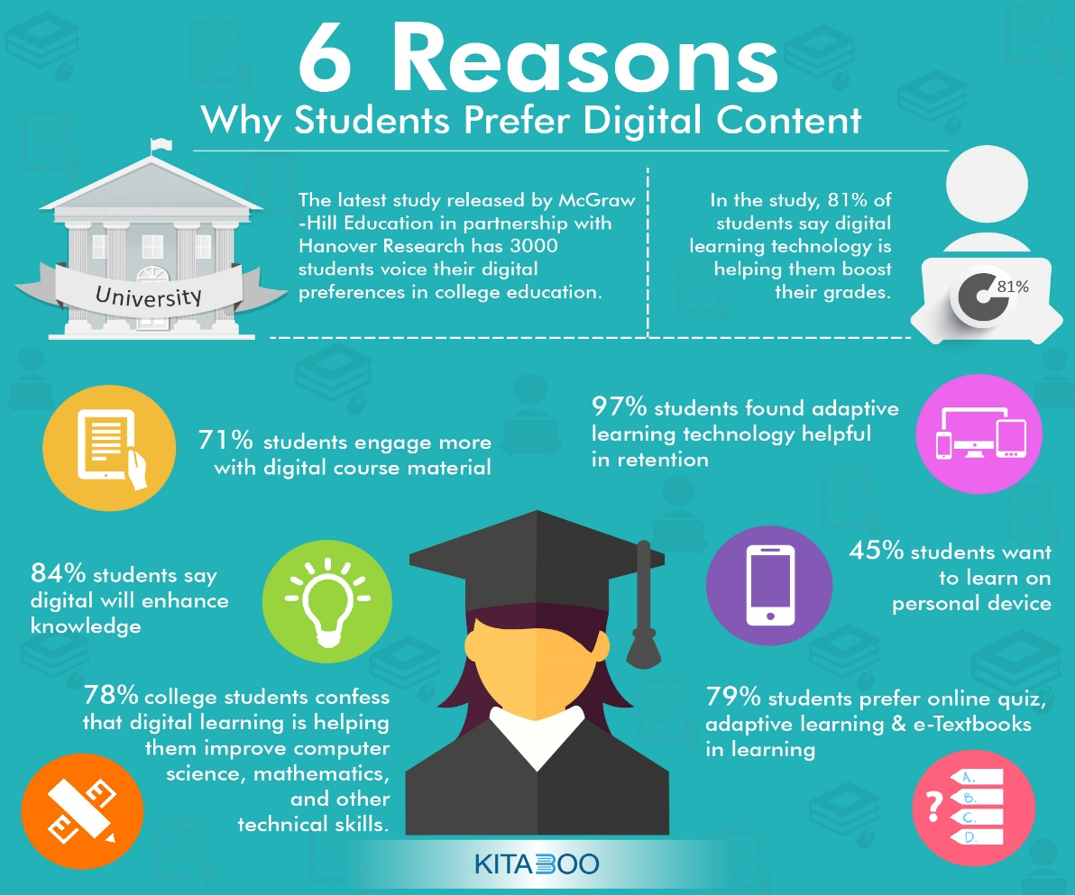
Method
https://kitaboo.com/6-reasons-students-prefer-digital-content/

Slide 8
Ethical Consideration
We have taken permission of UWTSD students to participate voluntarily.
Participating students were informed about the purpose of survey.
Participation on the survey will not hamper their ongoing study and course.
We assure to be respectful, kind and fair with the upmost integrity.
The outcome of the survey are not personally linked to the students.

Slide 9
Hypothesis
By knowing the most use of digital skill at UWTSD, it will emphasis students to be confidant on this particular skill and explore career based on this skill. Also, it will give them feedback to learn more on other skills.
On the other side, University admin and Teachers will know their area of attention to facilitate students more and in a way university can save more money.

Slide 10
References
Abid Haleem et al. (2022) ‘Understanding the role of digital technologies in education: A review’, Sustainable Operations and Computers, 3, pp. 275–285. Available at: https://doi.org/10.1016/j.susoc.2022.05.004.
Haider Th.Salim Alrikabi et al. (2022) ‘Smart Learning based on Moodle E-learning Platform and Digital Skills for University Students’, International journal of recent contributions from engineering, science & IT, 10(1). Available at: https://doi.org/10.3991/ijes.v10i01.28995.
Sinkowitz-Cochran, R.L. (2013) ‘Survey Design: To Ask or Not to Ask? That is the Question’, Clinical infectious diseases, 56(8), pp. 1159–1164. Available at: https://doi.org/10.1093/cid/cit005.
https://kitaboo.com/wp-content/uploads/2018/02/6-Reasons-Why-Students-Prefer-Digital-Content-01-1536x1349.jpg

