Slide 1
The Role And Importance Of Quality Service, Hospitality And Guest Services In The Hospitality Industry
Gulam Shah Nawaj
STUDENT ID: 2209347
Lecturer : Charlotte Joyner

Slide 2
Table of Content
Overview of Accor
Fairmont Hotels & Resorts
Fairmont Main Consumers
The Nature, Scope And Role Of The Guest Services And Facilities
The Need To Consider The Role And Function Of Guest Services
The Importance Of Hospitality And How The Hotels Meet/Exceed Guest Expectations
Conclusion
References

Slide 3
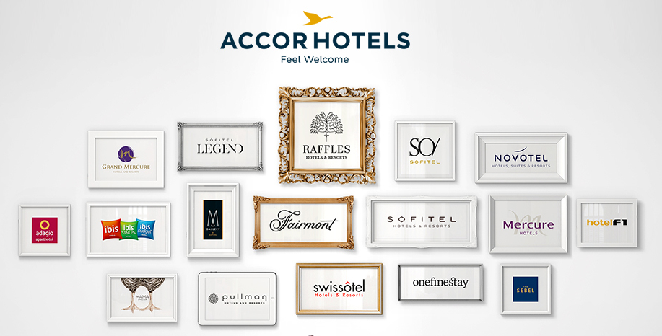
Overview of Accor
Accor is a well-known worldwide hospitality corporation known for its diverse collection of hotels and resorts under several names. Accor is dedicated to providing outstanding guest experiences and has a significant presence in the industry (Accor Hotels).
The company's focus to offering extraordinary hospitality has won it an excellent reputation, making it a favourite option for travellers all over the globe (Accor - world-leading hotel group in Hospitality). Accor aspires to create amazing stays that surpass guest expectations, guaranteeing that each visitor gets personalised attention, first-rate service, and a genuinely unique experience.

Slide 4

Fairmont Hotels & Resorts
Within the Accor group, Fairmont Hotels & Resorts is a famous luxury hotel brand. For more than a century, Fairmont has been linked with unparalleled elegance and excellent service. Its famous resorts are situated in prominent places across the globe, providing visitors with luxury rooms, exceptional dining experiences, and world-class spa and wellness facilities (Fairmont Hotels and resorts - luxury hotels). Fairmont's dedication to conserving architectural history, delivering personalised guest experiences, and encouraging sustainability distinguishes it as a premium hotel industry leader.

Slide 5
Fairmont Main Consumers
Fairmont Hotels & Resorts' primary customers are sophisticated luxury travellers seeking outstanding experiences and great service (Luxury Hotels & Resorts - Fairmont). These are often high-net-worth people, corporate leaders, celebrities, and wealthy leisure travellers who desire exclusivity, refinement, and personalised attention.
Fairmont's locations serve to visitors that value the better things in life and seek out opulent lodgings, great cuisine, and distinctive cultural and recreational experiences. The brand's reputation for providing great service and creating unforgettable encounters draws a devoted following of customers who value exceptional hospitality and seek the pinnacle of luxury in their travel experiences (Accor Hotels).

Slide 6
The Nature, Scope And Role Of The Guest Services And Facilities

Slide 7
The Nature, Scope And Role Of The Guest Services And Facilities
Accommodations
Fairmont provides opulent and stylishly equipped rooms, suites, and villas with first-rate facilities, providing guests' ultimate comfort and refinement.
Personal check-in and check-out services are provided by dedicated professionals, assuring a smooth and quick arrival and departure experience (Xiang et al., 2022).
Concierge Services
The concierge services at Fairmont are geared to aiding visitors with a variety of requests, such as restaurant reservations, ticket bookings, transportation arrangements, and insider information on local sites and activities.
The concierge crew ensures that visitors have a pleasant and memorable stay by catering to their specific tastes and requirements (Roques, 2015).

Slide 8
The Nature, Scope And Role Of The Guest Services And Facilities
Dining & Culinary Experiences:
Fairmont has a number of great restaurants, pubs, and lounges that serve a variety of cuisines ranging from fine dining to casual food.
Gastronomic pleasures created by famous chefs, superb wine choices, and creative cocktail experiences are available to guests, giving a culinary adventure inside the hotel itself.
Spa and Wellness Facilities:
The Fairmont's spa and wellness facilities provide a relaxing and rejuvenating haven.
Massages, facials, and body therapies are among the treatments available to guests, which are administered by professional therapists (Xiang et al., 2022).
Guests looking to maintain their well-being throughout their visit may take use of cutting-edge exercise centres, swimming pools, and wellness programmes.

Slide 9
The Nature, Scope And Role Of The Guest Services And Facilities
Event Spaces and Meeting Facilities:
Fairmont locations include sophisticated event rooms and conference facilities that appeal to both business and social groups.
Professional event planners and personnel guarantee that conferences, meetings, weddings, and other special events are executed flawlessly, offering total assistance from planning to execution.
Recreation and Leisure Activities:
Fairmont hotels provide a variety of recreational and leisure activities, such as golf courses, tennis courts, water sports, fitness programmes, and cultural experiences.
Guests may immerse themselves in the local culture, see neighbouring sights, or just relax in the tranquil surroundings of the hotel (Golosnichenko & Golosnichenko, 2022).

Slide 10
The Need To Consider The Role And Function Of Guest Services

Slide 11
The Need To Consider The Role And Function Of Guest Services
Personalization and Customization:
Hotel guest services enable them to personalise and customise their guests' experiences. Understanding individual tastes, wants, and special requests allows hotels to personalise services and facilities to each visitor, resulting in a unique and memorable experience (Golosnichenko & Golosnichenko, 2022). This personalised approach increases visitor pleasure and gives the impression of exclusivity.
Upselling and income Generation:
Upselling and cross-selling possibilities in guest services may help generate income. Well-trained personnel may detect and provide extra services, upgrades, or experiences that correspond to customers' preferences, improving the hotel's income per visitor (Lacalle, 2022).

Slide 12
The Need To Consider The Role And Function Of Guest Services
Problem Resolution:
visitor services are critical in dealing with and resolving visitor difficulties and complaints. Prompt and effective issue resolution indicates the hotel's dedication to client pleasure and may transform a poor experience into a good one. Handling guest problems properly contributes to the hotel's reputation and helps to avoid unfavourable reviews or internet reaction (Roques, 2015).
Brand Differentiation:
In a competitive market, a hotel brand's guest services may be a crucial differentiator. Providing great service distinguishes a hotel from its rivals and contributes to the development of a unique character and reputation (Xiang et al., 2022). Guests are more inclined to choose a hotel with exceptional guest services than one with a basic level of service.

Slide 13
The Importance Of Hospitality And How The Hotels Meet/Exceed Guest Expectations

Slide 14
The Importance Of Hospitality And How The Hotels Meet/Exceed Guest Expectations
Visitor Satisfaction
Hospitality is important in guaranteeing visitor satisfaction. Hotels can create a good and delightful experience for visitors by delivering polite, attentive, and personalised service (Golosnichenko & Golosnichenko, 2022). This involves anticipating visitors' requirements, swiftly resolving their problems, and going above and beyond to surpass their expectations.
Individualising Services
Successful hotels recognise that each client is unique and has different preferences and needs. Hotels may adapt the guest experience to match specific demands by providing personalised services and facilities (Roques, 2015). Understanding visitors' preferences for room layout, dietary restrictions, special events, and delivering customised advice and services are all part of this.

Slide 15
The Importance Of Hospitality And How The Hotels Meet/Exceed Guest Expectations
Increasing Loyalty
Exceptional hospitality encourages visitor loyalty. When visitors feel really welcomed and cared for, they are more likely to become repeat customers and hotel champions.
Hotels that prioritise hospitality develop a loyal client base, which leads to greater income and favourable word-of-mouth referrals (Lacalle, 2022).
Creating unique Experiences
Hospitality is all about providing visitors with unique experiences that leave a lasting impact. Hotels try to go above and beyond to surprise visitors with thoughtful gestures, personalised touches, and one-of-a-kind services (Golosnichenko & Golosnichenko, 2022).
These extraordinary events elicit good feelings and leave visitors with great memories that they appreciate and share with others.

Slide 16
Conclusion
Accor is a well-known worldwide hospitality corporation known for its diverse collection of hotels and resorts under several names. Accor is dedicated to providing outstanding guest experiences and has a significant presence in the industry.
The company's focus to offering extraordinary hospitality has won it an excellent reputation, making it a favourite option for travellers all over the globe. Accor aspires to create amazing stays that surpass guest expectations, guaranteeing that each visitor gets personalised attention, first-rate service, and a genuinely unique experience.

Slide 17
References
Accor - world-leading hotel group in Hospitality. Available at: https://group.accor.com/en (Accessed: 23 May 2023).
Accor Hotels - discover all our hotels: Accor (no date) all.accor.com. Available at: https://all.accor.com/brands/index.en.shtml (Accessed: 24 May 2023).
Fairmont Hotels and resorts - luxury hotels (no date) Fairmont Hotels and Resorts - Luxury hotels. Available at: https://www.fairmont.com/ (Accessed: 24 May 2023).
Golosnichenko, I. and Golosnichenko, D. (2022) ‘Legal regimes and administrative services: The relationship and the need to consider’, CONCEPTUAL BASIS OF DEVELOPMENT OF DOMESTIC ADMINISTRATIVE LAW AND PROCESS: TRENDS, PERSPECTIVES, PRACTICE, pp. 466–481. doi:10.30525/978-9934-26-233-3-16.
Lacalle, E. (2022) Five frequent hotel guest expectations and how to exceed them, Five frequent hotel guest expectations and how to excee... | Mews Blog. Available at: https://www.mews.com/en/blog/hotel-guest-expectations (Accessed: 24 May 2023).
Luxury Hotels & Resorts - Fairmont (no date) all.accor.com. Available at: https://all.accor.com/brands/fairmont.en.shtml (Accessed: 24 May 2023).
Roques, H. (2015) ‘CSR in the hotel industry: The Accor Perspective’, Responsible Business, pp. 171–178. doi:10.1002/9781119206156.ch11.
Xiang, K., Zhang, H. and Qiao, G. (2022) ‘How to create interactive rituals: Key factors and strategic configurations for host-guest interaction in Boutique Hotels’, Journal of Hospitality and Tourism Management, 52, pp. 428–438. doi:10.1016/j.jhtm.2022.08.002.
‘2. scope of analysis: Sample of regulated facilities’ (2020) Pollution Limits and Polluters’ Efforts to Comply, pp. 16–23. doi:10.1515/9780804777605-004.
‘Bostock, john, (30 Sept. 1916–26 Oct. 1977), Business Consultant; director: British Hartford Fairmont Ltd; British Hartford Fairmont Investments Ltd; Unibin Ltd’ (2007) Who Was Who [Preprint]. doi:10.1093/ww/9780199540884.013.u152473.

Slide 18
Thank
You!

