Slide 1
How the use of Multi-Sensory Resources can support an individual with a Specific Learning Difficulty
By Theresa Peters

Slide 2
Focus
To discuss a resource one has researched. To evaluate the impact this has on a child with Development Coordination Disorder (DCD)
Further discussion on the relevance of Multi-sensory resources and the role they play in a child's education

Slide 3
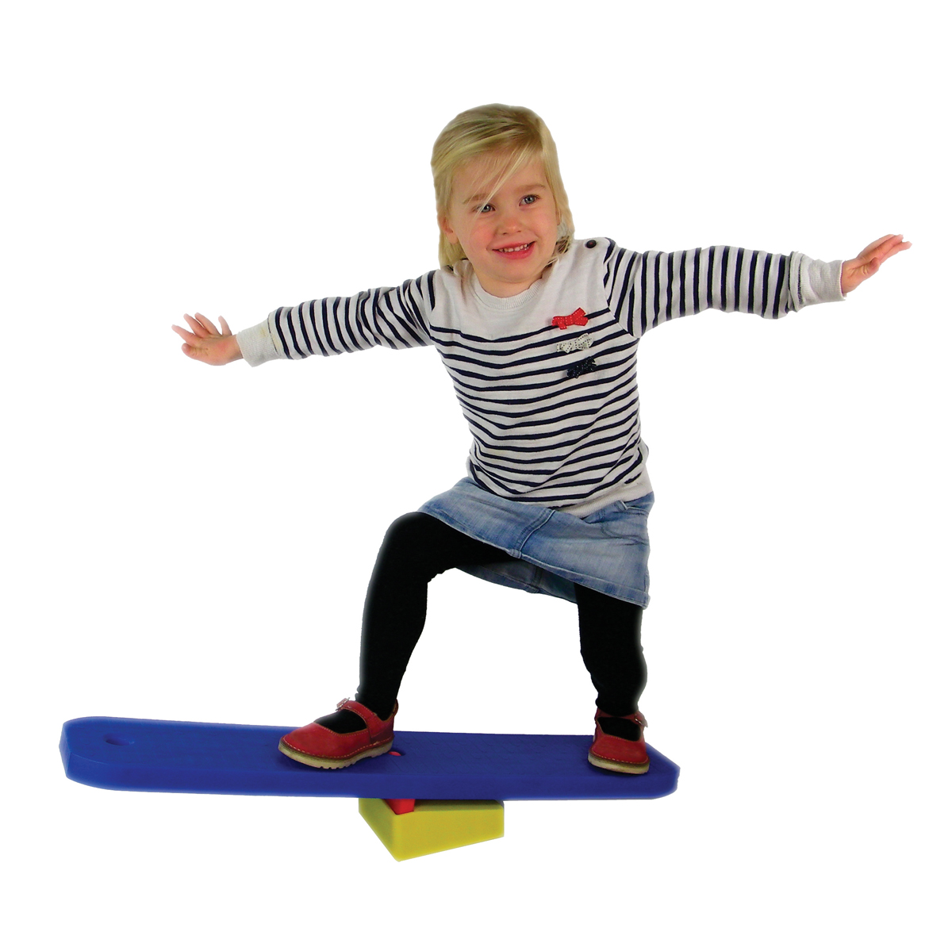
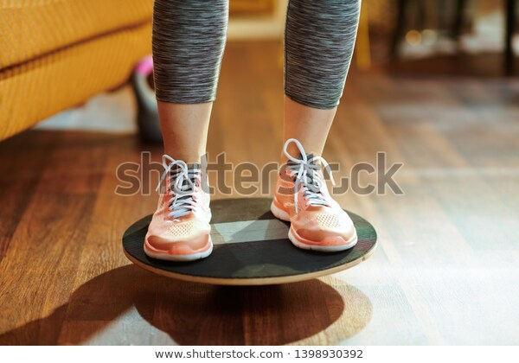
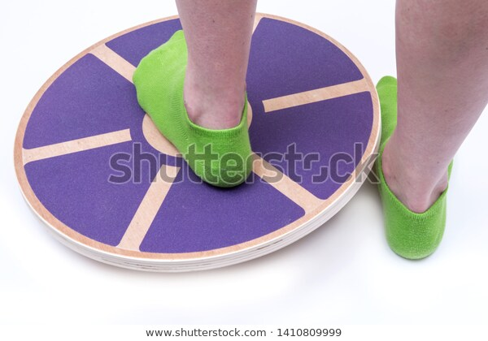
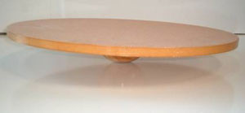
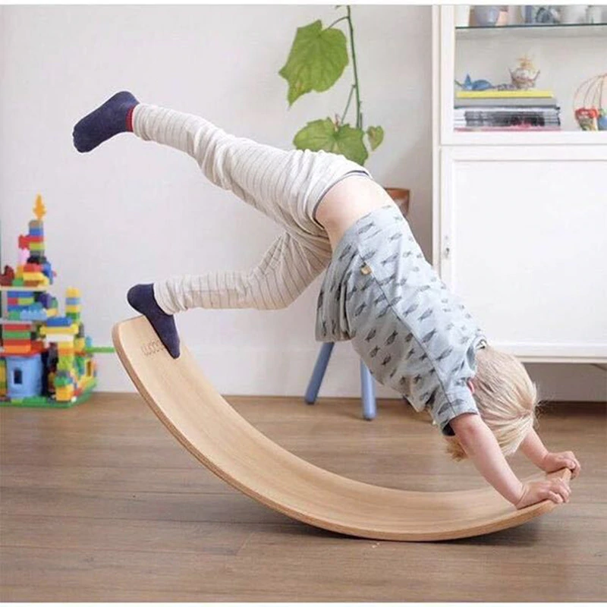
The resource – Balance/Wobble Boards
Alliance images n.d
Fantasticdyspraxic n.d.
Fantasticdyspraxic n.d.​
Bjphotographs n.d
Aliexpress.com n.d

Slide 4
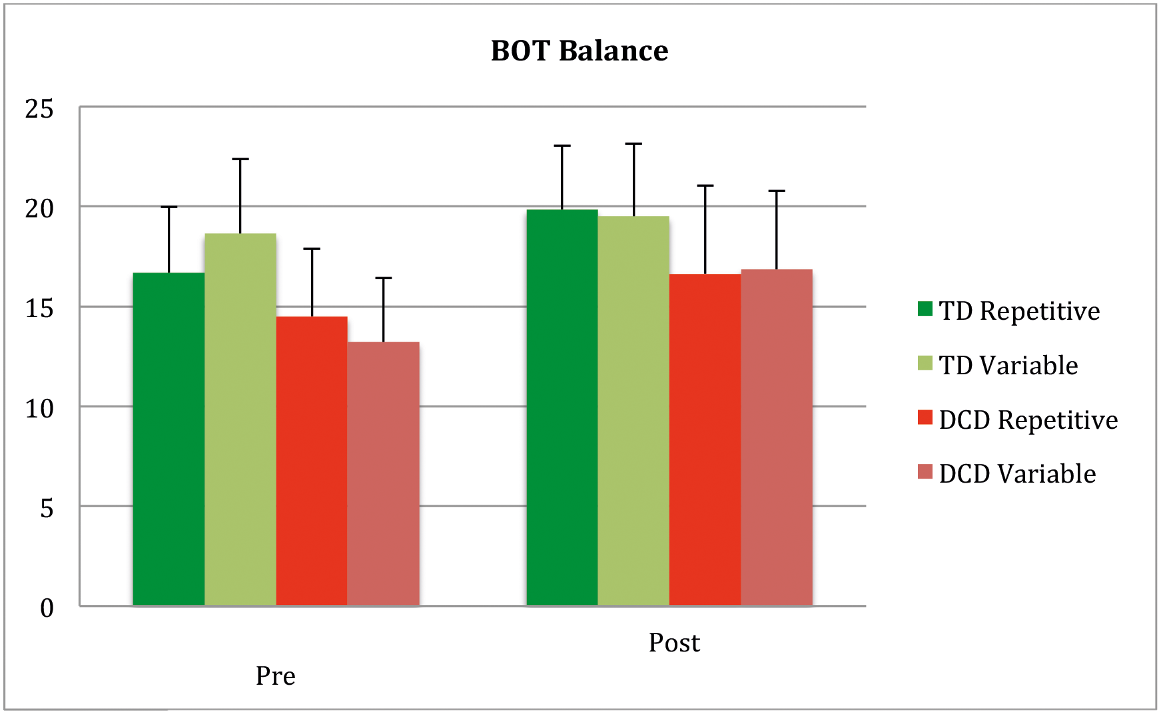
The Science behind it
Propriception
Neuromuscular activation
Mental Focus
Collaboration of muscles and body parts
Developement of gross motor skills
Bonney ,Jelsma ,Ferguson,Smits-Engelsman, 2017

Slide 5
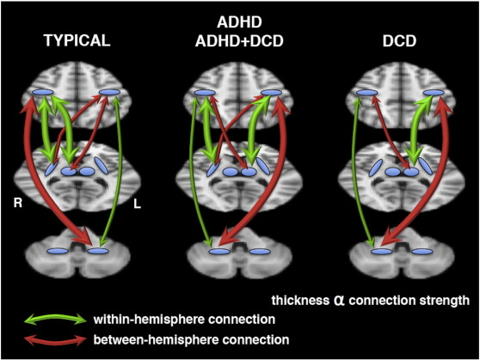
Use of balance board requires focus and concentration
Both sides of brain communicate with each other
Development of self-awareness and spatial awareness
Repeated, focused use results in improved coordination
McLeod, Langevin, Dewey and Goodyear (2016)

Slide 6
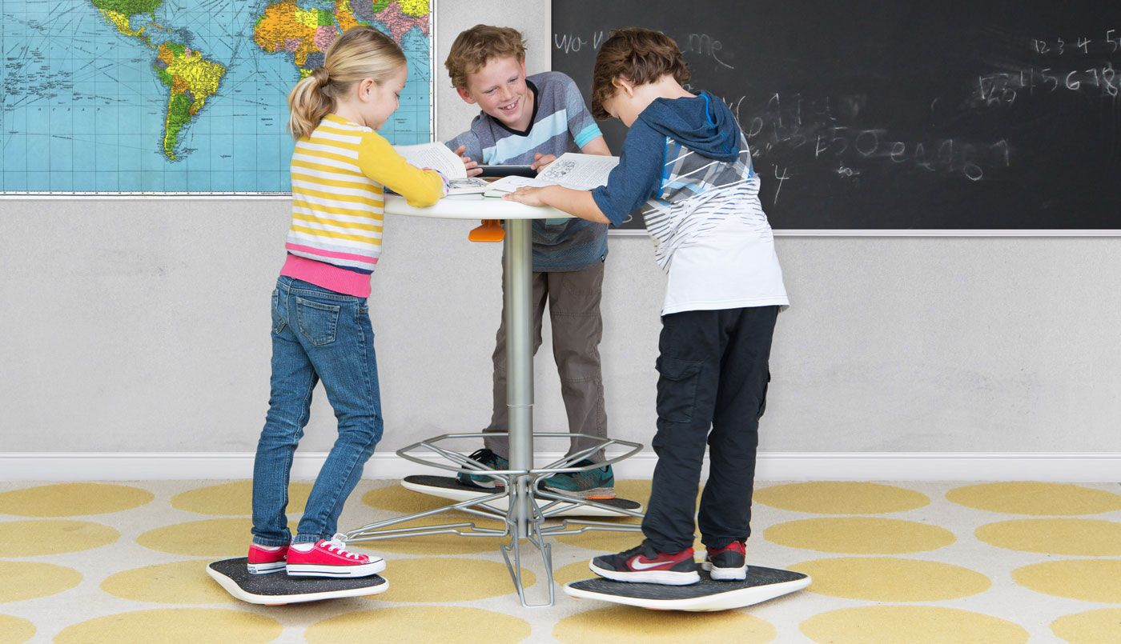
Activities and Methods of Use
Physical
Exercise is beneficial to idividuals with DCD
NHS
Balancing
Hand to hand throwing using bean bags, water balloons, scarves
Catching bubbles while using
Playing magnetic games, magnetic fishing, Hook a duck
Use while doing creative activities, drawing, painting, writing, playground chalking
Some can be used in class at desk
Cooper, 2016

Slide 7
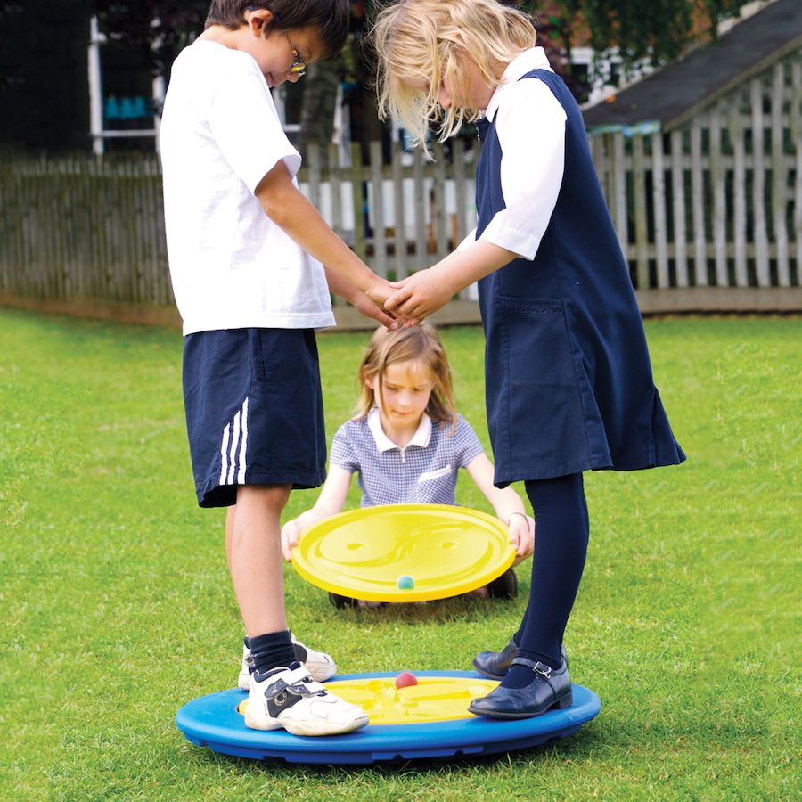
Social and Emotional
Throwing bean bag to friends, encouraging cooperation and turn taking
Working in circle time
Encourages child to verbalise their plans for movement
Reduces use of team games
Sensory Educational n.d.

Slide 8
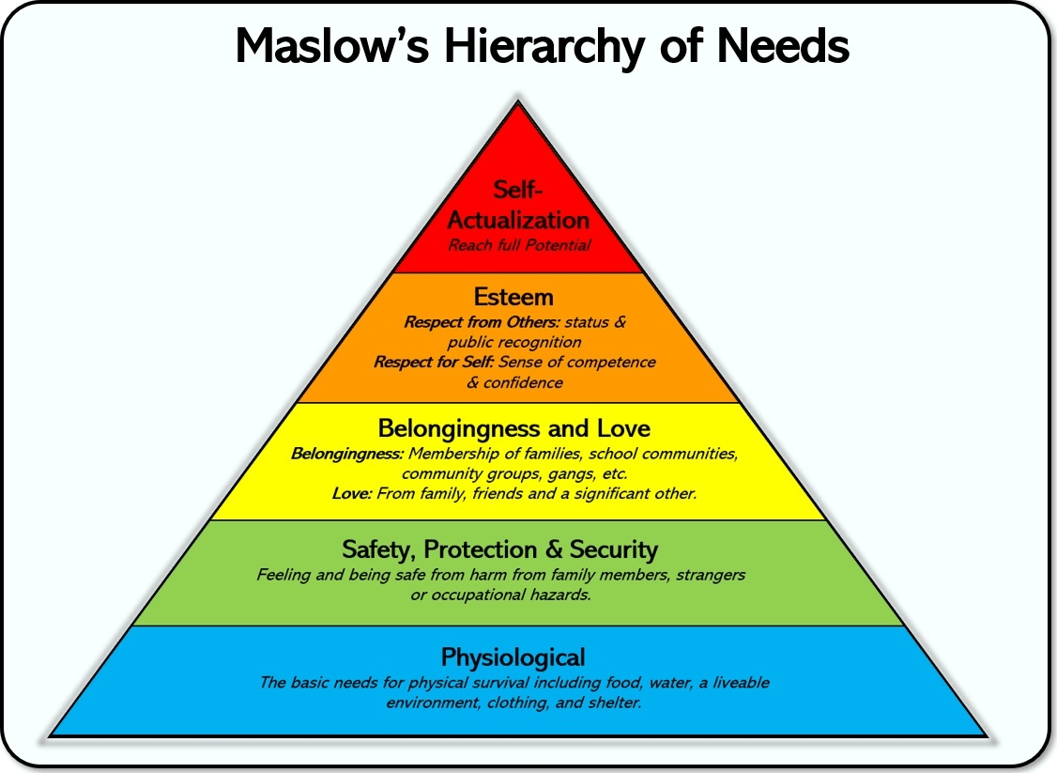
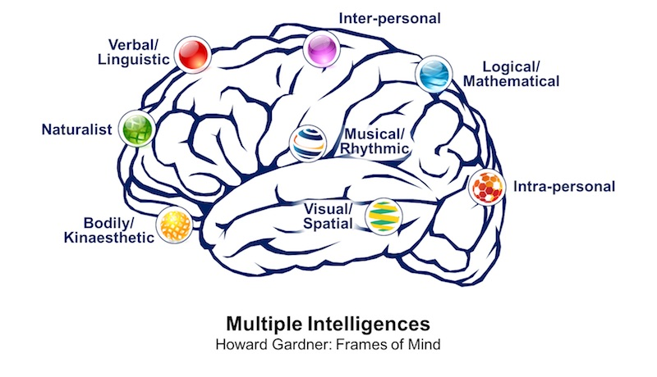
Links with theorists
Maslow
Maslows theory shows that self-esteem and confidence influence children's learning
Gardner's Theory of Multiple Intelligences
'Strengths and weaknesses in one area do not predict strengths and weakness in others'
Clayton 2018
Drew, n.d.

Slide 9
Four areas of SEN
Special educational needs and disability SEND
code of practice
2015
1. Communication and Interaction
3. Social, emotional and mental health difficulties
4. Sensory or Physical Needs
2. Cognition and Learning Needs​

Slide 10

Further Evidence
Shemy and Mohamed conducted a study where children with DCD were involved in research into the benefits of balance training.
Study Group
Various training in balance skills including balance boards and Nintendo Wii balance board
Control Group
No additional training given
Pixabay n.d.
Pixabay n.d.

Slide 11
Conclusion
Evaluation
Balance boards are:
a useful resource to develop gross motor skills
beneficial to promote good concentration skills
enables the child to participate in activities that may otherwise be difficult
Useful to create opportunities to develop friendships
FUN for all children but particularly those with DCD
THANK YOU FOR WATCHING

Slide 12
References:
Bonney, E., Jelsma, L.D., Ferguson, G. D., Smits-Engelsman, B.C.M (2017) Learning better by repetition or variation? Is transfer at odds with task specific training? https://journals.plos.org/plosone/article?id=10.1371/journal.pone.0174214 Accessed on 22/4/2020
https://www.fantasticdyspraxic.co.uk/wp-content/uploads/2016/04/balancebeamaction-tuftex-1-160x160.jpg Accessed on 22/4/2020
https://ae01.alicdn.com/kf/H397c2bea58a14b78871440611f7ba048Y/Balance-Board-Toy-Wooden-Seesaw-Indoor-Curved-Board-Baby-Double-Wooden-Outdoor-Seesaw-Yoga-Board-Outdoor.jpg Accessed on 22/4/2020
https://www.shutterstock.com/image-photo/closeup-on-fit-sports-woman-fitness-1398930392?irgwc=1&utm_medium=Affiliate&utm_campaign=Pixabay+GmbH&utm_source=44814&utm_term=https%3A%2F%2Fpixabay.com%2Fimages%2Fsearch%2Fbalance%2520boards%2F Accessed on 22/4/2020
https://www.shutterstock.com/g/bjphotographs?searchterm=wobbleboards&sort=popular Accessed on 22/4/2020
McLeod, K.R., Langevin, L.R., Dewey, D., Goodyear, B.G. (2016) Atypical within- and between-hemisphere motor network functional connections in children with developmental coordination disorder and attention-deficit/hyperactivity disorder https://www.sciencedirect.com/science/article/pii/S2213158216301176
Accessed on 22/4/2020
https://ars.els-cdn.com/content/image/1-s2.0-S2213158216301176-gr4.jpg Accessed on 22/4/2020
Cooper, D. (2016) There's a standing desk and balance board for kids now Engadget https://www.engadget.com/2016-05-02-theres-a-standing-desk-and-balance-board-for-kids-now.html?guccounter=1&guce_referrer=aHR0cHM6Ly93d3cuZ29vZ2xlLmNvbS8&guce_referrer_sig=AQAAAFJdzm-Pl6tVd9xWBH-Vh8dorF3yq9-Ks3a6en4zxk5XkgnDCFlFC4mbn3a8xOH3JWduYe_dZ3ralVmYYXZBBbPVvEcvIlQP5waJZNAHAenDr9UZtqW7tjKUW73XNUKhgBq1QH3o2o24lFB6zK2_ivjuCvW-8Jf2Gn5j_5HrL75g Accessed on 22/4/2020
https://www.cheapdisabilityaids.co.uk/ekmps/shops/podcmedia/images/tai-chi-balance-board-large-152184-1-p.jpg Accessed on 22/4/2020

Slide 13
References continued
https://www.gettingsmart.com/2019/10/4-holistic-classroom-ideas-inspired-by-maslows-humanist-approach/ Accessed 22/4/2020
GARDNER, H., (2017) Taking a multiple intelligences (MI) perspective. Behavioral and Brain Sciences, Volume 40, p. 67.
Department for Education, (2015) p.97-98 Special educational needs and disability code of practice: 0 to 25 years Statutory guidance for organisations which work with and support children and young people who have special educational needs or disabilities Accessed 22/4/2020
https://pixabay.com/illustrations/friend-boy-girls-kids-clipart-2782785/ Accessed 23/4/2020
El Shemy, S. A. and Mohamed, N. E. (2017) ‘Effect of Sensory Integration on Motor Performance and Balance in Children with Developmental Coordination Disorder: A Randomized Controlled Trial’, International Journal of Therapies & Rehabilitation Research, Volume 6, Issue (1), p. 1–9. doi: 10.5455/ijtrr.000000213.
https://www.nhs.uk/conditions/developmental-coordination-disorder-dyspraxia/treatment/ Acessed on 23/4/2020
https://www.pocketbook.co.uk/blog/2018/02/06/multiple-intelligences/multiple-intelligences-howard-gardner/ Accessed on 22/4/2020

