Slide 1


Group J
Jeffrey Elliss, Alex Baldwin, Duke Asamoah and Claudia Andre

Slide 2
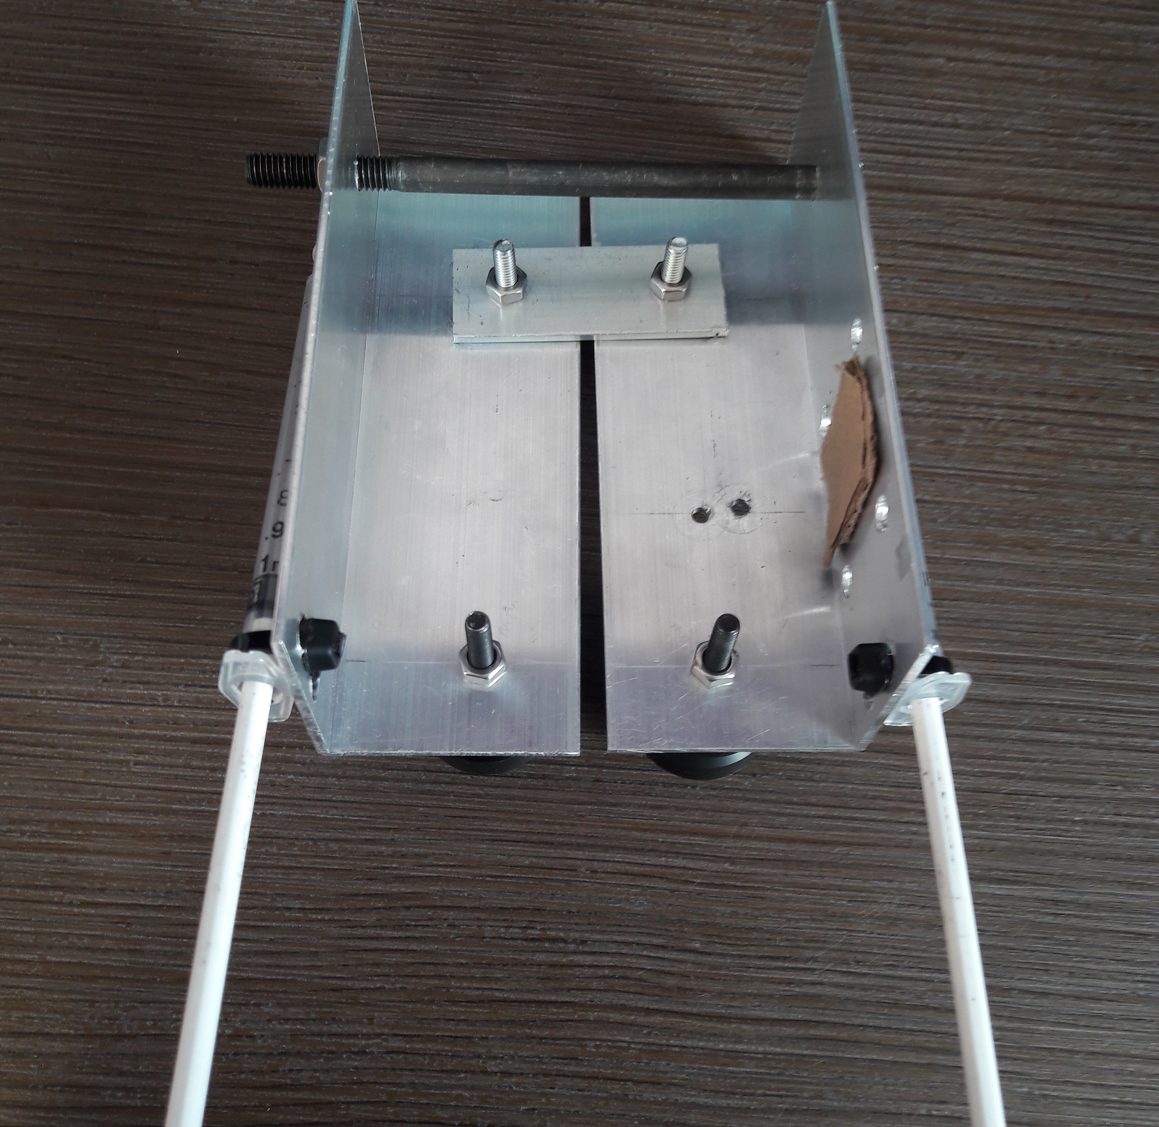
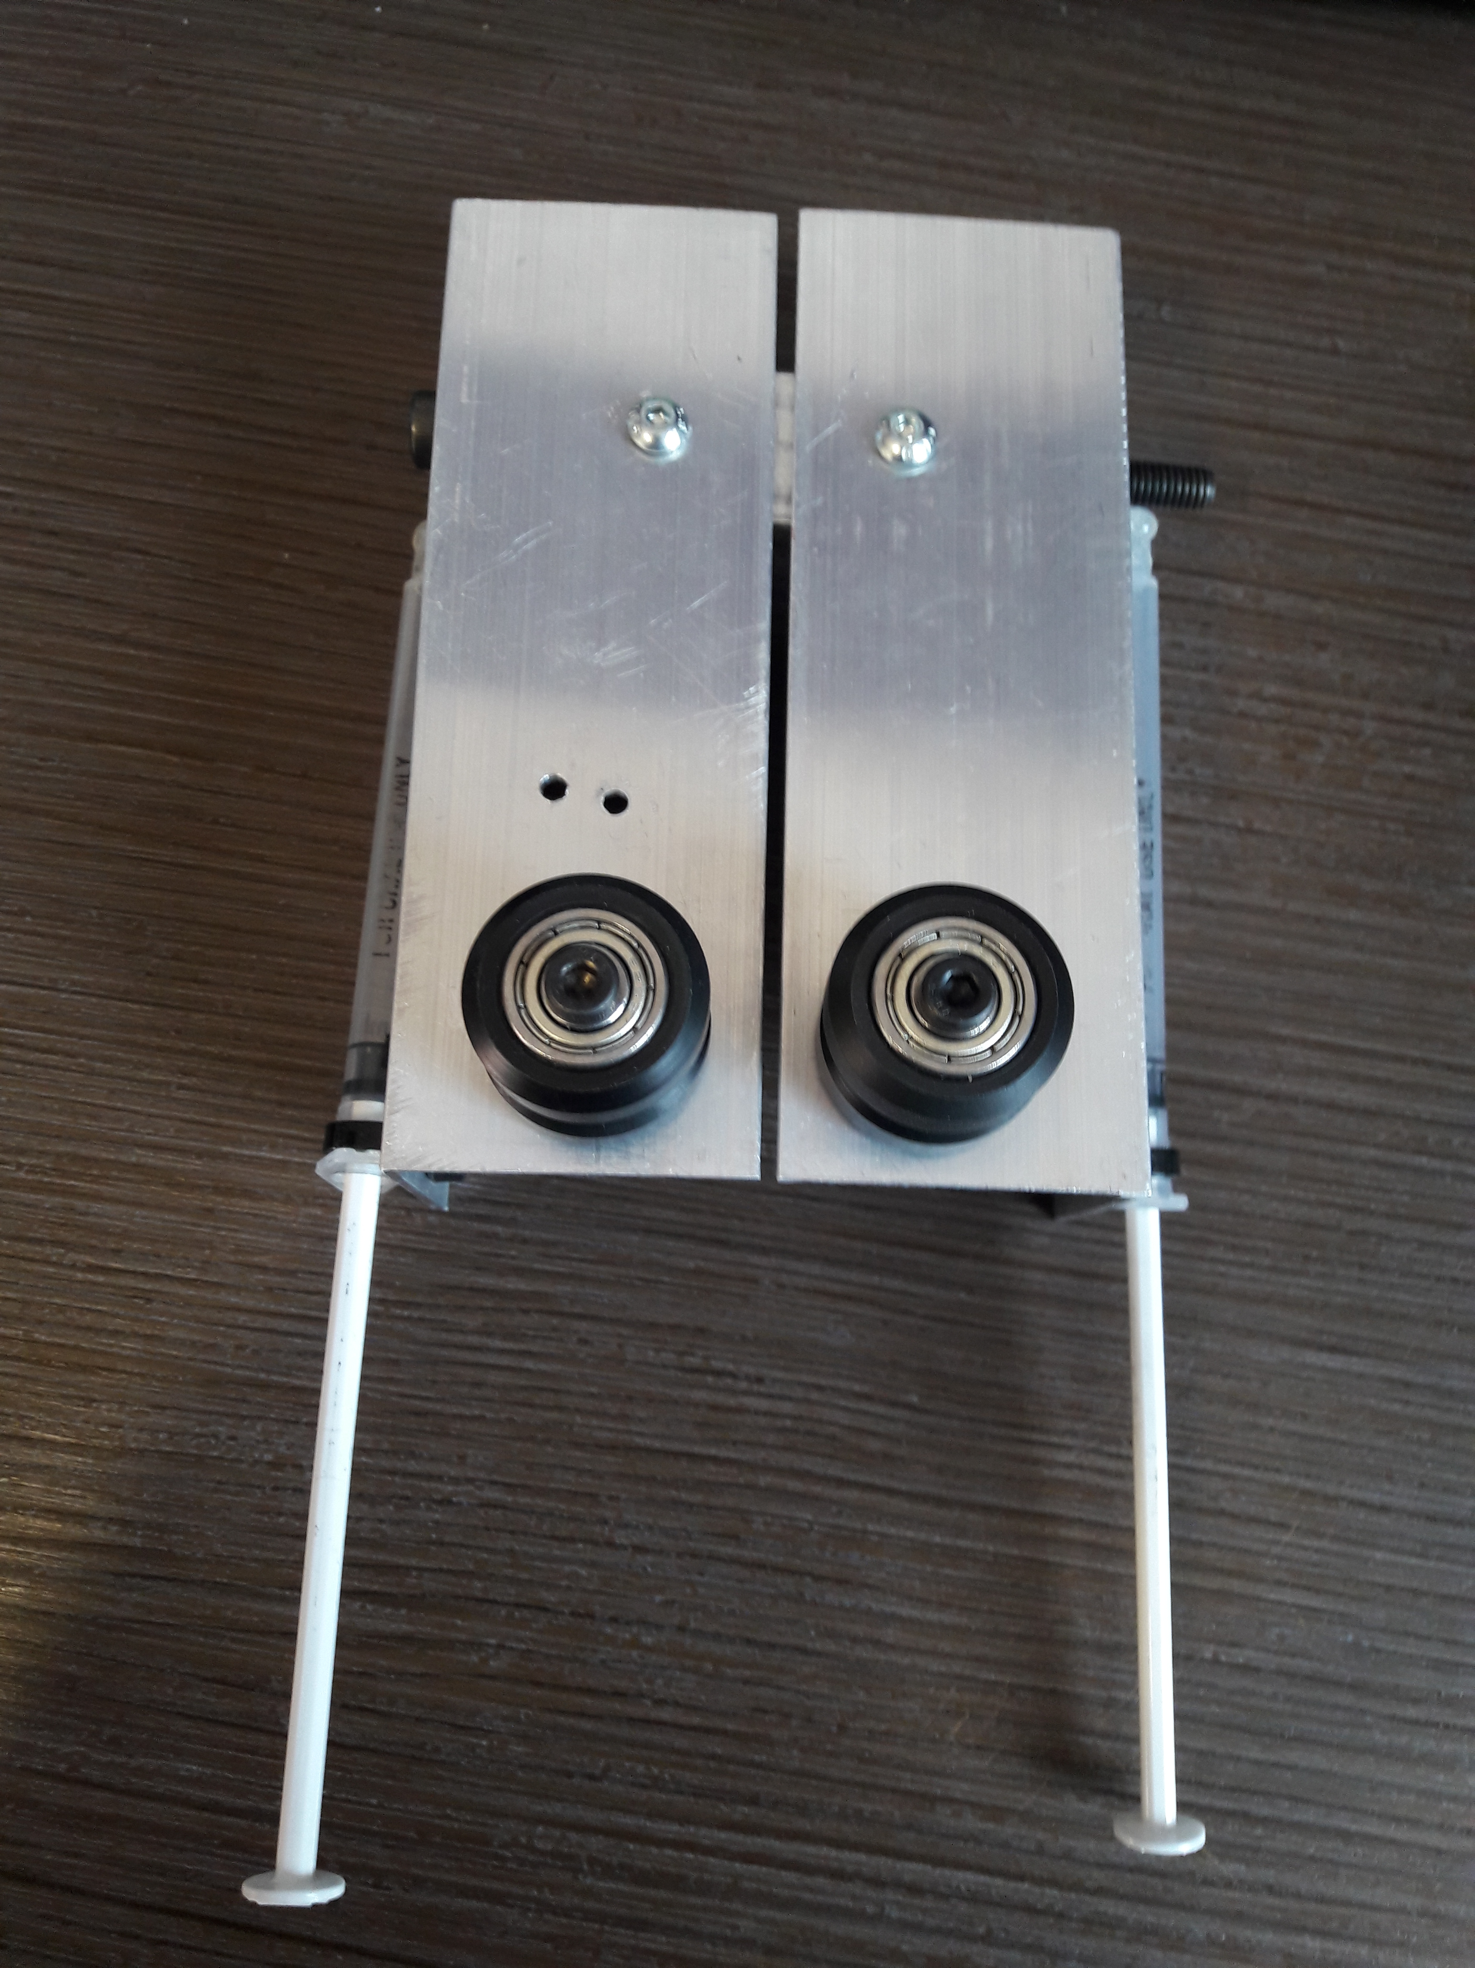
Jeffrey Elliss
Two Leg Design, Allowing both legs to pivot for adjustability.
Adjustability
Simple construction

Slide 3
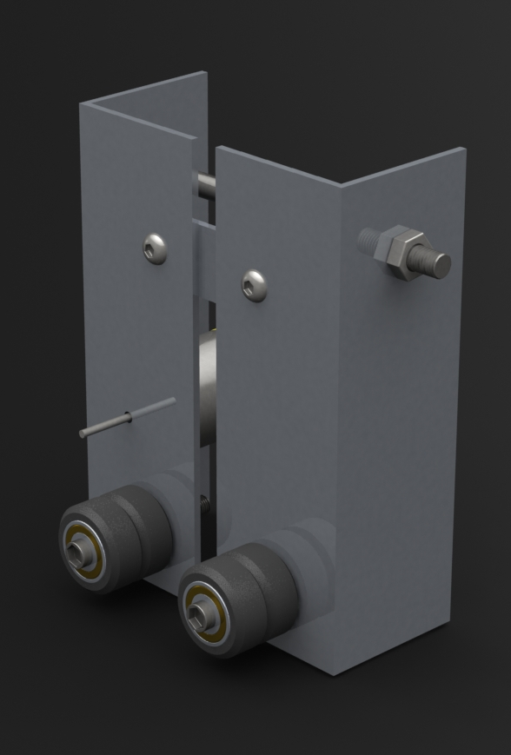
Alex Baldwin
Robustness
CAD
Chain

Slide 4
Duke Asamoah
Using the voltage and current of electric motor and batteries to calculate resistance
Calculation for syringe
Cost on electric motor from RS components £4.55
Cost on battery holder from Rapid £1.68
Cost on energizer batteries from battery force £2.10
Cost on syringes from Medi supplies £0.84
Total: £9.17
The group discussed and agreed to buy components that wouldn’t cost so much and shouldn’t exceed over £20. The reason to this was to keep £5 spare to buy on any spare components for the device.

Slide 5
Claudia Andre
The climbing robots can be grouped into four principal categories based on their characteristic
robots have two principal mechanisms
Forces loads and effects of vibration
Different propulsion systems are used with different robotic configurations
Miniaturization of propulsion systems
Wheels

