Slide 1

Component 1: Individual Presentation
Module: LCBB4009
Understanding Organisational Structure and Culture
Name: GHEORGHE MOLDOVAN
Student ID: 2236340
Submission Date: 26-07-2025

Slide 2
OUTLINE
What is organisational structure?
Importance of structure
Three structure types:
Line Structure
Process-Based Structure
Boundaryless Structure
Representation of structures
Example organisation: JD Sports
Conclusion
References

Slide 3
WHAT IS ORGANISATIONAL STRUCTURE?
The organisational structure determines how tasks and responsibilities along with authority distribution operate within a business framework.
The structure determines how workflows and how people communicate with each other and who reports to whom.
A well-designed structure leads to better efficiency and clearer communication and strategic alignment.
Source: Jones and George (2021)

Slide 4
IMPORTANCE OF STRUCTURE
The organisation provides employees with clear definitions of their responsibilities and performance targets.
The organisation achieves better coordination between different departments.
The organisation achieves better reporting lines and decision-making.
The system enables organisations to scale their operations and monitor performance.
The global retail business JD Sports maintains consistency and control through structure across its thousands of stores.
Source: Hitt et al. (2020)

Slide 5
LINE STRUCTURE
Traditional, vertical chain of command
Each employee has one direct supervisor
Clear authority and discipline
JD Sports Example: Store-level management — Store Manager → Assistant Manager → Sales Assistants
Advantages: Simple, disciplined, clear hierarchy
Disadvantages: Inflexible, managers can become overwhelmed
Source: McGraw-Hill Education (2021)

Slide 6
PROCESS-BASED STRUCTURE
The company establishes teams through business process-based organisation (e.g. customer service, logistics, product delivery).
The approach supports complete process understanding and team collaboration between different departments.
JD Sports Example: The online order fulfilment process included teams from IT, warehouse and customer support departments.
The advantages include a strong customer focus and improved efficiency.
The approach may lead to process duplication and confusion between different processes.
Source: Pearce and Robinson (2020)

Slide 7
BOUNDARYLESS STRUCTURE
Breaks down traditional internal and external barriers
The approach focuses on teamwork and flexible work arrangements and remote work practices.
The approach integrates suppliers and partners and global teams.
JD Sports Example: Coordination with global suppliers and remote logistics via cloud-based platforms
The advantages include innovation, agility, and real-time decision-making.
The disadvantages include the difficulty of managing and securing data across boundaries.
Source: Dess et al. (2022)

Slide 8
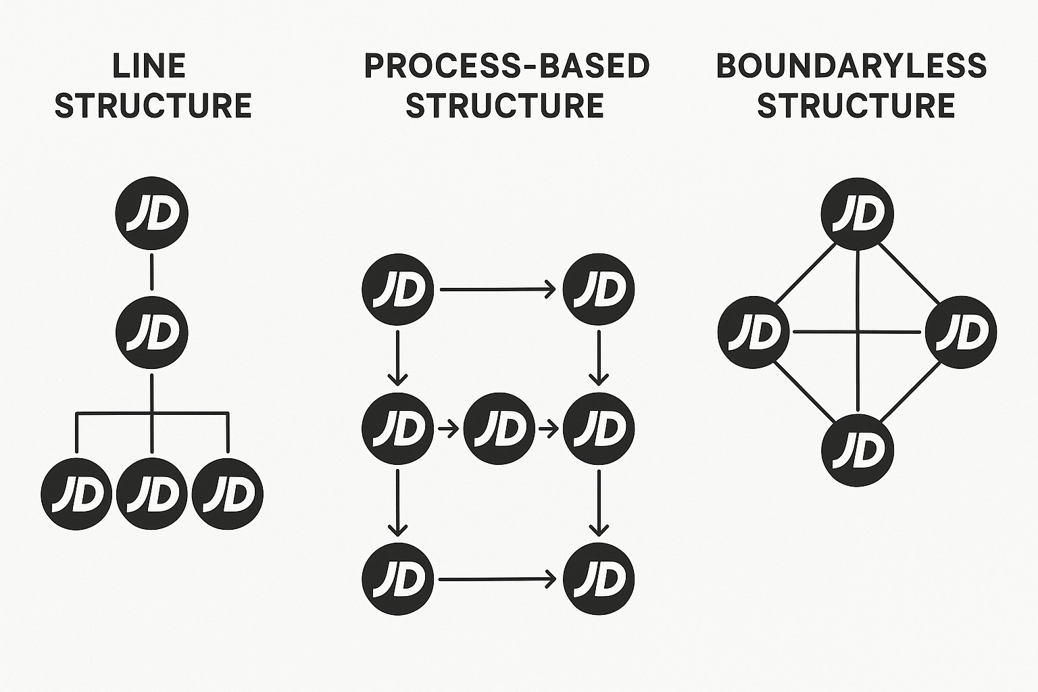
REPRESENTATION OF STRUCTURES CREATED BY ME

Slide 9
CONCLUSION
The operational framework of an organization depends heavily on its structural design
JD Sports implements three structural models which include line, process-based and boundaryless structures
The company maintains operational efficiency in stores while fostering process collaboration and market agility through its global operations.
Businesses that select appropriate structures gain the ability to adapt and succeed in competitive market environments.

Slide 10
references
Dess, G.G., Lombardi, J.A. and Eisner, A.B. (2022) Strategic Management. 10th edn. McGraw-Hill Education.
Hitt, M.A., Ireland, R.D. and Hoskisson, R.E. (2020) Strategic Management: Competitiveness and Globalization. 14th edn. Cengage.
Jones, G.R. and George, J.M. (2021) Contemporary Management. 11th edn. McGraw-Hill Education.
McGraw-Hill Education (2021) Line Organizational Structure. Glossary.
Pearce, J.A. and Robinson, R.B. (2020) Strategic Management. 14th edn. Pearson.
JD Sports (2024) Annual Report and Accounts 2024.

