Slide 1
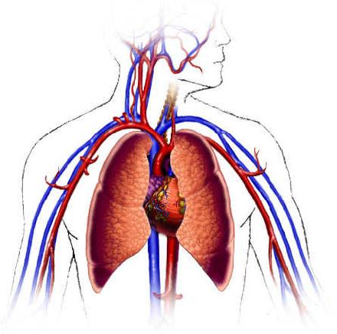
LEVEL 4 • CLINICAL & BIOLOGICAL FOUNDATIONS
Human Body Systems
and the Academic Interview
Explain the measurement, connect the systems and justify the conclusion
BMSC4009A
Notes:
Opening question: If the body were a busy city, which organs would provide transport, waste removal, communication and protection? Take quick answers before revealing the analogies later in the deck.
Sources and further reading:
• OpenStax, Anatomy & Physiology 2e, https://openstax.org/details/books/anatomy-and-physiology-2e

Slide 2
MODULE AIM AND LEARNING OUTCOMES
02
What this module is teaching
Module aim
Develop a holistic understanding of human anatomy and physiology and the clinical observation skills needed to connect biological systems with medical technology.
Learning outcome 1
Learning outcome 2
Demonstrate knowledge and understanding of the structure and function of human body systems and their interrelationships.
Apply clinical observation and patient interaction skills safely and professionally, recording and interpreting findings in a work-based context.
Teaching approach
Learn the anatomy first. Explain normal function next. Then apply that knowledge to a measurement, observation or patient scenario.
The aim is understanding and application, not memorising disconnected facts.

Slide 3
Eleven systems, one body
03
No system works alone
TRANSPORT
Cardiovascular
EXCHANGE
Respiratory
Carries oxygen, nutrients, hormones and heat
Moves oxygen in and carbon dioxide out
SUPPLY
Digestive
CONTROL
Nervous + endocrine
Breaks food down and absorbs nutrients
Coordinates fast signals and slower hormonal responses
SUPPORT
Skeletal + muscular
PROTECT
Skin + immune/lymphatic
Protects, stabilises and creates movement
Forms barriers, detects threats and returns tissue fluid
BALANCE
Urinary
CONTINUITY
Reproductive
Filters blood and regulates fluid, salts and pH
Produces sex cells and supports reproduction
Notes:
Ask pairs to choose one category and predict which other category it depends on most. Accept more than one answer if learners can justify the connection.
Sources and further reading:
• OpenStax, Anatomy & Physiology 2e, Chapter 1: An Introduction to the Human Body

Slide 4
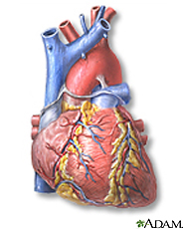
Cardiovascular system
04
The body’s transport network
THE PUMP + CONDUITS
MAIN JOB
The heart creates pressure. Blood vessels route blood. Blood delivers oxygen and nutrients, carries hormones and removes waste.
KEY STRUCTURES
Heart • arteries • capillaries • veins • blood
WORKS WITH
Arterioles change resistance and direct flow between organs. Veins store most blood volume and return it to the heart. Kidneys alter volume; nerves alter rate, force and vessel tone.
CLINICAL CLUE
A low BP can result from reduced cardiac output, reduced vascular resistance or reduced circulating volume.

Slide 5
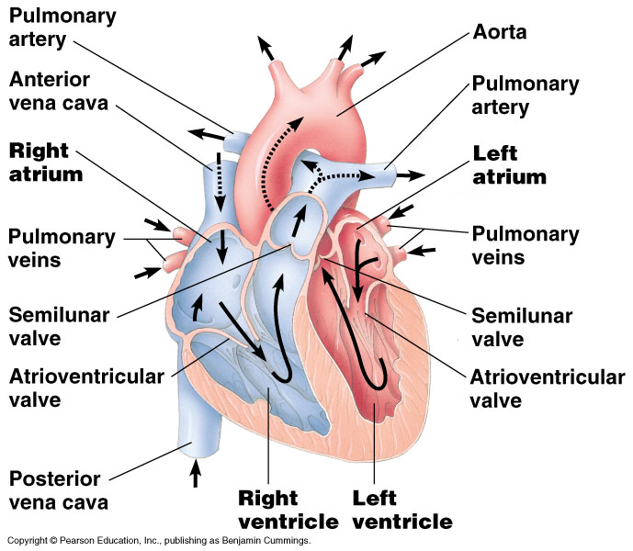
CARDIOVASCULAR SYSTEM
06
Heart anatomy
INTERVIEW FOCUS: NAME THE STRUCTURE, EXPLAIN ITS FUNCTION, THEN LINK IT TO THE MEASUREMENT
KEY ANATOMY
1
Right atrium receives blood returning from the body
2
Right ventricle pumps blood to the lungs
3
Left atrium receives oxygenated blood from the lungs
4
Left ventricle pumps blood to the body
5
Four valves keep blood moving in one direction
6
The septum separates the right and left sides
Main job
Works with
The heart creates pressure and flow by filling and contracting in a regular cycle.
Lungs oxygenate blood. Vessels route it. Nerves, hormones and kidneys help control pressure.
The left ventricle has the thickest wall because it pumps against systemic resistance.
Notes:
.

Slide 6
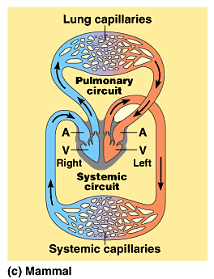
Circuits
Pulmonary circuit
  The blood pathway between the right side of the heart, to the lungs, and back to the left side of the heart.
Systemic circuit
  The pathway between the left and right sides of the heart.

Slide 7
Blood pressure
blood pressure, force originating in the pumping action of the heart, exerted by the blood against the walls of the blood vessels; the stretching of the vessels in response to this force and their subsequent contraction are important in maintaining blood flow through the vascular system.
Formula BP= CO X TPR cardiac output x total peripheral resistance .
Cardiac output is determined by heart rate x stroke volume ( the amount of blood ejected by the heart.

Slide 8
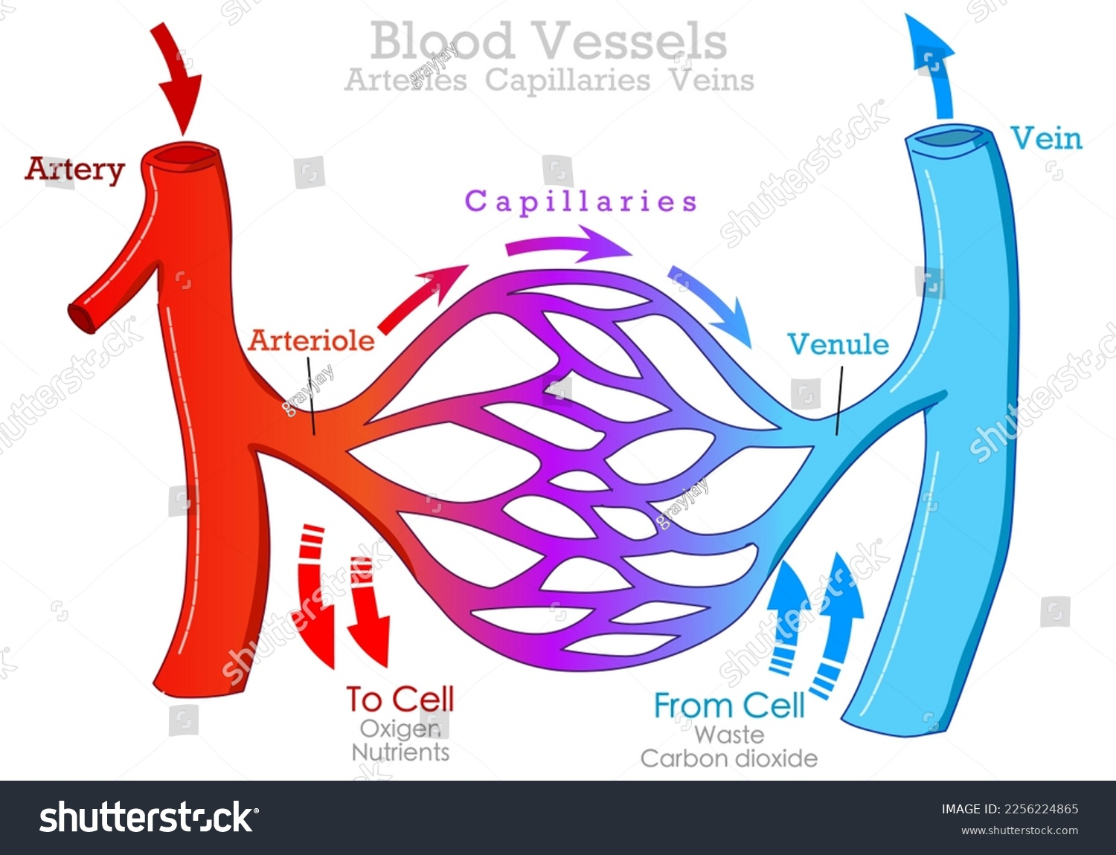
CARDIOVASCULAR SYSTEM
09
Blood vessels and circulation
KEY ANATOMY
1
Arteries carry blood away from the heart
2
Arterioles change resistance and control organ blood flow
3
Capillaries allow exchange with tissues
4
Venules collect blood from capillaries
5
Veins return blood and act as a volume reservoir
Vasoconstriction
Vasodilation
Smooth muscle narrows arterioles. Resistance rises and local blood flow falls.
Smooth muscle relaxes. Resistance falls and local blood flow rises.
Blood pressure depends partly on cardiac output and systemic vascular resistance.

Slide 9
MAP
MAP reflects the average pressure in the arteries over an entire heartbeat, taking into account both the systolic and diastolic phases. It’s an important indicator of whether the body’s organs are receiving enough blood and oxygen.
When MAP drops below 60 mmHg, tissues may become under‑perfused, increasing the risk of organ damage. Conversely, a consistently elevated MAP can signal hypertension or a heightened risk of cardiovascular complications

Slide 10
Blood vessels route blood—and defend pressure
48
Arterioles control resistance; veins control how much blood returns to the heart
ELASTIC ARTERIES
ARTERIOLES
CAPILLARIES
VEINS
Conduct blood and smooth the pulse created by ventricular ejection.
Primary resistance vessels. A small change in radius produces a large change in resistance and organ flow.
Large exchange surface for gases, fluid, nutrients and waste.
High-capacitance reservoir. Venoconstriction shifts blood centrally and raises venous return.
LOW BP / STRESS
ACTIVE TISSUE
PRIORITY ORGANS
Sympathetic α₁ vasoconstriction reduces skin, gut and renal flow so pressure and flow to vital organs are supported.
Low O₂, high CO₂, H⁺, K⁺ and metabolites promote local vasodilation so flow matches demand.
Coronary and cerebral flow are strongly influenced by local metabolic control; excessive hypotension can still reduce perfusion.
Vasoconstriction raises SVR and can preserve pressure, but it reduces flow to the constricted tissue.

Slide 11
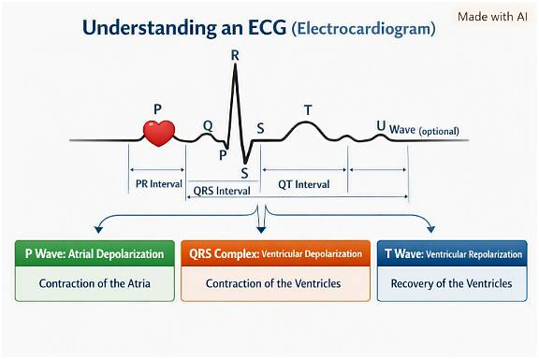

Slide 12
CARDIOVASCULAR SYSTEM
11
Cardiac measurements
Blood pressure
Systolic pressure occurs during ventricular contraction. Diastolic pressure occurs while the ventricles relax and fill.
Cardiac output
Cardiac output = heart rate × stroke volume. It describes blood pumped each minute.
ECG
Records voltage changes produced by cardiac depolarisation and repolarisation. It shows rate, rhythm and conduction.
An ECG does not directly measure blood pressure or cardiac output.

Slide 13
CARDIOVASCULAR SYSTEM
10
Blood and its components
Red blood cells
White blood cells
Haemoglobin carries oxygen and some carbon dioxide.
Support immune defence and tissue repair.
Platelets
Plasma
Help form a clot after vessel damage.
Carries cells, proteins, nutrients, hormones, electrolytes and waste.
Oxygen delivery depends on lungs, haemoglobin, cardiac output and tissue blood flow.
Notes:
Clarify the difference between oxygen saturation and haemoglobin concentration.

Slide 14
Baroreceptors: the rapid pressure reflex
41
Stretch receptors stabilise arterial pressure from one beat to the next
1
2
3
4
5
PRESSURE FALLS
AFFERENT FIRING FALLS
MEDULLA INTEGRATES
SYMPATHETIC ↑ / VAGAL ↓
PRESSURE SUPPORTED
Less stretch at carotid sinus and aortic arch
Carotid sinus via CN IX; aortic arch via CN X
Nucleus tractus solitarius changes autonomic output
Heart, arterioles and veins respond
HR, contractility, venous return and SVR rise
IF PRESSURE FALLS
Fewer impulses → sympathetic drive rises → vasoconstriction + faster, stronger heart.
IF PRESSURE RISES
More impulses → vagal drive rises and sympathetic drive falls → HR and vascular tone decrease.
Notes:
Baroreceptors sense stretch, not pressure directly. The reflex buffers rapid change but may reset during sustained hypertension. Ask students to reverse every arrow when pressure rises.
Sources and further reading:
• NCBI Bookshelf, Physiology, Baroreceptors
• OpenStax Anatomy & Physiology 2e, Autonomic Reflexes and Homeostasis

Slide 15
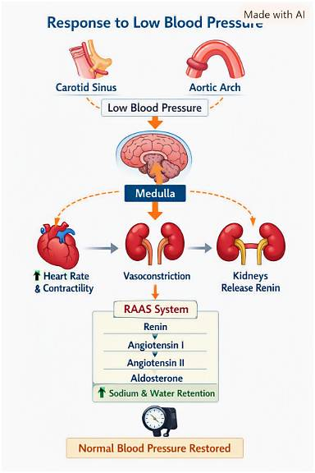

Slide 16
CARDIOVASCULAR EXAMPLE
12
Worked example: high blood pressure
INTERVIEW FOCUS: DEFINE THE RESULT, EXPLAIN THE PHYSIOLOGY, EVALUATE THE EVIDENCE, RESPOND SAFELY
Anatomy and physiology
Technique
OBSERVATION
BP can rise when cardiac output, arteriolar resistance or both increase.
Rest the patient. Support the arm and use the correct cuff size.
BP 168/96 mmHg
Pulse 88 bpm
The patient hurried to the clinic and talked during the reading. They feel well.
Repeat
Respond
Repeat without talking and compare with previous readings.
Follow local guidance if BP remains high or symptoms develop.
True high BP, temporary rise or poor technique?
Safe conclusion: the reading is high, but correct technique and a repeat are needed before interpretation.
Notes:
Academic interview link: analyse the discipline-specific physiological measurement, explain the normal physiology, identify possible interference, distinguish patient, environment, equipment or technique and pathological explanations, and reach a safe conclusion using scientific reasoning.

Slide 17
CARDIOVASCULAR EXAMPLE
13
Worked example: a loose ECG electrode
INTERVIEW FOCUS: DEFINE THE RESULT, EXPLAIN THE PHYSIOLOGY, EVALUATE THE EVIDENCE, RESPOND SAFELY
Likely artefact
Patient check
ECG SNAPSHOT
Poor contact can cause drift, noise or intermittent signal in the affected lead.
Ask about symptoms and compare the ECG rate with the pulse.
Displayed rate 118 bpm
The V2 baseline drifts and breaks. The V2 electrode edge is lifting and the patient moved.
Correct and repeat
Interpret
Prepare clean, dry skin. Secure or replace the electrode and repeat.
Persistent tachycardia or irregular rhythm may still be genuine and needs escalation.
Artefact, tachycardia or both?
Safe conclusion: V2 is unreliable until contact is corrected, but a genuine fast rhythm remains possible.
Notes:
Academic interview link: analyse the discipline-specific physiological measurement, explain the normal physiology, identify possible interference, distinguish patient, environment, equipment or technique and pathological explanations, and reach a safe conclusion using scientific reasoning.

Slide 18
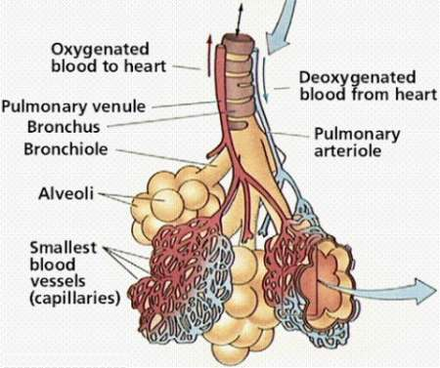
Respiratory system
05
Ventilation and gas exchange
THE GAS EXCHANGE HUB
MAIN JOB
Air reaches the alveoli. Oxygen diffuses into blood while carbon dioxide diffuses out for exhalation.
KEY STRUCTURES
Nose and mouth • trachea • bronchi • lungs • alveoli • diaphragm
WORKS WITH
The cardiovascular system transports the gases. The nervous system adjusts breathing rate and depth.
CLINICAL CLUE
Respiratory rate and SpO₂ describe different parts of oxygen delivery.
Notes:
Teaching prompt: Ask learners why the analogy “THE GAS EXCHANGE HUB” is useful, and where it becomes too simple.
Link the final clinical clue to observation, history taking or physiological measurement.
Sources and further reading:
• OpenStax, Anatomy & Physiology 2e, Chapters 22–23
• NHS, Pulse oximetry and respiratory observations

Slide 19
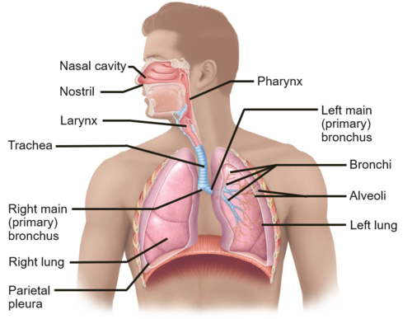
RESPIRATORY SYSTEM
14
Respiratory anatomy
INTERVIEW FOCUS: NAME THE STRUCTURE, EXPLAIN ITS FUNCTION, THEN LINK IT TO THE MEASUREMENT
KEY ANATOMY
1
Nose and mouth warm, filter and humidify air
2
Pharynx and larynx form the upper airway
3
Trachea divides into right and left bronchi
4
Bronchi branch into smaller bronchioles
5
Alveoli form the gas exchange surface
6
Diaphragm and intercostal muscles move air
Main job
Works with
The respiratory system ventilates the lungs and exchanges oxygen and carbon dioxide.
Blood carries gases. The brainstem controls breathing. Kidneys support longer-term acid-base balance.
Ventilation moves air. Gas exchange moves gases between alveoli and blood.
Notes:
Separate conducting airways from the respiratory zone. Academic interview link: students should use this anatomy to explain how a normal physiological measurement is generated and why altered function could change the result. Image retained from the supplied presentation.

Slide 20
RESPIRATORY SYSTEM
16
Alveoli and gas exchange
1
2
3
4
Air reaches alveoli
Oxygen diffuses
Carbon dioxide diffuses
Blood transports gases
Ventilation maintains oxygen and removes carbon dioxide.
Oxygen moves across the thin alveolar-capillary membrane into blood.
Carbon dioxide moves from blood into alveoli.
Haemoglobin carries oxygen to tissues.
Efficient exchange needs ventilation, blood flow and a thin diffusion surface.
Notes:
Explain diffusion as movement down a concentration or partial-pressure gradient.

Slide 21
RESPIRATORY ANATOMY
15
Why respiratory anatomy matters
Knowing the name is the first step. The interview requires students to explain why the structure changes function and the measured result.
STRUCTURE
WHY IT IS BUILT THIS WAY
WHY IT MATTERS CLINICALLY
Branching airways
Repeated branching distributes air to millions of alveoli while smooth muscle changes airway diameter.
Airway narrowing increases resistance and can reduce airflow and effective ventilation.
Alveolar-capillary membrane
The barrier is extremely thin and has a large surface area for rapid diffusion.
Fluid, inflammation or thickening slows gas exchange and may lower SpO₂.
Surfactant
It reduces surface tension so small alveoli remain open during expiration.
Loss of surfactant promotes alveolar collapse and increases the work of breathing.
Diaphragm
Its downward movement increases thoracic volume and lowers intrathoracic pressure.
Weakness or restricted movement reduces ventilation even when the lungs themselves are normal.
Academic interview link: connect airway, alveolar and muscle anatomy to respiratory rate, airflow and oxygen saturation.

Slide 22
🫁 The Body Likes a pH of 7.35–7.45
Your blood must stay in a very tight pH range: 7.35–7.45. If CO₂ rises, the blood becomes more acidic (pH drops). If CO₂ falls, the blood becomes more alkaline (pH rises).
So the body constantly monitors CO₂, O₂, and pH using chemoreceptors.

Slide 23
How Chemoreceptors Link to Blood Pressure & CO₂ Removal
CO₂ rises → blood becomes acidic (pH drops below 7.35)
Chemoreceptors fire faster.
Signals go to the medulla
The medulla increases:
Ventilation (faster breathing)
Depth of breathing
This removes CO₂ quickly → pH returns to 7.35–7.45.

Slide 24
Peripheral chemoreceptors also activate the sympathetic nervous system
This causes:
Vasoconstriction
Increased blood pressure
Why? Because raising blood pressure pushes blood faster to the lungs, helping remove CO₂ more efficiently.

Slide 25
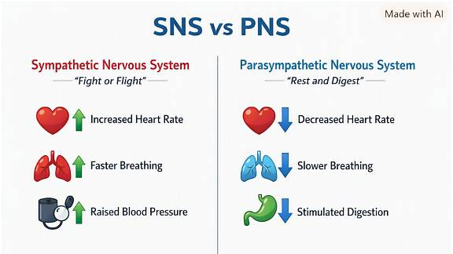

Slide 26
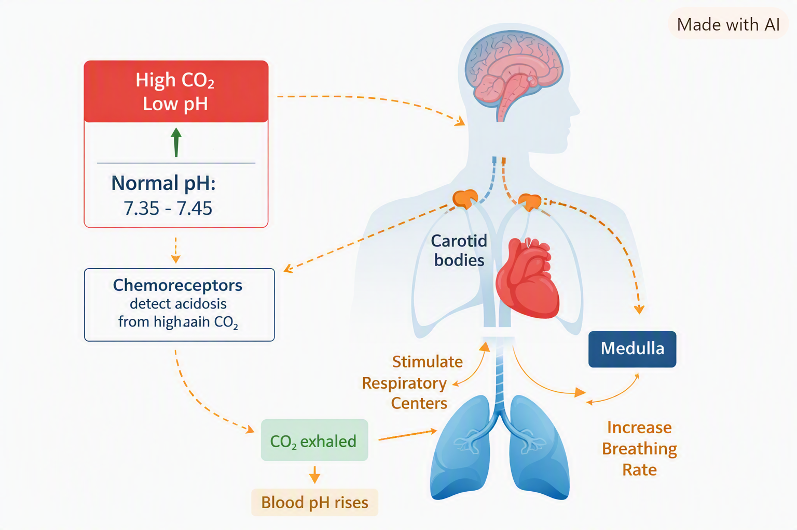
RESPIRATORY SYSTEM
17
Control of breathing
Central chemoreceptors
Respond mainly to carbon dioxide through changes in pH around the brain.
Peripheral chemoreceptors
Carotid and aortic bodies respond to low oxygen, carbon dioxide and pH.
Brainstem response
The medulla alters breathing rate and depth to restore balance.
Carbon dioxide rises when ventilation is inadequate, causing pH to fall.
Notes:
Keep chemistry and pressure receptors distinct: chemoreceptors monitor chemistry, baroreceptors monitor stretch.

Slide 27
RESPIRATORY SYSTEM
18
Oxygen saturation measurement
Reliable signal
SpO₂
Check probe position, pulse agreement and the waveform or signal indicator.
Estimated percentage of haemoglobin carrying oxygen
Possible interference
Movement, poor perfusion, bright light, nail products or a damaged probe can affect accuracy.
Uses red and infrared light through pulsating tissue
Clinical context
SpO₂ does not show carbon dioxide or identify the cause of a low value.
Target ranges vary. Use the prescribed target and local guidance.
Notes:
Emphasise signal quality and patient assessment before interpretation.

Slide 28
RESPIRATORY EXAMPLE
19
Worked example: low SpO₂ with cold hands
INTERVIEW FOCUS: DEFINE THE RESULT, EXPLAIN THE PHYSIOLOGY, EVALUATE THE EVIDENCE, RESPOND SAFELY
Patient
Signal
OBSERVATION
Assess breathing, colour, symptoms, speech and consciousness.
Warm the hand, reduce movement and reposition the probe.
SpO₂ 88%
Pulse 52 bpm
The patient speaks comfortably. Their hands are cold, they have dark nail varnish and the signal is weak.
Site
Repeat and escalate
Remove nail varnish or use a suitable alternative site under local guidance.
Cross-check the pulse. Repeat and escalate if the low value persists or the patient is unwell.
True hypoxaemia or unreliable signal?
Safe conclusion: artefact is possible, but true hypoxaemia remains possible until a reliable repeat is obtained.
Notes:
Academic interview link: analyse the discipline-specific physiological measurement, explain the normal physiology, identify possible interference, distinguish patient, environment, equipment or technique and pathological explanations, and reach a safe conclusion using scientific reasoning.

Slide 29
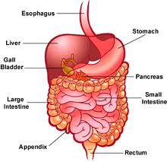
Digestive system
06
From food to usable molecules
THE PROCESSING LINE
MAIN JOB
Mechanical and chemical digestion break food down. The small intestine absorbs most nutrients into blood or lymph.
KEY STRUCTURES
Mouth • oesophagus • stomach • small intestine • large intestine • pancreas • liver
WORKS WITH
The gut absorbs water, salts and glucose into the circulation. The liver processes nutrients, while insulin and glucagon coordinate storage and release of fuel.
CLINICAL CLUE
Vomiting or diarrhoea → fluid loss → lower circulating volume → lower venous return, stroke volume, cardiac output and BP.
Notes:
Teaching prompt: Ask learners why the analogy “THE PROCESSING LINE” is useful, and where it becomes too simple.
Link the final clinical clue to observation, history taking or physiological measurement.
Sources and further reading:
• OpenStax, Anatomy & Physiology 2e, Chapter 23
• NIDDK, Your Digestive System & How It Works

Slide 30
DIGESTIVE EXAMPLE
37
Worked example: vomiting and diarrhoea
INTERVIEW FOCUS: DEFINE THE RESULT, EXPLAIN THE PHYSIOLOGY, EVALUATE THE EVIDENCE, RESPOND SAFELY
Digestive loss
Circulation
OBSERVATION
Water, sodium, potassium and digestive secretions leave the body.
Lower volume reduces venous return and may lower BP.
HR 108 bpm
Dry mouth
Frequent vomiting and diarrhoea for one day. The patient feels weak when standing.
Kidneys and hormones
Respond
RAAS and ADH conserve sodium and water, reducing urine output.
Assess observations, intake, output and symptoms. Escalate signs of dehydration or deterioration.
How can a digestive problem affect other systems?
Safe conclusion: a digestive disturbance can produce a whole-body fluid and electrolyte response.
Notes:
Academic interview link: analyse the discipline-specific physiological measurement, explain the normal physiology, identify possible interference, distinguish patient, environment, equipment or technique and pathological explanations, and reach a safe conclusion using scientific reasoning.

Slide 31
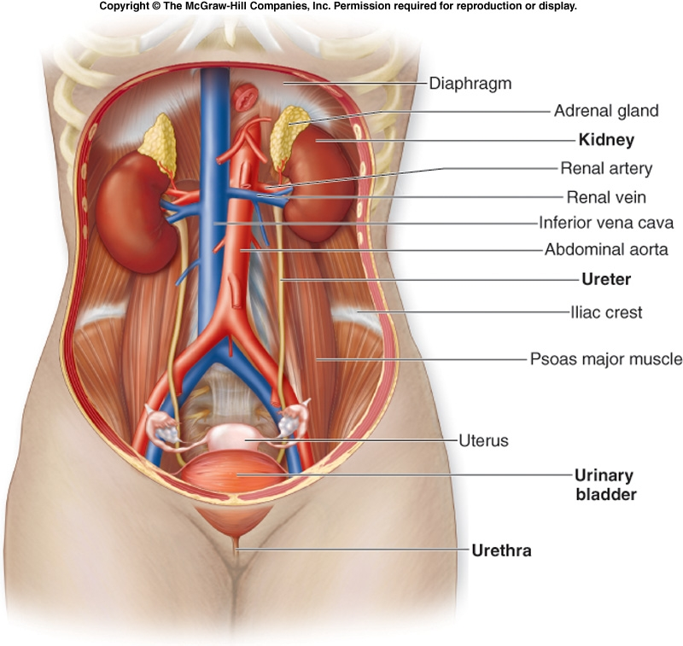
Urinary system
07
Filtration, recovery and balance
THE FILTER + BALANCER
MAIN JOB
The kidneys filter plasma, return needed substances to the blood and excrete waste and excess water as urine.
KEY STRUCTURES
Kidneys • nephrons • ureters • bladder • urethra
WORKS WITH
Renal perfusion links BP to filtration. ADH conserves water; aldosterone retains sodium; RAAS also raises vascular tone. Lungs and kidneys coordinate pH.
CLINICAL CLUE
Low renal perfusion can trigger renin, ADH and reduced urine output to defend circulating volume and BP.
Notes:
Teaching prompt: Ask learners why the analogy “THE FILTER + BALANCER” is useful, and where it becomes too simple.
Link the final clinical clue to observation, history taking or physiological measurement.
Sources and further reading:
• NIDDK, Your Kidneys & How They Work, https://www.niddk.nih.gov/health-information/kidney-disease/kidneys-how-they-work
• OpenStax, Anatomy & Physiology 2e, Chapters 25–26

Slide 32
URINARY ANATOMY
21
Why kidney anatomy matters
Knowing the name is the first step. The interview requires students to explain why the structure changes function and the measured result.
STRUCTURE
WHY IT IS BUILT THIS WAY
WHY IT MATTERS CLINICALLY
Glomerular capillaries
High-pressure fenestrated capillaries allow water and small solutes to enter the nephron.
Low renal perfusion reduces filtration and may contribute to reduced urine output.
Proximal tubule
A brush border creates a large surface area for reabsorbing filtered water and useful solutes.
Tubular injury can cause valuable substances to remain in urine and disrupt fluid balance.
Loop of Henle
Its arrangement in the medulla creates the concentration gradient needed to conserve water.
Without this gradient, the kidneys cannot concentrate urine effectively.
Collecting duct
ADH changes water permeability by increasing aquaporin channels.
Higher ADH produces smaller volumes of more concentrated urine during water loss.
Academic interview link: use nephron structure to explain filtration, urine concentration, ADH and changes in urine output.
Notes:
Teaching emphasis: ask students to use because and therefore. They should connect structure to function, then connect function to the measurement or observation.

Slide 33
URINARY SYSTEM
22
The nephron: filtration to urine
1
2
3
4
5
Glomerulus
Proximal tubule
Loop of Henle
Distal tubule
Collecting duct
Filters water and small solutes from blood.
Reabsorbs most filtered water, sodium, glucose and amino acids.
Creates the concentration gradient used to conserve water.
Fine-tunes electrolytes under hormonal control.
ADH alters water reabsorption before urine enters the renal pelvis.
Filtration removes material from blood. Reabsorption returns needed substances.
Notes:
Keep transport details simple. The main sequence is filter, reabsorb, secrete and excrete.

Slide 34
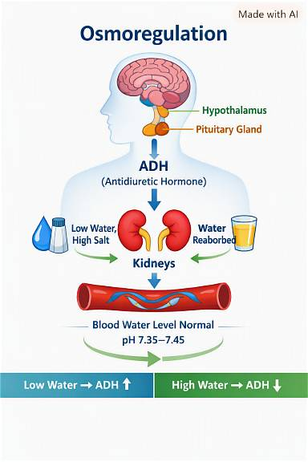
URINARY SYSTEM
23
ADH, RAAS and fluid balance
ADH
Water loss raises plasma osmolality. ADH increases water reabsorption in collecting ducts, reducing urine volume.
Renin-angiotensin-aldosterone system
Low renal perfusion triggers renin. Angiotensin II constricts vessels. Aldosterone increases sodium reabsorption.
Result
The body conserves sodium and water and supports circulating volume and blood pressure.
More ADH means more water reabsorbed and less urine produced.
Notes:
Clarify that ADH reduces water loss. It does not create water.

Slide 35
URINARY EXAMPLE
24
Worked example: dehydration and low urine output
INTERVIEW FOCUS: DEFINE THE RESULT, EXPLAIN THE PHYSIOLOGY, EVALUATE THE EVIDENCE, RESPOND SAFELY
Volume loss
Fast response
OBSERVATION
Less circulating volume reduces venous return, stroke volume and BP.
Baroreceptors increase sympathetic activity, causing tachycardia and vasoconstriction.
BP 92/58 mmHg
HR 112 bpm
Vomiting and diarrhoea for 24 hours. Dry mouth and reduced urine output.
Kidney response
Respond
Low renal perfusion activates RAAS. ADH reduces water loss.
Repeat observations, assess perfusion and fluid history, document and escalate persistent hypotension.
Why do BP and urine output fall?
Safe conclusion: low urine output can be a compensatory response, but persistent hypotension needs prompt review.
Notes:
Academic interview link: analyse the discipline-specific physiological measurement, explain the normal physiology, identify possible interference, distinguish patient, environment, equipment or technique and pathological explanations, and reach a safe conclusion using scientific reasoning.

Slide 36
One flight of stairs: the systems respond together
15
A normal example of integrated physiology
1
2
3
4
Demand rises
Control reacts
Transport adapts
Balance returns
Working muscles use more oxygen and glucose and produce more carbon dioxide and heat.
The nervous system increases heart rate and breathing. Hormones help mobilise fuel.
Cardiac output rises and blood flow is redirected towards active muscle.
Breathing removes carbon dioxide, skin loses heat and recovery restores resting conditions.
Key idea: a change in one system creates work for several others.
Notes:
Activity: Ask learners to predict what happens to pulse, respiratory rate, skin temperature and oxygen demand during exercise. Then ask which changes they could observe directly.
Sources and further reading:
• OpenStax, Anatomy & Physiology 2e, Chapter 24: Metabolism and Nutrition

Slide 37
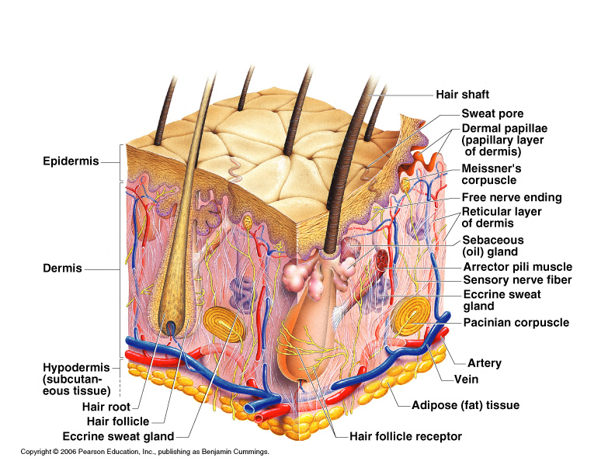
Integumentary system
12
The body’s visible protective boundary
THE BARRIER + THERMOSTAT
MAIN JOB
Skin limits fluid loss, blocks many hazards, supports sensation and helps control temperature through blood flow and sweat.
KEY STRUCTURES
Epidermis • dermis • glands • hair • nails • sensory receptors
WORKS WITH
Blood vessels regulate heat loss. Nerves detect touch, pain and temperature. Immune cells respond to breaches.
CLINICAL CLUE
Skin colour, temperature, moisture and integrity provide useful clinical information.
Notes:
Teaching prompt: Ask learners why the analogy “THE BARRIER + THERMOSTAT” is useful, and where it becomes too simple.
Link the final clinical clue to observation, history taking or physiological measurement.
Sources and further reading:
• OpenStax, Anatomy & Physiology 2e, Chapter 5

Slide 38
INTEGUMENTARY SYSTEM
38
Skin anatomy
INTERVIEW FOCUS: NAME THE STRUCTURE, EXPLAIN ITS FUNCTION, THEN LINK IT TO THE MEASUREMENT
KEY ANATOMY
1
Epidermis forms the outer barrier
2
Dermis contains blood vessels, nerves, glands and hair follicles
3
Subcutaneous tissue contains fat and larger vessels
4
Sweat glands support cooling
5
Sebaceous glands produce oil
6
Sensory receptors detect touch, pressure, pain and temperature
Main job
Works with
Skin protects the body, limits water loss, provides sensation and helps regulate temperature.
Blood vessels alter heat loss. Nerves detect temperature. Immune cells respond to barrier damage.
Skin colour, temperature, moisture and integrity provide clinical information.
Notes:
Use the image to distinguish epidermis, dermis and subcutaneous tissue. Academic interview link: students should use this anatomy to explain how a normal physiological measurement is generated and why altered function could change the result. Image retained from the supplied presentation.

Slide 39
INTEGUMENTARY ANATOMY
39
Why skin anatomy matters
Knowing the name is the first step. The interview requires students to explain why the structure changes function and the measured result.
STRUCTURE
WHY IT IS BUILT THIS WAY
WHY IT MATTERS CLINICALLY
Keratinised epidermis
Closely joined keratin-rich cells form a water-resistant physical barrier.
Barrier damage increases fluid loss and allows irritants or microorganisms to enter.
Dermal blood vessels
A rich vascular network can constrict or dilate to change heat transfer.
Cold vasoconstriction produces cool skin and can weaken peripheral sensor signals.
Sweat glands
Evaporation removes heat from the skin surface.
Dehydration can limit sweating and reduce effective cooling.
Subcutaneous tissue
Fat cushions deeper tissues, stores energy and slows heat loss.
Very little padding increases vulnerability over pressure points.
Academic interview link: use skin layers, perfusion and glands to explain temperature, colour, moisture and sensor quality.
Notes:
Teaching emphasis: ask students to use because and therefore. They should connect structure to function, then connect function to the measurement or observation.

Slide 40
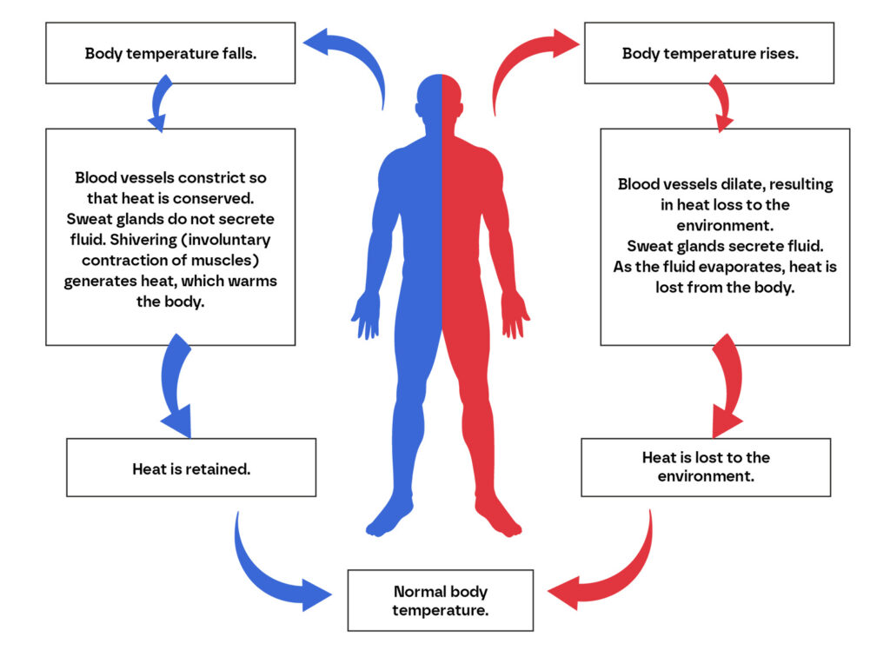

Slide 41
INTEGUMENTARY EXAMPLE
41
Worked example: an unexpectedly low temperature
INTERVIEW FOCUS: DEFINE THE RESULT, EXPLAIN THE PHYSIOLOGY, EVALUATE THE EVIDENCE, RESPOND SAFELY
Patient
Environment
OBSERVATION
Assess symptoms, skin, behaviour and level of consciousness.
Recent cold exposure may temporarily lower peripheral or ear readings.
Temperature 35.5°C
The patient has just come indoors from cold weather. The ear probe was inserted briefly and they feel well.
Technique
Repeat
Check the correct probe, placement, cleanliness and time needed for measurement.
Allow appropriate warming, repeat correctly and escalate a persistent low result or symptoms.
True hypothermia, environment or technique?
Safe conclusion: the first value may reflect exposure or technique, but persistent hypothermia requires action.
Notes:
Academic interview link: analyse the discipline-specific physiological measurement, explain the normal physiology, identify possible interference, distinguish patient, environment, equipment or technique and pathological explanations, and reach a safe conclusion using scientific reasoning.

Slide 42
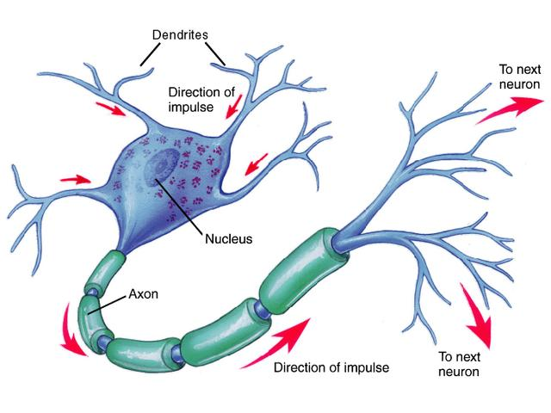
Nervous system
08
Fast electrical control
THE WIRING + CONTROL ROOM
MAIN JOB
Sensory pathways detect change. The brain and spinal cord process information. Motor pathways coordinate responses.
KEY STRUCTURES
Brain • spinal cord • peripheral nerves • sensory receptors
WORKS WITH
The autonomic system changes heart rate, contractility, vessel tone, breathing and digestion. Baroreceptors and chemoreceptors provide rapid feedback.
CLINICAL CLUE
Low BP reduces baroreceptor firing, increasing sympathetic output to the heart, arterioles and veins.
Notes:
Teaching prompt: Ask learners why the analogy “THE WIRING + CONTROL ROOM” is useful, and where it becomes too simple.
Link the final clinical clue to observation, history taking or physiological measurement.
Sources and further reading:
• OpenStax, Anatomy & Physiology 2e, Chapters 12–16

Slide 43
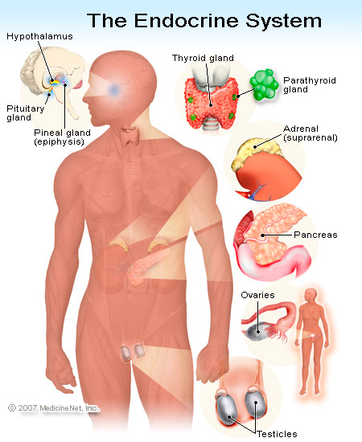
Endocrine system
09
Chemical messages carried in blood
THE CHEMICAL MESSENGER
MAIN JOB
Glands release hormones that alter target cells. Responses often develop more slowly but last longer than nerve signals.
KEY STRUCTURES
Pituitary • thyroid • adrenals • pancreas • ovaries/testes
WORKS WITH
Regulates growth, stress, metabolism, glucose, fluid balance and reproduction across several body systems.
CLINICAL CLUE
Insulin lowers blood glucose by promoting uptake and storage; glucagon raises it.
Notes:
Teaching prompt: Ask learners why the analogy “THE CHEMICAL MESSENGER” is useful, and where it becomes too simple.
Link the final clinical clue to observation, history taking or physiological measurement.
Sources and further reading:
• OpenStax, Anatomy & Physiology 2e, Chapter 17

Slide 44
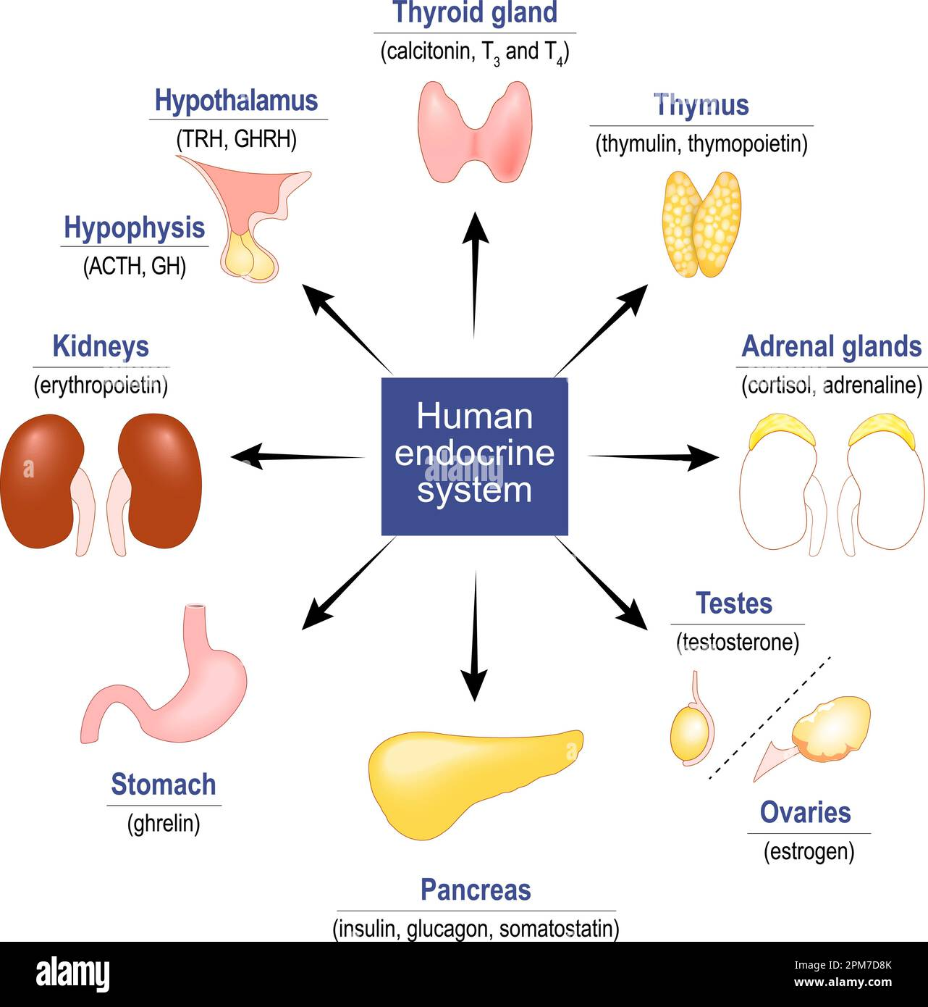

Slide 45
Hormone map: source, target and homeostatic effect
53
Focus on the direction of change and the organ that carries it out
HORMONE
SOURCE
MAIN TARGET
MAIN EFFECT
ADH
Hypothalamus / posterior pituitary
Kidney collecting ducts
Retains water; supports osmolality and volume
ALDOSTERONE
Adrenal cortex
Distal nephron
Retains sodium; excretes potassium; supports volume
INSULIN
Pancreatic beta cells
Liver, muscle, adipose tissue
Lowers blood glucose through uptake and storage
GLUCAGON
Pancreatic alpha cells
Liver
Raises blood glucose by releasing and producing glucose
ADRENALINE
Adrenal medulla
Heart, vessels, lungs, liver
Supports acute stress response and fuel availability
CORTISOL
Adrenal cortex
Many tissues
Supports longer stress response and glucose availability
T3 / T4
Thyroid gland
Most tissues
Increase metabolic activity; support growth and development
Notes:
This is a functional overview, not a complete endocrine pharmacology table. Ask students to cover the final column and predict the effect from the target organ.
Sources and further reading:
• NIDDK, pancreas response to low or high blood glucose
• Society for Endocrinology, You and Your Hormones

Slide 46
ENDOCRINE EXAMPLE
33
Worked example: raised blood glucose
INTERVIEW FOCUS: DEFINE THE RESULT, EXPLAIN THE PHYSIOLOGY, EVALUATE THE EVIDENCE, RESPOND SAFELY
Physiology
Validity
OBSERVATION
After a meal, glucose rises and insulin supports uptake and storage.
Check hand cleanliness, strip expiry, device readiness and sample technique.
Capillary glucose 14.2 mmol/L
The patient has recently eaten but also reports thirst and passing urine frequently.
Evidence
Respond
Thirst and frequent urination can occur when glucose remains high.
Repeat according to local procedure, document symptoms and escalate an unexpected persistent result.
Meal-related rise, measurement issue or persistent hyperglycaemia?
Safe conclusion: one result needs validation, but symptoms increase concern about genuine hyperglycaemia.
Notes:
Academic interview link: analyse the discipline-specific physiological measurement, explain the normal physiology, identify possible interference, distinguish patient, environment, equipment or technique and pathological explanations, and reach a safe conclusion using scientific reasoning.

Slide 47
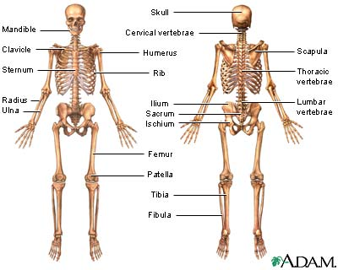
Skeletal system
10
Framework, protection and mineral store
THE FRAME + ARMOUR
MAIN JOB
Bones support the body, protect organs, store minerals and house marrow where blood cells form.
KEY STRUCTURES
Bones • joints • cartilage • ligaments • bone marrow
WORKS WITH
Muscles pull on bones to create movement. Calcium balance links bone, kidneys, gut and endocrine hormones.
CLINICAL CLUE
Immobility affects bone strength, circulation, breathing and skin integrity.
Notes:
Teaching prompt: Ask learners why the analogy “THE FRAME + ARMOUR” is useful, and where it becomes too simple.
Link the final clinical clue to observation, history taking or physiological measurement.
Sources and further reading:
• OpenStax, Anatomy & Physiology 2e, Chapters 6–8

Slide 48
SKELETAL SYSTEM
42
Skeletal system anatomy
INTERVIEW FOCUS: NAME THE STRUCTURE, EXPLAIN ITS FUNCTION, THEN LINK IT TO THE MEASUREMENT
KEY ANATOMY
1
Axial skeleton includes skull, vertebral column and rib cage
2
Appendicular skeleton includes limbs and girdles
3
Joints connect bones and allow different movements
4
Cartilage reduces friction and absorbs load
5
Ligaments connect bone to bone
6
Bone marrow produces blood cells
Main job
Works with
The skeleton supports the body, protects organs, enables movement and stores minerals.
Muscles pull on bones. Kidneys, gut and hormones regulate calcium. Marrow supports blood and immunity.
Bone is living tissue that continually remodels in response to load and hormones.
Notes:
Identify axial and appendicular skeletons, then connect bone marrow to blood-cell production. Academic interview link: students should use this anatomy to explain how a normal physiological measurement is generated and why altered function could change the result. Image retained from the supplied presentation.

Slide 49
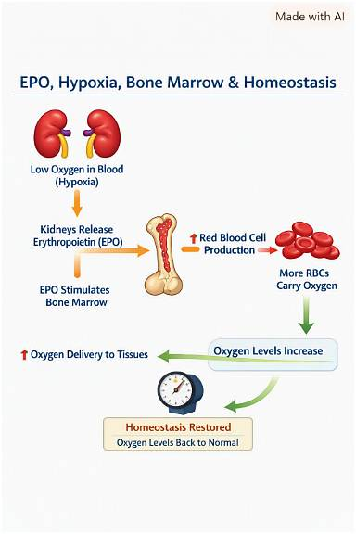

Slide 50
SKELETAL SYSTEM
44
Bone structure and joints
Compact bone
Spongy bone
Bone marrow
Dense outer tissue provides strength and resists bending.
A lighter internal network distributes force and contains marrow spaces.
Red marrow produces red cells, white cells and platelets.
Synovial joints
Remodelling
Articular cartilage, a capsule and synovial fluid support smooth movement.
Osteoblasts build bone and osteoclasts remove bone. Load and hormones influence the balance.
Movement, nutrition, calcium, vitamin D and hormones all influence bone health.
Notes:
This provides more anatomy without requiring microscopic detail beyond Level 4.

Slide 51
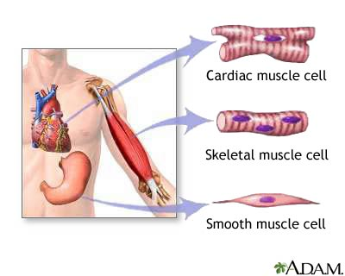
Muscular system
11
Movement, posture and heat
THE MOTORS
MAIN JOB
Skeletal muscle moves the body. Cardiac muscle pumps blood. Smooth muscle moves substances through hollow organs.
KEY STRUCTURES
Skeletal muscle • tendons • cardiac muscle • smooth muscle
WORKS WITH
Nerves trigger contraction. Circulation supplies oxygen and fuel. Muscles help venous return and generate heat.
CLINICAL CLUE
Weakness may reflect muscle, nerve, electrolyte, oxygen or energy problems.
Notes:
Teaching prompt: Ask learners why the analogy “THE MOTORS” is useful, and where it becomes too simple.
Link the final clinical clue to observation, history taking or physiological measurement.
Sources and further reading:
• OpenStax, Anatomy & Physiology 2e, Chapters 9–10

Slide 52
MUSCULAR SYSTEM
46
Muscular system anatomy
INTERVIEW FOCUS: NAME THE STRUCTURE, EXPLAIN ITS FUNCTION, THEN LINK IT TO THE MEASUREMENT
KEY ANATOMY
1
Skeletal muscle attaches to bones through tendons
2
Muscle fibres contain contractile proteins
3
Motor nerves trigger skeletal muscle contraction
4
Cardiac muscle forms the myocardium
5
Smooth muscle lines blood vessels and hollow organs
6
Contraction requires energy, oxygen and electrolytes
Main job
Works with
Muscles create movement, maintain posture, move substances and generate heat.
Nerves trigger contraction. Blood supplies oxygen and fuel. Muscles support venous return and breathing.
Skeletal, cardiac and smooth muscle have different structures and control mechanisms.
Notes:
Identify the three muscle types and give one location for each. Academic interview link: students should use this anatomy to explain how a normal physiological measurement is generated and why altered function could change the result. Image retained from the supplied presentation.

Slide 53
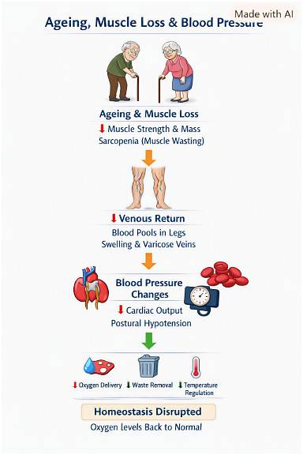

Slide 54
SKELETAL EXAMPLE
45
Worked example: prolonged immobility
INTERVIEW FOCUS: DEFINE THE RESULT, EXPLAIN THE PHYSIOLOGY, EVALUATE THE EVIDENCE, RESPOND SAFELY
Bones and joints
Muscles
PATIENT SNAPSHOT
Reduced loading contributes to bone loss and joint stiffness over time.
Disuse reduces muscle strength and endurance.
Limited mobility for 3 weeks
The patient has reduced weight-bearing after surgery and reports stiffness and weakness.
Circulation and lungs
Skin
Less movement reduces the muscle pump and can reduce ventilation depth.
Sustained pressure raises the risk of tissue damage.
Which systems may be affected?
Safe conclusion: immobility affects several systems, so prevention requires movement, positioning and multidisciplinary care.
Notes:
Academic interview link: analyse the discipline-specific physiological measurement, explain the normal physiology, identify possible interference, distinguish patient, environment, equipment or technique and pathological explanations, and reach a safe conclusion using scientific reasoning.

Slide 55
MUSCULAR EXAMPLE
48
Worked example: climbing one flight of stairs
INTERVIEW FOCUS: DEFINE THE RESULT, EXPLAIN THE PHYSIOLOGY, EVALUATE THE EVIDENCE, RESPOND SAFELY
Muscle demand
Cardiovascular
OBSERVATION
Active fibres use more oxygen and glucose and produce carbon dioxide and heat.
Heart rate and cardiac output rise to increase delivery and waste removal.
HR and RR rise
The leg muscles work harder. The person breathes faster and feels warmer, then recovers after stopping.
Respiratory
Recovery
Ventilation rises to supply oxygen and remove carbon dioxide.
As demand falls, feedback returns heart rate, breathing and temperature towards resting levels.
Why do several observations change?
Safe conclusion: these changes are a normal integrated response when they match activity and recover appropriately.
Notes:
Academic interview link: analyse the discipline-specific physiological measurement, explain the normal physiology, identify possible interference, distinguish patient, environment, equipment or technique and pathological explanations, and reach a safe conclusion using scientific reasoning.

Slide 56
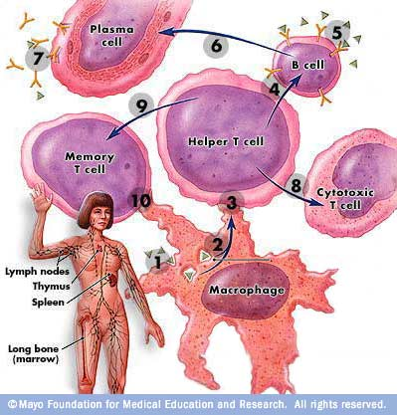
Lymphatic and immune systems
13
Fluid return, surveillance and defence
THE DRAINAGE + DEFENCE TEAM
MAIN JOB
Lymphatic vessels return excess tissue fluid to circulation. Immune cells recognise and respond to harmful agents.
KEY STRUCTURES
Lymph vessels • lymph nodes • spleen • thymus • white blood cells
WORKS WITH
Circulation moves immune cells. Skin and mucosa form first-line barriers. Bone marrow produces immune cells.
CLINICAL CLUE
Inflammation can cause redness, heat, swelling and pain while the body contains damage.
Notes:
Teaching prompt: Ask learners why the analogy “THE DRAINAGE + DEFENCE TEAM” is useful, and where it becomes too simple.
Link the final clinical clue to observation, history taking or physiological measurement.
Sources and further reading:
• OpenStax, Anatomy & Physiology 2e, Chapters 20–21

Slide 57
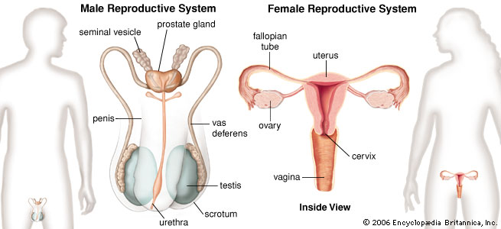
REPRODUCTIVE SYSTEM
52
Reproductive system anatomy
INTERVIEW FOCUS: NAME THE STRUCTURE, EXPLAIN ITS FUNCTION, THEN LINK IT TO THE MEASUREMENT
KEY ANATOMY
1
Ovaries produce oocytes, oestrogen and progesterone
2
Uterine tubes carry the oocyte towards the uterus
3
Uterus supports menstruation and pregnancy
4
Testes produce sperm and testosterone
5
Ducts transport sperm towards the urethra
6
Accessory glands add fluid to semen
Main job
Works with
The reproductive system produces sex cells and hormones and can support fertilisation, pregnancy and birth.
Endocrine hormones regulate cycles and development. Circulation supplies tissues and transports hormones.
Use accurate, inclusive language and obtain consent before sensitive questions or examinations.
Notes:
Keep anatomy factual and communication respectful. Academic interview link: students should use this anatomy to explain how a normal physiological measurement is generated and why altered function could change the result. Image retained from the supplied presentation.

Slide 58
REPRODUCTIVE EXAMPLE
54
Worked example: heavy menstrual bleeding and fatigue
INTERVIEW FOCUS: DEFINE THE RESULT, EXPLAIN THE PHYSIOLOGY, EVALUATE THE EVIDENCE, RESPOND SAFELY
Blood loss
Oxygen transport
PATIENT SNAPSHOT
Repeated loss may reduce iron and haemoglobin over time.
Lower haemoglobin can reduce the blood's oxygen-carrying capacity.
Tired and short of breath on exertion
The patient reports several months of heavy menstrual bleeding and increasing fatigue.
Compensation
Respond
Heart rate and breathing may rise with exertion to support oxygen delivery.
Use sensitive history-taking, assess symptoms and follow local investigation and escalation pathways.
How can reproductive blood loss affect other systems?
Safe conclusion: the pattern could link reproductive blood loss with reduced oxygen transport and needs clinical assessment.
Notes:
Academic interview link: analyse the discipline-specific physiological measurement, explain the normal physiology, identify possible interference, distinguish patient, environment, equipment or technique and pathological explanations, and reach a safe conclusion using scientific reasoning.

Slide 59
Breakout challenge: what is the body telling us?
17
Use systems thinking before choosing one explanation
PATIENT SNAPSHOT
1
Which systems are directly involved?
A patient has had vomiting and diarrhoea for 24 hours.
2
How could fluid loss explain the pulse and blood pressure?
HR 112 bpm
BP 92/58 mmHg
RR 22 breaths/min
Dry mouth
Reduced urine output
3
Why might urine output fall?
4
What would you repeat, check or escalate?
Work in groups for 5 minutes
There may be more than one defensible answer if the reasoning is clear.
Notes:
Suggested discussion: Digestive losses reduce circulating volume. Cardiovascular compensation raises heart rate. Reduced renal perfusion and hormonal responses reduce urine output. Respiratory rate may increase because of stress, compensation or illness. Learners should repeat observations, assess the patient, consider equipment/technique, and follow local escalation guidance. This is an educational scenario, not a diagnosis.

Slide 60
Fluid Loss and Homeostasis
1. Systems Involved
Digestive system: Vomiting and diarrhoea cause rapid loss of water, electrolytes (especially sodium and potassium), and digestive secretions.
Circulatory system: Blood volume falls because of fluid loss.
Renal system: Kidneys respond by conserving water and reducing urine output.
Endocrine system: Hormones such as aldosterone and antidiuretic hormone (ADH) are released to retain sodium and water.
Nervous system: Baroreceptors detect the drop in blood pressure and trigger sympathetic activation to maintain circulation.

Slide 61
How Fluid Loss Affects Pulse and Blood Pressure
When fluid volume decreases, venous return to the heart drops.
This reduces stroke volume (the amount of blood pumped per beat).
To compensate, the heart rate increases (tachycardia) to maintain cardiac output.
Despite this, blood pressure often falls (hypotension) because there’s less circulating volume.
Baroreceptors in the carotid sinus and aortic arch detect the low pressure and stimulate the sympathetic nervous system, causing vasoconstriction and increased heart rate.

Slide 62
Why Urine Output Falls
The kidneys receive less blood flow due to reduced pressure.
The renin–angiotensin–aldosterone system (RAAS) activates:
  Renin is released by the kidneys.
  It converts angiotensinogen → angiotensin I → angiotensin II, which constricts blood vessels and raises BP.
  Aldosterone promotes sodium and water reabsorption in the nephron.
ADH from the hypothalamus also increases water reabsorption. → Result: Urine output decreases to conserve fluid and restore blood volume.

Slide 63
What to Repeat, Check or Escalate
Vital signs: Monitor HR, BP, RR, and temperature regularly.
Fluid balance: Measure urine output and input.
Electrolytes: Check sodium, potassium, and urea levels.
Escalate: If hypotension persists or urine output remains low, IV fluids or electrolyte replacement may be required.

Slide 64
What the academic interview assesses
20
Component 1 carries 75% and lasts 11 minutes
01
DEFINE
02
EXPLAIN
What does the measurement record?
How is the result generated?
Signal • units • purpose
Anatomy • physiology • homeostasis
Name the physiological source, what the equipment displays and what the result can—and cannot—tell you.
Connect structures, control pathways and interacting systems. Explain each causal step rather than listing organs.
03
EVALUATE
04
CONCLUDE
Why is the result unexpected?
What should happen next?
Validity • alternatives • evidence
Checks • uncertainty • escalation
Compare patient, environment, equipment or technique, altered physiology and pathology. State what evidence supports each possibility.
Give the best-supported interpretation, acknowledge uncertainty, and describe safe checks, documentation and escalation within role.
Notes:
Keep this session focused on Component 1. Ask learners to choose a measurement from their own pathway and use it in every activity that follows.
Sources and further reading:
• UWTSD, PV2b CertHE Healthcare Science, BMSC4009A module specification, pp. 25–26 (03 August 2026)

Slide 65
Four homeostatic themes connect the pathways
22
Each discipline observes a different part of the same integrated body
OXYGEN + CO₂
PRESSURE + PERFUSION
Lungs exchange gases. Blood transports them. The brain adjusts ventilation. Kidneys support longer-term acid-base control.
The heart creates flow. Vessels change resistance. Baroreceptors and kidneys help stabilise pressure and organ perfusion.
SpO₂ • respiratory rate • spirometry • sleep study
ECG • heart rate • blood pressure • pulse waveform
FLUID + ELECTROLYTES
ENERGY + TEMPERATURE
Kidneys regulate water, sodium, potassium and pH. Hormones alter thirst, renal handling and vascular tone.
Digestion supplies fuel. Hormones regulate glucose and metabolism. Skin and circulation control heat loss.
Blood pressure • urine output • laboratory values
Temperature • glucose • patient symptoms
Notes:
Ask students to locate their own discipline in more than one theme. For example, audiology relies on neural signalling, cochlear blood supply and inner-ear fluid composition, while cardiac physiology also depends on respiratory gas exchange and renal fluid control.

Slide 66
Patient Snapshot
A 27‑year‑old woman arrives at a walk‑in clinic complaining of:
Chest tightness
A dry cough
Feeling “foggy” and tired
Mild shortness of breath
Vital signs:
SpO₂: 92% (low)
Respiratory Rate: 26 breaths/min (raised)
Heart Rate: 104 bpm
Temperature: 37.4°C
She reports she has had a cold for a week and feels worse today.

Slide 67
DEFINE
What does oxygen saturation measure?
Oxygen saturation (SpO₂) measures the percentage of haemoglobin molecules carrying oxygen in arterial blood. It is recorded using a pulse oximeter, which detects light absorption changes as oxygenated and deoxygenated haemoglobin differ in colour.
SpO₂ shows
How effectively the lungs are oxygenating blood
Whether gas exchange in the alveoli is impaired
Whether tissues may be at risk of hypoxia
SpO₂ cannot tell you CO₂ levels, ventilation adequacy, or acid–base status — RR helps provide that context.

Slide 68
EXPLAIN
Alveoli: site of gas exchange
Capillaries: carry deoxygenated blood to alveoli
Haemoglobin: binds oxygen
Respiratory muscles: drive ventilation
Physiology:
Oxygen diffuses from alveoli → blood due to concentration gradients.
Haemoglobin binds oxygen and transports it to tissues.
Adequate ventilation keeps alveolar oxygen high enough for diffusion.
Pulse oximetry reflects this process indirectly.

Slide 69
Homeostasis:
The body maintains oxygen levels through:
Chemoreceptors (carotid bodies, medulla) detecting low O₂ or high CO₂
Increasing RR and HR to improve oxygen delivery
Adjusting ventilation–perfusion matching in the lungs
In this scenario, SpO₂ is low (92%), and RR is raised (26/min), showing the body is trying to correct impaired oxygenation.

Slide 70
EVALUATE
Why is the oxygen saturation result unexpected? SpO₂ is 92%, which is lower than expected for a healthy young adult. RR is 26/min, showing the body is compensating.
Possible Causes (with evidence)
1. Viral Lower‑Respiratory Infection
Inflamed alveoli → reduced gas exchange
Evidence: cough, recent cold, mild fever, low SpO₂, raised RR
2. Early Pneumonia
Alveolar consolidation → impaired oxygen diffusion
Evidence: worsening symptoms, tachycardia, low SpO₂
Missing: high fever, chest pain

Slide 71
Evaluate Continued
Asthma Flare
Bronchoconstriction → reduced airflow
Evidence: chest tightness, raised RR
Missing: wheeze
Pulse Oximeter Artefact
Cold fingers, movement, nail varnish
Evidence: none given, but always check

Slide 72
Most Defensible Interpretation
Impaired gas exchange due to respiratory infection, causing:
↓ SpO₂
↑ RR (compensation)
↑ HR (sympathetic response)
➡️ Escalate to the medical team for assessment and decision‑making.

Slide 73
Clinical engineering: the measurement chain
27
A displayed number depends on both physiology and technology
01
02
03
04
05
PATIENT
SENSOR
PROCESSING
DISPLAY
CLINICAL DECISION
The body produces pressure, flow, heat, light absorption or electrical activity.
A cuff, electrode, thermistor or optical probe converts physiology into a signal.
Hardware and software amplify, filter, calculate and reject artefact.
The device presents a value, waveform, trend, warning or alarm.
A trained person checks signal quality, context and consistency before acting.
Homeostasis link
Monitoring technology samples the body’s response to change. A reliable value requires adequate physiology, a suitable sensor, correct setup and a functioning device.
Notes:
This slide separates the source of the physiological signal from the measurement process. It supports the assessment requirement to differentiate patient, environment, equipment or technique, and pathological explanations.
Sources and further reading:
• MHRA, The use and regulation of pulse oximeters: information for healthcare professionals
• UWTSD pathway: Clinical Engineering

Slide 74
Clinical engineering worked example: SpO₂ of 88%
28
The waveform and the patient matter as much as the displayed number
PHYSIOLOGY
Pulse oximetry estimates arterial oxygen saturation from pulsatile red and infrared light absorption. Healthy adults commonly read 95–100%, but prescribed targets and clinical context take priority.
DEVICE DISPLAY
SpO₂ 88%
Pulse 46 bpm
PATIENT
Cold peripheries or poor perfusion weaken the pulsatile signal. Movement can corrupt the calculation.
ENVIRONMENT
Strong ambient light may interfere with optical sensing.
The patient is talking comfortably. Their hands are cold and the pulse waveform is weak and unstable.
EQUIPMENT / TECHNIQUE
Probe misplacement, wrong probe size, nail products, cable damage or device fault may alter accuracy.
PATHOLOGY
True hypoxaemia remains possible and must not be dismissed because artefact is suspected.
Question: valid hypoxaemia or unreliable signal?
Action: assess the patient, warm/reposition the site, confirm the pulse and waveform, repeat, then escalate persistent abnormality.
Notes:
Explain that checking signal quality does not delay assessment of a potentially unwell patient. Follow local oxygen and escalation policies.
Sources and further reading:
• MHRA, The use and regulation of pulse oximeters, 26 March 2021: low perfusion, movement, nail polish, henna, tattoos and probe positioning can affect accuracy

Slide 75
Respiratory and sleep physiology: ventilation protects pH
31
Breathing links lungs, blood, brain, muscles and kidneys
VENTILATION
The diaphragm and chest wall move air. Airway calibre and lung mechanics affect flow and volume.
GAS EXCHANGE
Alveoli and pulmonary capillaries exchange oxygen and carbon dioxide.
CONTROL
Brainstem centres respond mainly to carbon dioxide and pH, with oxygen also influencing ventilation.
ACID–BASE HOMEOSTASIS
Lungs alter carbon dioxide within minutes. Kidneys provide slower bicarbonate and acid regulation.
SLEEP
Upper-airway tone and ventilatory drive change during sleep. Repeated obstruction may cause desaturation and arousal.
Notes:
Measurements can include spirometry, gas transfer, respiratory pressures, pulse oximetry, airflow, respiratory effort and sleep-study signals.
Sources and further reading:
• ARTP statement on pulmonary function testing 2020
• UWTSD pathway: Respiratory and Sleep Physiology

Slide 76
Respiratory worked example: low FVC on spirometry
32
A technically poor blow can imitate restrictive physiology
PHYSIOLOGY
FEV₁ measures volume exhaled in the first second. FVC measures total forced vital capacity. Interpret values against predicted ranges and the lower limit of normal.
SPIROMETRY RESULT
FEV₁: 2.40 L
FVC: 2.55 L
FEV₁/FVC: 0.94
PATIENT-DERIVED
Submaximal inspiration, hesitation, cough, early termination, variable effort or poor understanding.
ENVIRONMENT
Distraction, poor coaching conditions or incorrect temperature/pressure information may affect quality.
The volume–time curve stops early and the patient removed the mouthpiece before a complete exhalation.
EQUIPMENT / TECHNIQUE
Leak, obstructed mouthpiece, calibration/verification failure or incorrect demographic data.
PATHOLOGICAL
Low FVC may reflect restriction, air trapping, neuromuscular weakness or other disease when technically acceptable tests support it.
The ratio looks preserved, but FVC validity is doubtful.
Action: explain and demonstrate again, repeat acceptable manoeuvres, document quality and avoid interpreting an invalid FVC as restriction.
Notes:
The example shows why quality assessment comes before pattern interpretation. A low FVC from early termination can falsely suggest restriction and may leave the FEV1/FVC ratio falsely high.
Sources and further reading:
• British Thoracic Society, A Guide to Performing Quality Assured Diagnostic Spirometry
• CDC, Spirometry Quality Assurance: Common Errors and Their Impact on Test Results
• ARTP statement on pulmonary function testing 2020

Slide 77
Cardiac worked example: irregular ECG baseline
26
A trace can contain physiology, pathology and artefact at the same time
Observed
Displayed rate 118 bpm. Baseline varies. R–R intervals appear irregular. One chest electrode is visibly lifting.
NORMAL PARAMETERS
POSSIBLE INTERFERENCE
POSSIBLE PATHOLOGY
Sinus rhythm usually has a regular P wave before each QRS. Adult resting rate is commonly 60–100 bpm. PR is usually 120–200 ms and QRS under 120 ms.
Movement and muscle activity can distort the baseline. Mains interference may produce regular high-frequency noise. Poor electrode contact can cause drift or loss of signal.
A genuinely irregular rhythm may reflect atrial fibrillation or ectopy. Tachycardia may also accompany pain, anxiety, fever, hypovolaemia or illness.
Scientific conclusion
Replace or secure the electrode, reduce movement, repeat the ECG and compare the pulse. If irregular tachycardia persists, follow the clinical escalation pathway.
Notes:
The strongest answer avoids deciding too early. It describes the visible quality problem, explains how it can affect the waveform, corrects it, repeats the measurement and then evaluates whether the abnormal rhythm persists.
Sources and further reading:
• NHS, Electrocardiogram (ECG)
• FDA, Electrocardiograph Electrodes: acquisition and transmission of the electrical signal

Slide 78
Sleep physiology extension: repeated desaturations
33
Overnight signals require pattern recognition and quality checks
OBSERVED PATTERN
PHYSIOLOGICAL EXPLANATION
VALIDITY CHECKS
Repeated falls in SpO₂ from 96% to 86%, with recovery after each event. Several episodes coincide with absent airflow but continued respiratory effort.
Upper-airway obstruction reduces ventilation. Oxygen falls, carbon dioxide rises, autonomic activation increases and arousal restores airway tone.
Confirm probe signal, pleth waveform, body position, airflow sensor, effort belts, event timing and annotations. Motion or probe loss can mimic desaturation.
Scientific conclusion
A coherent pattern across airflow, effort and oxygen signals supports a physiological event. A single unstable channel requires caution and cross-checking.
Notes:
Use this as an optional example for students working mainly in sleep services. Interpretation should follow local scoring criteria and supervision.
Sources and further reading:
• UWTSD BMSC4014A: Sleep Physiology and Diagnostic Intervention
• MHRA pulse oximetry accuracy guidance

Slide 79
A consistent framework for any unexpected result
34
More than one explanation may be present
PATIENT-DERIVED
ENVIRONMENT-DERIVED
Movement, anxiety, pain, posture, poor effort, misunderstanding, medication or failure to follow instructions.
Noise, light, temperature, interruptions, vibration or electrical interference.
Can I see a change when I reassure, reposition, reinstruct or repeat?
Does the setting explain the pattern, and can I remove the disturbance?
EQUIPMENT / TECHNIQUE
PATHOLOGICAL
Wrong size or placement, loose connections, leaks, calibration, settings, incorrect data entry or damaged components.
A real change caused by disease, deterioration or altered physiology.
Is the device ready, suitable, connected and producing a quality signal?
Does the abnormality persist after validity checks, and does it fit the patient?
Notes:
Encourage students to state what evidence would increase or decrease the likelihood of each explanation. The highest-quality answer evaluates competing explanations rather than presenting a list.
Sources and further reading:
• UWTSD BMSC4009A assessment component 1

Slide 80
A clear structure for the 11-minute academic interview
35
Students need depth, prioritisation and scientific reasoning
0–1 min
DEFINE
Name the measurement, what it records and why the discipline uses it.
1–3 min
PHYSIOLOGY
Explain the body systems, structure–function relationships and homeostatic control behind it.
3–5 min
NORMAL
State the expected parameters, units and factors that alter the reference range.
5–8 min
EVALUATE
Describe the result. Compare patient, environment, equipment/technique and pathology.
8–10 min
RESPOND
Explain checks, repetition, documentation, escalation and limits of role.
10–11 min
CONCLUDE
Give the most likely explanation while acknowledging uncertainty and alternatives.
A safe answer never forces a diagnosis from an invalid measurement.
Notes:
The timings are a teaching guide rather than a formal examination script. Students should answer follow-up questions directly and use discipline-specific language they understand.
Sources and further reading:
• UWTSD BMSC4009A assessment component 1: Academic interview, 11 minutes, 75%

Slide 81
Complete academic interview case
36
Cardiac physiology: a 12-lead ECG obtained during palpitations
DEFINE
What electrical activity does a 12-lead ECG record—and what does it not measure?
CASE
A 58-year-old patient reports intermittent palpitations and light-headedness.
EXPLAIN
How do the conduction system, myocardium, autonomic nerves and circulation generate the findings?
ECG display: 132 bpm
Rhythm appears irregular
Baseline artefact in V1–V3
V2 electrode partly detached
EVALUATE
Which features could be artefact, altered physiology or pathology? What evidence separates them?
CONCLUDE
What should be checked, repeated, documented and escalated within role?
The patient remains alert and is speaking normally.
Interview rule: validate the signal before attributing it to disease.
Notes:
This fictional case is used only to rehearse Component 1. Local clinical policy and scope of practice still frame any safe-action answer.

Slide 82
Worked component 1: model academic interview answer
37
The answer progresses from physiology to validity, interpretation and safe action
WHAT THE ECG MEASURES
A 12-lead ECG records voltage differences produced by cardiac depolarisation and repolarisation from several anatomical viewpoints. It provides rate, rhythm, conduction and waveform information, but it does not directly measure cardiac output or blood pressure.
EXPECTED PARAMETERS
In an adult at rest, sinus rhythm commonly has a rate of 60–100 bpm, a P wave before each QRS, PR 120–200 ms and QRS under 120 ms. The patient’s rate of 132 bpm is tachycardic and the rhythm appears irregular.
VALIDITY AND ALTERNATIVES
The detached V2 electrode can explain local baseline instability but cannot automatically explain irregular R–R intervals across the trace. Movement, muscle activity and anxiety may contribute. A persistent irregular tachycardia could be pathological, including atrial fibrillation, but the recording must first be made technically valid.
SAFE CONCLUSION
I would assess symptoms, compare the displayed rate with the pulse, secure the electrode, reduce movement and repeat the ECG. I would document the original quality issue. If the irregular tachycardia remains or symptoms worsen, I would escalate promptly within local policy and my scope of practice.
Notes:
Model delivery should sound conversational rather than memorised. Examiners may interrupt with questions. Students should justify why each check distinguishes technical artefact from persistent physiological abnormality.
Sources and further reading:
• UWTSD BMSC4009A assessment component 1
• NHS, Electrocardiogram (ECG)

Slide 83
Activity: explain the fall in blood pressure
51
Work in groups for eight minutes, then give a 45-second answer
1
What disturbance started the sequence?
CASE
A patient has had vomiting and poor intake for 24 hours.
2
How do the heart and blood vessels respond?
3
What do the kidneys detect and what does RAAS do?
BP 88/56 mmHg
HR 112 bpm
Dry mouth
Low urine output
Cool peripheries
4
Why does ADH rise, and what changes in the urine?
5
Which findings show compensation, and which suggest it is insufficient?
6
What immediate checks and escalation would be appropriate within role?
Assume the readings are technically valid.
Notes:
Give each group the interaction template. Ask the reporter to use the words variable, sensor, effector, feedback and safe action. Do not ask students to diagnose beyond their role.

Slide 84
Worked answer: dehydration and pressure regulation
52
A linked explanation is stronger than a list of systems
DISTURBANCE
Fluid loss reduces circulating volume, venous return and stroke volume. Blood pressure falls.
FAST RESPONSE
Reduced baroreceptor stretch increases sympathetic activity. Heart rate rises and peripheral vessels constrict, producing tachycardia and cool peripheries.
RENAL RESPONSE
Low renal perfusion stimulates renin. Angiotensin II constricts vessels and stimulates thirst, aldosterone and ADH.
HORMONAL RESPONSE
Aldosterone promotes sodium reabsorption. ADH promotes water reabsorption, so urine output falls and urine becomes more concentrated.
INTERPRETATION
The compensatory responses are present, but BP remains low. This suggests the disturbance exceeds the current compensation and requires prompt clinical review.
SAFE ACTION
Assess symptoms and perfusion, repeat observations using correct technique, review trends and fluid history, document clearly and escalate according to local policy.
Notes:
Assessment wording: This answer explains mechanism, links systems, uses the observations as evidence and ends with safe action. Local escalation policies and patient-specific targets take priority.

Slide 85
Worked interview answer: low BP after fluid loss
62
Model the language of cause, evidence, limitation and safe conclusion
Blood pressure is the force exerted by circulating blood on arterial walls. MAP is governed mainly by cardiac output and systemic vascular resistance; cardiac output equals heart rate × stroke volume.
DEFINE
Vomiting reduces extracellular and circulating volume. Venous return and preload fall, so stroke volume and cardiac output fall. The BP therefore falls unless vasoconstriction raises SVR sufficiently.
EXPLAIN
Reduced carotid and aortic baroreceptor stretch increases sympathetic output: heart rate, contractility, arteriolar resistance and venous return rise. Low renal perfusion activates RAAS; ADH conserves water in collecting ducts.
CONNECT
Tachycardia, cool peripheries and low urine output fit compensation, but technique, cuff size, posture, trend, medicines, symptoms and other causes of hypotension still need evaluation.
EVIDENCE
The pattern is consistent with reduced circulating volume with active compensation, but the persistent low BP may indicate inadequate compensation. I would repeat correctly, assess perfusion and symptoms, document and escalate promptly within policy.
CONCLUDE
Why this works: every claim states a mechanism and ties it to an observation or a limitation.
Notes:
Ask one learner to deliver this answer in 90 seconds, then another to challenge one assumption. A strong answer can be shorter than the model if every link is justified.

