Slide 1
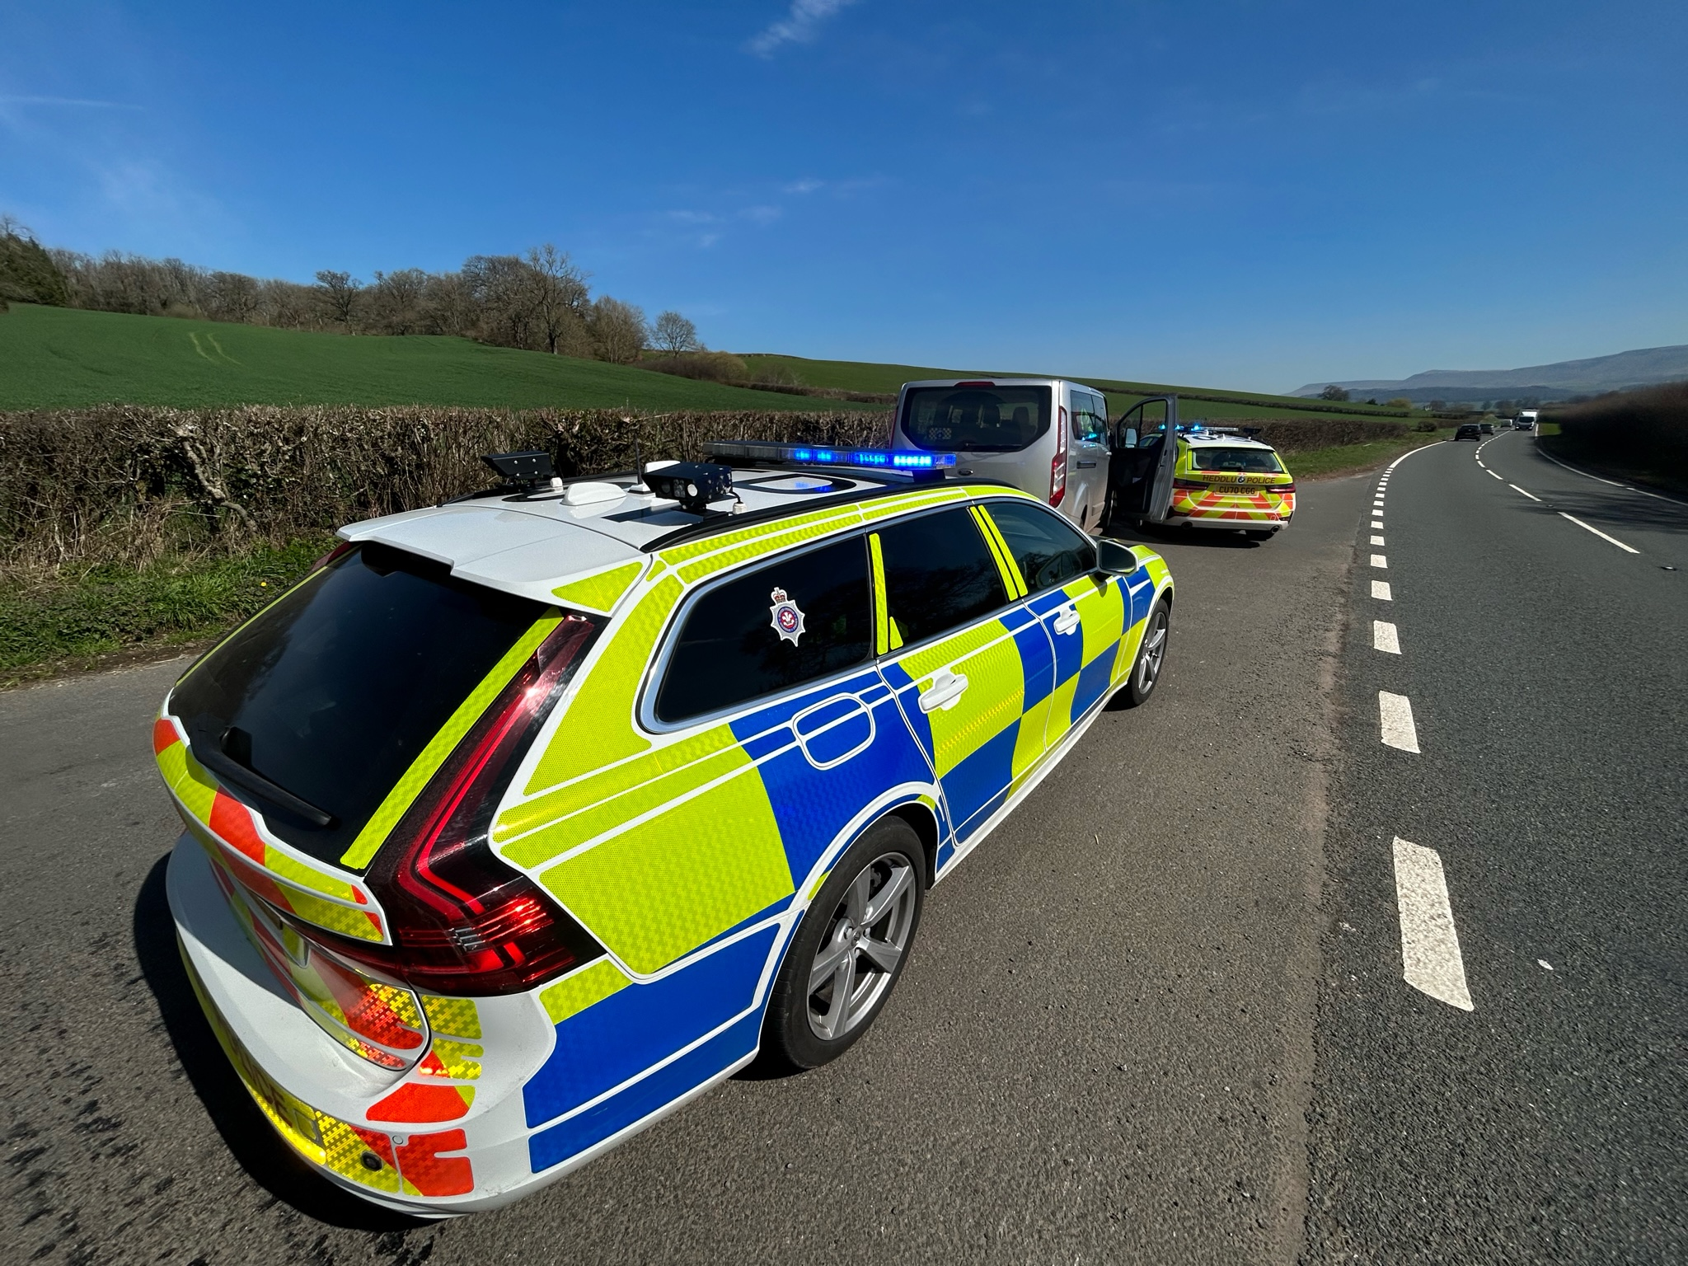
Categories of Vehicles

Slide 2
By the end of the session, students will be able to:
Identify a selection of mechanically propelled vehicles identifying which are also motor vehicles (intended for use on the road, and which are not motor vehicles).

Slide 3
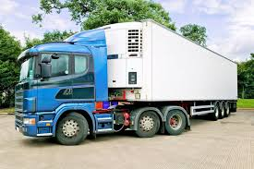
Heavy locomotive S. 185(1) RTA 1988
“heavy locomotive” means a mechanically propelled vehicle which is not constructed itself to carry a load other than any of the excepted articles and the weight of which unladen exceeds 11690 kilograms,

Slide 4
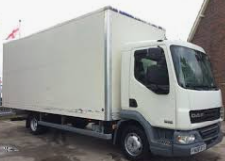
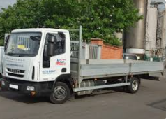
Light locomotive S.185(1) RTA 1988
“light locomotive” means a mechanically propelled vehicle which is not constructed itself to carry a load other than any of the excepted articles and the weight of which unladen does not exceed 11690 kilograms but does exceed 7370 kilograms,

Slide 5
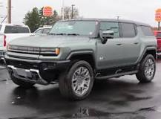
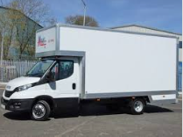
Heavy Motor car S. 185(1) RTA 1988
“heavy motor car” means a mechanically propelled vehicle, not being a motor car, which is constructed itself to carry a load or passengers and the weight of which unladen exceeds 2540 kilograms,
(Hummer is 4,500 kg)
(Land rover is approximately 2603 kg).
(“Luton van” is 3,500kg unladen).

Slide 6
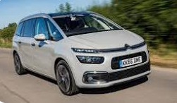
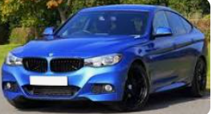
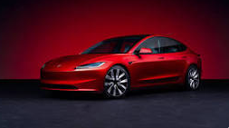
Motor car S. 185(1) RTA 1988
“motor car” means a mechanically propelled vehicle, not being a motorcycle or an invalid carriage, which is constructed itself to carry a load or passengers and the weight of which unladen—
(a)if it is constructed solely for the carriage of passengers and their effects, is adapted to carry not more than seven passengers exclusive of the driver and is fitted with tyres of such type as may be specified in regulations made by the Secretary of State, does not exceed 3050 kilograms,
(b)if it is constructed or adapted for use for the conveyance of goods or burden of any description, does not exceed 3050 kilograms, or 3500 kilograms if the vehicle carries a container or containers for holding for the purposes of its propulsion any fuel which is wholly gaseous at 17.5 degrees Celsius under a pressure of 1.013 bar or plant and materials for producing such fuel,
(c)does not exceed 2540 kilograms in a case not falling within sub-paragraph (a) or (b) above,

Slide 7
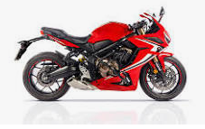
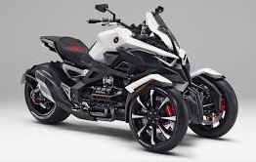

Motorcycle S. 185(1) RTA 1988
“motorcycle” means a mechanically propelled vehicle, not being an invalid carriage, with less than four wheels and the weight of which unladen does not exceed 410 kilograms,

Slide 8
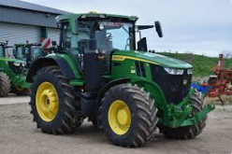
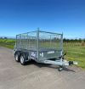
Motor Tractor S. 185(1) RTA 1988
“motor tractor” means a mechanically propelled vehicle which is not constructed itself to carry a load, other than the excepted articles, and the weight of which unladen does not exceed 7370 kilograms,
“trailer” means a vehicle drawn by a motor vehicle.

Slide 9
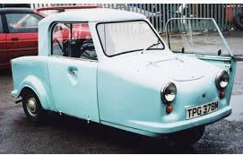

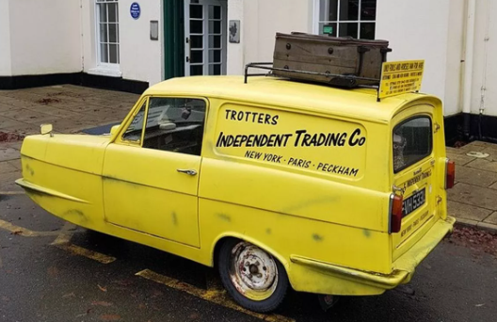

Invalid Carriage S. 185 RTA 1988
“invalid carriage” means a mechanically propelled vehicle the weight of which unladen does not exceed 254 kilograms and which is specially designed and constructed, and not merely adapted, for the use of a person suffering from some physical defect or disability and is used solely by such a person.
A three-wheeler motor car is not an invalid carriage it is classified as an unrestricted motorcycle at 850cc, 456kg and top speed of 80-85mph requiring a Cat A licence.

