Slide 1
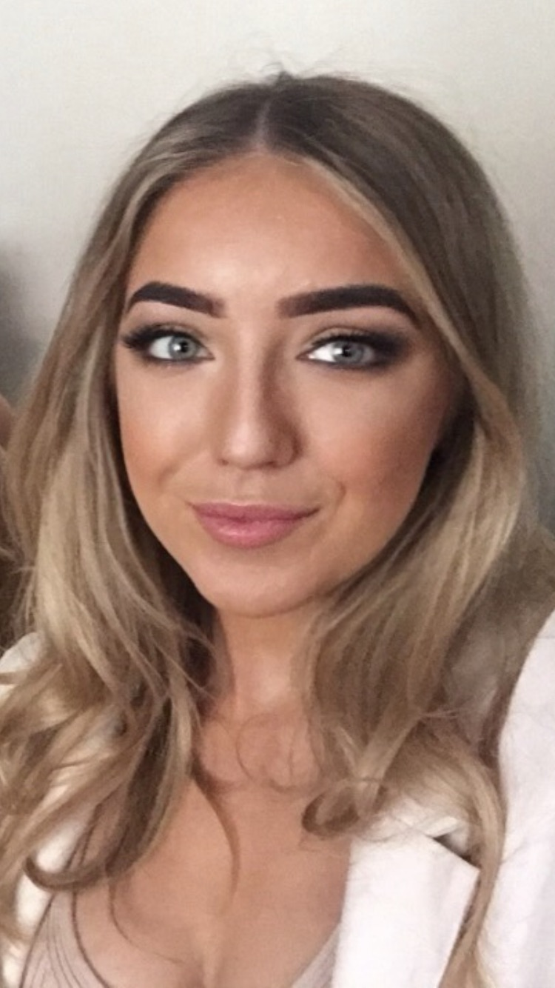
Amdana i
About Me
My name is Elise Nicholas and I am Secondary Mathematics PGCE student. I have always enjoyed the challenge of mathematical problems and hope to pass this on to future pupils. In my spare time, I enjoy keeping fit and spending time with my friends.
Y math o athro hoffaf bod
The kind of teacher I aspire to be
As a teacher I hope to become a role model for the pupils. I hope to encourage them to enjoy the subject, always motivate and have good command of the subject content, in order to get the best out of every individual.
Cefndir academaidd
Academic history
Dwr-y-Felin Comprehensive School
Neath Port-Talbot College
Swansea University
Currently – University of Wales Trinity
Saint David
Meysydd / pynciau medraf eu haddysgu
Areas / subjects I could teach
Rhesymau dros ddewis addysgu fel proffesiwn
Reasons for entering the teaching profession
Since being a young child I have always had an interest in the teaching profession. Through work experience in primary and secondary settings I soon realised that it was teaching that I wanted to do as a career. Having a natural flair for mathematics, it was this subject that I chose to focus on. I hope to encourage pupils to enjoy maths and to help them to develop in to strong, independent learners.
Mathematics
Welsh Baccalaureate

