Slide 1
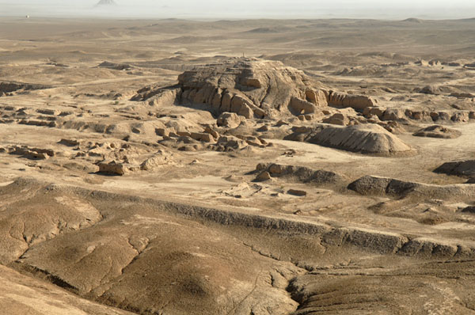
HPAR4006
Origins of Towns in Mesopotamia

Slide 2
Origins of Towns
Appearance of towns: 4th-3rd millennium BC in the Near East marks a major transformation in the organisation of human society:
  Childe’s Urban Revolution
What do we mean by urbanisation?
How do we define a town?
How & why do towns appear?
  What are the potential benefits & problems?

Slide 3
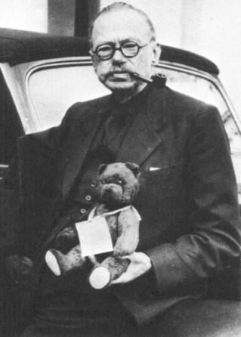
Childe’s Urban Revolution
Transformation of small, non-literate village communities into large, socially complex, urban societies
Childe applied concepts & theories from the social sciences to interpret archaeological finds
Model of urban revolution
  With ten separate criteria
Gordon Childe

Slide 4
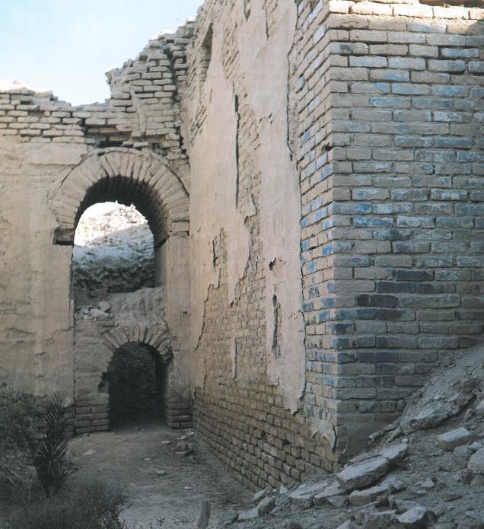
Childe’s Urban Revolution
Large population & large settlements (towns)
Full-time (craft) specialization & division of labour
Production of an agricultural surplus to support state & specialists
Monumental public architecture
A ruling class
Walls of ancient Uruk

Slide 5
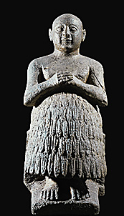
Childe’s Urban Revolution
Writing:
  Bureaucratic system of government
Exact & predictive sciences
  Arithmetic, geometry, astronomy, calendars
Sophisticated art styles
Long-distance trade (for luxuries)
The state
  Attached specialist craftsmen
Mesopotamian scribe

Slide 6
Definition of an Urban Settlement
“[A] permanent settlement within the larger territory occupied by a society considered home by a significant number of residents whose activities, roles, practices, experiences, identities, & attitudes differ significantly from those of other members of the society who identify most closely with “rural” lands outside such settlements
(Cowgill 2004: 526)

Slide 7
Causes of Urbanisation ?
Increasing urbanism an unintended consequence of increasingly large & complex political systems?
Associated with monumentality: expression of political power of elite
Cowgill: urbanism was not simply a result of technological, political, & economic innovations
    Towns were actively & intentionally created:
  Monumental structures have agency: shape behaviour, attitudes & emotions by which power is both legitimized & enacted

Slide 8
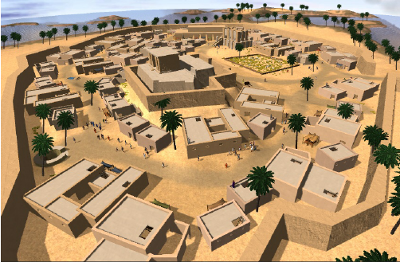
Origins of Towns
First identified in ancient Near East
Mesopotamia:
  Ubaid culture (6-early 4th millennium BC)
  Uruk culture (4th millennium BC)
Indian subcontinent:
  Harappan culture (c.3rd millennium BC)
Syro-Palestine:
  3rd millennium BC
Reconstruction of Uruk, c. 3000 BC

Slide 9
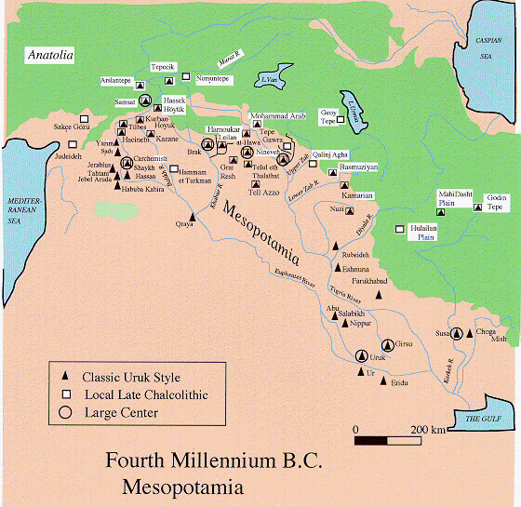
Uruk Period: c.3800-3100 BC
“the most innovative period in the history of Mesopotamia”
(Crawford 1991: 170)
Heartland: southern Mesopotamia
Expansion to Syria & Anatolia

Slide 10
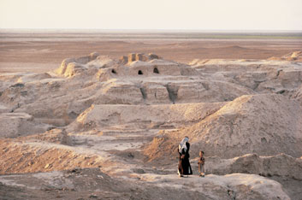
Uruk Period: Characteristics
Highly stratified society
Rapid increase in number of settlements
Four-tiered settlement hierarchy:
  Cities, towns, villages, hamlets
The development of a complex administrative system
A period of technological innovation in a vast range of fields
Ruins at Uruk

Slide 11
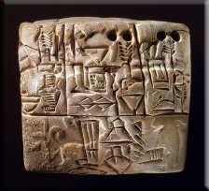
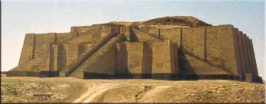
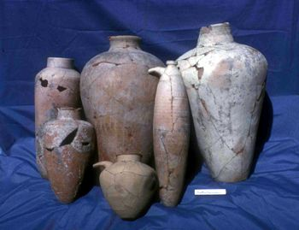
Attributes of Uruk Culture
Urban centres
Monumental construction:
  Fortifications
  Temples
Craft specialisation:
  Mass production of pottery & metallurgy
  Elite craft production
Writing
Seals & seal impressions

Slide 12
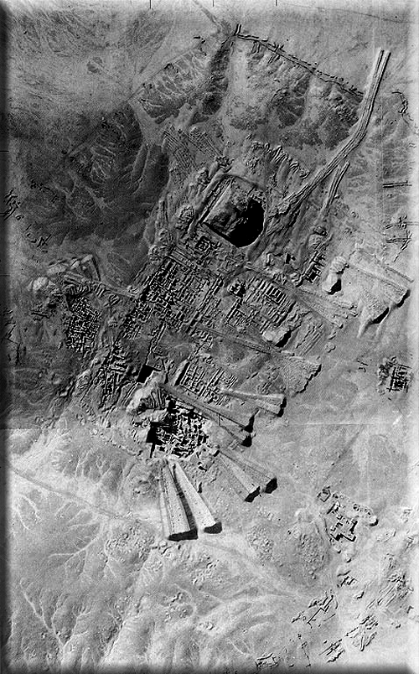
Defining Urban Centres
Size?
Function. A settlement that performs a variety of specialised functions:
Primary occupation of inhabitants need not be agricultural:
  Dependent on hinterland for production of food
  Centres of economic activity especially craft production
The walls of Uruk
Aerial view of Ur

Slide 13
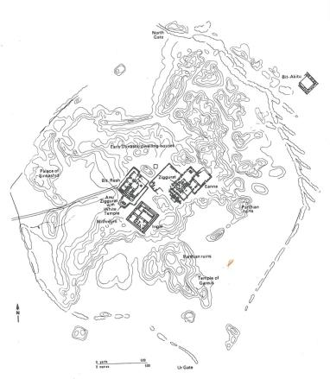
Defining Urban Centres
Location for religious & political activities in specialised buildings:
  Specialist religious personnel
  Administrative & political organisation
The walls of Uruk
Aerial view of Ur
4th millennium Uruk

Slide 14
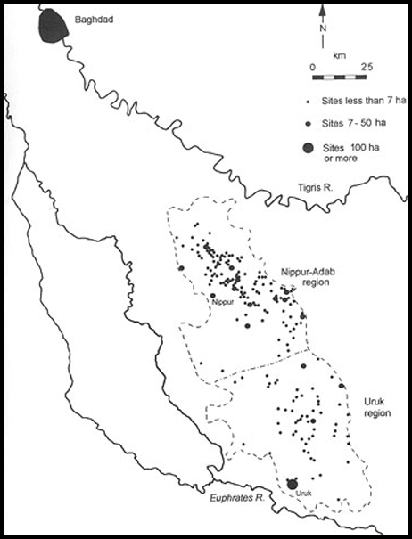
Settlement Hierarchy
Developed settlement hierarchy typical of urbanised landscape
Major centres:
  100 hectares (Ur & Uruk)
Smaller towns
  Between 7 & 50 hectares
Villages & hamlets:
  Farming communities supporting towns

Slide 15
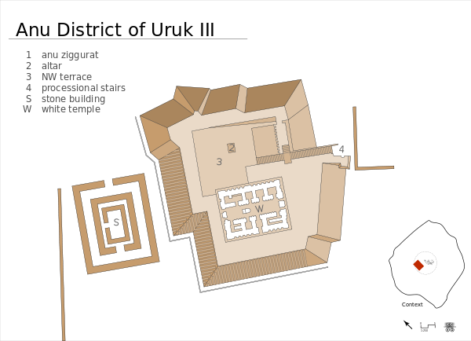
Uruk Towns
Most of our evidence for dates to 3rd millennium or later
4th millennium remains:
  Walls
  Temples: Anu & Eanna precincts
  The houses of ordinary individuals have not been excavated
Constrains what we can say about early urbanism

Slide 16
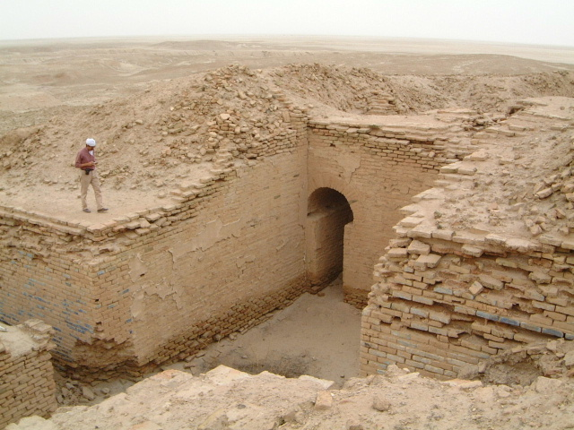
Uruk Towns
Mudbrick fortifications:
Mobilisation of manpower & organisational skills
Defensive structures (development of military class?)
Symbolic communication:
  Identity of city/town
  Its power, wealth & importance of the city
Uruk: ramparts

Slide 17
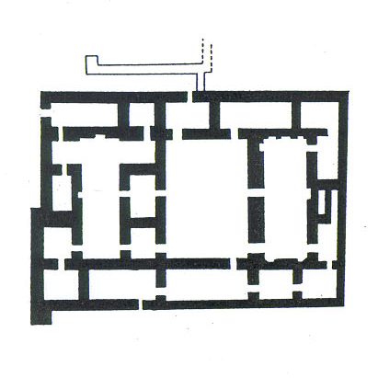
Uruk Habitation
Based on Digital Globe satellite imagery:
  Residential area tends to be in SE of settlement (temples in NW)
Houses: tripartite plan
Some compounds up to 100-300m square
Suggested sheep & cattle are still kept within settlement overnight
Uruk house

Slide 18
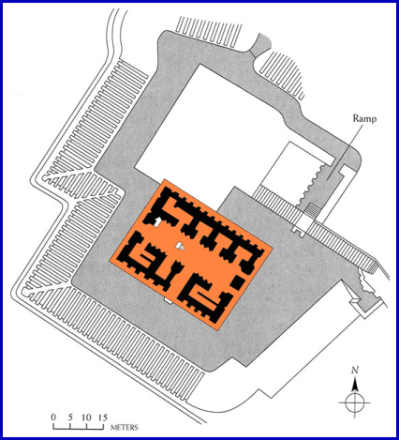
Temples
Dominated the urban centres
Responsible for political and economic control
The earliest cities were perceived as estates belonging to the gods
By Early Dynastic period (2900-2500 BC) the city temples controlled production & redistribution of goods
Ur, Anu precinct

Slide 19
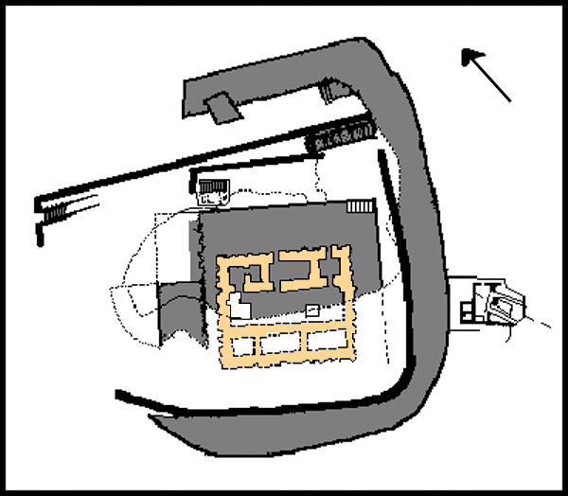
Temples
Mudbrick structures on a low mudbrick platform (origins of ziggurat)
  Increasing height to get the temple closer to the heavens.
Designed to impress local community
  Repeated expression of grandiosity & power
  Mediated relations between religious elite & wider community
Uqair

Slide 20
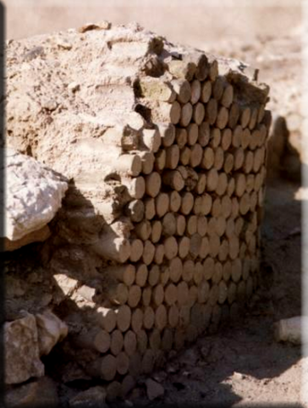
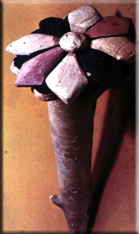
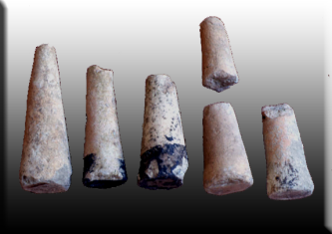
Temples
Lavish temple decoration making use of limited local resource
Columns in two rows, side walls & platform decorated with painted terracotta cones & geometric designs
Terracotta temple decorations

Slide 21
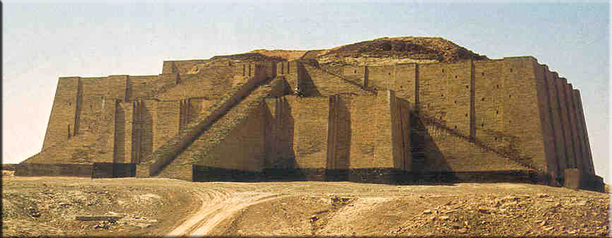
Monumentality & Power
Temples dominated the Sumerian skyline
Physical home of the deities
Monumental: enormous expenditure of human labour in construction
Production of goods & agricultural surplus under the patronage of the deities
Increasing centralisation of economic activity within the temples
Nanna ziggurat, Ur

Slide 22
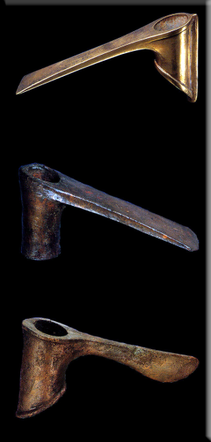
Craft Specialisation
Major transformation in habitus:
  Production moves out of the household into specialist craft shops
Two levels:
  Production of goods for everyday use
  Production of prestige goods for elite consumption
Specialised craft quarters:
  Uruk: discrete areas for production of carnelian & flint artefacts
  Specialist metallurgical areas
Ceremonial adzes

Slide 23

Pottery Production
Centralisation & mass production:
  Control over workshops?
Technological innovation:
  Potter’s wheel
Most pottery was undecorated
Uruk pottery

Slide 24
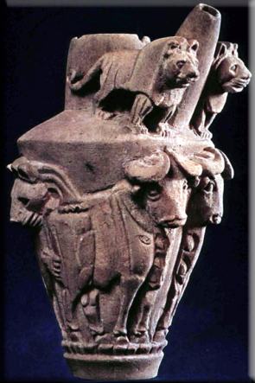
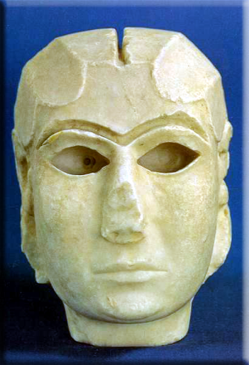
Elite Production
Specialist workshops producing rare luxury prestige goods, with limited distribution
Control over imported exotics
Symbolic communication
Stone sculptures & specialised vases
Development of complex iconography
Ceremonial stone
vase
Lady of Uruk

Slide 25
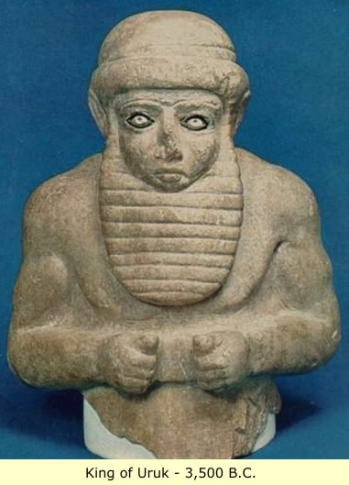
Reasons for Urbanisation?
Why do communities choose to congregate in larger urban communities?
  Are we looking at beneficial social relationships?
Loss of economic independence & increased coercion
Elite groups controlling production & resource
Manipulating symbolic worlds to legitimise new power structures

Slide 26
Summary
Increasing agricultural production allowed increasingly large populations to congregate together
By 4th millennium in southern Mesopotamia we see earliest urban communities:
  Childe’s urban revolution
Little known about Uruk households
Increasing specialisation of activities with urban communities
Monumentalisation of urban landscape
Development of technologies for control & coercion
To what extent is urbanism & monumentality an elite strategy of control?

