Slide 1

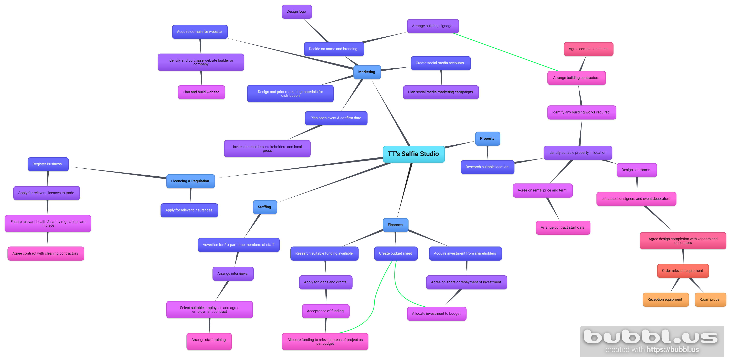
Purpose
To create an immersive experience
To create a new environment for parties
Create a new type of photography studio
Stakeholders
Local community
Photographers
Models
General public
Local event decorators
Local vendors
Local artists
Owner (myself)
Local business
Local councils
Sponsors / Shareholders
Bank
Desired End Result
Maintain a regular number of attendees
Become an established place to attend
Create jobs for local area
Become a place of “influence” on social media
Measures of Success
Number of customers / repeat customers
Collaboration with local community and stakeholders
Involvement from local council
Profits
Number of pre bookings
Completing within budget
Number of followers on social media
Project Outline
To create an immersive “Selfie” Photography Studio which allows individuals to create a portfolio of images with unique and creative backgrounds, lighting and props. With 92 million selfies taken each day , this new and exciting project can be a great way to get friends and family together for a fun night out, used for art projects, music videos or simply used in the growing trend of posting images on social media. To achieve this it a suitable location will be required with easy public access. The project plans to work with local event decorators and artists to create a extraordinary immersive photography experience.
Quad Chart
Power/ Interest
Budget
Type | Amount | Frequency
Property
Rental | £20,000 | per year
Builders | £4,000
Decorators / Decorating supplies | £5,000 | per year
Electricians | £2,000
Flooring | £850
Utility Bills | £1,200 | per month
Marketing
Website Domain | £30 | per year
Website Builder | £500
Social Media | £300 | per month
Printed Literature | £1,100 | per year
Signage | £2,000
Open Event | £1,500
Staffing
2 x Part Time Staff | £20,000 | per year
Payroll taxes | £1,220 | per year
Staff beverages | £40 | per month
Finances
Insurances | £420 | per month
Loan Repayments | £350 | per month
Equipment
360 Camera Booth | £1,500
Ring Lights x 6 | £420
Props | £600 | per month
Sound Speakers | £500
High Power, Low Interest
Local councils
High Power, High Interest
Customers
Low Power, High Interest
Local vendors
Low Power, Low Interest
Local event decorators
General public
Bank Funding
Local artists
Photographers
Models
Local community
Local business
Sponsors / Shareholders
Owner (myself)
Students
Employees
Risk Assessment
Project not complete within timeframe or budget Slips, trips and falls Theft of equipment & props Aggression and violence Damage to property
WBS

