Slide 1

Welcome to Academic Skills!
LCLM4001 Academic Skills
Week 5

Slide 2
Remembering last week
We learnt:
  Referencing and why it is important
  Integrity in academic and business work
  In text citations using (Author, Year)
  What plagiarism is and how to avoid it
  Using AI and library tools in an honest way
Why this matters:
It helps people trust your work
It protects you from plagiarism
It supports clear business writing

Slide 3

From last week to this week
Let’s go to VEVOX

Slide 4
What today is about
Paraphrasing, which means using your own words
Understanding the difference between copying and paraphrasing
Learning simple steps to paraphrase safely
Practising paraphrasing with business and academic texts

Slide 5

Paraphrasing

Slide 6
Why Paraphrasing Matters when Writing
In a paragraph:
your main idea
evidence from a source
explanation in your own words
link ideas together/link back to the question or business decision
This is also known as a TEEL paragraph structure (more on this next week!)
Paraphrasing helps you:
Use evidence safely
Show understanding, not copying
Write clear business paragraphs
Paragraphs need your words, not copied text.

Slide 7
What Is Paraphrasing? What Is It Not?
Paraphrasing IS:
Using your own words
Keeping the same meaning
Showing understanding
Used in the E and E of TEEL
Paraphrasing is NOT:
Copying the sentence
Changing only one or two words
Keeping the same sentence structure
If it looks like the original, it is not paraphrasing.

Slide 8
Nick & Sarah: Who Did it Better?
Nick and Sarah are Business students working on their referencing.
Go to the worksheet and decide who paraphrased better and why.
With a partner, decide and discuss:
Which part of the extract both students used (highlight in the original)?
2) Who received the lower marks and why?
3) What are the differences between Sarah and Nick’s use of sources?

Slide 9
Copying vs Paraphrasing vs Summarising
Original (from a source):
Customer complaints increased by 15 percent last month.
Copying:
Customer complaints increased by 15 percent last month.
Paraphrasing
There was a clear rise in customer complaints during the last month.
Summarising
Customer complaints are increasing.

Slide 10
How Paraphrasing Fits into a TEEL Paragraph
Customer complaints are becoming a serious business issue.
Reports show a noticeable increase in complaints (Smith, 2023).
This suggests customers are less satisfied with the service.
If the business does not respond, sales may fall.

Slide 11

Spot the Difference

Slide 12
What are the differences?
You will see:
One original source sentence
Three student versions
Your task is to decide:
Which version is allowed
Which version is preferred for TEEL writing
Which version is risky
Talk about
  Which words changed
  Whether the meaning stayed the same
  Which version sounds most like the student’s own writing
We are learning to choose the best option, not just what is allowed.

Slide 13
Here are the sentences
Original: Employees who receive regular training are more productive and make fewer mistakes at work.
Version A: “Employees who receive regular training are more productive and make fewer mistakes at work” (Doe, 2017, p. 4).
Version B: Regular staff training can improve productivity and reduce errors in the workplace (Doe, 2017).
Version C: Employees who get regular training are more productive and make fewer mistakes in their work (Doe, 2017).

Slide 14

Paraphrasing step-by-step

Slide 15
How Do We Paraphrase? Step by Step
We will do this together
Read a short paragraph
Find the key ideas
Hide the original text
Look at a paraphrase
Spot what changed
Learn simple techniques
Paraphrasing is a skill. We learn it step by step.

Slide 16
Original Paragraph
Your task:
Read the paragraph
List the key ideas
Do not worry about grammar or spelling
Focus on meaning, not wording.
Many small businesses struggle to keep customers. Long waiting times and poor communication often cause customer dissatisfaction. When customers feel unhappy, they are less likely to return or recommend the business to others. This shows that customer loyalty is important for business success.

Slide 17
Possible key ideas
Small businesses can lose customers easily
Poor service (slow or unclear communication) leads to dissatisfaction
Unhappy customers are less likely to recommend the business
Customer loyalty is important for business success
Good service helps businesses keep customers and grow
Paraphrasing starts with ideas, not copying sentences.

Slide 18
Spot the Difference: Paraphrasing Techniques
Work in pairs. Look at the two texts next to each other and try and spot what has changed. Make note of the changes.
Original:
Many small businesses struggle to keep customers. Long waiting times and poor communication often cause customer dissatisfaction. When customers feel unhappy, they are less likely to return or recommend the business to others. This shows that customer loyalty is important for business success.
Paraphrased Text:
Long waits and unclear communication can make customers dissatisfied, which can make it harder for small businesses to keep them. Customers who have a negative experience may not visit the business again or suggest it to other people. Overall, loyal customers are important for businesses to succeed.
Notes:
Now we are going to look at two versions of the same idea from the text. One is the original and one is a paraphrase. Your job is to work with your partner and discover what has changed — not just what is different, but how it has changed.
Don’t worry about getting it perfect. The aim is to notice patterns in how academic writing changes information.
First, look at the two texts side by side. Read them carefully.
Now, with your partner, start by underlining any words or phrases that are the same or very similar in both versions. This helps you see what has stayed the same.
Next, look for differences. Think about these questions as you work through it:
Has any word been replaced with a different word with the same meaning?
Has the order of information changed?
Have any sentences been combined or split?
Can you spot any changes in grammar, like noun to adjective?
Are there any linking words added, like as a result or overall?
Work slowly and discuss your ideas. You don’t need to write full sentences — just note down the changes you can see.
After a few minutes, we will share ideas together and build a list of paraphrasing techniques.
If you are unsure, focus on meaning first — then think about how the wording has been changed.

Slide 19
What did you notice?
Look at your notes from the activity
What differences did you find?
Talk with another pair
Think:
What changed in the wording?
What stayed the same?

Slide 20
Simple Paraphrasing Techniques
You can paraphrase by:
Using synonyms: unhappy → dissatisfied; poor → unclear
Changing word order
Combining sentences
Changing word form:
The business is a success→ The business is successful.
customer dissatisfaction → customers become dissatisfied
Notes:
These are simple techniques you can use when paraphrasing. You do not need to use all of them in one sentence. Even one or two changes can make your writing much safer and clearer.
Always start by thinking about the meaning. Then choose small changes that help you express that meaning in your own words.

Slide 21
Back to Nick
Remember Nick?
He's been working on his paraphrasing after feedback from his last report. In his next report he has paraphrased the below:
"Teamwork in business helps employees complete tasks more efficiently" (Brown, 2025, p.5)
Nick changes this to:
Cooperation in business helps employees finish tasks more efficiently (Brown, 2025).
Discuss with a partner:
What has Nick changed from the original?
Will Nick's teacher be happy with this? Why or why not?

Slide 22
Back to Nick
What has Nick changed from the original?
'Teamwork' → 'Cooperation', 'finish'→ 'complete'
2) Will Nick's teacher be happy with this? Why or why not?
No!
Nick has not changed enough of the original.
He has only selected two key words and used
synonyms. This is not enough of a change.
REMEMBER: Effective paraphrasing is a combination of
paraphrasing techniques! Changing only a few key words
still keeps the majority of the paraphrase the same!
REMEMBER:
Effective paraphrasing is a combination
of paraphrasing techniques!
Changing only a few key words
still keeps the majority of the paraphrase the same!

Slide 23
Break time!
See you in 10 minutes ☺

Slide 24
Check Your Understanding!
Let’s go to VEVOX

Slide 25
Let’s try it together: Gallery Walk
Move around the room and visit each poster.
At each poster:
Read the sentence.
Think about the meaning first.
Write your own paraphrase.
Try to use more than one paraphrasing technique.
Keep the same meaning.
After you have completed at least three posters, go back to your first one and look at the other answers and how they compare to yours.
Then try at least 1-2 more posters.
Remember:
There is more than one correct paraphrase.
You do not need perfect English! Just try your best.
Notes:
Now we’re going to get up and practise paraphrasing with a gallery walk. Around the room, you will see different posters with sentences to paraphrase. At each poster, read the sentence carefully and think about the meaning before you start writing. Then write your own paraphrase and try to use more than one technique, such as changing words, word order, sentence structure or word form. Make sure the meaning stays the same.
You do not need to complete every poster. Start by completing at least three carefully. After that, go back to your first poster and read some of the other answers. Notice how other students have expressed the same idea in different ways and compare their versions with yours. Then, if there is time, move on and try one or two more posters.
Remember, there is more than one correct way to paraphrase a sentence. The aim is not perfect English. The aim is to keep the meaning and practise expressing it in your own way.

Slide 26

Guided Practice

Slide 27
Paraphrasing Paragraphs
Work in pairs
You will:
  Read a short business paragraph
  Identify the main ideas
  Paraphrase the paragraph using your own words
Remember:
  Focus on meaning, not copying
  You do not need long sentences
  There is more than one correct paraphrase

Slide 28
Exchange and Notice
Now work with another pair
Exchange your paraphrased paragraph
Read the other version quietly
Do not correct grammar
Do not rewrite their text
Talk about
  Is the meaning the same as the original?
  What is different from your paraphrase?
  What wording or structure works well?

Slide 29
Vevox – What Did We Notice?

Slide 30
Break time!
See you in 5 minutes ☺

Slide 31

Independent Paraphrasing Practice

Slide 32
Let’s paraphrase!
Work on your own
You will:
  Read a short business paragraph on resilience
  Identify the main ideas
  Paraphrase the paragraph in your own words
Important:
Focus on key ideas, not replacing every word
You can write fewer sentences than the original
Simple language is fine

Slide 33

What Did We Practise?
Today you practised:
Finding main ideas in a source
Letting go of the original wording
Explaining ideas in your own words
Paraphrasing without copying
What matters
There is more than one good paraphrase
Simple language is OK
Paraphrasing improves with practice

Slide 34

Reflection
Please answer:
What did you learn about paraphrasing today?
What part of paraphrasing do you still find difficult, and what would help you?
Write full and short sentences. Use simple English.
You will post your answers on Moodle in the forum “Reflection Space – Individual”.
Only you and the tutor can see your post.
This is not marked.
You do not need to share with the class.

Slide 35

Recap

Slide 36
Today we learnt:
What paraphrasing is
Why paraphrasing matters
How to use our own words
How to find key ideas in a text
How to write a short summary
Why summaries help business decisions

Slide 37


Next Week:
Writing in a business context

Slide 38
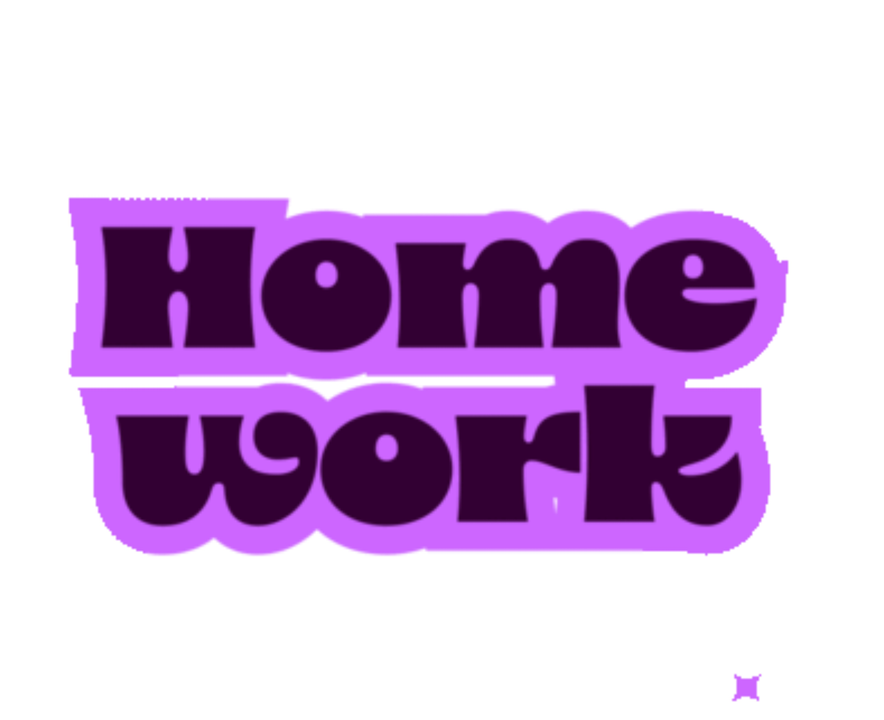
Homework for Week 6
Open Moodle
Go to this module (Academic Skills)
Click Assessment Information and Submission
If you haven't yet done so, complete the lesson:
AS2: Paragraph Writing: Assessment Information and Help
Your teacher WILL be checking if this is complete by next week!
Open Moodle
Go to this module (Academic Skills)
Click Week 5
Complete the 2 tasks identified.

