Slide 1

Embedded Counselling Skills
‘Its good to talk’

Slide 2

Embedded session unplanned
Time available for first session limited
Model used depends on subject
This Photo by Unknown Author is licensed under CC BY-NC-ND

Slide 3

Being present while doing your day job
Difficult to balance the clients expectations and ensure we stay within ethical boundaries
Embedded Counselling requires: (Mcleod & Mcleod, 2011)
Self Aware
Curious about people and how they cope
Sensitive to cultures
You see the worth in people
Interested in relationships
Being realistic about what can be achieved
‘do no harm’ especially applies here (Bond, 2015)
This Photo by Unknown Author is licensed under CC BY-NC-SA

Slide 4
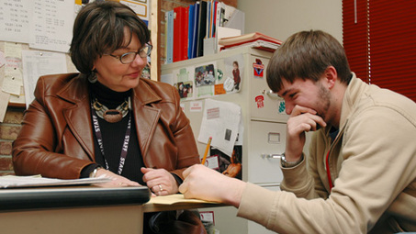
Understanding people as ‘social beings and not psychological issues
(Mcleod & Mcleod, 2011)
This Photo by Unknown Author is licensed under CC BY-SA

Slide 5

Human Contact
Over the years of austerity the space available is being limited
Staff are expected to do more
Becoming less human, more automation
Dangers of insufficient supervision for practitioners
Training and skills allowing responses to empathic opportunities
Limited time slots managed by counsellors/practitioners
Moving clients onto formal counselling
This Photo by Unknown Author is licensed under CC BY-NC-ND

Slide 6

Areas where embedded counselling can be used.
Medical settings – nursing, doctors, palliative care, Community services
Elderly Residential Care
Older People
Schools & Youth Work
Universities & College
Social Work & Family Advice
Advice Workers such as Debt, Rights, Domestic Abuse, Victim Support
This Photo by Unknown Author is licensed under CC BY-SA

Slide 7

Felt that digging too much could cause time problems.
This could be dangerous in actual counselling
Exploring clients attitudes and their origins took time.
Also time consuming to establish persepective
Quicker to give advice
Takes longer to question clients within a counselling model
Need to see issues for themselves
This Photo by Unknown Author is licensed under CC BY-SA

Slide 8

Serious issue presented
First time client opened up to anyone
If formal counselling required there is a extensive wait
Client left holding the issue
Risk to practitioners if self care and supervision not used.
Risks of Embedded Counselling
This Photo by Unknown Author is licensed under CC BY-SA

Slide 9

Being Human and Compassionate
This Photo by Unknown Author is licensed under CC BY-SA

Slide 10
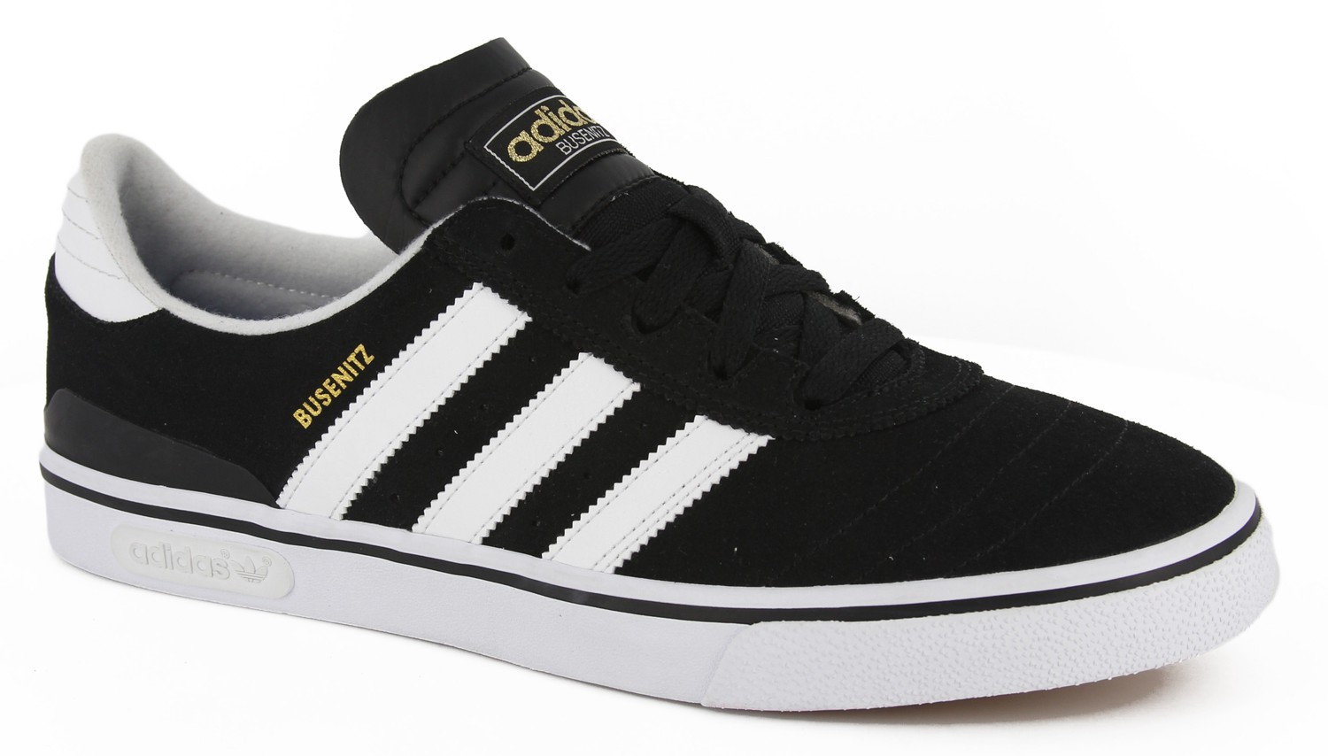
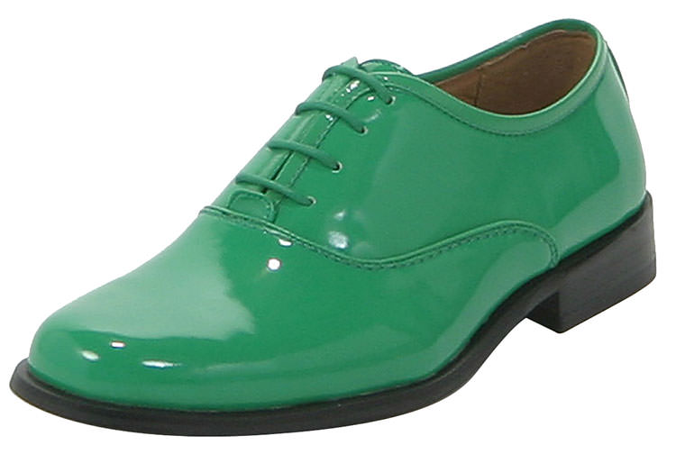

“The shoe that fits one person pinches another; there is no recipe for living that suits all cases”
Carl Jung (Howard, 2000)
This Photo by Unknown Author is licensed under CC BY-ND
This Photo by Unknown Author is licensed under CC BY-ND

Slide 11
References
Bond, T., 2015. Standards and Ethics for Counselling Action. 4th ed. London: SAGE Publications Ltd.
Howard, A., 2000. Philosophy for Counselling and Psychotherapy. Basingstoke: Palgrave.
Mcleod, J. & Mcleod, J., 2011. Counselling Skills, a practical guide for counsellors and helping professionals. Second Edition ed. Maidenhead: Open University Press.

