Slide 1
Comparative Study of Happiness with Modern Western Culture and the Three Chinese Traditions
Xuefeng Cui

Slide 2
The Aims and Objectives
To have a comprehensive understanding of happiness with broader cultural perspectives rather than based on a dominant modern wester culture;
By introducing new dimensions of the way of living a good life from ideas of the Chinese traditions, namely Confucianism, Taoism and Buddhism, we want to give readers a guidance on how to achieve the genuine happiness;
To bridge the culture gap between West and East in the studies of happiness and provide a reference for future research.

Slide 3
Method and Structure of Research
The methodology is a comparative study and evaluation of concepts of happiness with Chinese and Western cultures.
First, two major types of western views on the notion of happiness are identified and analysed.
Second, through both study of ancient classic books and researches of scholars, the concepts of happiness as well as the ways to a good life under the three Chinese traditions are equally examined.
Lastly, the major domains of differences about happiness between the modern western and Chinese traditional cultures are identified and discussed.

Slide 4
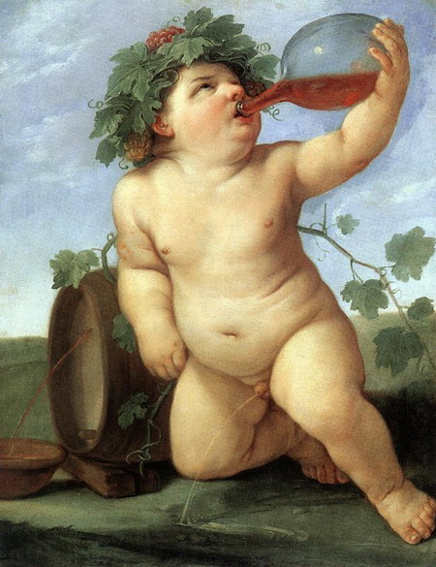
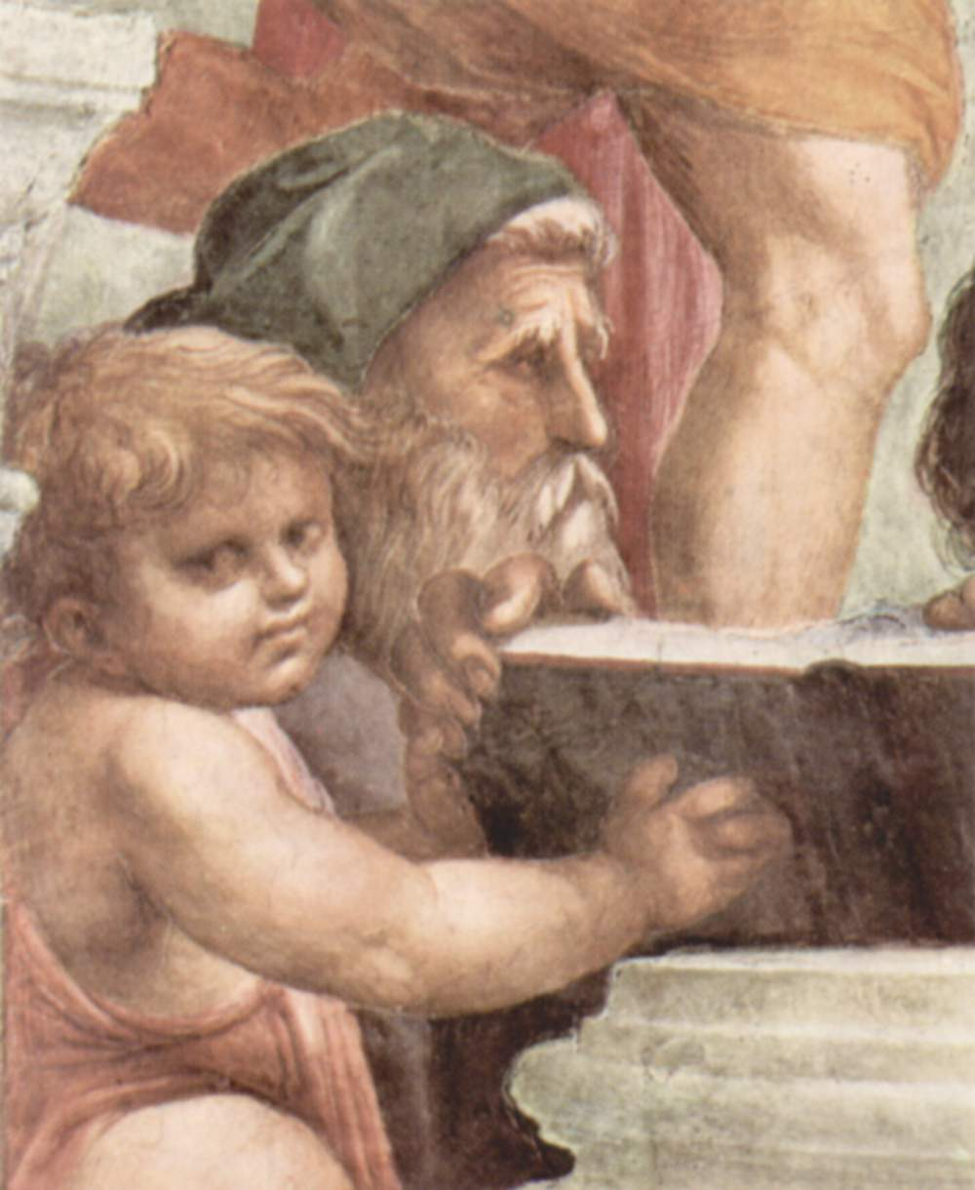
Happiness in Western Cultures
Hedonism
Eudaimonia

Slide 5
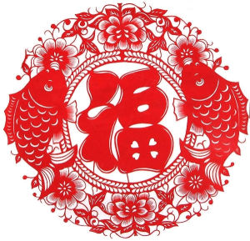
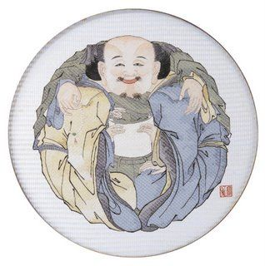
Happiness in Chinese Traditional Cultures
“fu”-- Happiness in Chinese
Chinese Three Teachings

Slide 6
Happiness in Confucianism, Taoism and Buddhism
Confucianism
Buddhism
Taoism
No-self as an enlighten mind;
Meditation: Be-unaffected with any external or internal stimuli;
Live with compassion.
Liberation from human desires;
Live with Dao;
Live harmoniously with Nature.
Learn & Self-cultivation;
Live with benevolence;
Live harmoniously in Society.

Slide 7
Comparison with Modern Western Cultures and Chinese Traditional Cultures
Hedonism vs. Eudaimonism
Self-Enhancement vs. Self-Transcendence
Master vs. Harmony

Slide 8
Conclusion and Relevance to Interfaith Study
To conclude, the ideas of happiness have a distinct contrast between the Chinese traditional cultures perspective and the predominant Western cultural perspective. Concerning to the modern western culture, the notions of happiness emphasis on pursuing pleasure based on individualism, while that of Chinese traditions focuses on virtue and wisdom with self-transcendence orientation and the spirit of harmony.
This paper serves as an interfaith study among Chinese and western philosophies about the notion of Happiness or Subject Well-being, and among the first attempts to bridge the gap of the understanding of happiness between not only the West and East but also the past and present.

Slide 9
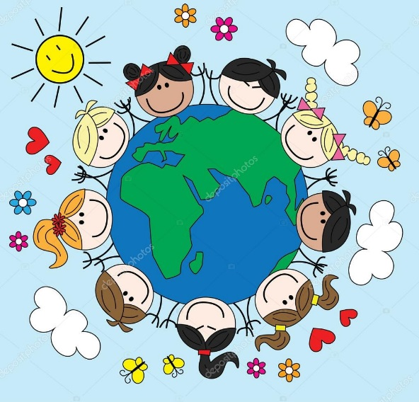
Q&A: Happy?

