Slide 1
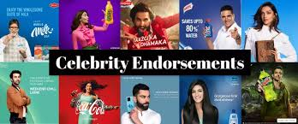
Celebrity Endorsements in Modern Business Marketing
Vanessa Andreea Eftimie

Slide 2
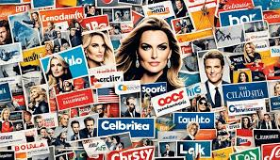
Introduction
Celebrity endorsements are a persuasive form of marketing used to affect perceptions, build trust, and create emotional connections with consumers or viewers. Evidence supports that celebrities influence consumer perceptions by transferring the image, credibility, and value of the celebrity onto the products created by the brand (Nautiyal, 2023). In the current, digital experience of marketing, social media and the influencer ecosystem have further heightened celebrity presence through marketing to a political level (Akingbade, 2024). Understanding how and why endorsements work will be necessary for evaluating contemporary business marketing.

Slide 3
What Academic Research Shows
Celebrity endorsements can boost brand associations, credibility, and emotional appeal, especially when their public persona matches the brand’s personality (Jun et al., 2023).
Studies note that endorsements are only effective when consumers deem them authentic and relevant; inaccurate partnerships decrease consumer trust (Ambroise and Albert, 2020).
Furthermore, the kind of celebrity used, such as traditional celebrities or social media influencers shapes how consumers interpret the campaign’s message (Zhou et al., 2024).
In summary, celebrity endorsement continues to be a tactical mechanism for working towards the formation of consumer attitudes and reinforcing brand identification (Nautiyal, 2023).

Slide 4
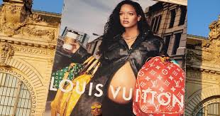
Real-World Example: Rihanna in Pharrell Williams’s LV Menswear Campaign
For his first Louis Vuitton menswear campaign, new creative director Pharrell Williams selected Rihanna to anchor the launch of a new luxury leather bag line. In retrospect, Rihanna’s participation in a menswear campaign challenged traditional notions of branded gendered marketing in the fashion industry. Rihanna’s global status as an icon of music and fashion as well as a cultural trendsetter allowed the campaign to leverage her presence to heighten visibility and emotional engagement. Even while pregnant with her second child, when she appeared in the campaign, Rihanna demonstrated, throughout the collection launch, how maternity fashion should be defined and aligned the spirit of creativity, inclusiveness, and individuality that Williams desired to communicate.
This is one simple example of how celebrity participation in advertising can shift audience perceptions and extend cultural meaning for a brand, a critical role that celebrity endorsement theory aims to elucidate (Jun et al., 2023; Ambroise and Albert, 2020).

Slide 5
References
Ambroise, L. and Albert, N., 2020. Celebrity endorsement: Conceptual clarifications, critical review, and future research perspectives. Recherche et Applications En Marketing (English Edition), 35(2), pp.97–122.
Akingbade, O., 2024. The political economy of digital and social media celebrity influencer marketing. Political Economy of Contemporary African Popular Culture: The Political Interplay, p.239.
Jun, M., Han, J., Zhou, Z. and Eisingerich, A.B., 2023. When is celebrity endorsement effective? Exploring the role of celebrity endorsers in enhancing key brand associations. Journal of Business Research, 164, p.113951.
Nautiyal, A., 2023. Impact of Celebrity Endorsement on Consumer’s Mindset.
Zhou, Y., Li, Y.Q., Ruan, W.Q., Zhang, S.N. and Yang, T.T., 2024. Who should the spotlight be on? The interactive effects of celebrity endorser type and destination personality. Tourism Management, 105, p.104957.
https://fashionista.com/2023/06/pharrell-williams-louis-vuitton-rihanna-campaign

