Slide 1






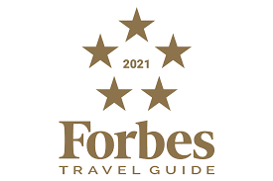
Forbes Travel Reviews
Global Luxury Grading & Excellence Training

Slide 2

Verifying Luxury
Training
Quality Assessments – Rate 2,000 global hotels, restaurants & Spa’s
Global Partnerships - Annual Standards & Benefits
Custom Standards – Competitive Analysis

Slide 3
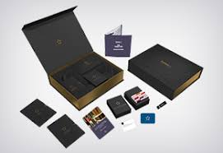
Service Training
Virtual
On Location
Adapt to Needs
Operational Frontline – Executive Strategic Leadership
Training Tool Kits

Slide 4

Best Practice
Service Excellence
Luxury
Guest Safety
Guest Loyalty
Experience
Authenticity
Immersion
Personalisation

Slide 5
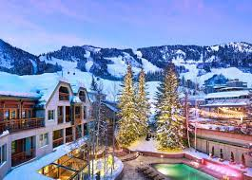
Training Excellence
Knowledge
Golden Nugget
Guest Interaction
Guest Needs
Personalise
Attitude

Slide 6

Seamless Onboarding
Orientation
Implementation – Challenge & Solution
Personalised Learning
Group Hierarchy
Operational Roll Out
Enterprise
Empowerment
Culturally Relevant
Customization – Unique to the Business

Slide 7
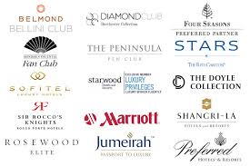
What Makes 5 Star?
900 + Standards!
Beautiful Beds
Distinctive Drinks
Supreme Service
Memorable Meals
Helpful Housekeeping
Genuine Interest
Exceeding Expectations

Slide 8
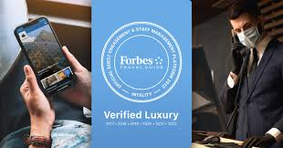
Impacts of Covid

Slide 9
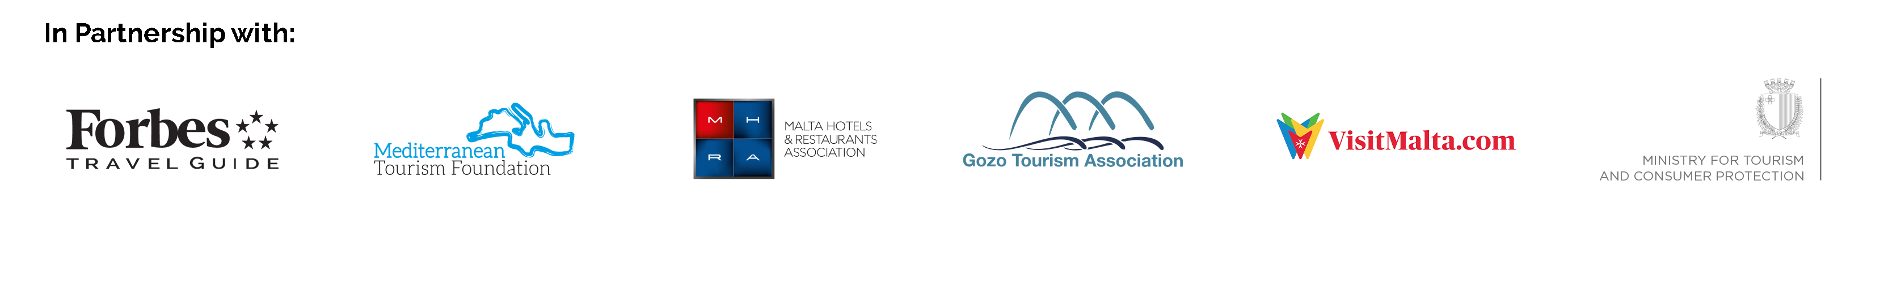
Malta
Setting Malta as a Quality Tourism Destination
in partnership with Forbes Travel Guide

Slide 10
MALTA
During the past months, as tourism travel restrictions started to be lifted, the Malta Hotels and Restaurants Association, the Ministry of Tourism, and the Malta Tourism Authority recognized the need to embark on a coordinated effort to ensure that the Maltese hospitality sector is viewed as adequately safe and prepared to welcome and service the most discerning tourists.
Towards this end, a team of experts facilitated by the Mediterranean Tourism Foundation developed the STAR Journey initiative, a comprehensive quality programme which aims to set Malta as an In-Partnership Forbes Travel Guide Destination with a focus on Service Excellence and Safety – a FIRST in the world.

Slide 11
MALTA - The STAR Journey powered by Forbes Travel Guide
Aims to promote:
SAFETY - If you are a hotel (5, 4, 3, 2 and boutique hotels) and wish to demonstrate to guests your commitment in ensuring a safe environment whilst staying at your hotel, you can have access to a health security platform that allows you to put to record your efforts in adhering to protocols and accordingly earn a VERIFIED badge with Forbes Travel Guide.
TUTORSHIP - If you are hotel, restaurant, or an individual working in or studying about tourism, you are eligible to access on-line training opportunities related to service and management excellence by Forbes Travel Guide and other training partners as a continuation to the successful on-line Winning Training.
ACCOMMODATION - f you are a hotel (5, 4, 3, 2 and boutique hotels) and wish to get a detailed evaluation of mainly your hotel’s service – and a chance to earn a Forbes Travel Guide Service Excellence Accreditation

Slide 12

Forbes Travel Guide 2022 & Beyond

