Slide 1

Event Title: “Wild Croeso: A Welsh Sense of Place Experience”
Subtitle: Feasibility Study Presentation
BMIH6007
International Meetings Management for the Hotel Industry
Student: Aiga Bordasa
Student nr: 2238996
Lecture: Kathryn Flynn
AI Declaration
I confirm that I have not presented any AI generated text as my own work. I confirm I have copies of my drafts, notes, and other resources I used before, and after the use of AI tools which I may be asked to provide in evidence.

Slide 2
Event Content & Context
Focus: Promote Wales as a culture and well-being destination through experiential experiences (Leung, 2019).
Type: Hybrid MICE event featuring live interactive experiences and online elements
Theme: Sense of Place — highlighting Welsh natural environments, heritage, food, and culture (Bowdin et al., 2023).
Objective: Invite international delegates to share Welsh culture and establish business relationships (Shum, Gatling and Shoemaker, 2018).
Notes:
Welcome everyone. Today, I’m excited to present a feasibility study for an original event concept titled “Wild Croeso: A Welsh Sense of Place Experience.” This event is designed to support Visit Wales’ “Year of Croeso 2025” campaign by promoting Wales as a leading destination for eco-tourism and wellness. Wild Croeso will offer international delegates a multisensory journey through Wales’ landscapes, culture, and traditions, with activities such as VR immersion, wellness workshops, and local networking opportunities.
This feasibility study will set out the event's strategic aim, its purpose and suggested content, target market and demand, operational strategies, and a clearly defined financial model. I will demonstrate how this event is a reaction to international tourism trends, capitalizes upon Wales' individual strengths, and is aligned to national tourist goals. In general, the research contends for Wild Croeso as a feasible, attractive event that will improve Wales' international reputation and facilitate sustainable tourism development.
The event is structured to fully immerse delegates in the spirit of Wales' land, culture, and wellness products. It couples physical experiences such as traditional food tasting and cultural performances with virtual VR tours of the major destinations. This blended format ensures global accessibility and intensive interaction, highlighting the "Sense of Place" that Wales uniquely provides.

Slide 3

Market Factors – Target Audience
Primary Target: International tour operators, wellness retreat organizers, travel media, and influencers (Singjai, Winata and Kummer, 2018).
Secondary Target: Travel buyers, hospitality sector professionals, and cultural institutions (George, 2025).
Demand Drivers: Increased interest in wellness tourism, sustainable tourism, and cultural authenticity (Hestler, Spilling, and Scirri, 2020).
Market Trends: Post-pandemic trend towards nature and experience tourism
Notes:
Our target segment consists of professionals who shape travel patterns worldwide — wellness retreat organizers and tour operators who are looking for new destinations. Emerging trends in wellness and sustainable tourism drive demand for experiences based on nature and culture. The timing is opportune as consumers increasingly favor authenticity and mental health.

Slide 4
Market Factors – Supply & Competition
Competing Events: Conventional travel trade exhibitions, wellness shows, regional tourism expos (Bilgihan and Ricci, 2023).
Unique Selling Points (USPs): Distinctive Welsh cultural immersion, blended mode, collaboration with Visit Wales (Nam, et al., 2021).
Collaborators: Local Welsh businesses, cultural groups, hospitality providers (Serra-Cantallops et al., 2018).
Notes:
While other events highlight overall travel possibilities, Wild Croeso delivers an in-depth experience highlighting Wales' culture and wellness offerings. Niche positioning like this minimizes direct competition. Collaborations with Visit Wales and local suppliers add validity and stakeholder engagement.

Slide 5
Operational Factors – Location & Venue
Location: Royal Armouries Museum, Leeds
Availability: Available for a weekday in early summer, consistent with pre-summer travel booking patterns (Davahli et al., 2020).
Suitability: Contemporary conference halls, exhibition halls, VR technological infrastructure, inner accessibility (Le and Phi, 2021).
Accessibility: Great transport facilities by rail, road, and air for UK and overseas delegates (Kandampully, Zhang and Jaakkola, 2018).
Notes:
The Leeds Royal Armouries Museum provides a high-end and accessible venue that combines history with high technology. It can hold large networking areas, workshop rooms, and VR areas. Transport in Leeds makes it the perfect place to draw delegates from Europe and the UK.

Slide 6

Operational Factors – Staffing & Skills
Core Team: Operations Manager, Marketing Coordinator, Event Manager
Support Staff: VR technicians, well-being facilitators, caterers, registration volunteers
Major Skills: Coordination of events, stakeholder management, use of digital technology, hospitality management (Singjai Winata and Kummer, 2018).
Notes:
Multi-skilled operation is necessary for successful delivery. The event manager coordinates overall, marketing takes care of promotion, and operations see to it that logistics are in order. Specialist input in the form of VR technology and well-being instructors contributes authenticity and participation, while volunteers assist guest services.

Slide 7
Operational Factors – Resources
Catering: Welsh-themed meals with dietary alternatives
Technical: Rental of VR equipment, sound equipment, lighting
Facilities: Delegates' seating, exhibition stands, parking for delegates
Health & Safety: Venues' regulations adherence, first aid, insurance
Notes:
Resource planning takes care of all necessary elements for a hassle-free event experience. Welsh catering showcases local ingredients, and VR technology offers immersive tours. Networking and exhibition are facilitated by venue facilities. Health and safety procedures are built into ensuring delegate welfare and event compliance.

Slide 8
Financial Factors – Cost Breakdown
Category | Estimated Cost (£)
Venue Hire | 4,000
VR Equipment Rental | 2,000
Catering | 1,875
Wellness Workshop | 500
Marketing & Design | 1,200
Staffing & Volunteers | 800
Gift Bags & Materials | 625
Travel & Logistics | 1,000
Contingency (10%) | 1,000
Total Expenditure | 13,000
Notes:
The budget is around £13,000. Venue rental and VR hire are big-ticket items, offset by catering and marketing costs. There is also a 10% contingency budget to cover unforeseen expenditure. All costs are based on thorough market research and quotes from suppliers.

Slide 9
Financial Factors – Income Sources
Source | Expected Income (£)
Visit Wales Sponsorship | 6,000
Partner Booth Fees | 4,000
Delegate Registration | 3,000
Total Income | 13,000
Notes:
Revenue is forecast from three primary sources: Visit Wales sponsorship accounts for the largest proportion, backed by partner fees from exhibitors at stands and delegate registration fees. The balance of income and outgoings ensures that the event is financially viable and sustainable.

Slide 10
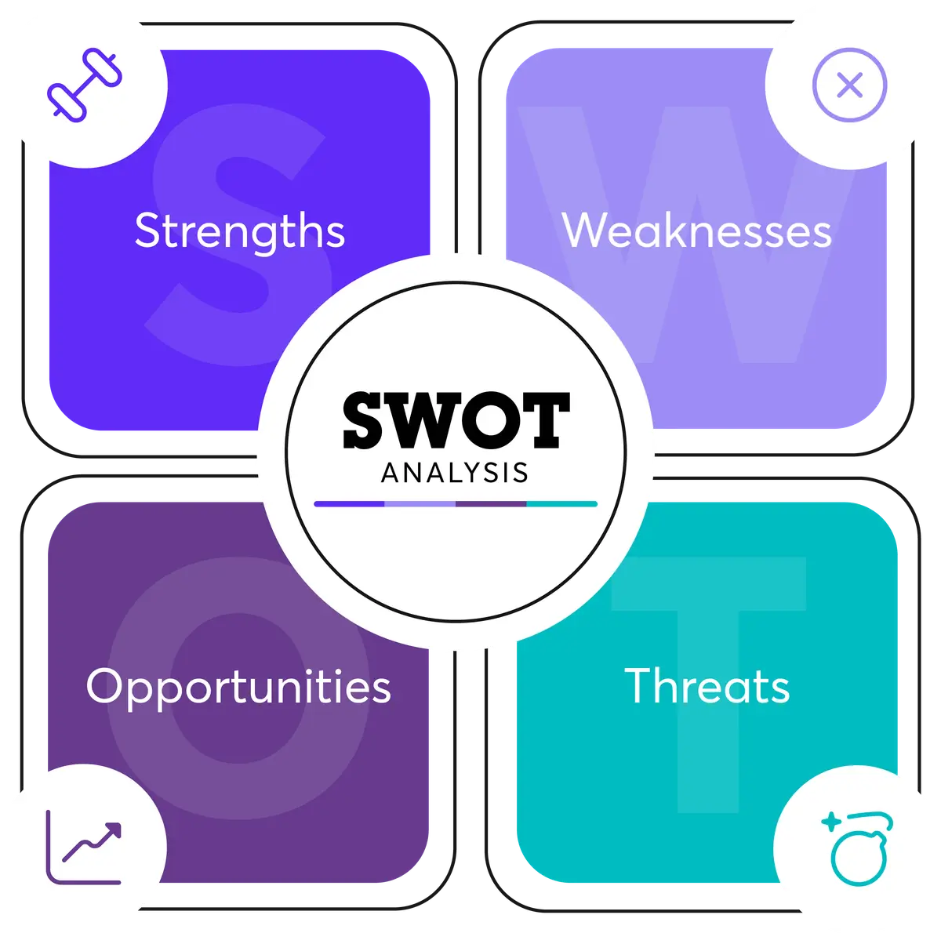
SWOT Analysis
Strengths: Good cultural theme, support from Visit Wales, hybrid event format (Elias, 2023).
Weak points: Inexperienced event, dependency on partner involvement
Opportunities: Increasing wellness tourism, trends of digital technology, increasing global market (Baum, T., 2019).
Threats: Economic uncertainties, travel restrictions, other events (Legrand, Chen and Laeis, 2022).
Notes:
A SWOT analysis outlines major internal strengths and weaknesses and external opportunities and threats that affect the Wild Croeso event. Strengths are high cultural appeal, Visit Wales backing, and a hybrid format that combines immersive experiences with online engagement. Opportunities emerge from increasing wellness tourism, sustainable travel, and increased international interest in authentic cultural events. Weaknesses, such as newness of the event and reliance on partner collaboration, need to be addressed, however. Externally, economic uncertainties, travel bans, and alternative events pose threats. Acknowledging them enables proactive risk management to boost event resilience and maximise success.

Slide 11
Strategic Considerations & Risk Management
Marketing emphasis in core global markets (North America, Europe)
Contingency planning for travel disruptions and technical failures
Sustainable practices: Local sourcing, reduction of waste
Stakeholder engagement to ensure continuing partnership strength (Alonso et al., 2020).
Notes:
Wild Croeso's strategic emphasis guarantees focused outreach to target international and national markets, expanding its scope and influence. By integrating environmental sustainability into all phases of planning, the event is strongly aligned with Wales' robust eco-tourism principles, attracting mindful travellers. Regular and open communication among stakeholders such as Visit Wales, tour operators, and wellness providers encourages cooperation and confidence, enhancing overall event performance and responsiveness to evolving challenges. This strategy not only increases the credibility of the event but also facilitates long-term collaborations and enhances Wales' status as a premier sustainable tourism destination.

Slide 12

Conclusion
Wild Croeso is a timely, strategic, and affordable event to fit Visit Wales' "Year of Croeso" values.
01
Blends cultural immersion, well-being, and digital innovation for global influence (Sharma and Srivastava, 2018).
02
Next steps: Complete partnerships, finalize bookings, initiate targeted marketing campaigns (Yang, Henthorne, and George, 2019).
03
Notes:
In conclusion, Wild Croeso presents a unique stage to show the rich Welsh heritage and awe-inspiring Welsh nature, thus setting the nation on the stage as a first-rate wellness destination as well as eco-tourism destination. The comprehensive planning strategy and analysis of feasibility seal the event as being highly poised to draw attention globally and for generating sustainable tourist growth. Through a focus on efficient operational management and carefully targeted marketing, the event is well-positioned to provide significant interaction and long-term partnerships. In the future, a focus will be on seamless delivery and stakeholder collaboration to guarantee Wild Croeso realizes its goals and establishes a model for subsequent tourism development.

Slide 13
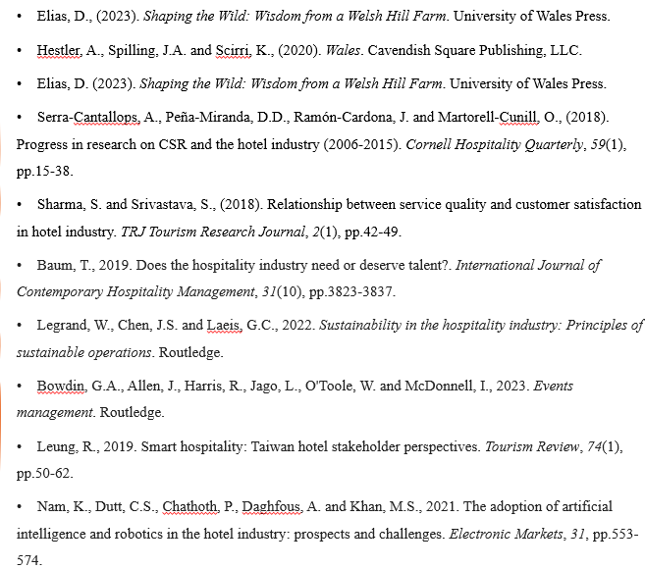
References

Slide 14
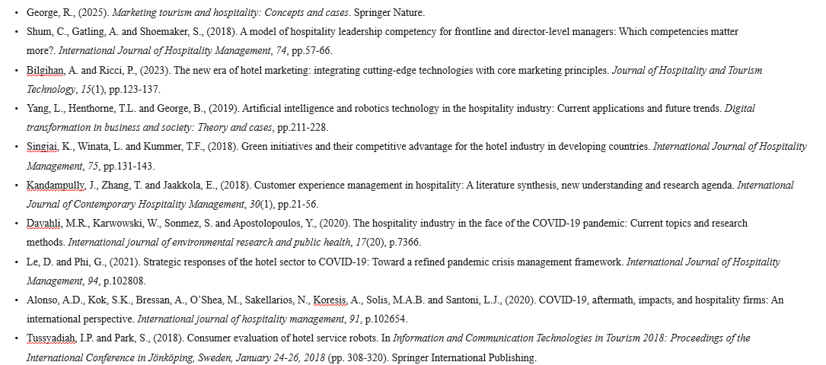
References

