Slide 1

Title: ( Go Green Un - limited) Company
Samsul Alom (Leader) 1605851
Clarrisa Adela Kover 1605694
Zarrar Zafar 1605852
Farhat Zafar 1605787
Nassaba Guiba 1605896
Tutors Name : Mushfiqul Rahman

Slide 2
Contents
1. Introduction
2. Aims & Objectives
3. Company Description Mission and Vision
4. Natural Mineral Consumption
5. Population Growth
6. Legal Compliance
7. Management Process/Marketing
8. Current State of Market
9. SWOT analysis
11. Conclusion
10. PESTEL Analysis
12. Questions and Answer Session

Slide 3
Introduction
1. Innovation in Farming
2. Hydro ponic
3. Aqua ponic
4. Aero
ponic
5. Using Far Less Space
6. Half the time
7. Environmentally Safe
8. Encourage Healthy Eating

Slide 4
Aim and Objectives
Aim is to:
Grow 100% Natural Plants, Fruits, Salad and Flowers with no known Chemicals as a Business to gain income with sustainable profit

Slide 5
Objectives
Buy Land and build huge Green houses
Purchase
Production tools & facilities
Raise Environmental Awareness
Manage budget
Promote
Network & build sustainable stake holders

Slide 6
Company Description Mission and Vision
Provide natural organic produce
Environmentally Friendly
No Chemicals
No Pesticide or Fertilizers
No Tractors
No Heavy Tools
Healthy for Humans

Slide 7

Reduce Water Consumption

Slide 8
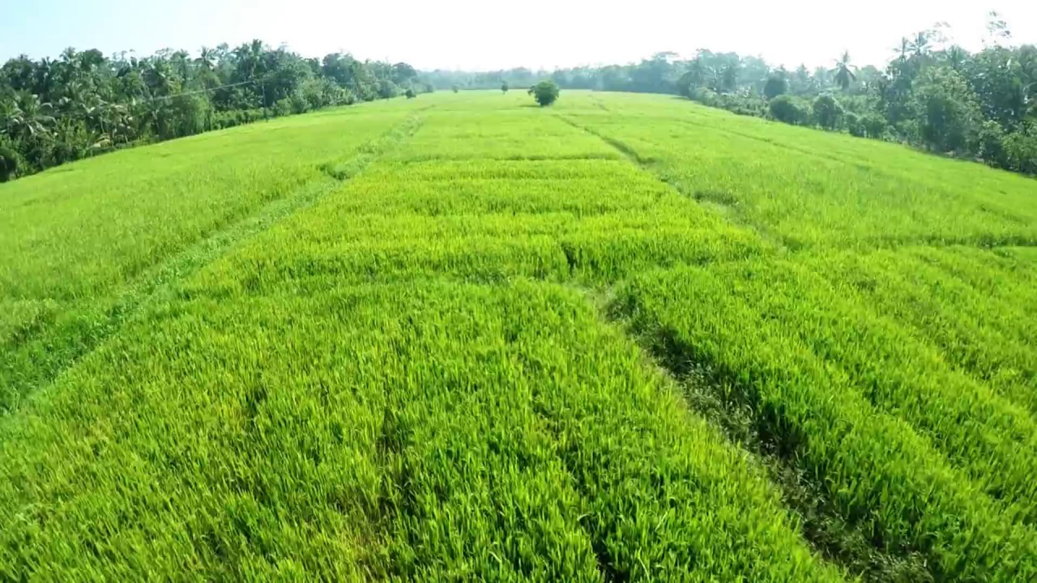
Use of land mass reduced by 1/40th

Slide 9
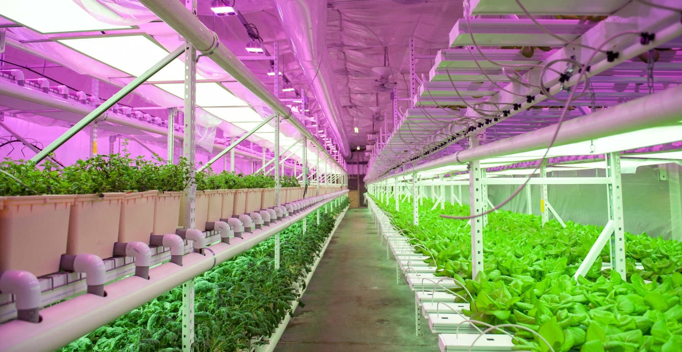
Low Concentration of Nutrients Consumption

Slide 10
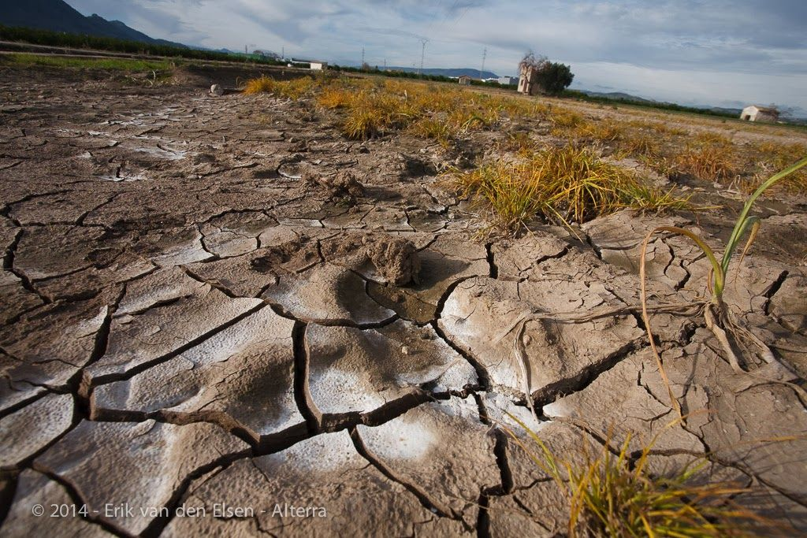
No need to degrade soil

Slide 11
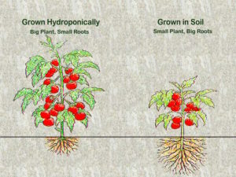
Variation from soil to Hydroponic plant growing
Big plant. Small Roots Small plant. Big Roots

Slide 12
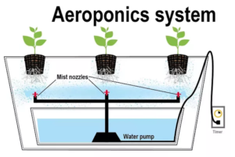
Mist nozzles Water Pump Electricity

Slide 13
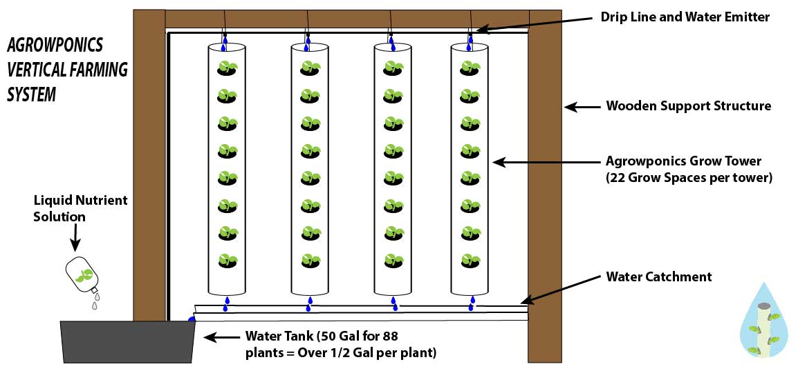
Vertical plant growing

Slide 14
Different Types of Water used for the Auqa Farm
Shallow
Deep Water
Static Water
Running Water
Sprinkling Water
Dripping Water

Slide 15
Different Types of Fish for the Auqa Farm
Talapia
Cod
Cat
Sword
Food provided for fish become nitrogen
This becomes nutrients for the plants

Slide 16
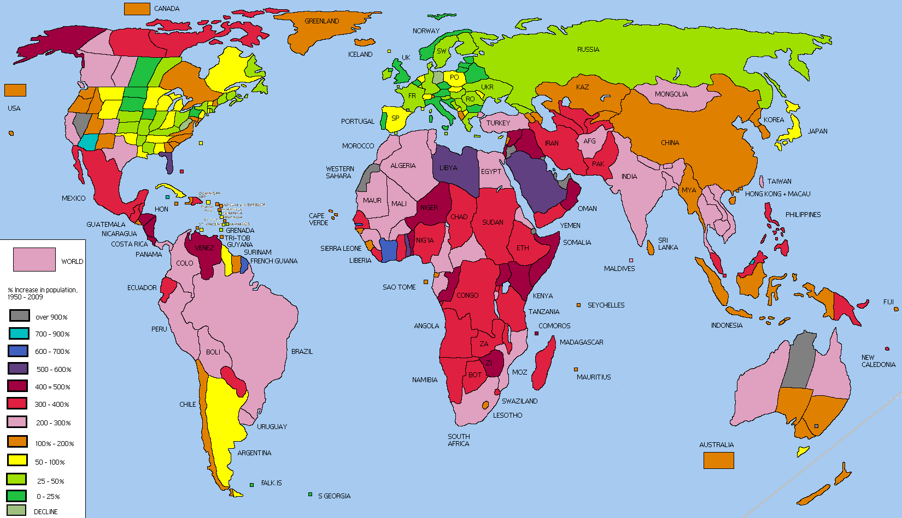
Rapid growth of the world population demands innovation
Growing of food innovation must evolve

Slide 17
Legal Compliance
Legally Approved
Environmentally Friendly
Use Non-Hazardous Chemicals
PH Meters
Unlimited Company
Adhering with Laws & Acts

Slide 18
Management Process/Marketing
Setting up online brochure
Leaflet distribution
Flyers distribution
Adverts on bus stops train station
Contact farming businesses
Advertising via media and radio outlets

Slide 19
Management Process/Marketing Cont..
Our main consumers will be:
Food chains,
Hotels,
Greenhouse equipment manufacturers,
Large scale vegetable producers,
Horticultural input companies,
Retailers and,
Government Organizations

Slide 20
Sales Target and Objectives
The cost of a green house is £10k
Product , Service and Development: The preparation for the equipment will cost £30k
Sales Forecasts: is £150,000 profit

Slide 21
Current state of market
Market Situation: Hydroponics Compound Annual Growth Rate (CAGR) = Anticipated to grow to USD 27.29 Billion by 2022 at an estimated CAGR of 6.39% from 2015 to 2020.
Market Competitors: This is a product that is being used in America, Asia, middle East and Australia and still in its infancy

Slide 22
Management of care for workers & administration
Create a manageable work rotas
Create signing in and out systems for workers
Create attendance management systems
Create review work training for up skilling
Health & Safety awareness of known chemicals
Administer recruitment exercise programs
Facilitate workers with comfortable rest areas with scheduled breaks

Slide 23
Management of work tasks & pay
Provide above national minimum wage
Increase pay on business profit
Provide reasonable tasks for workers
Create a work life balance culture
Hold regular work group meetings
Hold one to one meetings with individual workers
Establish weaknesses & strengths
Over come barriers of workers

Slide 24
SWOT Analysis 1.
Strengths:
Environmentally low cost recyclable natural resources
No chemicals
No wastage
Energy efficient
Use 1/40th of land and grow vertical plants, fruits and flowers
The water used is also used to farm fish
Strict Non contamination procedures
Weather will not damage or impact on these products
Unique Selling Point (USP) is the regeneration of forests

Slide 25
SWOT Analysis 2.
Weakness:
New venture still in its infancy
Productivity, resources and facilities maintain itself
Employment will not be regular
If our funding is lower, competitors will produce on larger scale

Slide 26
SWOT Analysis 3.
Opportunity:
Governments: breakthrough in reducing pollution and change in policy
Others learning these skills and transferring to their own businesses
Change in trends such as going more green awareness
New technologies such as vertical growing farms
Less use of land that can be used for animals
More trees and fields to be free from degradation and destruction

Slide 27
SWOT Analysis 4.
Threats:
What obstacles do you face? None
What are your competitors doing? Also in their infancy
Are quality standards or specifications for your job, products or services changing? Yes evolving with world population growth
Is changing technology threatening your position? No rather improving
Do you have bad debt or cash-flow problems? No also this is low cost
Could any of your weaknesses seriously threaten your business? Not at all

Slide 28
PESTEL Analysis
Political Factors:
Our business model is encouraged by government policy for its low emissions as it is stable for the environment and the business will not contravene any trade, tax or labour law. The business will sustain and adjust to any new laws in the foreseeable future.
Economical Factors:
The impact on the growth, interest rates, inflation, exchange rates and disposable income, which includes our Business to Consumers (B2C) micro policy will be insignificant due to the actual nature of the business and its environmental contribution, and health benefits. The product will be sold at very low retail price to any consumer or businesses due to the high volumes in production. It will revolutionise the vegetable, fruit and fish market where every business and consumer will benefit.

Slide 29
PESTEL Analysis
Social Factors:
This business will only have positive impact in all socio-cultural and raise huge awareness for health and use of 90% less land for other natural uses that will be beneficial for the air we breath. The population growth of the world demands this innovative way of production.
Technological Factors:
The technology used to produce the products are from recyclable material such as plastic and water that circulates to also farm the fish. Distributing goods is made light and easy. Communication will be effective as all media electronic systems will be in operation in hand with the business.

Slide 30
PESTEL Analysis
Environmental Factors:
The pollution will not target the environment, rather it will improve the natural order of the environment as 90% less land is used that the current conventional area. The use of soil limits plants growth potential and forests around the world will regenerate.
Legal Factors:
Health & Safety (H&S) is of high importance as only qualified trained and professional personnel with years of experience will over see and consolidate newly trained personnel. Easy to see labelling and warning signs, safety exits will be put in place and fully checked by government H&S official's. Adhering to all land trade laws and the right to trade globally by following all regulations.

Slide 31
Conclusion
Vertical Farming Market
Exceed by USD$13 Billion by 2024
Research by Global Market Insight Inc.
Providing impetus for growth in indoor farming
Advent of LED lights
Growth mechanism such as Aeroponics, and Hydroponics
- Low labour costs,
- Closer to consumer bases,
- Accessibility to fresh produce,
- Zero pesticides usage are the key to
- Market dynamics sprouting up the growth.
https://globenewswire.com/news-release/2017/05/17/986832/0/en/Vertical-Farming-Market-to-exceed-13bn-by-2024-Global-Market-Insights-Inc.htm

Slide 32
Any Question?

Slide 33
Learning Log
Students Names:
Samsul Alom (Leader) 1605851
Clarrisa Adela Kover 1605694
Zarrar Zafar 1605852
Farhat Zafar 1605787
Nassaba Guiba 1605896

Slide 34
Learning Log
How did you work together
Date: 28/02/2018
On this date I gathered the group together to discuss various types of echo-friendly
business ideas that would support sustainability. One of the ideas that was discussed
was presented by Zarrar group member. His idea was extremely echo-friendly and
healthy for the environment and the community. It was producing fruit and vegetable
products for vast quantity and quality distribution. I wrote down his ideas and
discussed it with the group and asked them what they thought. As it was new and
fresh idea I decided to take the lead on this and explained to them that I would do
research on it and send them my findings via whats App video and or emails for
them to watch and once they had done so I asked them to provide their thoughts and
feed-back. Clarisa was returning feed-back and thought the idea was really
interesting for a business. She grasped the idea and concept immediately. At the
next meeting wewould also discuss the idea with our group member Nassaba as she
was looking after her sick mother and could not be there that week. There was no
need for Zarrar to get back to me as it was his idea and he already had wide
knowledge of the product already.

Slide 35
Learning Log
Who did what
Date: 07/03/2018
On the 07/03/2018 at Trinity University, I had a meeting with my group to discuss the process of the type of business that
had already sent videos and information to them about via email and (What’s App) smart phones.
A group member, Zarrar provided the information for the idea a week before at the university and I passed on videos and
information after I had researched the product for the rest of the team to research and investigate for discussion at the next
university meeting. At the meeting we looked at and discussed the way in which the product contributed to the sustainability of
the environment and its support to create jobs locally and nationally. The group were very passionate about the product
especially Zarrar as he had already started sampling the product in his garage at home. He stated that he had huge plans
already for his idea. I then discussed the purpose that it would serve to the community and the environment. We discussed the
business and who would be responsible for different phases of the business. Farhat was given the task for researching the cost
and accounting side. Nassaba contributed great ideas on how the group would be given different phases of the tasks and look
at the marketing side. Zarrar agreed to investigate the expansion and growth of the product as he was already well ahead of
handling the practical aspects of the product. He had knowledge of networking with businesses that were already running their
own farms. Clarisa was given the task for promotion and advertising the product once all the other aspects of the business were
set and agreed by the group on a later date. I was leading the group and listening and also learning about the product as well as
assisting where ever necessary and available for communication if barriers appeared in any group member’s research and or
investigation. We wrote down the different elements of the business structure and plan and decided that we would go away
and do our research and always be available for communication for support advice and guidance whenever necessary.

Slide 36
Learning Log
What went wrong
Date: 14/03/2018
The class was cancelled
Due to the busy domestic and work schedules we could not meet up in person often so it was a little
difficult in that sense. We were not always able to communicate on time either on our mobile devices at
times when we needed to. Some group members also required support as to the actual assignment writing
and understanding, which was a challenge. However, I managed to take the time out and provide my
support to everyone that required support, advice and guidance.

Slide 37
Learning Log
What went well and did we meet often
Date: 21/03/18
Today was interesting in that we gathered and caught up with our group and discussed many types of the
business, plan strategy and the innovation behind it. Zarrar was explaining to us the core details of how the
mechanism and the dynamics of the business would run its full course and be sustainable and
environmentally friendly. I probed and requested in depth answers as to the wide range of materials that
were required to put together the product and how it actually works in practical terms. Zarrar was very
explicit in explaining the different types of ways in which plants and vegetables can grows by this
environmentally echo-friendly manner. We looked at videos from on the actual final product and discussed
how far it can reach out to customers and build partnerships with investors. We looked at the growth
expansion and the speed at which the actual product grows compared to the traditional growth. We were
surprised to hear that the area of space required to utilise was 1 / 40th of the current space and area used
to grow the same fruits and vegetables. We all agreed that this is definitely the type of business that will
provide the environment a healthy future, save of energy and waste and extremely cost effective. We
also learned that it only requires a one-time set up and fixture and it literally can run on its own with
minimum energy and resources. It will create new jobs and training programs for young apprentices as the
product is easy to set up and low in cost.

Slide 38
Learning Log
What went well and did we meet often - continued
Date: 25/03/2018
On this day Sunday, I decided to look deeply into the work already completed and to understand more
about the whole assignment by reading more. I started to complete the Management process and
Marketing and create the Presentation for the group and also my personal Reflective Submission.
Date: 07/04/2018
I looked at the power point slides and added more information into the Aims and Objectives as Mr M
Rahman, our lecturer advised us to. I restructured the management process of the way in which a business
can provide quality life work balance for the workers onto the power point slides. I looked at my own
employment and imagined what would is best for the business should will inevitably always come from the
workers. Quality treatment and level of care and Health and Safety for the workers is key to get the best
out of workers. Regular in groups and in one to one review meetings is one of the important aspects in
order to improve skills and sustain business delivery. These are the types of points I have put into my
power point slides. The SWOT and PESTEL analysis was completed on my own for this
particular business.

Slide 39
Learning Log
Using social media to communicate
Social media was our primary source of communication and that was very effective after a while when we
all got familiar and I actively encouraged it by explaining the importance of deadlines for this assignment.
We created a group chat on Whats App (WA) to effectively communicate with all members. All members were always
Polite, well mannered and professional. I will miss that most of all.
Did that work well
Our WA we worked extremely well at all times as stated above. Any issues were raised via the WA chat and
these were immediately resolved.
Were there any technical issues
All group members were given their roles and slides to learn and once that was done after I completed the
research into the product and created the slides and numbered them with each individual members names,
no technical issues arose at all what so ever.

Slide 40
Learning Log
Did group members refuse to meet on-line
There was never any such thing that we experienced. If that was the case the assignment would have
experienced delays and time world have been wasted on unproductive issues rather that the actual
assignment.
Were there any members not pulling their weight and what did you do to resolve it.
I did my upmost to keep the group together. It was not a case of pulling weight rather it was due to lack of
language barrier of the quality and standard required to complete research task that was difficult for one
member. This was then tackled by myself by discussing with complete sympathy that I had for them and
for that I provided easy tasks for them. This was very much appreciated and the relationship grew much
stronger between the group. There is a very good professional and friendly communication amongst the
group now that we all understand each other really well.
Did you divide the work / Was the work fairly shared out
The work was not fully divided rather it was based on one persons idea Zarrar. The idea was then given to
me to do the research and create the power point and business slides for the presentation. I then would
provide the update of my work status. In group meetings however, every did contribute to the way in
which the process was heading and any input from any group member was valued and considered such as
changes in my progress of business plan and power point.

Slide 41
Learning Log
What did you learn from this experience
I have learnt that it is not how you think in situations but it is how you react to difficult situations. I have
also learnt that to start a business with other people it is only best when you know each other’s strengths
and weaknesses. You can only learn this by working with them, associating with them and communicating
with them on a regular basis. There is a great saying that “You only know a person when you either work
with them or live with them”. I can easily say that I have learnt a lot from my group member’s behaviours
and their strengths from this experience. It is a great feeling and I will miss them dearly. Hopefully we will
keep in touch and maybe even go into business together as one member Zarrar stated that he would like to
do that with me. He and the group are very nice people. Good luck to all of them.

Slide 42
References
https://globenewswire.com/news-release/2017/05/17/986832/0/en/Vertical-Farming-Market-to-exceed-13bn-by-2024-Global-Market-Insights-Inc.htm
http://www.powerhousehydroponics.com/8-economic-benefits-commercial
hydroponics/
http://www.powerhousehydroponics.com/commercial-hydroponic-technology
grows-money/
https://ecopostblog.wordpress.com/2014/07/14/the-environmental-benefits-of
hydroponics/

