Slide 1
Cynhyrchu / Producing
Alun Thomas

Slide 2
Dinasyddiaeth Citizenship | Rhyngweithio a chydweithio Interacting and collaborating | Cynhyrchu Producing | Data a meddwl cyfri adurol Data and computational thinking
1) Hunaniaeth, delwedd ac enw da / Identity, image and reputation 2) Iechyd a lles / Health and well-being 3) Hawliau digidol, trwyddedu a pherchnogaeth / Digital rights licensing and ownership 4) Ymddygiad ar-lein a Seiberfwlio / Online behaviour and cyberbullying | 1) Cyfathrebu / Communication 2) Cydweithio / Collaboration 3) Storio a rhannu / Storing and sharing | 1) Cynllunio, cyrchu a chwilio / Planning, sourcing and searching 2) Creu / Creating 3) Gwerthuso a gwella / Evaluating and improving | 1) Datrys problemau a modelu / Problem solving and modelling 2) Llythrennedd gwybodaeth a data / Data and information literacy

Slide 3
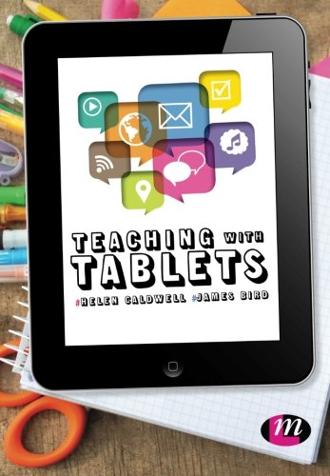
“Smashing Apps”
Caldwell & Bird (2015)

Slide 4




Animeiddiad / Animation

Slide 5


Slide 6


Slide 7
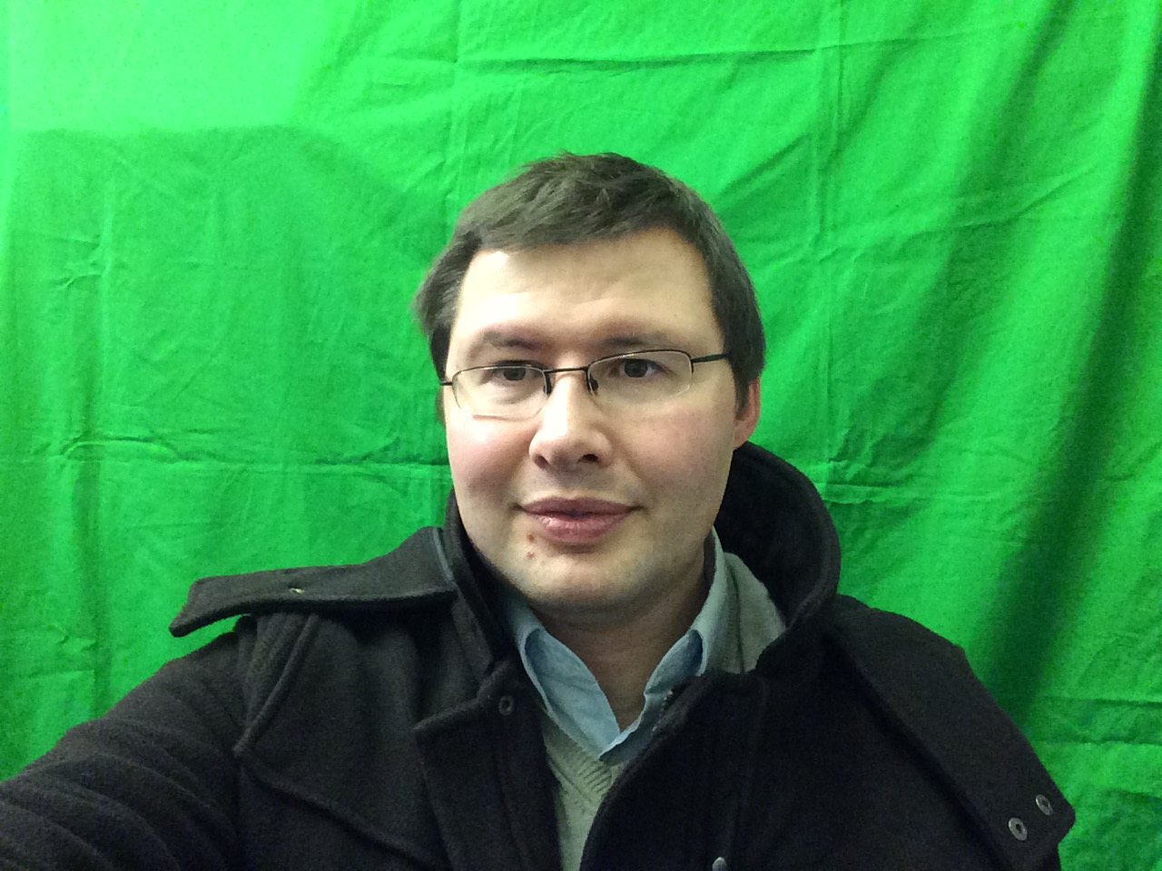

Slide 8
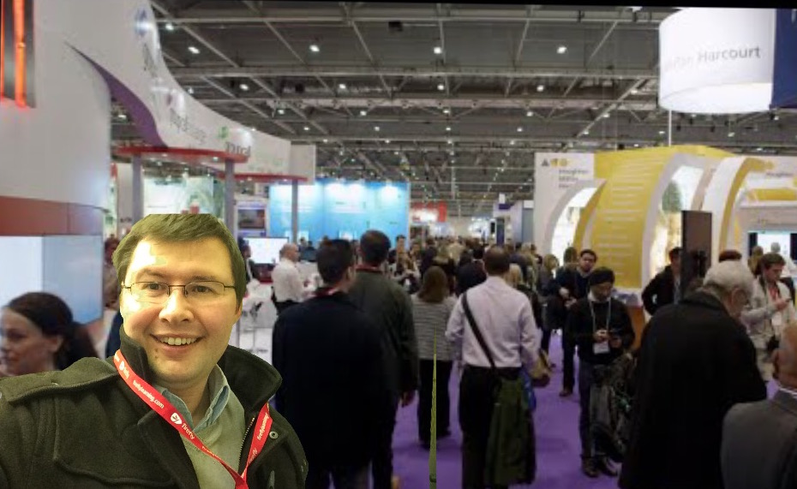

Slide 9
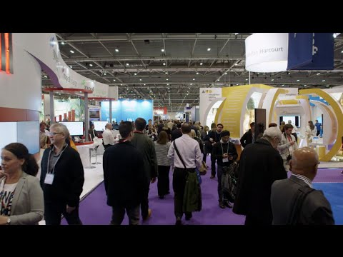

Slide 10
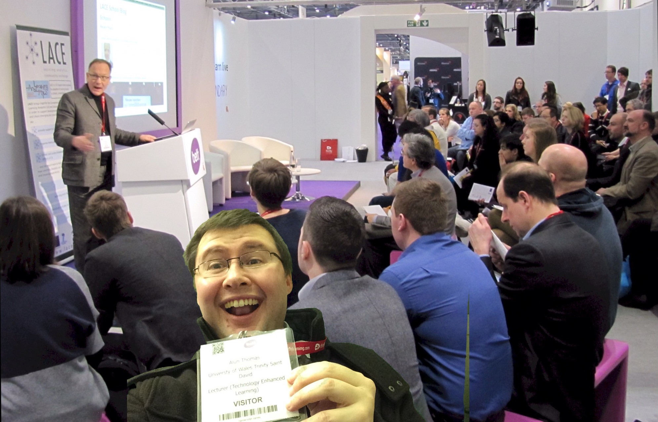

Slide 11
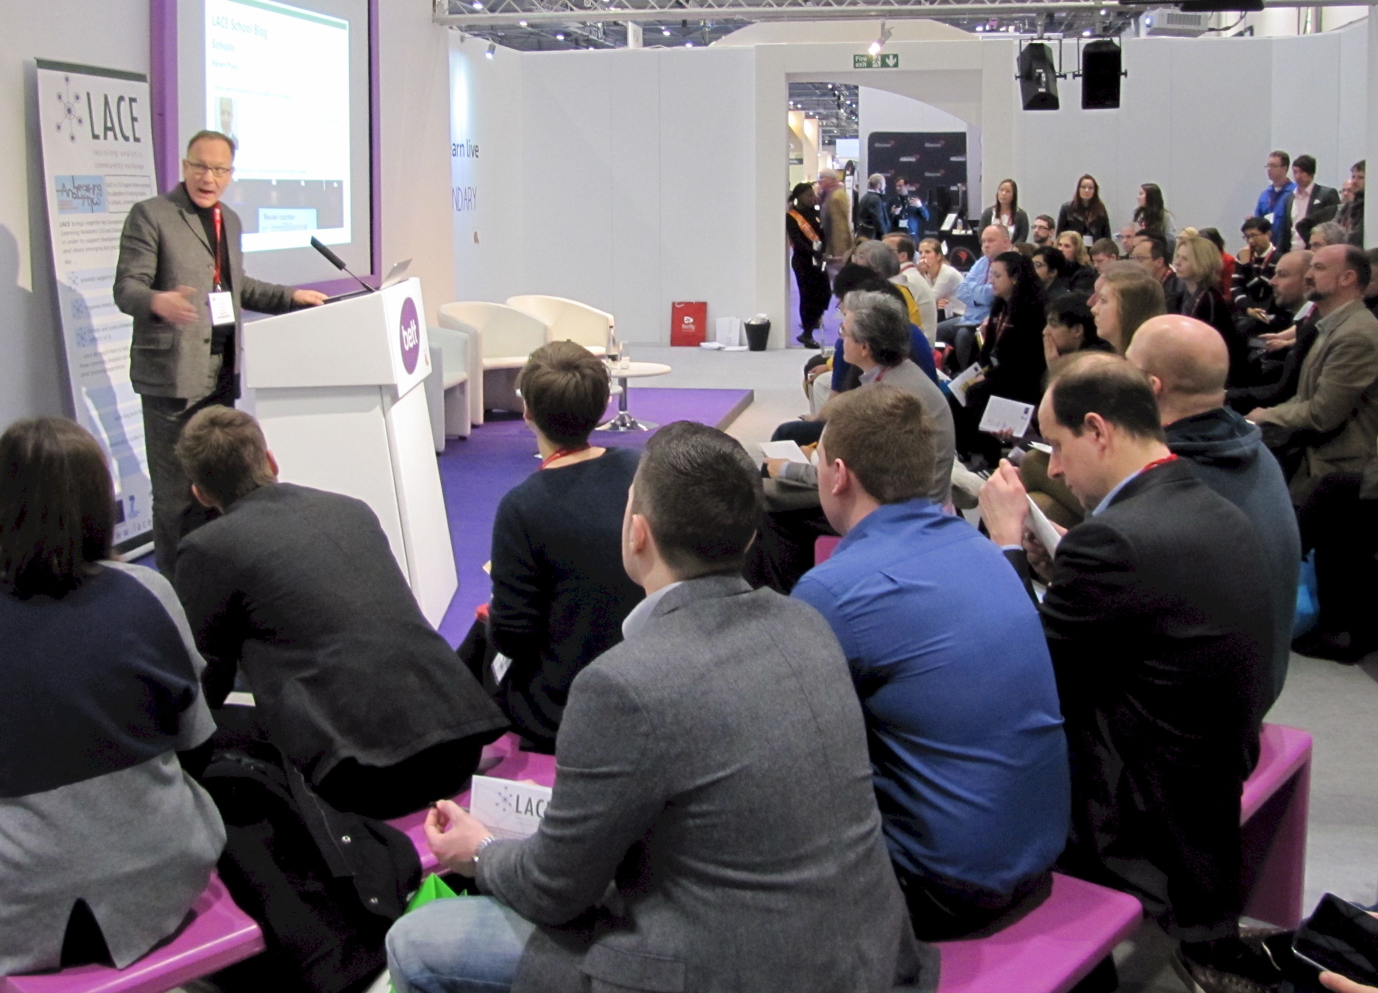

Slide 12
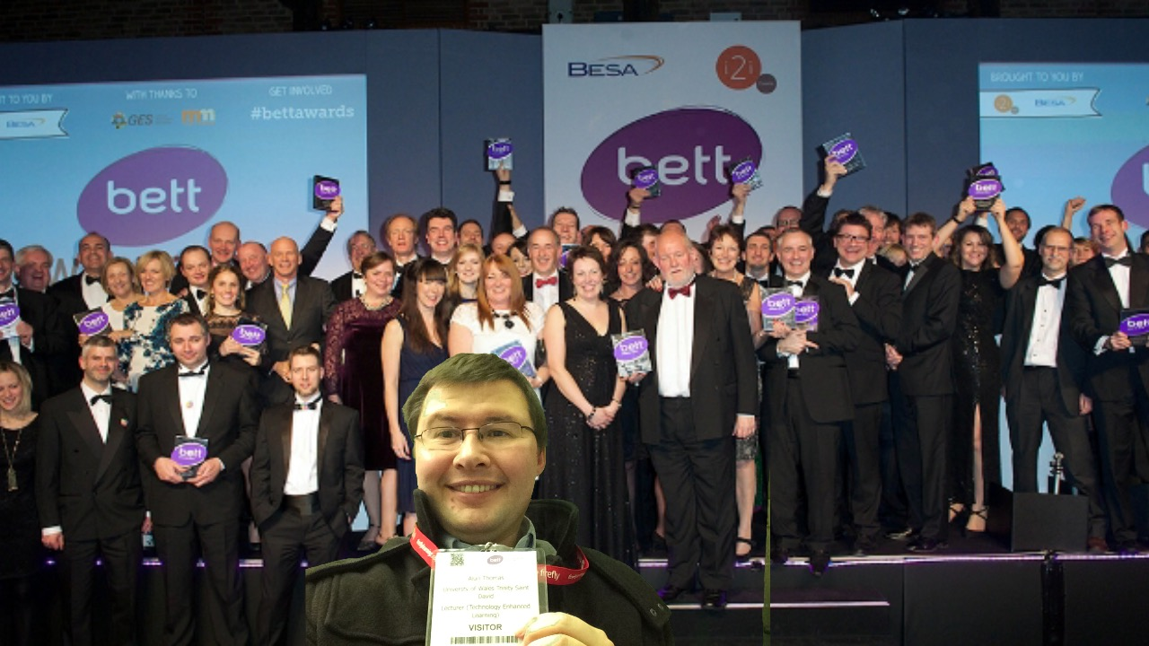

Slide 13
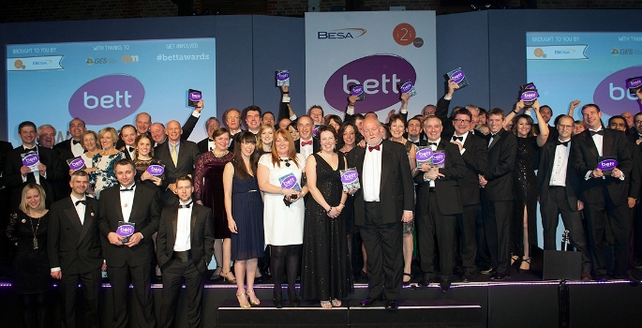

Slide 14


Slide 15
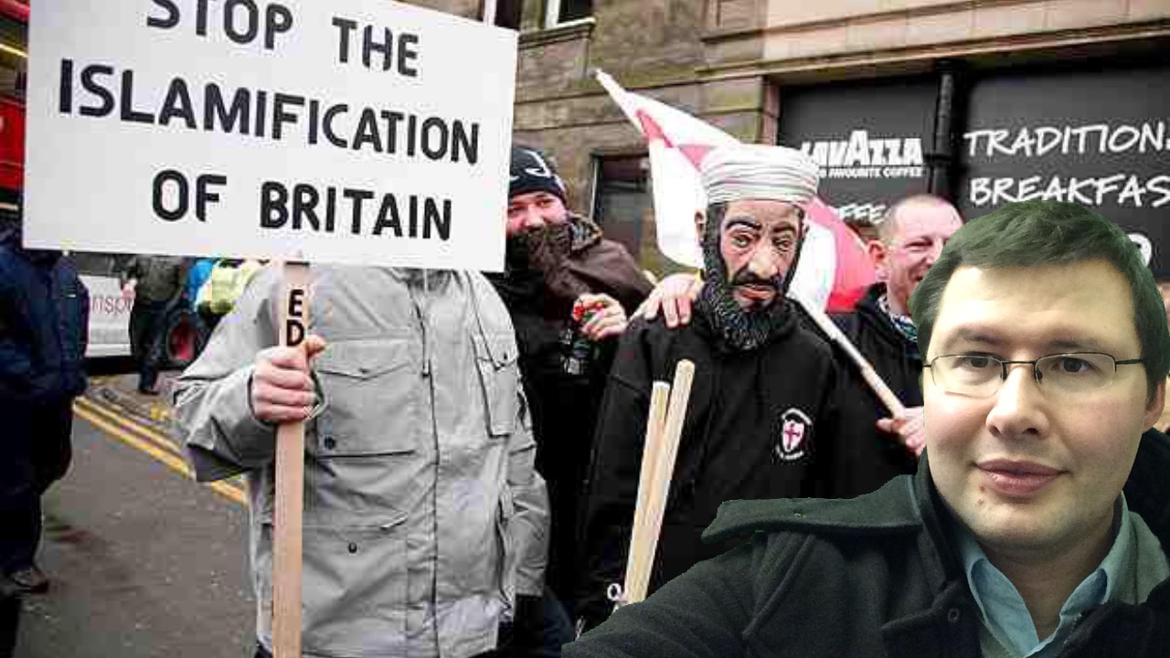

Slide 16
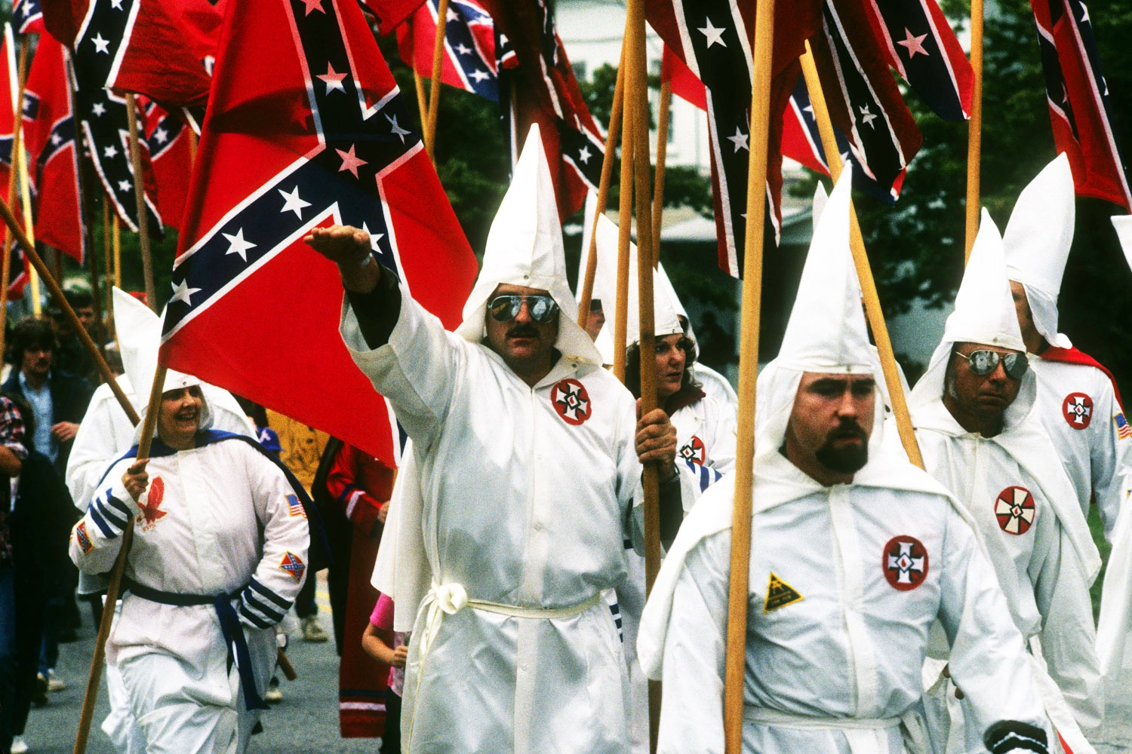

Slide 17


