Slide 1

PEN Test of a Wireless Sensor Network
Laurance Cutforth
P146632
University of Wales Trinity Saint David

Slide 2
Aim and Objectives of the Project
The Aim of this project is to run a black box Penetration Test, on a wireless sensor network. This penetration test is being done under the request of a privet company
The objectives of this project are: -
Provide a literature review on penetration testing and hacking software
Establishing an understanding on how to attack a wireless network
Learn how to use the Linux based Operating System Kali Linux
Run penetration tests on a controlled wireless sensor environment
Run penetration tests on the live wireless network
Gather results and analyse data
Recommendations

Slide 3
The background to the proposed research
Penetration testing is the authorized use of cyber-attacks, to perform an investigation in to the security of a network. There are two types of penetration testing methodologies, White Box and Black Box tests.
During a White Box penetration test, the investigator is provided with the specific details of the network, such as the system information of the devise.
The Black Box methodology on the other hand, the investigator is provided only the basic information, or no information at all.[1]

Slide 4
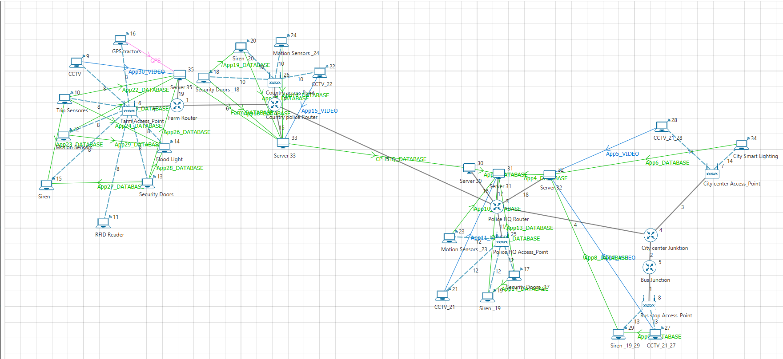
Background Research
Wireless sensor networks [2] are a collection of wirelessly connected sensor devices, which are used to record a set of physical conditions such as motion e.g. Motion sensors for physical security. Figure 1 shows a wireless network with motion sensor nodes, and CCTV cameras.
Figure 1: Wireless network with CCTV camera nodes [3]

Slide 5
The research and development methods that will be used
The research methodology, is the way that research on a project is conducted, the philosophy, strategy and instruments used in the pursuit of achieving the goals. The methodology used for this project are:-
Positivism, the uses of observing data from an objective viewpoint and using variation of variable to try and repeat, or change the results.
Deduction, is the collection of observational data, to test a specific hypotheses.
Experiments (Laboratory/Field) , Laboratory Experiments will be used to provide the researcher with the ability to identify the correct methods to use to cyber-attack a network. The field experiments will be used to test the results of the laboratory experiments in a live environment. [4]

Slide 6
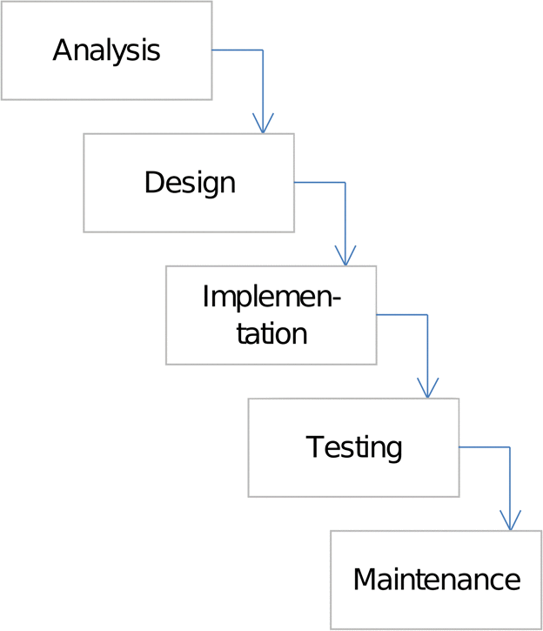
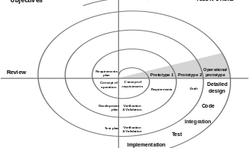
The research and development methods that will be used
Philosophy
  Positivism, only recognizing data that can be verified and repeated.
Approach
  Deduction, developing a Hypothesis based on a existing theory, and then testing that hypothesis.
Research strategy
  Experiments (Laboratory/Field).
lifecycle models
  Waterfall, a Software lifecycle in a sequential approach with specific phases.
  Spiral, risk driven development process that involves retesting experiments multiple times. [5]
Figure 2: Waterfall [6]
Figure 3: Spiral [7]

Slide 7

Any issues you expect to encounter

Slide 8
Identify risks
Risk to Investigator:
Risk of accusation of impropriety, such as unauthorised accessing of data.
As this project is being conducted with the permission and formal documentation of the company, that has requested the Penetration test the likely hood of this is low.
Risk to University:
Bad publicity in the event of the investigator is accused of impropriety.

Slide 9
Ethical and legal issues
Computer Misuse Act 1990
Computer misuse offences
1.—(1) A person is guilty of an offence if— Unauthorised access to
he causes a computer to perform any function with intent to computer secure access to any program or data held in any computer; material.
the access he intends to secure is unauthorised; and
he knows at the time when he causes the computer to perform the function that that is the case.

Slide 10
Ethical and legal issues
Computer misuse offences
(2) The intent a person has to have to commit an offence under this section need not be directed at—
any particular program or data;
a program or data of any particular kind; or
a program or data held in any particular computer.
(3) A person guilty of an offence under this section shall be liable on summary conviction to imprisonment for a term not exceeding six months or to a fine not exceeding level 5 on the standard scale or to both.

Slide 11
Ethical and legal issues
British Computing Society Code of conduct
Duty to Relevant Authority
You shall:
carry out your professional responsibilities with due care and diligence in accordance with the Relevant Authority’s requirements whilst exercising your professional judgement at all times. b.
seek to avoid any situation that may give rise to a conflict of interest between you and your Relevant Authority. c.
accept professional responsibility for your work and for the work of colleagues who are defined in a given context as working under your supervision.
NOT disclose or authorise to be disclosed, or use for personal gain or to benefit a third party, confidential information except with the permission of your Relevant Authority, or as required by Legislation.
NOT misrepresent or withhold information on the performance of products, systems or services (unless lawfully bound by a duty of confidentiality not to disclose such information), or take advantage of the lack of relevant knowledge or inexperience of others.

Slide 12
Possible Outcome of Research
There are two end scenarios for this project:
Failure to gain access to the network using penetration testing techniques, this is the most preferred out come as it means the company’s network is reliable enough to use with a live connection to the internet.
Success by gaining access to the network, this would show that the network is not reliable and should not be given an internet connection.

Slide 13
evaluating results
To evaluate a Penetration test one must :
Determine if the objectives of the test where met
Assess if weaknesses were found
Review the exploitations used
Comparing the results with a external bench mark [8]

Slide 14
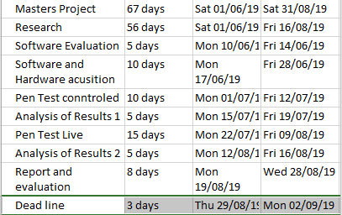
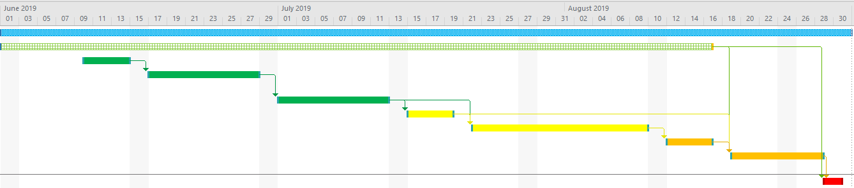
Time Scale Gantt chart
This Gantt chart shows the time scale that this project has to work with.
Figure 4 shows the amount of time slated to each section of the project, for example the controlled environment penetration test has been allocated ten days.
While Figure 5 shows a colour coded chart that represents when each task needs to be done and in what order. Also shown is the colour scale used to show how close to the project deadline each task is, with red being the deadline time.
Figure 4: Gantt Chart time scale
Figure 5: Gantt Chart graphic

Slide 15
References
Komargodski, M. Naor and E. Yogev, "White-Box vs. Black-Box Complexity of Search Problems: Ramsey and Graph Property Testing," 2017 IEEE 58th Annual Symposium on Foundations of Computer Science (FOCS), Berkeley, CA, 2017, pp. 622-632. https://ieeexplore-ieee-org.ezproxy.uwtsd.ac.uk/document/8104095
M. Razfar et al., "Wireless network design and analysis for real time control of launch vehicles," IEEE International Conference on Wireless for Space and Extreme Environments, Baltimore, MD, 2013, pp. 1-2. https://ieeexplore-ieee-org.ezproxy.uwtsd.ac.uk/document/6737574
L.J.M.S. Cutforth, “Design, Simulate and Evaluation of a potential real-life Communication System” 2019
http://www.is.cityu.edu.hk/staff/isrobert/phd/ch3.pdf
S. Wu, C. Song, H. Chen and J. Zhan, "E-learning Teaching Method Research and Ideas," 2010 International Conference on Web Information Systems and Mining, Sanya, 2010, pp. 140-143. https://ieeexplore-ieee-org.ezproxy.uwtsd.ac.uk/document/5662299
J. Wieczorkowski and P. Polak, "Analysis and implementation phases in the two-segmental model of information systems lifecycle," 2012 Federated Conference on Computer Science and Information Systems (FedCSIS), Wroclaw, 2012, pp. 1041-1046. https://ieeexplore-ieee-org.ezproxy.uwtsd.ac.uk/document/6354420
Spiral model (Boehm, 1988)
J. Creasey, “A guide for running an effective Penetration Testing programme April 2017 2 A guide for running an effective Penetration Testing programme DTP notes A Good Tip A Timely Warning An insightful Project Finding,” 2013. https://www.crest-approved.org/wp-content/uploads/CREST-Penetration-Testing-Guide.pdf

Slide 16
Questions ?

Slide 17

Thank You

