Slide 1
Name: Stephygraph Anem
Course: MSc Public Health and Social Care in Practice
Module: LCHS7008 Practice-Based Research
ID: 2435901
Raise in Cholesterol level of Asian People who lives in UK (25-65)

Slide 2
INDEX
INDEX
Title & Student Details
Prevalence
Rationale
Research Question
Aim & Objectives
Research Impact
References

Slide 3
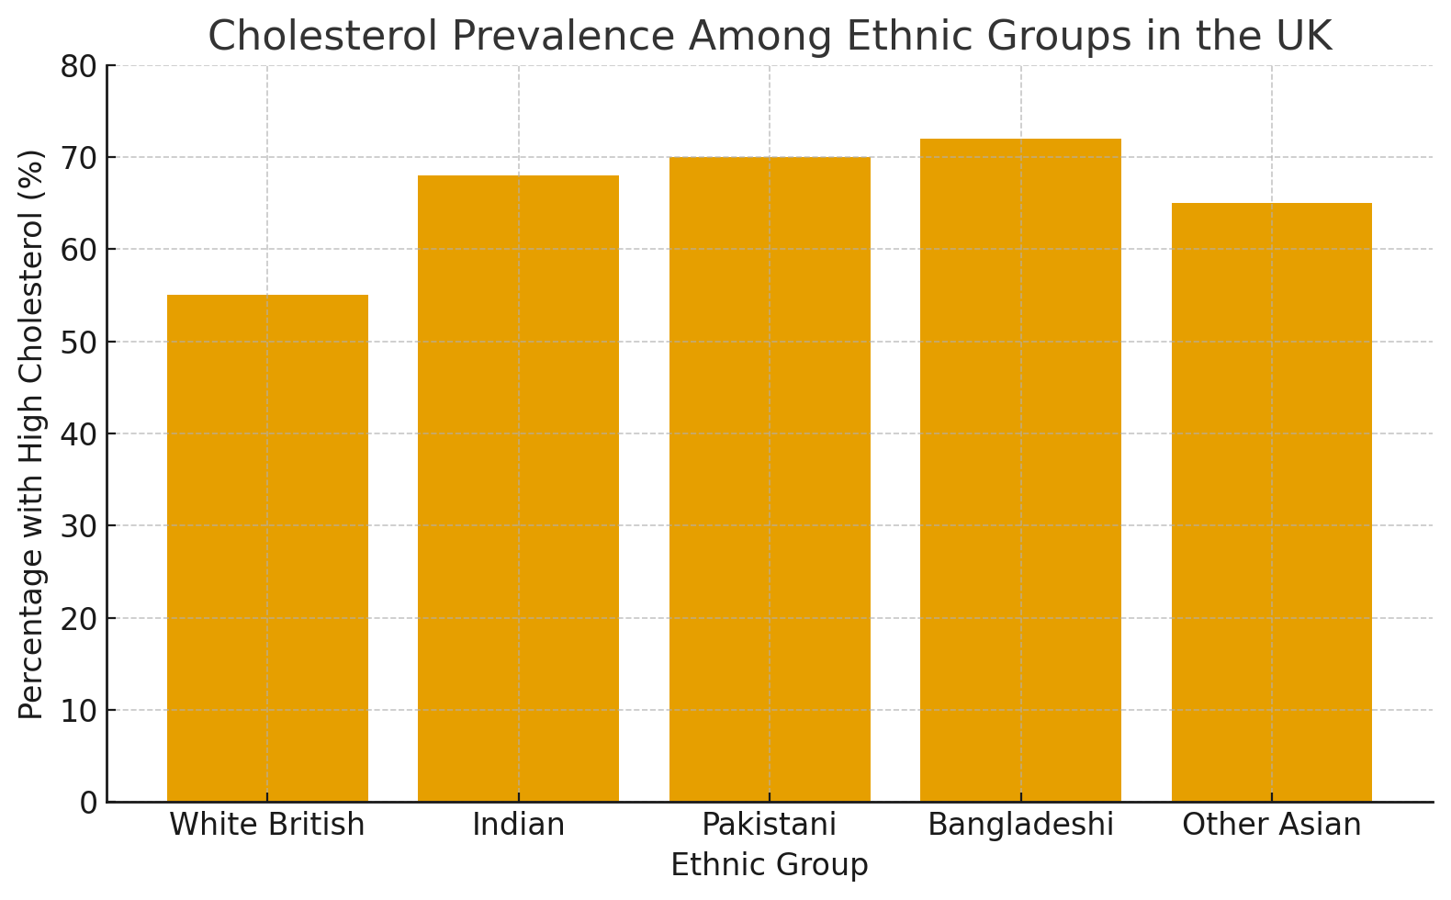
Prevalence
Cholesterol-related diseases (like heart disease) are a leading cause of mortality in the UK.
According to the British Heart Foundation (2024), around 60% of UK adults have cholesterol above recommended levels.
South Asian communities (Indian, Pakistani, Bangladeshi origin) have 20–40% higher rates of elevated LDL (bad cholesterol) than the White British population.
Studies show that Asian men and women are diagnosed with coronary heart disease nearly 5–10 years earlier than their White counterparts.
Contributing factors: diet high in saturated fats, genetics, lack of physical activity, and limited health screening awareness.

Slide 4

Rationale
Why this topic matters:
South Asian communities represent ~9% of the UK population but face disproportionate cardiovascular risks.
NHS data shows increased cholesterol levels and early-onset heart disease in this population.
Despite awareness campaigns, cultural and dietary habits remain a key barrier to prevention.
There is limited research on how social, cultural, and lifestyle factors interact in cholesterol management among Asians in the UK.
Importance:
Findings can inform culturally tailored interventions, health education, and NHS preventive policies.

Slide 5

Research Question
How do lifestyle effects the cholesterol level of Asian people living in the UK ?(25-65)

Slide 6

Aim & Objective
Aim:
To investigate lifestyle, dietary, and socioeconomic factors contributing to increased cholesterol levels among Asian adults in the UK.
Objectives:
To assess the prevalence of high cholesterol within Asian communities in the UK.
To explore dietary and lifestyle habits influencing cholesterol levels.
To evaluate current public health strategies and identify culturally appropriate interventions.

Slide 7

Research Impact
Health Impact:
Can reduce the incidence of heart disease and strokes within Asian communities.
Policy Impact:
Supports NHS and Public Health England in designing culturally sensitive dietary and screening programs.
Social Impact:
Promotes awareness and self-management of cholesterol through community-based education.
Professional Impact:
Equips healthcare workers with better cultural competence in managing South Asian patients.

Slide 8
References
British Heart Foundation. (2024). UK Factsheet: Heart and Circulatory Diseases Statistics.
NHS Digital. (2023). Health Survey for England: Cardiovascular Risk.
Office for National Statistics. (2022). Ethnic Group Demographics in the UK.
Misra, A. & Khurana, L. (2021). Obesity and the Metabolic Syndrome in Developing Countries. Nutrition Reviews.
Gupta, M., et al. (2020). Ethnic Variations in Lipid Profiles and Cardiovascular Risk Factors. The Lancet.
World Health Organization. (2023). Noncommunicable Diseases Country Profiles: United Kingdom.
British Heart Foundation. (2024). UK Factsheet: Heart and Circulatory Diseases Statistics. London: BHF.
NHS Digital. (2023). Health Survey for England: Cardiovascular Risk. Leeds: NHS Digital.
Office for National Statistics. (2022). Ethnic Group Demographics in the United Kingdom. London: ONS.
Misra, A. & Khurana, L. (2021). Obesity and the Metabolic Syndrome in Developing Countries. Nutrition Reviews, 79(5), 379-389.
Gupta, M. et al. (2020). Ethnic Variations in Lipid Profiles and Cardiovascular Risk Factors. The Lancet, 396(10245), 112-124.
World Health Organization. (2023). Noncommunicable Diseases Country Profiles: United Kingdom. Geneva: WHO.
Public Health England. (2021). Health Matters: Preventing Cardiovascular Disease. London: PHE.
Rahman, S., Patel, J. & Singh, R. (2022). Prevalence of Dyslipidemia and Associated Factors among South Asian Adults in England. Journal of Public Health Research, 11(3), 455-467.
National Institute for Health and Care Excellence (NICE). (2023). Cardiovascular Disease: Risk Assessment and Reduction, Including Lipid Modification (CG181). London: NICE.
Gujral, U.P., Pradeepa, R., Weinstock, R.S. & Narayan, K.M.V. (2021). Type 2 Diabetes and Cardiovascular Risk in South Asians: Epidemiology and Prevention. Journal of Diabetes Research, 2021, 1-12.
Bhopal, R.S. (2019). Epidemiology of Cardiovascular Disease in South Asian Populations: Lessons for Preventive Strategies. Heart Asia, 11(1), e011111. Kumar, D., Farooq, S. & Malhotra, N. (2022). Socioeconomic and Cultural Determinants of Hypercholesterolemia among Migrant South Asians in the United Kingdom. BMC Public Health, 22(1), 1645-1658.

