Slide 1
Title: Effective Teamworking – Theory and Practice.
Certificate of Higher Education in Employability Skills
Module: Effective Team-working and Communication
Module code: BMSW4009
Module Lead: Rhiannon Akers
Student name: Barbara Dorota Bak
Student number: 2317808

Slide 2
Introduction
In this presentation, we will share our reflections on effective teamwork, based on both the theoretical knowledge gained during this module and our practical experiences within the hospitality industry.
Over the past two months, we have developed a deeper understanding of team dynamics, communication, and motivation. We explored several theories, models, and strategies, which helped us recognise that effective collaboration is not solely based on task allocation, but also relies on mutual trust, clear communication, respect, and flexibility.
This presentation will focus on a selection of theories we found particularly valuable in practice. To illustrate two of them – Belbin’s Team Roles Theory and Herzberg’s Two-Factor Motivation Theory – I will draw on my personal experience managing a family-run restaurant in Dorset. My colleagues will present additional theories and share their own reflections.
Notes:
How presentation will benefit audience: Adult learners are more interested in a subject if they know how or why it is important to them.
Presenter’s level of expertise in the subject: Briefly state your credentials in this area, or explain why participants should listen to you.

Slide 3
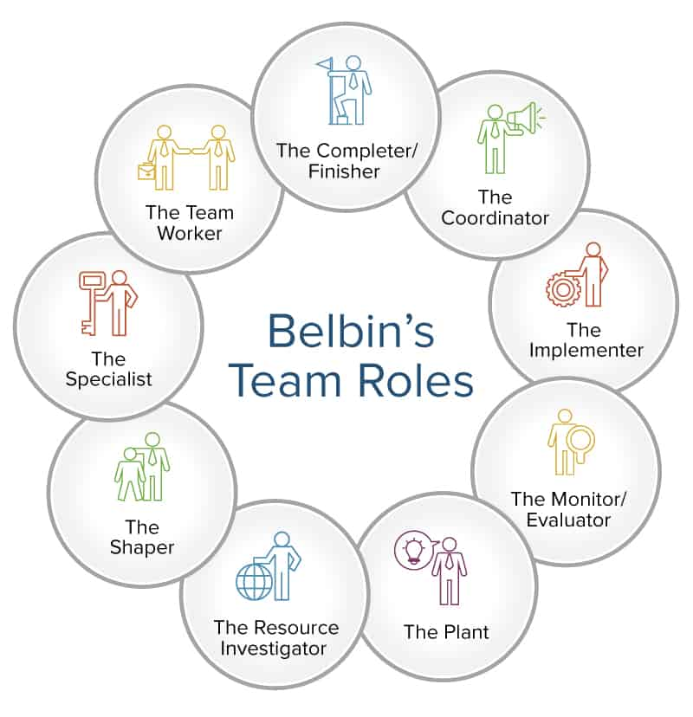
Belbin’s Team Roles – Theory
Belbin (1981) identified nine distinct roles within a team, categorised into action-oriented, people-oriented, and thinking-oriented roles.
Effective teams demonstrate balance among these roles to enhance collaboration and reduce interpersonal friction.
Recognising and assigning tasks according to each member’s strengths leads to improved outcomes.
Notes:
Lesson descriptions should be brief.

Slide 4
Belbin’s Team Roles – Restaurant Example
In our family-run restaurant in Dorset, I applied this theory directly:
I performed the Coordinator and Monitor Evaluator roles, managing finances, branding, and overall team coordination.
My husband, as the head chef, acted as Plant and Implementer – creating menu concepts, managing kitchen logistics, and ensuring execution.
Our waitstaff played the roles of Team Workers and Resource Investigators, delivering excellent customer service and contributing ideas to enhance the guest experience.
The cleaner fulfilled the Completer Finisher role – maintaining hygiene and organisation.
This division of roles, based on individual strengths, created a cohesive and efficient team with clearly defined responsibilities and fewer misunderstandings.
Notes:
Example objectives
At the end of this lesson, you will be able to:
Save files to the team Web server.
Move files to different locations on the team Web server.
Share files on the team Web server.

Slide 5
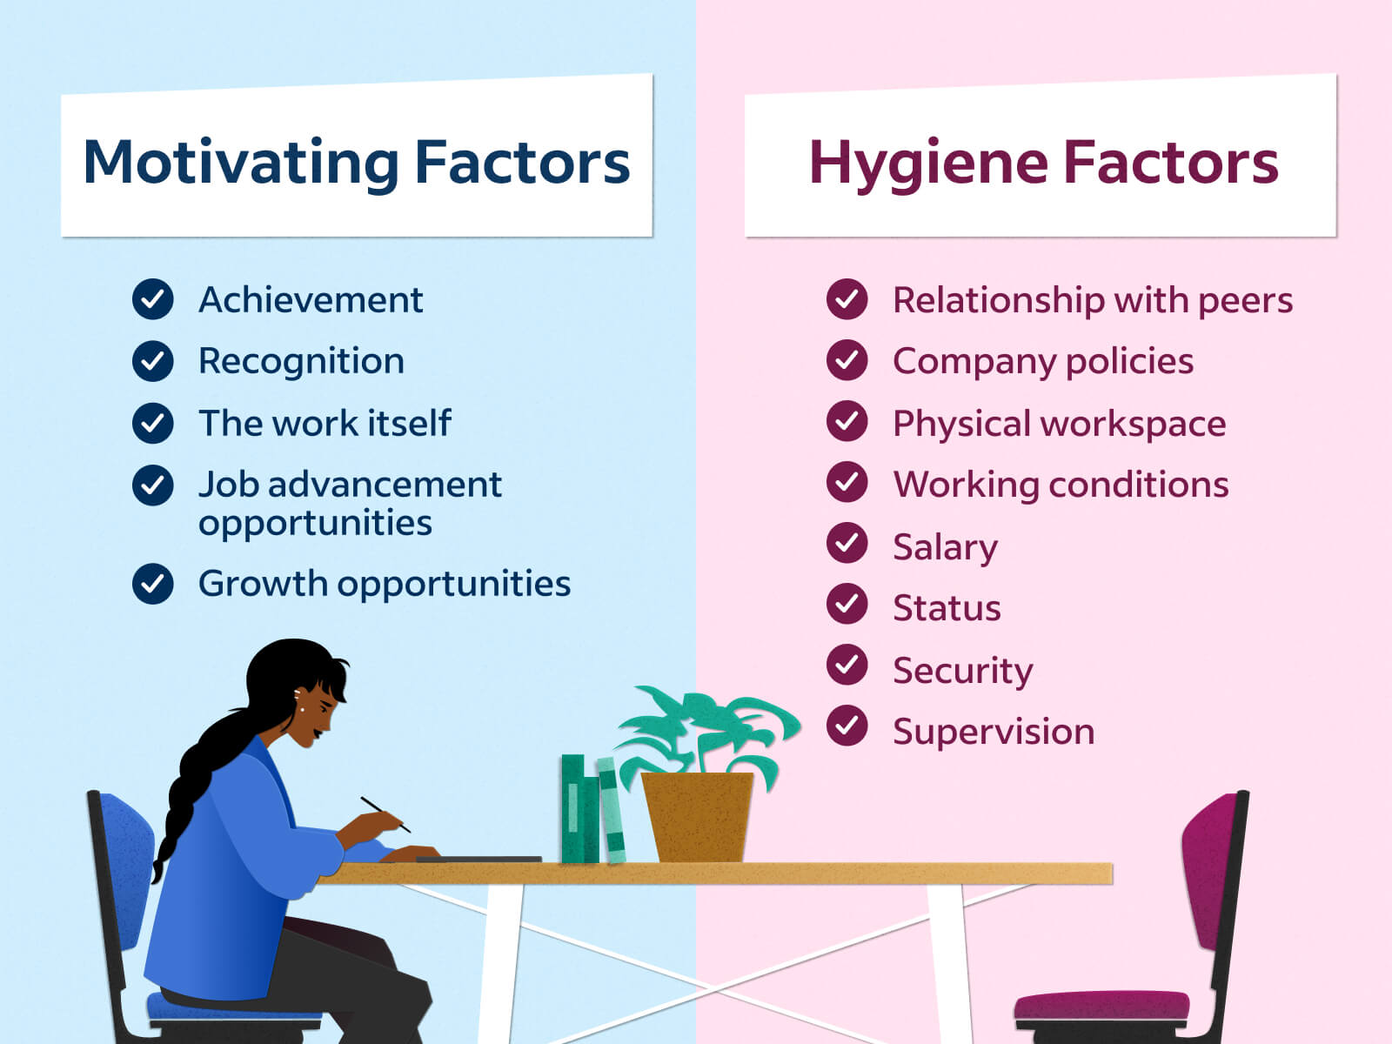
Herzberg’s Two-Factor Theory – Overview
Herzberg’s motivation-hygiene theory, developed in 1959, distinguishes between two types of workplace factors:
Hygiene factors, such as salary, working conditions, and job security, which prevent dissatisfaction but do not motivate by themselves.
Motivators, like achievement, recognition, and responsibility, which genuinely drive employee satisfaction and performance.
According to Herzberg, true motivation stems from internal factors that give employees a sense of meaning and fulfilment in their work

Slide 6
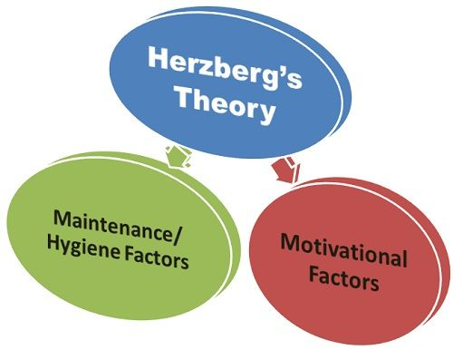
Herzberg in Practice – Hospitality Example
In our restaurant, we ensured hygiene factors were in place:
Staff had predictable and fair schedules.
Wages were appropriate and paid on time.
Communication was respectful and open.
However, we went further to include motivators:
Team members were encouraged to contribute ideas for the menu and dining layout.
They had autonomy in shift swaps and daily responsibilities.
We gave regular praise and celebrated small achievements.
These steps helped our staff feel involved, valued, and motivated, which resulted in lower turnover and a stronger sense of commitment to the business.

Slide 7
Conclusion:
By applying Belbin’s and Herzberg’s theories in our restaurant, we learned that successful teamwork depends on more than just assigning tasks.
Belbin helped us build a balanced team by matching roles to individual strengths, reducing conflict, and improving structure. Herzberg reminded us that fair pay is essential, but proper motivation comes from meaningful work, recognition, and involvement.
Together, these theories contributed to:
• Better teamwork and organisation
• Higher morale and staff engagement
• Increased personal responsibility
• Stronger overall performance
Our experience demonstrates that these theories are practical tools that can transform team dynamics and yield tangible results in the workplace.

Slide 8

To end, I would like to share a quote that perfectly captures the essence of the theories we discussed:
"Talent wins games, but teamwork and intelligence win championships." – Michael Jordan.
This shows that success doesn’t rely on individuals alone, but on strong collaboration and the commitment of the whole team.

Slide 9
References:
Adair, J. (2009) Effective Team Building: How to Make a Winning Team. 3rd edn. London: Kogan Page.
Belbin, R.M. (2010) Team Roles at Work. 2nd edn. Oxford: Butterworth-Heinemann.
Hayes, J. (2022) The Theory and Practice of Change Management. 6th edn. London: Palgrave Macmillan.
Herzberg, F., Mausner, B. and Snyderman, B.B. (1959) The Motivation to Work. 2nd edn. New York: John Wiley & Sons.
Mullins, L.J. (2016) Management and Organisational Behaviour. 11th edn. Harlow: Pearson Education.

