Slide 1
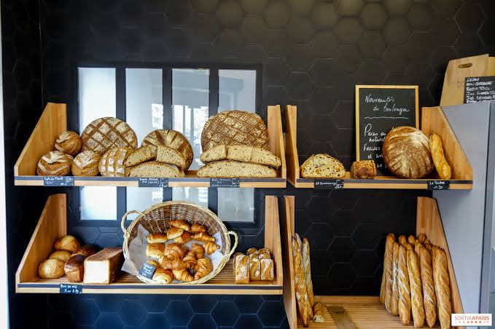

BASIL'S BAKERY
A Problem-Solving Analysis of Stagnating Sales
Kamil Sroka
2541227
Lecturer's Name: Bohdan Kovalev
Module Code: LCLM 4004
Module Name: Problem Solving and Decision-Making
Component 1: Basil's Bakery

Slide 2

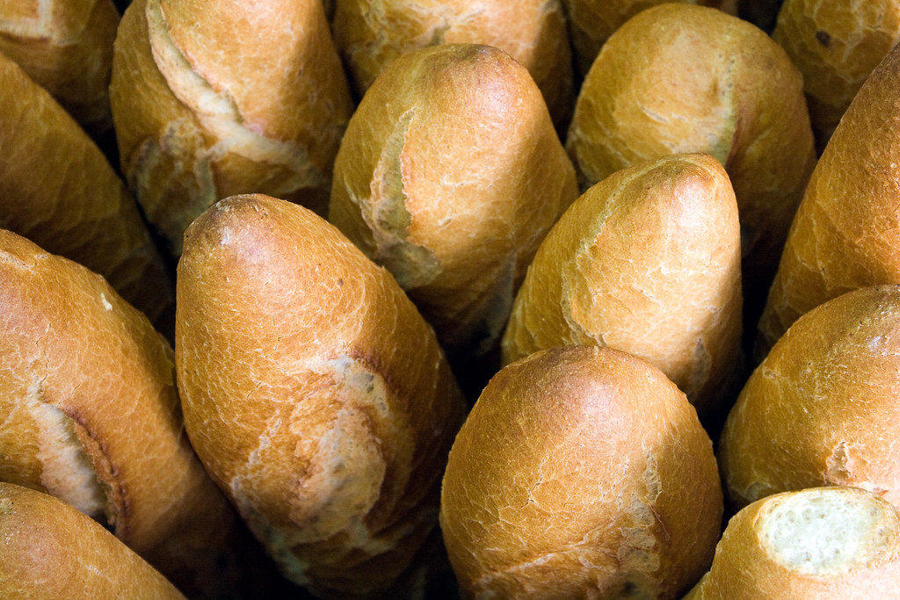
Presentation Overview
1
Background An introduction to Basil's Bakery and the context of the case study
2
The Problems The nature and scope of the issues behind the lack of sales growth
3
PESTEL Analysis A critique of the framework and its application to the bakery
4
Cause-and-Effect A critique of the Fishbone model and its application to the bakery
5
Key Findings A summary of the main conclusions from the analysis

Slide 3

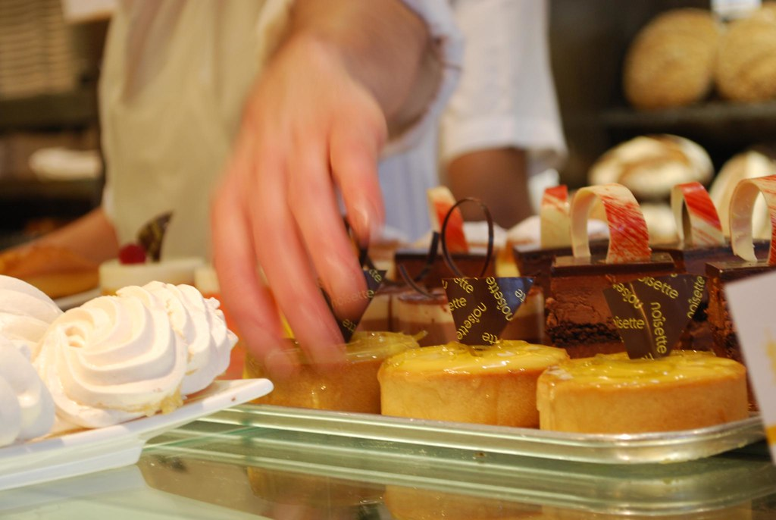



Background: Basil's Bakery
The business
Small independent bakery in a retail park in Coventry, UK — open since 2015
The product
Cakes, pastries and bread made with high-quality organic ingredients
The customers
Local shoppers, plus office and warehouse workers from the nearby area
The trend
Sales grew until 2020; from 2023–2025 they sit ~25% below the 2019 level

Slide 4

Insight into the Problems
ROOT PROBLEM: Stagnation in sales — stuck ~25% below the 2019 level since 2023
EXTERNAL — little / no control
INTERNAL — within Basil's control
Decreasing retail park footfall, closing shops
Hybrid working. Shops depend on staff and customer footfall. Staff footfall decreased drastically.
Many loyal customers lost their jobs when shops closed.
Rising costs of running a business.
Rising costs of utilities, business rates and insurance.
No delivery service: Basil has to be on the premises to bake all the loaves himself.
Pre-Orders: The phone often goes unanswered, so orders can't be processed.
Lines: Customers don’t want to wait in long lines during peak times.
Inventory: Unpredictable sales can’t be budgeted with an all organic menu.
Focus at this stage is on understanding the problems — not on solutions.

Slide 5





Critique of the PESTEL Framework
What is it?
Why / where is it used?
A tool to analyse the macro-environment for six factors- Political, Economic, Social, Technological, Environmental and Legal ( Marinović Matović and Arsić, 2020).
Used in developing business plans and in market research to identify the opportunities and threats outside of the organisation that are uncontrollable.
Benefits
Limitations
Concise, inexpensive and structured; gives an overview of external environments and facilitates informed decisions.
Only lists external factors —Minimizes internal problems; tendency to simplify; analysis quickly becomes outdated because situations can change quickly.

Slide 6
PESTEL Applied to Basil's Bakery
P
Political
E
Economic
S
Social
Post-Covid government policy concerns high-street policy; a change to business rates policy will significantly impact small retailers.
Inflation: Rent, utilities, and insurance cost much more than 2019; Customers have less buying power.
Hybrid work has become the norm, with 44% of employees in Great Britain working from home or in a hybrid arrangement last year (ONS, 2023). This greatly reduced weekday workplace attendance.
T
Technological
E
Environmental
L
Legal
No online or phone orders/pickup. We accept pre-paid orders by phone.
Organic crops may fail for numerous reasons. Although failures may also happen with non-organic crops, planning financially for organic crops is much harder due to the unpredictability of organic farming.
Costs related to compliance with rules and regulations related to food (i.e. food safety and food labelling), as well as the costs related to the signing of leases and insurance, represent fixed costs for the business.
Sources: Marinović Matović and Arsić (2020); ONS (2023); Pantano et al. (2020); Troise et al. (2021)

Slide 7

Critique of the Cause-and-Effect Model
What is it?
Why / where is it used?
Ishikawa's 'Fishbone' diagram: Ishikawa created the “Fishbone” diagram to visually represent the causes of a problem by branching out from a central location. (Kumah et al., 2024)
Used in quality management to progress past symptom analysis and to structure problem definition. Also used in brainstorming sessions to determine the underlying causes of problems.
Benefits
Limitations
Single page description of complex problems; raises and captures team suggestions; distinguishes root causes from symptoms to focus improvements efforts (Kumah et al., 2024).
This method relies on people's opinions. Causes are not ranked or weighted. Some problems are so complicated that it may be necessary to create a diagram for each of the root causes.
Source: Kumah et al. (2024)

Slide 8
Fishbone Applied to Basil's Bakery
People
Methods
Machines
Customers lost local jobs
Hybrid-working office staff
No delivery service
Phone-only pre-orders
No online ordering tech
Basil tied to the ovens
Sales stuck
~25% below
2019 levels
Volatile organic stock costs
Crop-failure risk
Quieter retail park
Shop units closing
Rising overheads vs 2019
Sales ~25% below 2019
Materials
Environment
Measurement
Fishbone (cause-and-effect) model: Kumah et al. (2024)

Slide 9

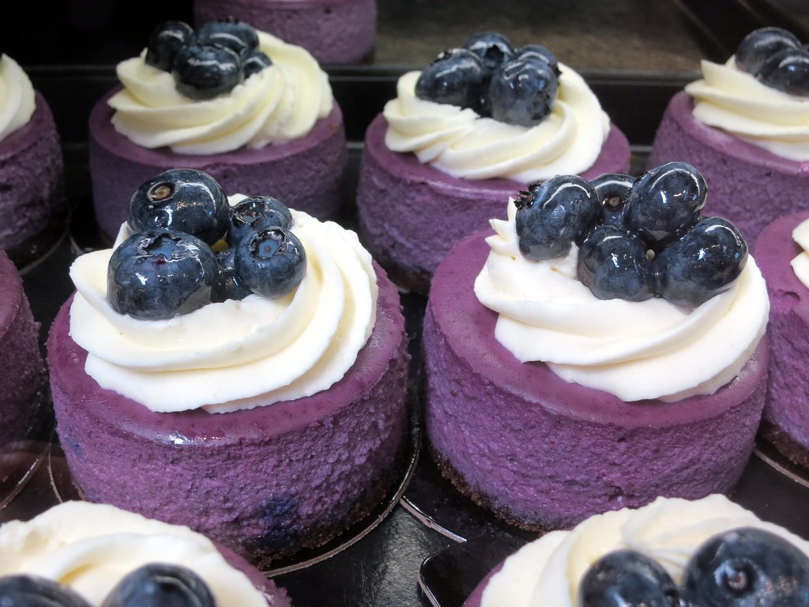
Key Findings
1
The root problem is sales stagnation —Stagnant sales have caused a significant drop in revenue, about 25% from 2019 levels, from 2023 onwards.
2
The biggest drivers are external:Declining retail park footfall, closure of high street shops and embedded hybrid working (ONS, 2023).
3
Internal weaknesses make it worse: There are no deliveries, unpredictable pre-orders, and supply costs that constantly change organically.
4
PESTEL and the Fishbone diagram together separate what Basil can control from what he cannot — the essential first step before any decision.

Slide 10

Reference List
Kumah, A., Nwogu, C.N., Issah, A.-R., Obot, E., Kanamitie, D.T., Sifa, J.S. and Aidoo, L.A. (2024) ‘Cause-and-effect (fishbone) diagram: a tool for generating and organizing quality improvement ideas’, Global Journal on Quality and Safety in Healthcare, 7(2), pp. 85–87. Available at: https://doi.org/10.36401/JQSH-23-42
Marinović Matović, I. and Arsić, L. (2020) ‘Ecological dimension of PESTEL analysis in small enterprises in the Republic of Serbia’, Recycling and Sustainable Development, 13(1), pp. 63–71. Available at: https://doi.org/10.5937/ror2001063M
Office for National Statistics (ONS) (2023) Characteristics of homeworkers, Great Britain: September 2022 to January 2023. Available at: https://www.ons.gov.uk/employmentandlabourmarket/peopleinwork/employmentandemployeetypes/articles/characteristicsofhomeworkersgreatbritain/september2022tojanuary2023 (Accessed: 22 September 2026).
Pantano, E., Pizzi, G., Scarpi, D. and Dennis, C. (2020) ‘Competing during a pandemic? Retailers’ ups and downs during the COVID-19 outbreak’, Journal of Business Research, 116, pp. 209–213. Available at: https://doi.org/10.1016/j.jbusres.2020.05.036
Troise, C., O’Driscoll, A., Tani, M. and Prisco, A. (2021) ‘Online food delivery services and behavioural intention – a test of an integrated TAM and TPB framework’, British Food Journal, 123(2), pp. 664–683. Available at: https://doi.org/10.1108/BFJ-05-2020-0418

Slide 11

Thank you for listening

Slide 12

Questions & Answers
I welcome your questions on the analysis.

