Slide 1
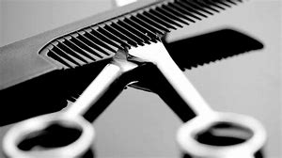
The education of hairdressing
Staci newnian
1808270

Slide 2
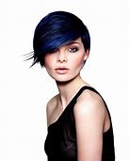
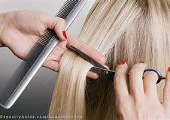
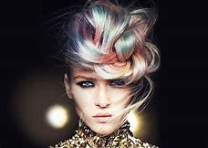
Introduction to hairdressing
In this PowerPoint we will be explaining all aspects of hairdressers from starting as an apprentice to qualifying as a hair stylist going through all the different levels from shampooing to colouring to cutting with everything you need know.

Slide 3
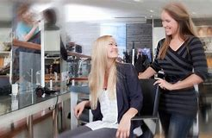
First steps of hairdressing.
  Starting as a apprentice.
  Meeting and greeting your client.
  Always offering refreshments and magazines.
  Making sure your client is comfortable in salon environment.
  Ensuring the stylist has all equipment they need to out go there service.
  Helping pass any tools to the stylist such as clips, rollers, straighteners.
  In charge of washing and drying towels so the salon is not low on towels.
  Ready to brush down and take the client to reception for the bill and there coat.

Slide 4
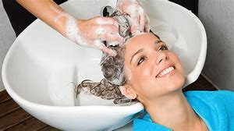
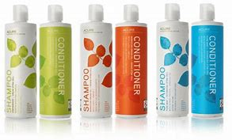
Shampooing and conditioning
  first of all gown client up .
  Wrap a towel around clients neck.
  Position the neck of the back wash directly in line the their shoulders.
  Ask your client to sit back .
  Always ask if there comfortable.
  Start wetting clients hair.
  The main part of shampooing is how the find there hair,
  Is it dry, damaged, greasy, curly.
  Pick the shampoo.
  Pea size on in your hand.
  Apply to head, rub then rinse apply shampoo twice.
  Once rinsed a pea size amount of conditioner run through the ends.
  Rinse and client can be taken back to station for stylist.

Slide 5
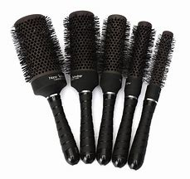
Blow-drying
  Section the hair in to 4 hot cross buns shapes on the head.
  From back section separate them in half.
  Decide what brush your going to use.
  Potion the chair at right height to start blow drying.
  Make sure the hair dryer is on the right temperature that your client is happy with.
  Once you Finnish one section move on to next until your dried all the hair.
  Always Finnish off with products.

Slide 6
Colouring in hairdressing
    all of the opposite colours contract each other so you would use blue or purple on yellow or orange.
  Learn which colour can mix together. .
  How long each colour can be left on for.
  First we learn all the colour wheel.
  y you would use practical colours on some people rather than others.
  All the depths of colours from 0-12.
  Difference between semi permanent to permanent.
  All the level of peroxides.

Slide 7
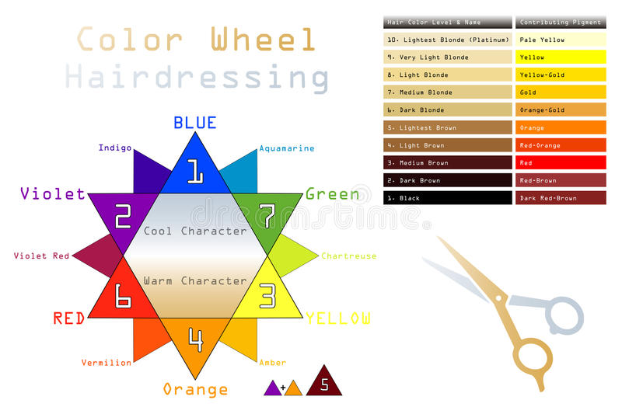
The colour wheel

Slide 8
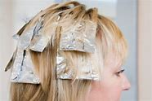
Colour technques
  Root tints
  All over colour
  Hallf head foils
  Full head foils
  ¾ head foils
  Streaks
  Ombres
  Semi permanent
  Permanent
  Bleach roots
  Full head bleach

Slide 9
3 basic ways of Cutting
One length
This cut is cut completely on the out shape or edge.
layered cut
This is cut all over the hair with various different angels.
Graduated cut
This hair cut is held away from outside edge reducing weight and fullness on the edge moving it to a higher line

Slide 10
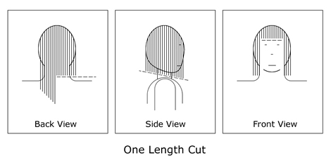
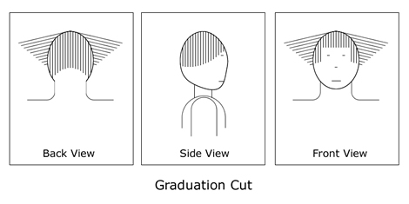
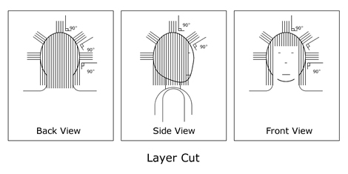
Images of basic cutting

Slide 11
Hairdressing
Throughout the slides I have gone over everything you would need to pass nvq level 1 and 2 ready to go advance to level 3.
Refence list
https://www.bing.com/images/search
http://www.hair-heads.co.uk/cutting-hair/three-basic-hair-cuts.php

