Slide 1
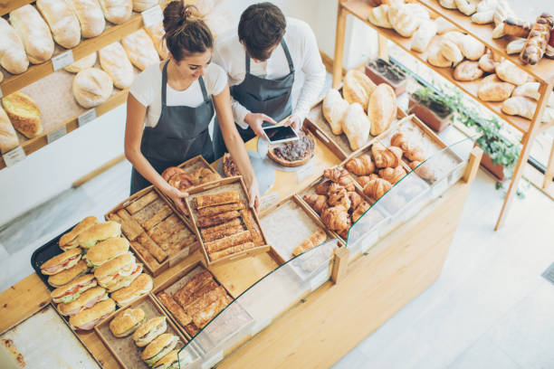
Basil bakery
The operational and strategic challenges

Slide 2
Basil bakery
The PESTLE framework helps evaluate external macro-environmental factors that influence the bakery’s operations and strategy.
Political
Local government policies affecting small businesses, such as business rates or grants for high street revitalization.
Food safety legislation enforced by local authorities.
Brexit-related trade regulations impacting imported ingredients.
Economic
Inflation affecting commodity prices, especially imported baking ingredients.
Fluctuating disposable income of local customers in Coventry impacting sales volume.
Interest rates influencing loans for business expansion or equipment purchases.
Social
Increasing demand for health-conscious baked goods (e.g., gluten-free, low-sugar, vegan): opportunity for niche products.
Demographic trends in Coventry, including population growth and cultural diversity, affecting product types and marketing strategies.
Local lifestyle shifts, e.g., higher takeaway and delivery demand.
Technological
Adoption of digital ordering systems and food delivery apps to reach customers beyond walk-in traffic.
Automation or modern baking equipment improving efficiency and consistency.
Online marketing through social media platforms and local business directories to enhance visibility.
Legal
Compliance with food hygiene, labelling, and allergen regulations (e.g., UK Food Safety Act).
Employment laws regarding wages, contracts, and working hours.
Intellectual property for recipes or brand protection, if applicable.
Environmental:
Sustainability trends, including eco-friendly packaging and food waste reduction.
Climate impacts on ingredient availability and cost.
Local environmental initiatives, such as single-use plastic reduction.

Slide 3
Problem and PESTLE
Example Application
Problem: Reduced footfall during weekdays in the retail park.
PESTLE Insights:
Social: Morning commuters prefer grab-and-go options.
Technological: Implement a mobile ordering app.
Economic: Offer seasonal promotions aligned with local school holidays or pay periods to stabilize revenue.(Income)
PESTLE analysis provides a structured lens to examine external factors shaping that problem. Combining both helps the bakery make informed, resilient, and strategically aligned decisions.
This approach is particularly crucial for small independent businesses operating in competitive retail environments like Coventry’s shopping parks, where external pressures and consumer behavior shifts can rapidly impact performance.

Slide 4

The Core Problem
1. The Problem
For Basil's Bakery, a small independent business located in a shopping retail park in Coventry, UK, the “problem” represents a strategic or operational challenge affecting its viability, growth, or competitive positioning. Based on typical challenges facing independent bakeries in a retail park setting, the problem could include:
Declining footfall due to competition from supermarkets, online grocery apps, and other nearby bakeries.
Rising input costs, such as flour, butter, and sugar, exacerbated by inflation or supply chain disruptions.
Labor constraints, including recruitment and retention of skilled bakers or staff at competitive wages.
Changing consumer preferences, such as increased demand for vegan, gluten-free, or low-sugar products, which may require recipe development and menu diversification.
Limited marketing reach, as small businesses often rely on word-of-mouth or local signage rather than broader digital presence.
In essence, the problem is the gap between Basil’s Bakery’s current performance or capabilities and the desired outcome—sustainable profitability, competitive presence, and alignment with modern consumer expectations.
2. PESTLE Analysis for Basil's Bakery
The PESTLE framework helps evaluate external macro-environmental factors that influence the bakery’s operations and strategy.
Who?
What?
Why?
Where?
When?
How?

Slide 5
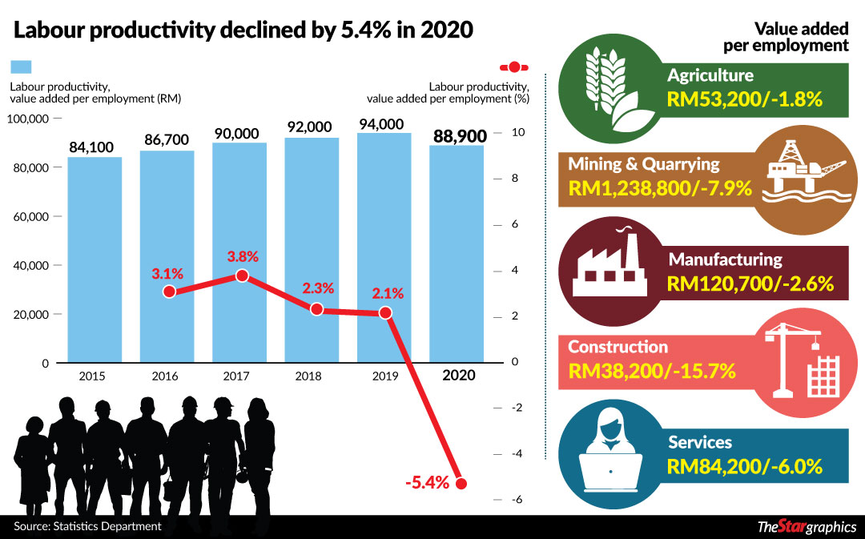
UK bakeries and small business trends provide a reliable proxy to assess the effects during the COVID-19 pandemic in 2020.
1. Operational Disruptions
Temporary Closure & Reduced Footfall: Basil’s Bakery likely experienced periods of full or partial closure due to national lockdowns. UK SMEs in food and hospitality reported a 20–30% drop in turnover in the lockdowns’ initial phase (Hurley & Walker, Bank of England, 2021).
Staff Furloughs: Some employees were probably placed on the Coronavirus Job Retention Scheme (CJRS), mitigating immediate layoffs but reducing workforce availability. Nationwide, employment in affected sectors, including food and accommodation, fell by up to 9% at the peak (ON S 2022).
2. Changes in Consumer Demand
Home Baking Surge: Lockdowns generated increased consumer interest in baking at home, leading to higher demand for flour, yeast, and DIY baking kits. Independent bakeries shifted to providing pre-measured kits and comfort foods like sourdough and pastries (ET-Chem, 2020).
Online Orders & Delivery: Basil’s likely introduced or expanded delivery and online ordering services. The convenience of contactless delivery, subscription boxes, and ‘click and collect’ mitigated footfall loss and tapped into a growing market trend (British Baker, 2021).

Slide 6
Core Operations- Basil Bakery
Operational Disruptions
Temporary Closure & Reduced Footfall: Basil’s Bakery likely experienced periods of full or partial closure due to national lockdowns. UK SMEs in food and hospitality reported a 20–30% drop in turnover in the lockdowns’ initial phase (Hurley & Walker, Bank of England, 2021).
Staff Furloughs: Some employees were probably placed on the Coronavirus Job Retention Scheme (CJRS), mitigating immediate layoffs but reducing workforce availability. Nationwide, employment in affected sectors, including food and accommodation, fell by up to 9% at the peak (ON S 2022).
2. Changes in Consumer Demand
Home Baking Surge: Lockdowns generated increased consumer interest in baking at home, leading to higher demand for flour, yeast, and DIY baking kits. Independent bakeries shifted to providing pre-measured kits and comfort foods like sourdough and pastries (ET-Chem, 2020).
Online Orders & Delivery: Basil’s likely introduced or expanded delivery and online ordering services. The convenience of contactless delivery, subscription boxes, and ‘click and collect’ mitigated footfall loss and tapped into a growing market trend (British Baker, 2021).
3. Product and Service Innovation
Packaged Goods & Extended Shelf Life: Enhanced hygiene protocols meant an emphasis on tamper-proof packaging and longer-lasting products, reducing frequent in-person purchases while reassuring customers (Bakels, British Baker, 2020).

Slide 7
Product and service innovation
Overall Adaptation Outcome
Drawing on sector analysis:
Basil’s Bakery would have faced moderate to severe operational disruptions, particularly during Q2 2020 lockdowns.
Rapid adaptation via online sales, delivery, DIY kits, and hygiene enhancements likely allowed the bakery to maintain engagement and revenue.
Long-term effects included consumer behaviour shifts, such as continued home baking, a preference for packaged products, and digital ordering patterns that outlasted immediate lockdown restrictions.
sources collectively indicate that Basil’s Bakery faced the full spectrum of pandemic-induced challenges but deployed adaptive strategies consistent with successful UK artisan bakeries
.Innovation in Business Model
Click and Collect / eCommerce Adaptation: The bakery likely adopted online ordering, click-and-collect services, and eCommerce platforms to reach customers who could not visit in person.
Home Delivery of Specialty Items: Similar to other artisanal bakeries studied during the pandemic, Basil’s possibly offered curated boxes or subscription services for bread, pastries, or afternoon tea.

Slide 8

Thank you.

