Slide 1

Communication and Networking
By Ruby Khatun, Renee Bailey, Grazia Martone, and Ella Williams
Notes:
Ella:
Welcome the learners into lesson.
Introduce the team:
Hello everyone, we are Ruby, Renee, Grazia, and Ella and we would like to talk to you about communication and networking.
This lesson is going to last 40 minutes long and we do expect to have each and every one of you to participate within each activity we have created for you. I hope you all listen as you will be quizzed on the session at the end within a game of Kahoot.
If you have any questions please feel free to stop one of us and ask, but there will also be a chance at the end of the PowerPoint.

Slide 2

Aims and Objectives
Aim:
The aim of this learning process is to inform the learners and to introduce a segment of communication and networking.
Objectives:
1. Define communication and networking
2. Identify the importance of communication and networking
3.To understand the Shannon weaver model of communication
4. To work in groups to improve communication and networking interactions
Notes:
Ella:
The aim of this learning process is to inform the learner and to introduce a segment of communication and networking.
Within this session you will take part in numerous activities to help you have the understanding of the objectives we want you to be able to achieve by the end of this session.
Objective one is to be able to define communication and networking.
The second objective is to identify the importance of communication and networking. The third objective is to understand the Shannon and Weaver model of communication, and the fourth objective is to work in groups to improve the communication and networking interactions.

Slide 3


What is Communication?
Notes:
Ella:
Ask the learners what communication is and see what they think it means. Then explain the definition below.
Communication is the process with one or maybe more individuals who transmit information to others. The nature of the interaction can include concepts, facts, beliefs, views, feelings and behaviours. Communication is extremely important as it is the only way humans can work together as a team (RNCI, 2020).

Slide 4
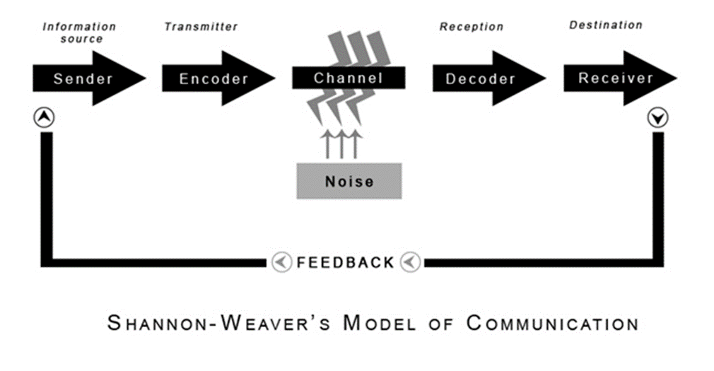
Quick Communication Activity
Notes:
Ella:
The learners will need to be split into two groups of six and each will be given a step one of the Shannon and Weaver communication model steps.
To begin with, the learner who is the sender will be given information (information source) which they will then have to choose a message to send to someone, someone to send the message to, and a channel through which to send the message.
The learner who is the encoder is the transmitter. This means they have to convert the idea into signals so they can then be sent from the sender to the receiver. This learner will turn an idea into either spoken words or sign language to communicate the idea to the next learner.
Then, the learner who is the Channel of communication will collect the information from the sender and transmitter through the decoder and receiver (sometimes called the medium). However, as the session is conducted within a classroom this learner will use the sound waves from their voice which will carry the sound from the learners mouth to the receivers year.
The fourth learner within the group will be the noise. The noise interrupts the message whilst it moving from the sender learner to the receiver. This shows the group that there is some understanding that noise could interrupt a message which has been sent.
The next learner will be the Decoder. As the communication was not sent through technology the learner will decode the secret message to make it understandable for the rest of the group.
The sixth learner is will be given the role of the receiver which they will be the person to receive the message. The feedback stage will then occur when the receiver student tells the sender what the message was that they had received (Drew, 2020).

Slide 5
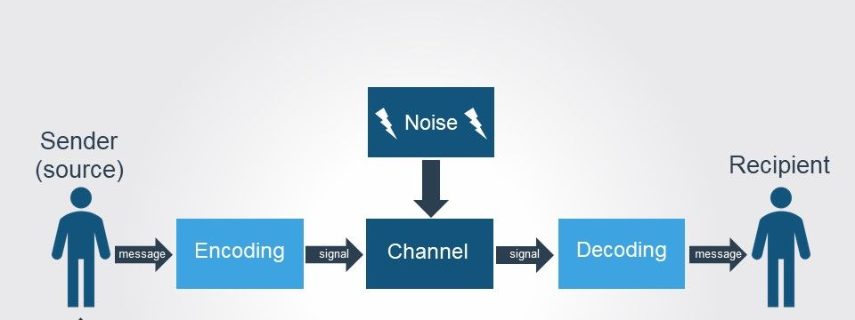
Did you enjoy the communication activity?
Notes:
Ella:
Once the task is finished, ask the learners if they received the message that the sender sent at the beginning at the end. Explain to the learners how they just undertook a task using the Shannon and Weaver model. The learners will have an understanding of how communication works and how important it is to communicate efficiently to make sure everyone understands what was said.
Explain the theory Shannon and Weaver theory to the learners and describe each of the stages.
The communication model refers to the Shannon and Weaver communication theory. The model shows the process of how communication is transferred from one person to another, from the sender to the receiver.
Sender – The model begins with the sender who are the person, thing or object who has the information to start off with.
Encoder (Transmitter) – The encoder is the person or machine who converts the message into signals which can be sent from the sender to the receiver.
Channel – The channel of communication enables the information to move from the sender and transmitter through to the decoder and receiver. This is usually called the medium.
Noise – Within this stage the noise interrupts the message whilst it is on the way from the sender to the receiver. There are two types of noise; internal and external. Internal noise happens when the sender makes a mistake when they encode a message, or when the receiver makes a mistake decoding the message. External noise occurs once something external (something not in control of the sender or receiver) to delay the message.
Decoder – This is where the reception of the signal is held and converts signals into a message. This stage of the communication process is a reverse process of the encode stage.
Receiver (Destination) – This stage is when the person finally gets the message, or what is left of the message after the noise stage.
Feedback – The feedback stage was not originally in the Shannon and Weaver communication model in 1948. However, Norbert Weiner decided a feedback stage was needed after there was criticism of the linear approach. The feedback occurs when the person receiving the message responds to the sender to finish the communication circle. They may respond to the sender telling them that they either heard the message clearly without any noise, or how they did not understand the message very well. However, feedback does not occur all of the time. For example, when someone is watching television they will not usually let the people on TV know what they are thinking about, instead they will watch the television show. However, feedback can occur when during an email, talking to someone, or through body language when in a conversation (Drew, 2020)

Slide 6

“The fundamental problem of communication is that of reproducing a message sent from one point, either exactly or approximately, to another point” (Shannon, 1948, p. 379).
Notes:
Ella:
“The fundamental problem of communication is that of reproducing a message sent from one point, either exactly or approximately, to another point” (Shannon, 1948, p. 379).
Read the quote out and explain to the learners that it outlines the theory and explains what the goal of his model was.

Slide 7
Group Discussion
Why is communication so important?
Notes:
Grazia:
-Asking groups of 4 their opinions as group discussions will help others voice opinions, and once after discussion for 2 minutes, moving onto the next slide giving the reasons as to why it is important this will enable peers to reflect their own answers to the answer given and take notes.

Slide 8
Why communication is so important
Having good communication is important for any organisations survival and growth, this is seen as something that miens the tasks of organising, planning, managing and encouraging.
Increasing employee engagement
Voicing opinions
Aquatinting
Building trust
Notes:
Grazia: communication is an important life skill that is learnt from an early age, with huge benefits in the workplace solving problems any disputes, benefitting your everyday life with work relationships and relationships at home. By communicating will give the opportunities to better situations and make huge differences in some occasions. It will enable networks to come together creating diversity and in some cases making ways more ethical. It will lead others to get more work done even in hierarchical working environments as face to face communication is a better way of understanding situations. There are many forms of communication being face to face, and in todays generation technology can make communicating a lot easier to connect with peers around the world if needed conducting meeting over video call or email so jobs are done more efficiently. For some it can be beneficial for individuals mental health to talk about any problems they are facing in the workplace leading to greater success for everyone. practice it has a great role in employee motivation where it can be used to communicate the expectations from an employee while take feedback from employees about operational details and process modification if needed for better operations (Ryan, 2012). The communication is also used to get intrinsic motivation in among the employees. The best performer or achiever of a business objective is communicated among all in the business so that people feels the belongingness more. communication also opens the door for better suggestions via feedback mechanism. The intrinsic motivation is received by the employee when the name and achievement is been communicated to all that which psychologically boosts the individual in question. Sainsbury choose the communication as part of a regular mode of employee engagement achievement by boosting their morale (Williams et al. 2003).

Slide 9
Networking
Networking being a very important aspect, it is there to guide others to improve skills and achieve more, it is put into place to develop relationships which have the same goal to help each other with personal growth in their careers (Jackson, 2020).
Networking consists of building business partnerships to implement growth, and act on any opportunities within organisations whilst sharing knowledge and following different business associates (Gay, 2014).
Networking allows making connections with professionals in the same area of work or others that wish to join the same venture, giving opportunities to communicate and more acquainted (Bonds-Raacke, 2017).
‘’the action or process of interacting with other individuals exchanging information developing professional and social contacts’’ (Webster, 2020).
Notes:
Grazia-
Networking can be used through online sites today to use different ways to interact with organisations and potential employers, they will offer the chance to become a part of different cultures (Border, 2020).
It is important for the growth of careers it will create long-term relationships and portrays a positive reputation for the coming years. It can be meeting the new people you could be working with in the coming years and hopefully supporting one another (Jackson, 2020).
It will help support people to enhance skills or develop new ones, stay on the job market and meet potential clients and partners. Giving more options for future resources they may find very useful. This comes with the saying its not that you know it is who you know (Bonds-Raacke, 2017).
LinkedIn is a brilliant networking source that I recommend you all have for future jobs. They offer online forums, letting people connect with different professionals you are able to put yourself out there as you please and portray yourself how ever you wish. With aspects like browsing for jobs or to recognise job applicants.

Slide 10
Group Discussion
Why is networking so important?
Notes:
Grazia:
- The learners have 1 2 minutes to discuss it

Slide 11
Why is networking so important?
Influence growth
Develop long lasting relationships
An extra resource library
Improves creative intellect
You can get noticed
Notes:
-Grazia
networking is such an important aspect in life and sometimes we do not even realise that it is happening we are always connecting in different ways.
Influencing growth- by developing your career status don’t come by itself it is worked on and can take a long time to do so and this depends on how you focus your networking journey. Contacts that you keep are mainly indorsed to your growth. Your connections that you make from a young age are powerful (Cole, 2020).
Developing long lasting relationships- by making it a two-way process using your own knowledge can come with advantages, by giving and taking will open new doors for firmer relationships creating trust. And it is seen that if you make networking your solitary priority you will be able to form careers that are relevant to your set down goals (Cole, 2020).
An Extra Resource Library- by having a platform like LinkedIn which is associated to your career can be an extra resource library which provides updated information on the latest career developments which are relevant for yourselves as you can always keep up to date with the fast pace changing environments and not get left behind even from home.
Improves creative intellect- good innovations and aspirations are from the external factors where we find ourselves. Having the intellectual ability in your career is improved massively from our contacts we have built over time. Just by having one small conversation can change a year-long research if work resulting in a revolution. Sharing ideas can set free the creative talent within yourselves.
You can get noticed- as an individual if you look for publicity either in your private life or work life people tend to quickly get noticed when they have stronger competencies to make them more relevant. When you stand out in whatever it is you want to be seen it will create an opening door of partnership which can build careers (Cole, 2020).

Slide 12
Networking Activity
Speed Networking
Against the clock
Objectives
Pairs
Notes:
Grazia: for this activity everyone is required to stand up at the front off the classroom, you will be assigned a partner, everyone will then start to move around the room having conversations with others, it will be timed so a timer will be set and will notify you when to move onto a different pair to talk with them. There will be an objective set for each pair these will be in your pairs you should find out something they already didn’t know about the other member and the aim being to find out the answer from their pair.
Doing these activities will boost confidence and learning things about your peers. Breaking the ice if you are introverted is a good way to overcome hurdles.

Slide 13
Networking activity – how did you get on
Time is up !
Remember your information
Hope you managed to gather enough information from your peers
Notes:
Grazia:
timer stopped, we got learners to stop and sit back down in their seats and then went around the room in a circle gathering and sharing information

Slide 14
Group Discussion
What makes communication and networking successful
What types of environments do we use communication and networking in?
Notes:
Grazia:
Ask the learners to discuss this for 1 minute per question

Slide 15
What makes communication and networking successful for organisations?
Communication- promotes motivation, altering employees' attitude and controlling process.
Networking- lower employee turnover, professional development
Notes:
Grazia:
Communication
Promoting motivation – it will clear up any tasks that need completion with employees and how to improve performance if not up to standards.
Altering employees' attitude – for example, an individual who is well informed will have a better attitude towards work and a less-informed employee. By conducting meetings and other forms of oral or written communication will help to mould employees' attitudes towards their careers.
Controlling process – it can help management with controlling the organisations employee's behaviour if many different ways as there are a lot of different hierarchical and assured principles in organisations today that must be followed. By having more communication it allows employees to perform job roles professionally and communicate any problems and grievance to management this is why it can help with the controlling function of management (Communication Flows in an Organization, 2020).
Networking
Lower employee turnover – teams can feel more connected with each other and tend to have a more clear picture of purpose in the organisation by building more mutually benefitted relationships create a better impact on employees fulfilment.
Professional development – within the organisation you are already working for you may be able to discover new career opportunities by asking casual questions like which certifications may be more benefitted for your own development this will enable you to discover new business trends and industries and finding out more about the organisations visions and missions (Stangarone, 2018).

Slide 16
What type of environments do we use communication and networking in?
Networking- both traditional and online settings
Notes:
Grazia: will ask learners for their answers first to see their ideas
networking and communication will involve researching, designing and implementing the regional use of larger areas in organisations. Companies that use mobile services that will link computers to one another. And the internet is so big that it can allow any device around the globe to interact with one another.

Slide 17
Sharing Ideas
Can you think of any ideas on how to improve communication and networking?
Notes:
Grazia: in the groups they will be given the opportunity to share ideas by giving out papers and pens to write down their thoughts and ideas for ways and how to improve networking and communication. And once the task is completed groups will be required to share with other groups their ideas and findings.

Slide 18

One-word ice breaker activity
Notes:
Ella:
The learners will take part in an activity called one word ice breaker.
To play the game the learners will be split into three groups of four and given a topic. Each member will need to think of one words that describe it. Whilst the learners are undertaking the activity walk around the classroom and check that everyone is participating and no one is left out.
After each group have had a few goes each a few participants will be requested to share with the wider group, making a wider interaction with others. Each group can research into the relevant questions and ask other leaners questions as they stand in front of the class.
The students will then all sit down once they are finished and we will then process onto the next slide which is related to this group activity (Heathfield, 2020).

Slide 19

How well did you work well in your groups during the activity?
Notes:
Grazia: Icebreaker
Asking how peers got on with each other will increase feedback for future group activities to see if different voiced opinions effected their way of answering and understanding the topic of choice, or if they felt introverted within the group and could not give the desired choice of answer giving them also an understanding of their preferred method of learning for their own personal use.
Reference

Slide 20

Recap Learning
Notes:
Ella:
To recap the whole session and to see if the learners understood everything, they will complete a Kahoot quiz we created for them.
The learners will need access to a mobile phone if they have one, but if they do not have one they will be provided with a university iPad for the quiz as it is online.
As soon as each individuals have access to the Kahoot quiz and they will be able to use the Kahoot code to log in and type a username in so they know what score they get throughout the game. Once this is all complete the quiz will be able to start.
The quiz will consist of multiple-choice questions linked to the theme of communication and networking to engage all of the learners. The learners will be timed 20 seconds for each question and there will be 10 questions in total.
During the quiz walk around the room and check on each table to see if everyone is participating or cheating.
As soon as the Kahoot quiz is complete it will show who came first, second and third. The individual who comes first will be given a packet of sweets in reward for all of their hard work (Kahoot, 2020).
The game link to play: https://create.kahoot.it/details/7bc8653d-c65d-4978-912e-74de25297f45.

Slide 21
Feedback session
As a group we would appreciate your feedback given, on the paper honest opinions are accepted, also they will be anonymous if you wish. When you have completed, we would kindly ask for your feedback sheets to go in different box’s Green, Amber and Red
Green- you understood the topic
Amber- needing slightly more assistance with the topic
Red- does not understand the topic
Notes:
Grazia:
Feedback session = this is voluntary for peers which will allow future improvements and to see if the topic was easily understood for others.
Grazia references
References
Bonds-Raacke, J., 2016. Should I Be Networking? Exploring The Importance Of Networking For Students. [online] Apa.org. Available at: <https://www.apa.org/ed/precollege/psn/2017/01/importance-networking> [Accessed 10 August 2020].
Cole, B., 2020. Redirect Notice. [online] Google.com. Available at: <https://www.google.com/amp/s/www.forbes.com/v/s/www.forbes.com/sites/biancamillercole/2019/03/20/why-networking-should-be-at-the-core-of-your-career/amp/%3famp_js_v=0.1&usqp=mq331AQFKAGwASA%253D#ampf=> [Accessed 10 August 2020].
Gay, B., 2014. Open innovation, networking, and business model dynamics: the two sides. Journal of Innovation and Entrepreneurship, 3(1), p.2.
Jackson, S., 2020. Professional Networking In Social Work | Socialwork.Org. [online] SocialWork.org. Available at: <https://www.socialwork.org/resources/professional-networking/> [Accessed 10 August 2020]. Managementstudyguide.com. 2020. Communication Flows In An Organization. [online] Available at: <https://managementstudyguide.com/communication-flows.htm> [Accessed 10 August 2020].
Webster, M., 2020. Definition Of NETWORKING. [online] Merriam-webster.com. Available at: <https://www.merriam-webster.com/dictionary/networking> [Accessed 10 August 2020].
Stangarone, C., 2018. How Internal Networking Helps Employees And Organizations. [online] Randstadrisesmart.com. Available at: <https://www.randstadrisesmart.com/blog/how-internal-networking-helps-employees-organizations> [Accessed 10 August 2020].

Slide 22

Notes:
Ella:
Thank you so much for your participation.
I hope you have all enjoyed today’s session. If you have any questions, please speak to us once you have put your piece of paper in one of the coloured boxes.

