Slide 1
Strategic capabilities Part two– the Strengths and Weaknesses for your SWOT Analysis

Slide 2
Learning objectives
Introduce The Value Chain

Slide 3
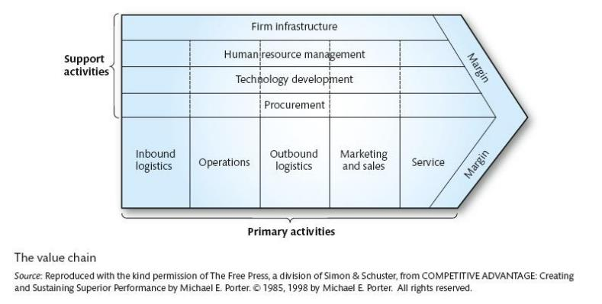
The value chain
Selling organisations compete for business by trying to offer enhanced value, and they do this through a coordinated chain of activities.
These include product design, production, marketing, delivery and support.
Porter (1985) referred these activities as the Value Chain.
Notes:
he value chain, conceptualized by Michael Porter in 1985, is a framework that describes the full range of activities a firm undertakes to design, produce, market, deliver, and support its products or services, ultimately adding value for the customer and achieving competitive advantage. By analyzing these activities—categorized as either primary or support activities—companies can identify opportunities to increase efficiency, reduce costs, and differentiate their offerings, thereby creating more value than their competitors.
Key Aspects of the Value Chain
Activities:
The value chain comprises numerous activities, including product design, production, marketing, delivery, and customer support, as well as support functions like procurement, technology development, human resources, and infrastructure.
Value Creation:
Each activity adds value to the product or service, increasing its worth to the final consumer.
Competitive Advantage:
By optimizing these activities, businesses can create a competitive edge, whether by offering a lower price or by providing a unique product or service perceived as superior to competitors.
Profit Margin:
The difference between the total value created and the total cost of performing these activities represents the profit margin a company earns.
Business-Wide Application:
While the concept was initially applied to manufacturing, the value chain framework is applicable to all types of organizations, including service providers and non-profits, to help them understand and improve their operations.
How It Works
Identify Activities:
A company maps out the specific activities it performs to bring a product from conception to delivery and beyond.
Categorize Activities:
These activities are typically broken down into primary activities (e.g., inbound logistics, operations, outbound logistics, marketing & sales, service) and support activities (e.g., procurement, technology development, human resource management, firm infrastructure).
Analyze Value and Cost:
The goal is to understand how each activity contributes to customer value and how to perform it more efficiently or effectively.
Enhance Competitiveness:
Companies can then use this analysis to streamline operations, reduce costs, improve product features, or enhance customer service to gain a competitive advantage.

Slide 4
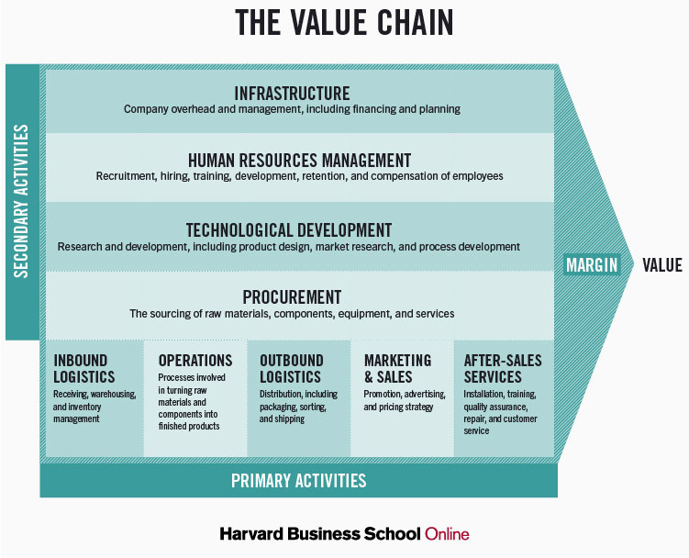
The value chain
Describes the categories of activities within an organisation, which, together, create a product or service.
Consists of five primary activities (which are directly concerned with the creation or delivery of a product or service)
Also consists of four support activities (which help to improve the effectiveness or efficiency of primary activities).
Competitive advantage can be analysed in any of these activities.
Notes:
A value chain is the complete set of activities a business performs to bring a product or service from its conception to its end use and disposal, adding value at each step to maximize customer value while minimizing cost. Coined by Michael Porter, the model categorizes activities into primary activities (like inbound logistics, operations, and marketing) and support activities (such as procurement and human resource management). Analyzing the value chain helps a company increase efficiency, achieve a competitive advantage, and strategically manage its operations for greater profit margins.
Key Aspects
Value-Adding Activities:
Each stage in the chain, from sourcing raw materials to providing customer support, adds value to the product or service.
Cost vs. Value:
The core goal is to deliver maximum value to the end-user at the lowest possible total cost.
Strategic Tool:
Companies use value chain analysis to identify opportunities for efficiency, cost reduction, and differentiation to gain a competitive edge.
Scope:
A value chain can be contained within a single firm or span across many firms and geographical locations, forming a global value chain.
Beyond Production:
The chain encompasses all activities, including design, marketing, distribution, and post-sale service, as well as the entire lifecycle from disposal and recycling.
Porter's Value Chain Model
Michael Porter's model provides a framework for understanding these activities.
Primary Activities:
These are directly involved in the creation, sale, and delivery of a product or service.
Inbound Logistics: Receiving, storing, and distributing inputs.
Operations: Transforming inputs into outputs.
Outbound Logistics: Collecting, storing, and distributing the final product.
Marketing & Sales: Creating, communicating, and delivering value to customers.
Service: Providing support to keep the product working effectively for the buyer after the sale.
Support Activities:
These activities provide the underlying infrastructure and support for the primary activities.
Procurement: Acquiring inputs.
Technology Development: Research and development, IT.
Human Resource Management: Hiring, training, and managing employees.
Firm Infrastructure: Management, finance, and legal functions.

Slide 5
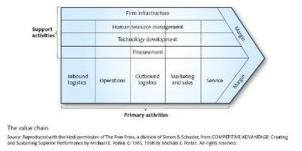
Benefits of value chain analysis
A generic description of activities – understanding how the discrete activities (or clusters of linked activities) contribute to customer benefit.
Identifying activities where the organisation has particular strengths or weaknesses.
Analysing the competitive position of the organisation using the VRIO criteria – thus identifying sources of sustainable advantage.
Looking for ways to enhance value or decrease cost in value activities (e.g. outsourcing).
Notes:
Analyzing a value chain benefits businesses by improving cost efficiency and customer value through identifying strengths and weaknesses, informing strategic decisions like outsourcing, and pinpointing opportunities for competitive advantage via VRIO analysis and process optimization. This systematic approach clarifies how each activity adds value, aligns operations with the overall strategy, and ultimately enhances profitability and market position.
Here are the specific benefits of a value chain analysis:
Improved Cost Efficiency and Customer Value:
Cost Advantage: Value chain analysis helps identify areas of high cost or inefficiency, allowing businesses to optimize activities and establish a cost advantage over competitors.
Value Enhancement: By understanding how discrete activities contribute to customer benefit, companies can focus on enhancing their value proposition and increasing overall customer satisfaction.
Strategic Decision-Making:
Strategic Alignment: The framework provides an overview of the company's operations, enabling better-informed strategic decisions regarding partnerships, market expansion, and product development.
Make or Buy Decisions: It helps businesses decide which activities to perform internally and which to outsource to external providers, optimizing costs and leveraging specialized skills.
Competitive Advantage and Sustainable Growth:
Identifying Strengths and Weaknesses: The analysis highlights an organization's unique capabilities and areas for improvement, which is crucial for developing effective strategies.
VRIO Analysis: By applying the VRIO criteria (Value, Rarity, Imitability, Organization), businesses can identify sources of sustainable competitive advantage and build enduring strengths.
Process Optimization and Alignment:
Diagnosing Inefficiencies: The analysis can pinpoint specific points of ineffectiveness within the business processes, allowing for targeted corrective action.
Cross-Functional Collaboration: By mapping out the value chain, businesses can improve communication and collaboration between different departments, leading to increased productivity and alignment.

Slide 6
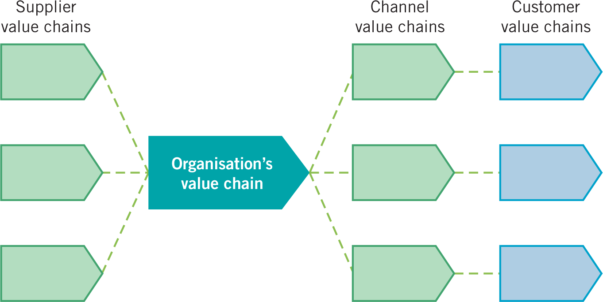
The value system
Important to understand:
Which activities need to be part of the Organisation’s value chain because they are key to achieving competitive advantage?
The value system comprises the set of inter-organisational links and relationships that are necessary to create a product or service.
It looks at an organisation’s value chain in the context of links to other value chains.
Competitive advantage can be derived from linkages within the value system.
Notes:
A value system is a network of organizations, including partners, suppliers, and customers, with inter-organizational links and relationships that work together through interactive, value-generating processes to create and deliver a product or service. It's a broader concept than a traditional supply chain, emphasizing the collaborative and dynamic nature of value creation across multiple actors and evolving over time.
Key Aspects of a Value System
Interdependence:
Organizations within a value system are interdependent, relying on each other's interactive processes to create value.
Value-Generating Processes:
The core of a value system lies in these processes, which are not clearly defined at their start or end points and occur dynamically over time.
Beyond the Supply Chain:
Unlike a simple linear supply chain, a value system is more complex and interconnected, encompassing the entire network of relationships needed for value creation.
Competitive Differentiation:
Companies can gain a competitive advantage by effectively managing their relationships within their own value network and across the broader ecosystem.
Dynamic and Evolving:
Value systems are not static; they are constantly changing, with groups of actors interacting and evolving to meet market demands and create new value.
Example
Consider the process of making a smartphone. The value system includes the creators of the hardware, the software developers, the manufacturers, the logistics providers, the marketing teams, the retailers, and even the end-users. Each group has unique skills and provides value, and their interconnectedness forms the overall value system for the product.

Slide 7
Benefits of value system analysis
Understanding cost/price structures across the value system – analysing the best area of focus and the best business model.
Identifying ‘profit pools’ (i.e. levels of profit in different parts of the system) – seeking ways to use existing capabilities in order to exploit these.
The ‘make or buy’ decision – which activities to do ‘in-house’ and which to outsource.
Partnering – deciding who to work with and the nature of these relationships.
Notes:
Value system analysis offers benefits like cost reduction and resource optimization by identifying unnecessary components or processes, enhanced quality through improved functionality, increased innovation by fostering creative solutions, improved customer satisfaction by meeting needs efficiently, and a competitive advantage by delivering better value at a lower cost. It also improves teamwork and communication and provides a solid foundation for sound business decisions.
Here are the key benefits of value system analysis:
Cost Reduction:
By systematically examining a product or service, organizations can identify and eliminate high-cost areas, unnecessary components, or inefficient processes.
Improved Quality and Functionality:
The analysis focuses on defining and enhancing the core functions of a product, leading to improvements in overall quality and performance.
Innovation and Creativity:
Value system analysis encourages teams to explore alternative designs and processes, fostering innovative and more effective solutions.
Enhanced Customer Satisfaction:
By balancing cost, quality, and functionality, the final product or service better meets customer expectations, leading to higher satisfaction levels.
Competitive Advantage:
Delivering superior value at an optimal price point provides a significant edge over competitors in the market.
Efficient Resource Allocation:
The breakdown of services and parts helps companies understand where resources are best utilized, preventing waste and optimizing usage.
Better Teamwork and Communication:
Workshop-based analysis brings together different departments, fostering collaboration and improving communication among team members.
Informed Decision-Making:
By clarifying functions and needs, value system analysis provides a sound basis for making critical business decisions.
Risk Mitigation:
By proactively identifying potential issues, such as a component being withdrawn from the market, organizations can avoid costly future maintenance or recalls.

Slide 8
summary
To be able to achieve sustained competitive advantage resources / capabilities need to be unique and distinctive.
To be distinctive and provide for sustainable competitive advantage, resources and capabilities need to fulfil the VRIO criteria of being Valuable, Rare, Inimitable and supported by the Organisation.
Ways of diagnosing organisational resources and capabilities include:
VRIO analysis of resources and capabilities to evaluate if they contribute to competitive advantage.
Analysing an organisation’s value chain and value system to understand how value to a customer is created and can be developed.
Strategic analysis frameworks such as PESTEL, SWOT etc. drawing together an understanding of the strengths, weaknesses, opportunities and threats an organisation faces.
Benchmarking to understand the relative performance of organisations.
It is important for an organisation to recognise such redundant capabilities and to eliminate them.

Slide 9
Summary
Introduced The Value Chain

