Slide 1
Discuss the concept of poverty referring to theory, policy and practice
By Jaimie coakley
1801568

Slide 2
What is poverty?
Something that affects millions of people in the UK
Not being able to meet basic needs; e.g. heat your home, pay your rent, or buy essentials
Individuals facing insecurity, uncertainty and impossible decisions about money
Facing marginalisation and discrimination
JRF

Slide 3
Consequences of poverty
Health problems
Housing
Being a victim of crime
Lower educational achievement
Homelessness
Teenage parenthood
JRF

Slide 4
Definitions of poverty
Definitions of poverty:
set standards which we determine whether the incomes and living conditions of the poorest in society are acceptable or not.
Are important for seeing questions of fairness. From these definitions follow all actions to help the poorest
ESRC Poverty and exclusion project (2014)

Slide 5
Poverty
Absolute Poverty- It is focused on the minimum needs to ensure physiological efficiency
Relative poverty- it extends the approach from a lack of necessities that is needed for ‘physical efficiency’.
Persistent poverty- it is show as being in relative income poverty in the current year and at least two of the three previous years.
Rowntree 1901.
Townsend and kennedy 2004

Slide 6
Poverty is a wicked problem
Poverty is a wicked issue- complex, multidimensional unclear and changeable. There is not one problem to be addressed. If we are not dealing with a set, specific problem, or even a defined process, there is little point in chasing after definitive, mechanistic answers’
Spiker (2018)

Slide 7
Sociological theories of poverty
People’s moral failings, fecklessness or dependency cultures
Result of how resources and opportunities are unequally distributed across society
Stigma and shame
Shildrick&Rucell, 2015)

Slide 8
Measuring poverty
Resources
Costs
A wider frame work
Food banks
Mental health
Barnard 2018

Slide 9
Measuring Poverty
Wood et al, 2012 say that poverty is currently measured by just looking at income, is both too abstract to relate to people’s everyday lives and not informative enough to help practitioners tackle poverty
Wood et al, 2012

Slide 10
What causes poverty
Low paid work
Lack of education & technical skills
Issues in home life (domestic violence, substance abuse..)
Inequalities in benefits
Cost of living
Five Main Causes of Poverty in the UK, August 19, 2017

Slide 11
Poverty in Wales
During 1994 to 1997 27% of people in Wales lived in poverty
Poverty among couples with children keeps on rising since 2003-2006
Poverty in pensioner has fallen, but not as much as how much it has fallen in England, Scotland and Northern Ireland.
In 1994 to 1997 poverty in pensioners accrued after housing costs, was similar to England and lower than Scotland. In 2013/16 it was higher
Barnard 2018

Slide 12
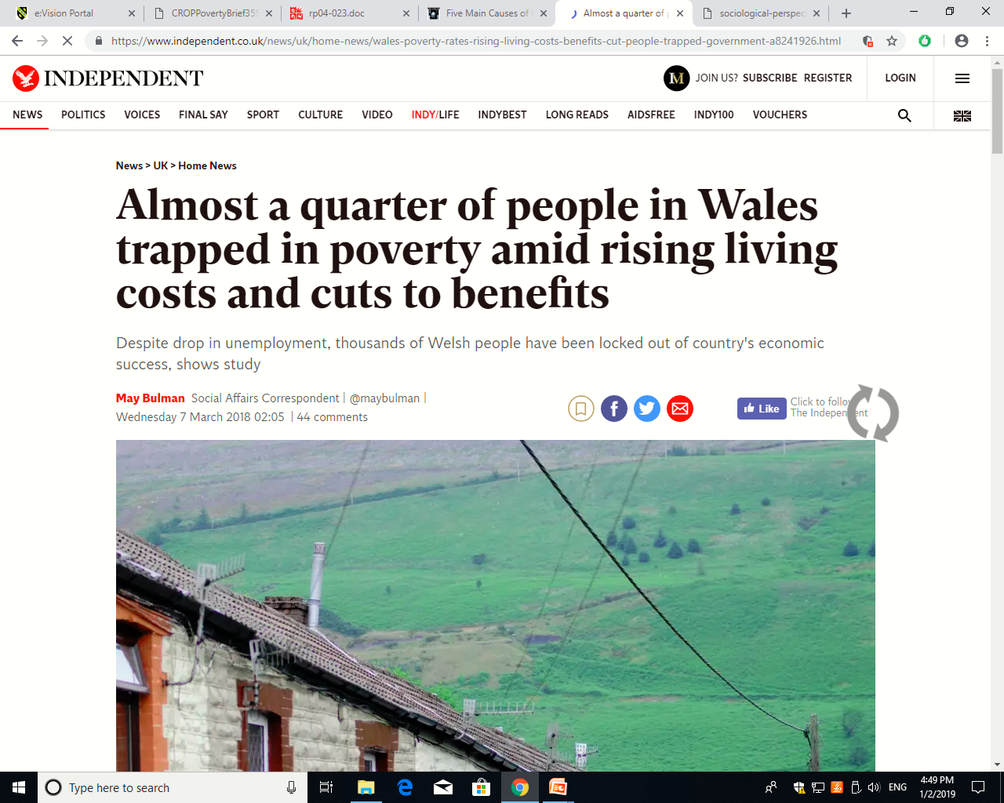
Bulman, 2018

Slide 13
How is it tackled
By focusing on the areas where the most impact is seen
The early years, for young peoples future
Helping people into work- (Fair and decent work)
Creating a strong economy which delivers prosperity and securing for individuals in Wales.
Welsh Government, 2018

Slide 14
Tackling poverty
Raising low incomes
Get more people into paid employment
Create more and better jobs
Support those who do not work
Meet minimum needs
Winckler and Trickey, (2014)

Slide 15
Oxfam
Campaigning
Researching
Raising voices
Working
(Oxfam, 2018)

Slide 16
Merthyr Tydfill
The reputation of crime, drugs and poverty is terrible in Merthyr.
It has been dubbed ‘sick note city’ in the press
More than 20% on benefits
Life expectancy is 5 years lower than somebody living somewhere wealthy
‘There needs to be more job opportunities’
McCarthy, 2017

Slide 17
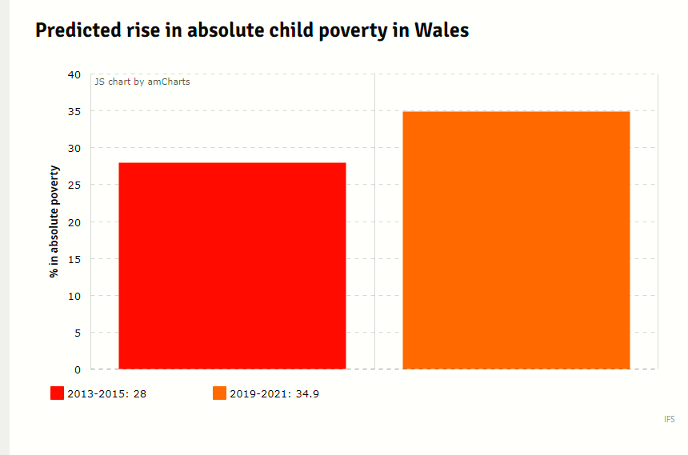
Child poverty in Wales
Williamson, (2017)

Slide 18
References
http://cpag.org.uk/content/what-causes-poverty
https://www.theguardian.com/business/2018/dec/04/four-million-british-workers-live-in-poverty-charity-says
Joseph Rowntree Foundation (2018) Poverty in Wales (2018). Online: https://www.jrf.org.uk/report/poverty-wales-2018 [Accessed:22/11/18]
https://www.jrf.org.uk/blog/we-have-new-way-measure-poverty-now-act-solve-it
http://www.bris.ac.uk/poverty/downloads/keyofficialdocuments/HOC%20Poverty%20Measures%20and%20Targets%202004.pdf
https://moodle.uwtsd.ac.uk/pluginfile.php/218521/mod_resource/content/1/CROPPovertyBrief35Spicker%20%281%29.pdf
https://www.jrf.org.uk/report/sociological-perspectives-poverty

Slide 19
https://www.jrf.org.uk/report/poverty-wales-2018
https://www.demos.co.uk/files/Poverty_-_final.pdf?1354014565
http://www.poverty.ac.uk/definitions-poverty
https://www.independent.co.uk/news/uk/home-news/wales-poverty-rates-rising-living-costs-benefits-cut-people-trapped-government-a8241926.html
https://www.oxfam.org.uk/cymru/poverty-in-wales
https://www.walesonline.co.uk/news/wales-news/life-gurnos-what-its-really-12422321
https://www.walesonline.co.uk/news/politics/warning-wales-could-see-biggest-13845675
https://www.jrf.org.uk/our-work/what-is-poverty

